Slide 1
Nonadiabatic Decelerator Transitions
Parity Flips Suppressed by Λ,
but how about m=3/2 to m=1/2 ?

Slide 2
Background
Meijer observes flips on chip decelerator
Hinds checks during switching
Tim checks on axis during switching

Slide 3
OH Stark Effect

Slide 4
In – Flight Hops
Minimum E-field when flying between de-energized stage. How small?

Slide 5
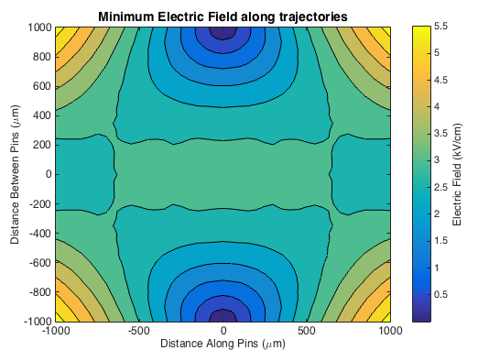
In – Flight Hops

Slide 6
In – Flight Hops
Minimum E-field when flying between de-energized stage. How small?
How about the corresponding Energy Gap?

Slide 7
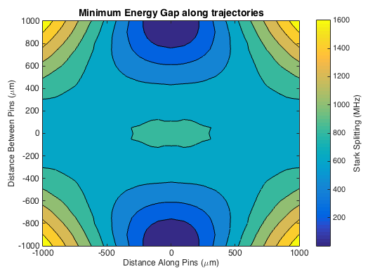
In – Flight Hops

Slide 8
In – Flight Hops
Minimum E-field when flying between de-energized stage. How small?
How about the corresponding Energy Gap?
Approximation from L-Z Formula:
Gap = 100 MHz,
dH/dx = 100 kV/cm/5mm = 10 GHz /mm
v = 750000mm/s (Neon)
LZ ~ (100 MHz )^2 / (10 GHz * 1 MHz) ~ 1

Slide 9
Calculate Schrodinger Equation
Propagate state according to ihdy/dt = Hy beginning far from the gap, at varying distance from central axis:

Slide 10
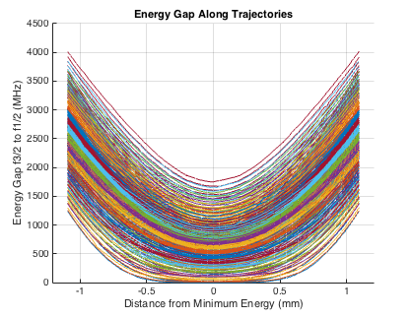
Calculate Schrodinger Equation
Propagate state according to ihdy/dt = Hy beginning far from the gap, at varying distance from central axis:

Slide 11
Calculate Schrodinger Equation
Propagate state according to ihdy/dt = Hy beginning far from the gap, at varying distance from central axis.
State Probability over the worst case trajectory which just grazes the pin:

Slide 12
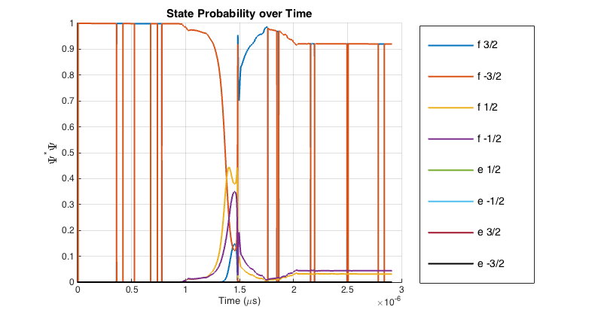
Calculate Schrodinger Equation

Slide 13
Calculate Schrodinger Equation
Propagate state according to ihdy/dt = Hy beginning far from the gap, at varying distance from central axis.
State Probability over the worst case trajectory which just grazes the pin.
Full map, after an hour on 32 cores:

Slide 14
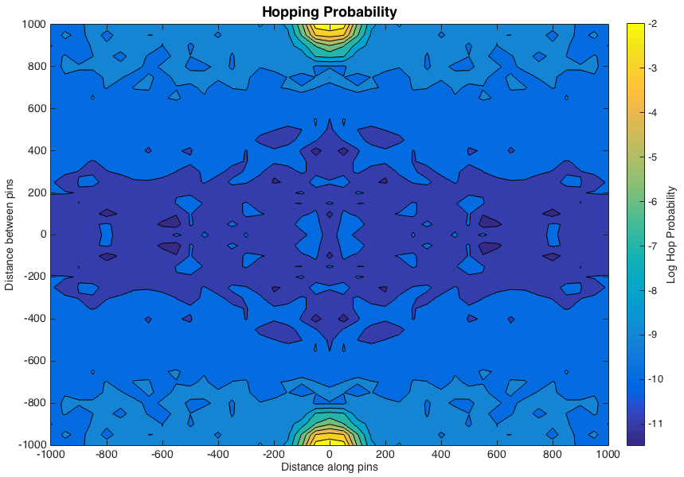

Slide 15
In-Flight Hops
Some molecules do hop.
Not more than a few percent.
Off-axis switching hops?

