Slide 1
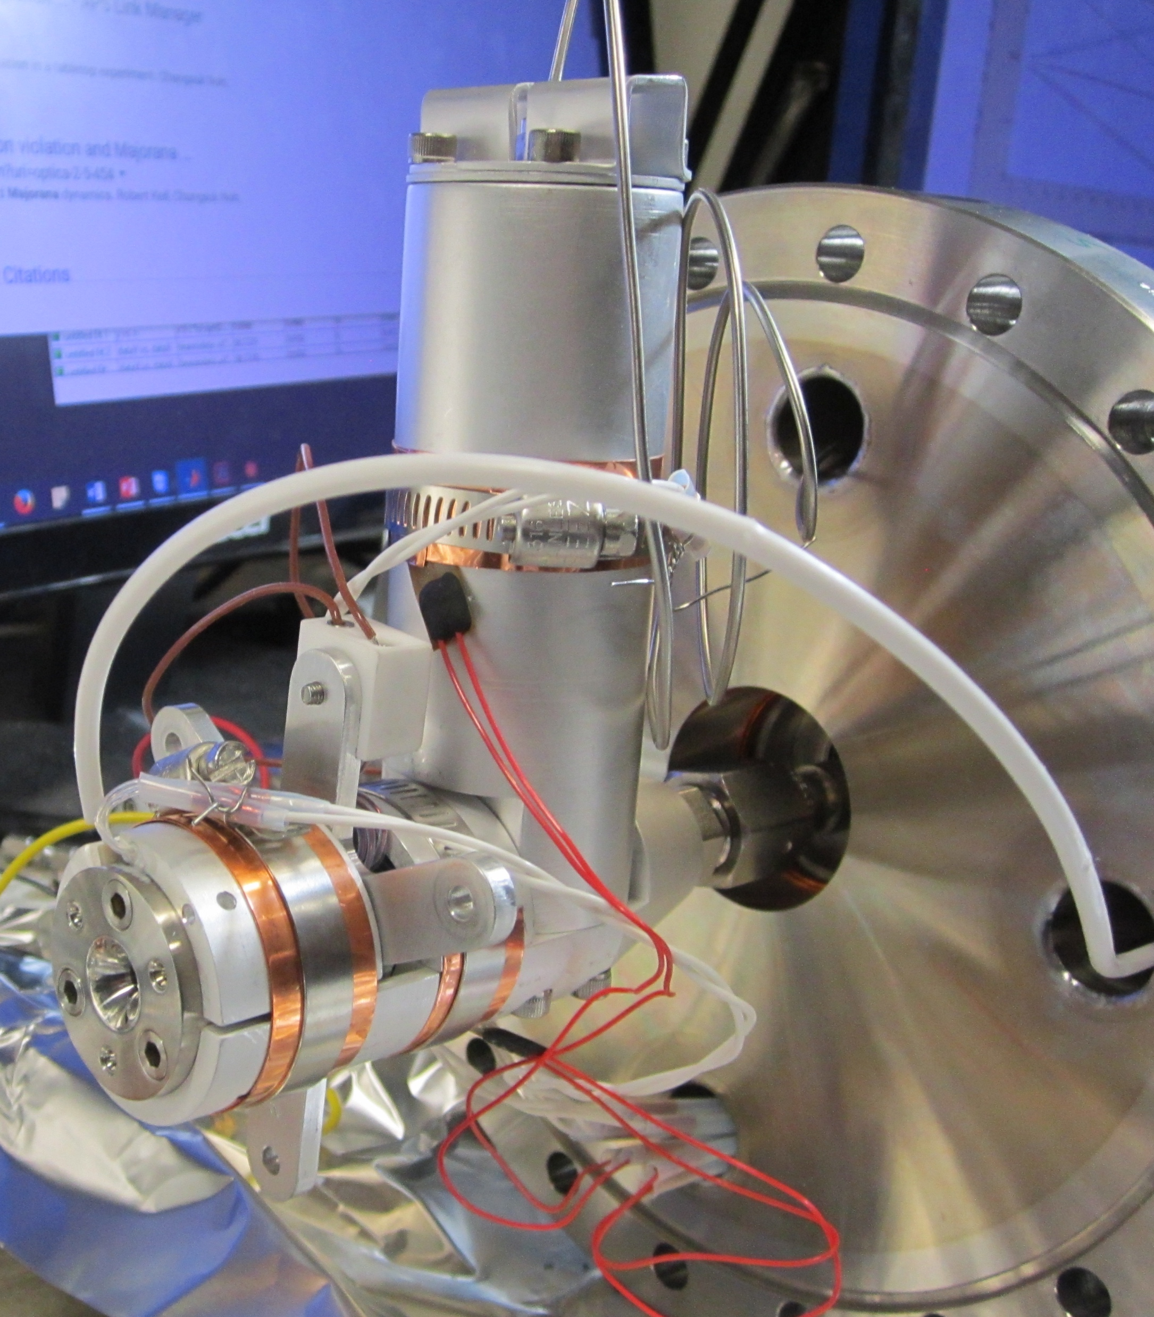
(ii)
(x)
(vii)
(vi)
(viii)
(iv)
(ix)
(iii)
(i)
(v)

