Slide 1
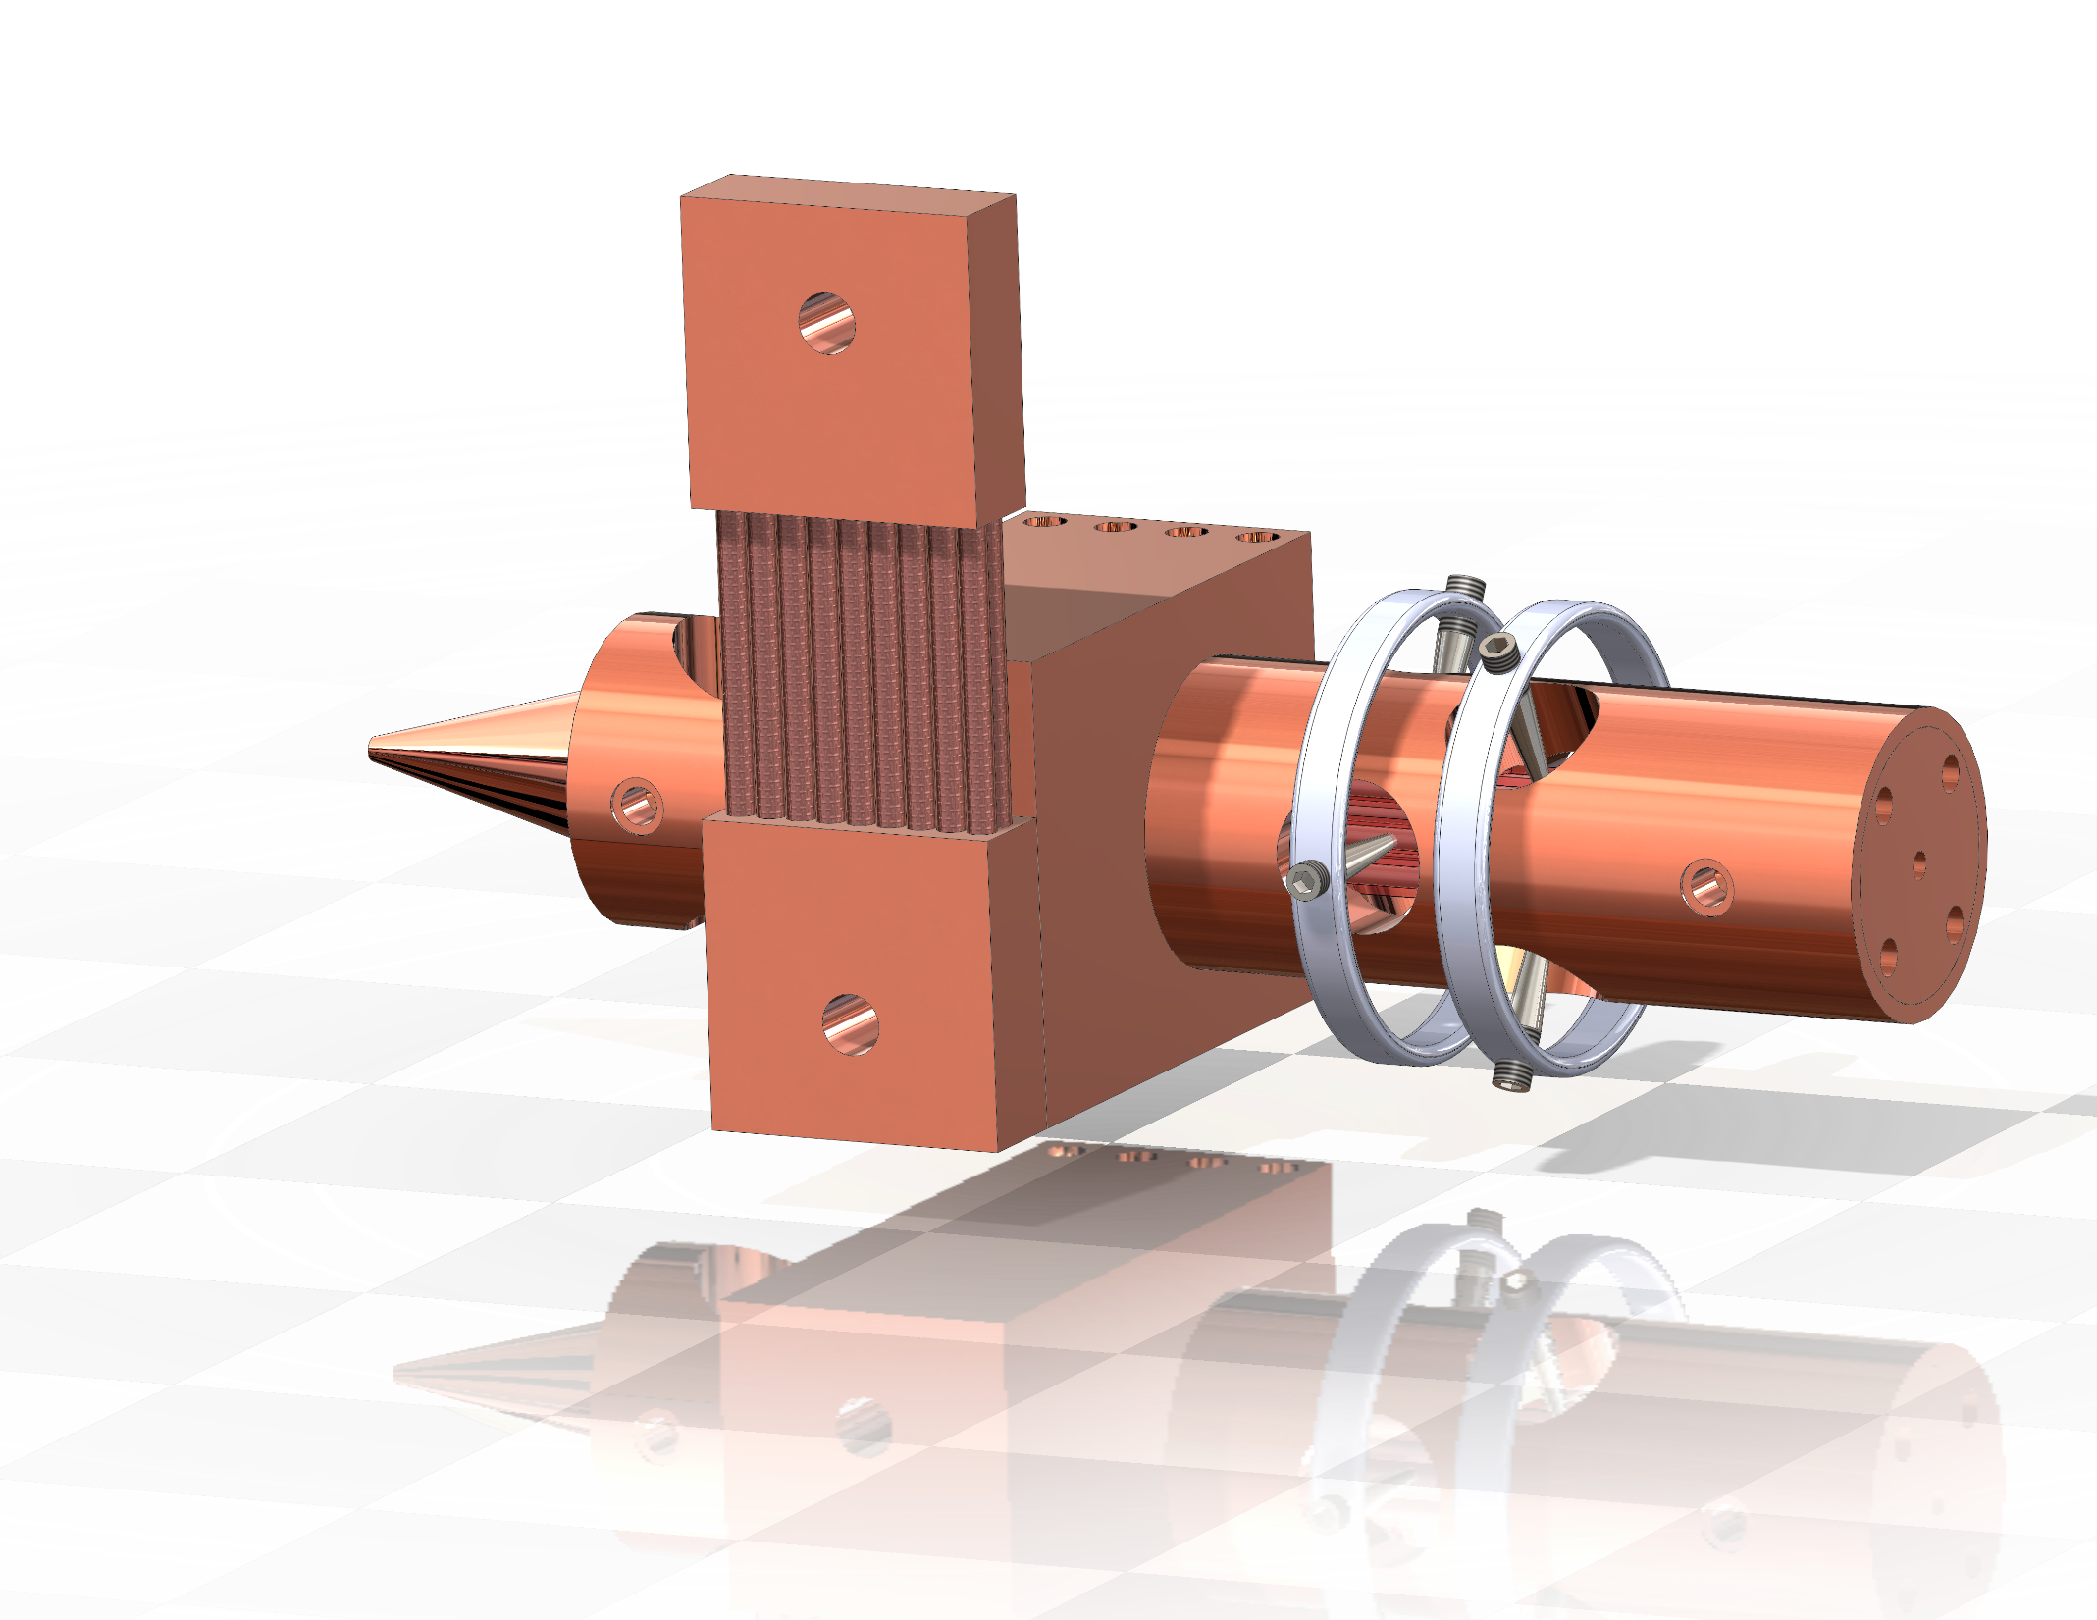
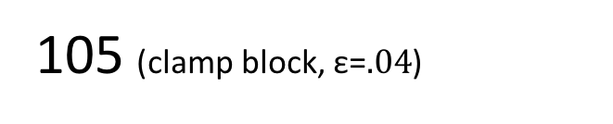
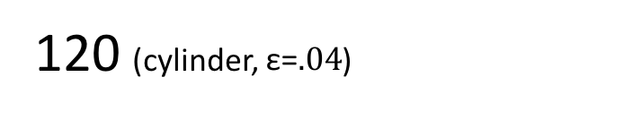
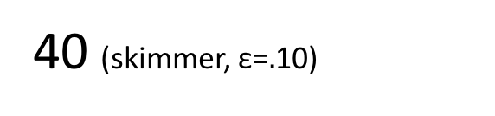
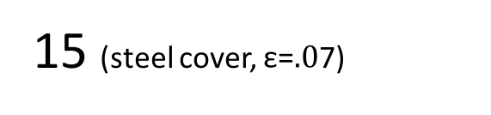
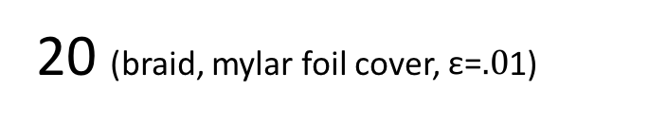
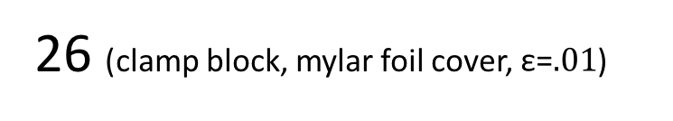
(a) Thermal Conductivity (W/˚K @ 10˚K)
(b) Radiative Heat Load (mW @ 285˚K)
12 (300 kg x 4 screws, Au coat)
26 (clamp block, mylar foil cover, $\text{ε}\text{=}.01$)
10 (grease to cold head, not shown)
75 (300 kg x 4 brass screws, Au coat)
105 (clamp block, $\text{ε}\text{=}.04$)
20 (braid, mylar foil cover, $\text{ε}\text{=}.0$1)
0.7 (x2?)
100 (indium solder)
40 (skimmer, $\text{ε}\text{=}.$10)
0.5 (grease, 3 cm²)
15 (steel cover, $\text{ε}\text{=}.0$7)
12 (300 kg x 4 screws, Au coat)
120 (cylinder, $\text{ε}\text{=}.04$)
Total: 0.6 (cold head to skimmer)
Total: 300 (cold head to skimmer)

