Slide 1
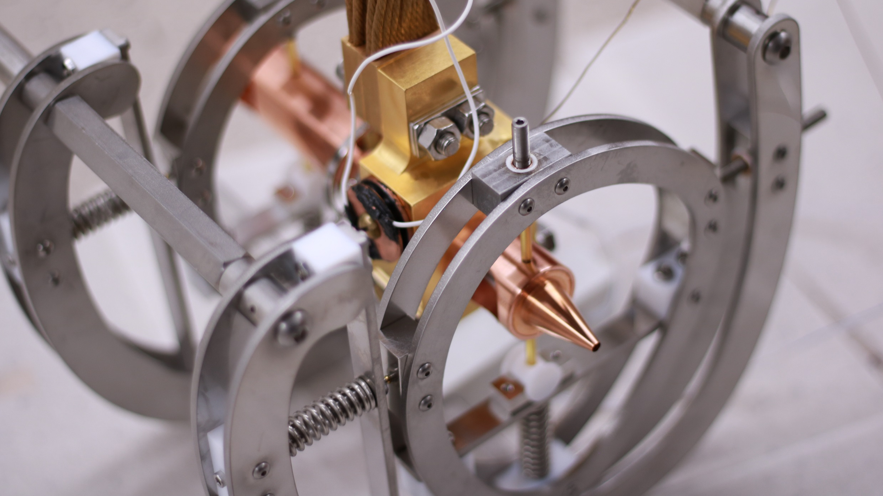
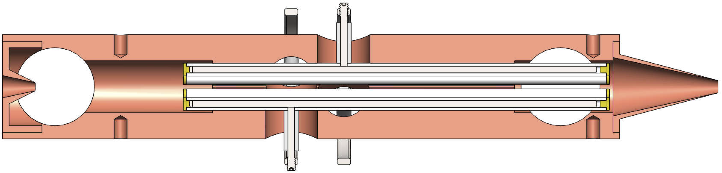
(a)
(ii)
(vi)
(v)
(ix)
(iv)
(i)
(vii)
(iii)
(viii)
(b)
(ix)
(iv)
(x)
(i)
(iii)
(v)
(ii)
(vi)
(viii)
(vii)

