Slide 1
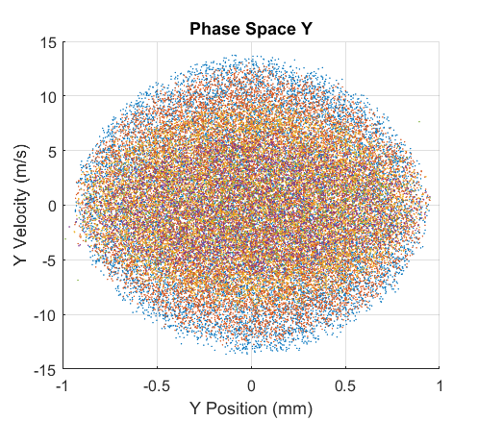
Blue VSF²
Red VSF
Yellow SF
Purple F
Green S=1

