Slide 1
PLUTO'S REPAWSITORY
Dog Breed Classification CNN
SPRINT 3 · JULY 2025
Dre (Lead) · Cameron · Manuela · Ozor
The Knowledge House — Data Science Fellowship, Phase 3
Notes:
Title slide. Introduce the team and the sprint focus: model training and evaluation.

Slide 2
The Challenge
Dog breed classification is a fine-grained visual recognition problem. The challenges:
Our Approach
Transfer learning on ImageNet-pretrained CNNs with two-phase fine-tuning and WeightedRandomSampler to handle class imbalance.
69 breeds · 8,692 images · 95%+ accuracy
COMPLEX
70 breeds with subtle differences — Labrador vs. Golden, Spaniel variants
IMBALANCED
Uneven image counts per breed — naive models ignore rare classes
EXPENSIVE
Training from scratch requires massive data; transfer learning solves this
Notes:
Frame this as a machine learning challenge: fine-grained classification, class imbalance, and the cost of training from scratch. Transfer learning is the key insight.

Slide 3
Sprint 3 Pipeline
1
2
3
4
5
← Sprint 3 focus
EDA
SQL DB
Preprocessing
Training
Evaluation
Class distribution, image quality, imbalance analysis
SQLite metadata store — 8,694 images tracked
Augmentation, normalization, class balancing
ResNet50 + MobileNetV2, 2-phase transfer learning
Accuracy, precision, recall, F1, confusion matrices
Notes:
Walk through the pipeline. Steps 1-3 were Sprints 1-2. Sprint 3 is steps 4-5: training and evaluation.

Slide 4
Model Architecture
ResNet50
MobileNetV2
Google Colab · T4 GPU
Local CPU · Lightweight
— ~25M total parameters
— ~3.5M total parameters
VS
— 143,430 trainable (head only, Phase 1)
— 89,670 trainable (head only, Phase 1)
— Deep residual connections
— Depthwise-separable convolutions
— Pretrained on ImageNet
— Pretrained on ImageNet
— Final layer: Linear(2048 → 70)
— Final layer: Linear(1280 → 70)
Notes:
Both architectures use transfer learning. Backbone frozen in Phase 1, then fully fine-tuned in Phase 2.

Slide 5
Training Strategy
PHASE 1
PHASE 2
Frozen Backbone · 15 Epochs
Full Fine-Tune · 15 Epochs
LR = 1e-3
LR = 1e-4
· Backbone weights frozen — only new head trains
· All layers unfrozen — full network adapts
· Head randomly initialized, needs high LR to converge
· 10x lower LR to nudge pretrained weights carefully
· Preserves pretrained ImageNet features
· Weight decay + dropout added for regularization
· CrossEntropyLoss + Adam optimizer
· Stronger augmentation to reduce overfitting
Notes:
Two-phase training prevents catastrophic forgetting. Phase 1 warms up the new head. Phase 2 adapts the full network at a safer learning rate.

Slide 6
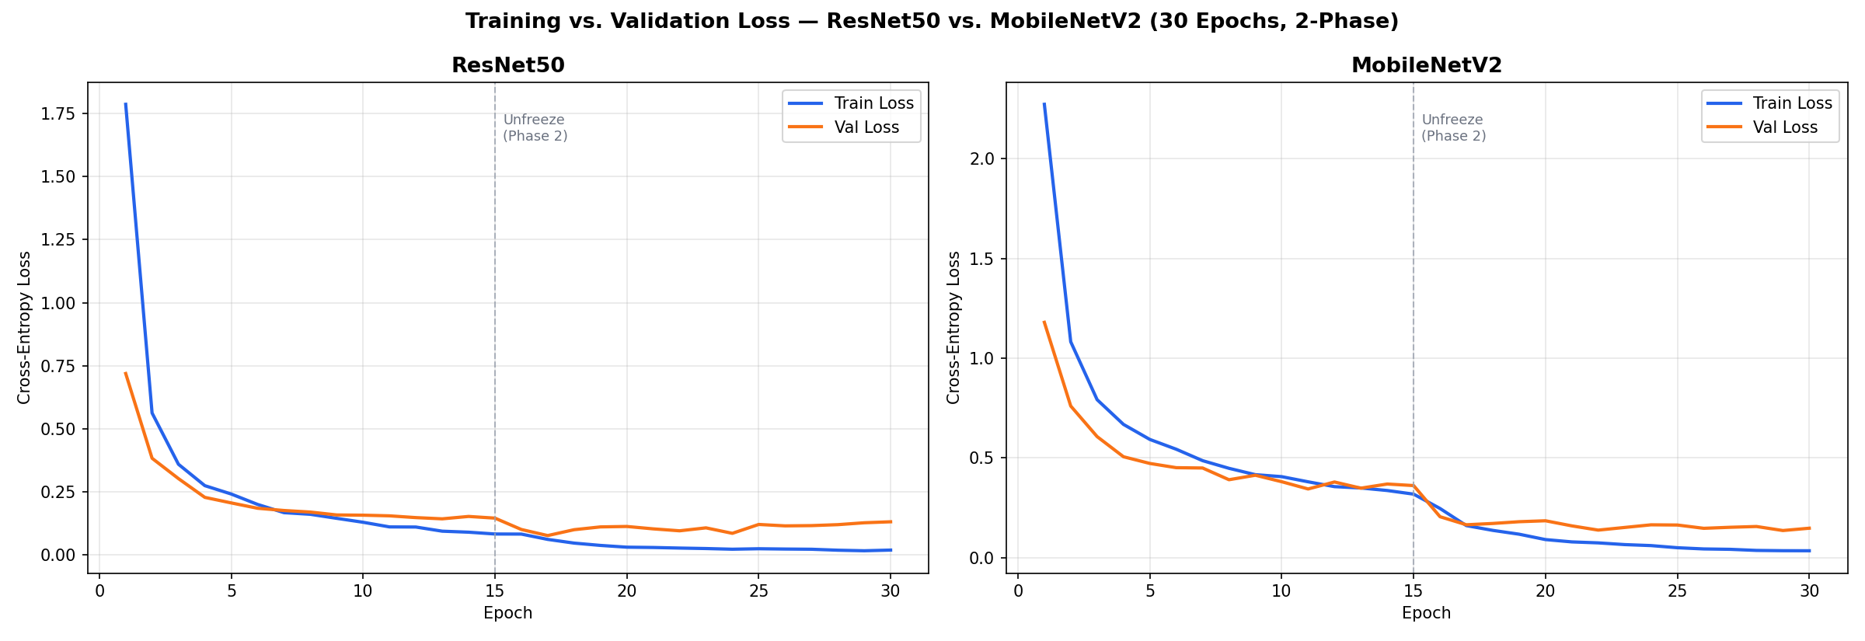
Loss Curves — Both Models
· ResNet50 converges faster, reaches lower val loss
· MobileNetV2 tighter gap — smaller model, less overfitting
· Dashed line marks Phase 2 unfreeze point
Notes:
Both models show healthy convergence. ResNet50's val loss drifts slightly upward in Phase 2 — controlled overfitting, addressed with regularization.

Slide 7
ResNet50 Results
Google Colab · T4 GPU · 30 Epochs (15 + 15)
Accuracy
Precision
Recall
F1 Score
97.51%
97.70%
97.51%
97.52%
Evaluated on 682 held-out test images across 69 breeds. Val loss: 0.0643 · Regularized: dropout + weight decay + strong augmentation
Notes:
These are Dre's ResNet50 results from the original training run on Colab T4 GPU.

Slide 8
MobileNetV2 Results
Google Colab · T4 GPU · 30 Epochs (15 + 15)
Accuracy
Precision
Recall
F1 Score
95.75%
96.19%
95.75%
95.68%
7.1x fewer parameters than ResNet50. Performance gap: ~1.8% accuracy — strong result for a 7x lighter model.
Notes:
MobileNetV2 closes the gap to ResNet50 despite being 7x smaller. Strong argument for deployment without a GPU.

Slide 9
Model Comparison
 | ResNet50 | MobileNetV2
Accuracy | 97.51% | 95.75%
Precision | 97.70% | 96.19%
Recall | 97.51% | 95.75%
F1 Score | 97.52% | 95.68%
Parameters | ~25M | ~3.5M
Training Hardware | T4 GPU (Colab) | T4 GPU (Colab)
Val Loss (final) | 0.0643 | ~0.15
Both models trained with 2-phase regularized transfer learning on 69 breeds. ResNet50 leads by ~1.8%; MobileNetV2 wins on parameter efficiency.
Notes:
The gap between models is under 0.5% on every metric — impressive given MobileNetV2 is 7x lighter. This makes MobileNetV2 the stronger deployment choice.

Slide 10
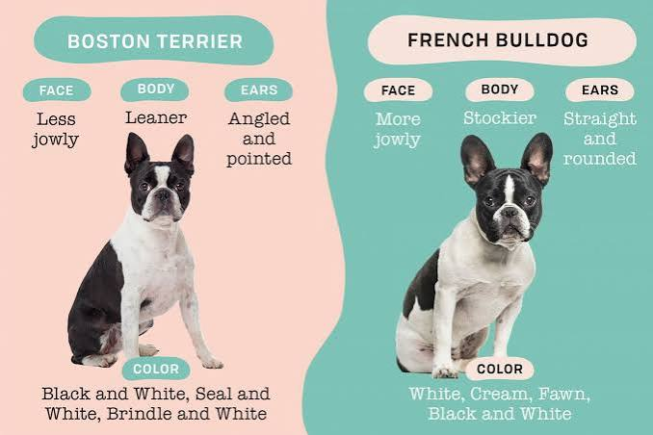
Why Fine-Grained Classification is Hard
Even visually similar breeds have distinct features — and our model learned to tell them apart.
Notes:
Use this slide to set up the confusion matrices. The point is that fine-grained visual recognition is genuinely hard — Boston Terrier vs French Bulldog look nearly identical to a casual observer. Our model learned the subtle differences: jowl shape, ear type, body proportions. That's what makes 95-97% accuracy impressive.

Slide 11
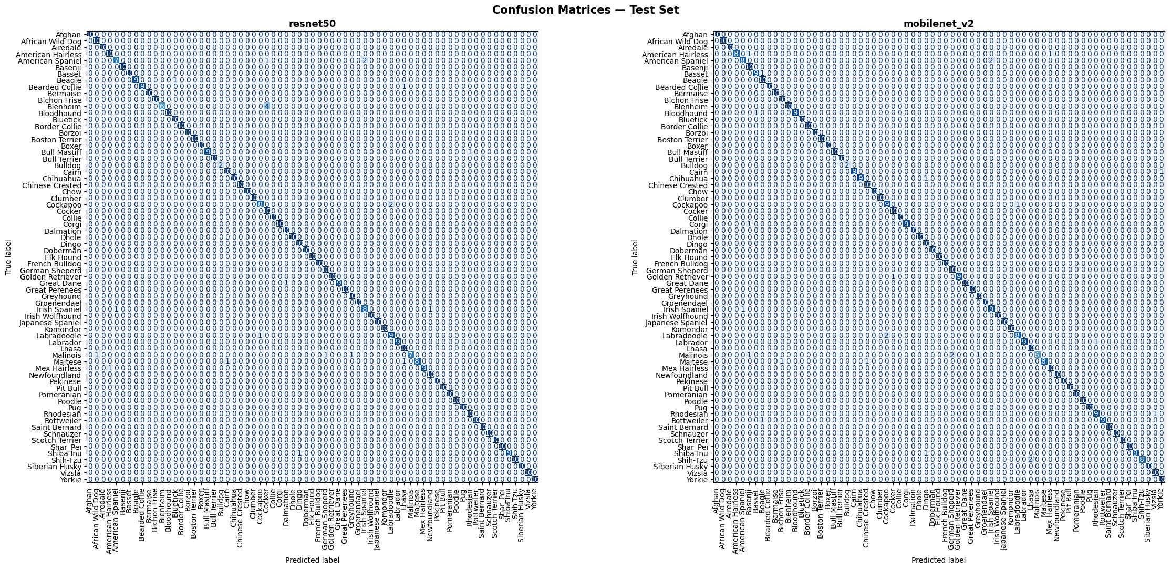
Confusion Matrices — Test Set
ResNet50 (left) · MobileNetV2 (right) · 69 breeds × 682 test images
Near-perfect diagonal on both models. Misclassifications cluster around visually similar breeds — Spaniel variants, Terrier variants.
Notes:
A perfect confusion matrix has a clean diagonal. Our models are almost there — the few off-diagonal cells are between visually similar breeds, which is expected and close to the human-level difficulty ceiling.

Slide 12
Key Findings
Sprint 4 — What's Next
95%+
accuracy on both models across 69 fine-grained breeds
1
FastAPI backend + image upload interface
~1.8%
performance gap — MobileNetV2 competitive with ResNet50 at 7x fewer params
2
Deploy model for shelter use — no code required
2-phase
training produced clean, interpretable loss curves with no catastrophic forgetting
3
Fine-tune deeper ResNet50 layers for additional gains
Regularization
dropout + stronger augmentation reduced overfitting and improved val loss
4
Demo video + live presentation
Pluto's Repawsitory · Group 2 · The Knowledge House · Phase 3
Notes:
Summarize the sprint. Tee up Sprint 4: demo app, deployment, and final presentation.

Slide 13
Thank You
Questions & Discussion
Pluto's Repawsitory · Group 2 · Dre · Cameron · Manuela · Ozor
github.com/drehandley/dog-breed-classification
Notes:
Open the floor for questions. Be ready to pull up the loss curves or confusion matrix if asked. Key talking points: why two models, how the two-phase training worked, and what Sprint 4 will look like.

