Slide 1
THE KNOWLEDGE HOUSE · DATA SCIENCE FELLOWSHIP · PHASE 3
Pluto's Repawsitory
Dog Breed Classification · Sprint 4 Final Presentation
69
95.75%
8,692
MobileNetV2
BREEDS
ACCURACY
IMAGES
ARCHITECTURE
GROUP 2
Dre Handley (Lead) · Cameron Bridgwater · Manuela Chalen · Ozor Moya
July 15, 2025

Slide 2
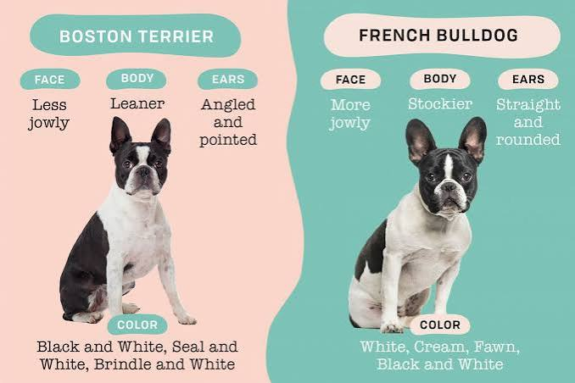
THE PROBLEM
Animal shelters identify
breeds by eye.
Slow. Inconsistent. Error-prone.
Misidentified breeds affect adoption listings and housing eligibility for adopters. A dog labeled as the wrong breed can be passed over entirely — or rejected from a building with breed restrictions.
Two visually similar breeds — easily confused on intake

Slide 3
OUR SOLUTION
One photo.
Instant breed ID.
We trained a convolutional neural network on 8,692 images across 69 breeds — served through a web app anyone can use in seconds.
1
2
3
Upload a photo
Neural network scans
Top 3 results
Drag-and-drop or browse. Any clear photo of a dog works.
MobileNetV2 processes the image against 69 breed signatures in under a second.
Primary breed with confidence score, plus two alternatives and breed facts.

Slide 4
BUSINESS CASE
Why this matters beyond the classroom.
3,500+
Housing
eligibility
< 1 sec
95.75%
animal shelters in the US intake dogs daily with no automated breed identification tool
breed restrictions in 73% of rental properties — misidentification directly costs adoptions
inference time on CPU — no GPU required, deployable on any shelter computer
top-1 accuracy across 69 breeds on a held-out test set of 682 images
Deployed as a free, open-source tool — no code required for shelters to use it.

Slide 5
PIPELINE
End-to-End Architecture
Kaggle
Dataset
SQLite
Database
Preprocessing
Training
Model
.pt file
FastAPI
App
70 Dog Breeds
8,692 images
69 classes
Metadata store
file path · label
split · quality flags
Resize 224×224
Augmentation
WeightedSampler
MobileNetV2
ResNet50
2-phase fine-tune
9.1 MB
CPU inference
95.75% acc
POST /predict
Top-3 breeds
localhost:8000
Raw Data → Structured Metadata → Normalized Tensors → Trained Weights → Live Predictions
Sprint 1–2
Sprint 2
Sprint 3
Sprint 3
Sprint 3
Sprint 4

Slide 6
DATASET
Kaggle: 70 Dog Breeds Image Dataset
gpiosenka · kaggle.com/datasets/gpiosenka/70-dog-breedsimage-data-set
69
8,692
70 / 15 / 15
224×224
breed classes
total images
train / valid / test split
input resolution
Why 70/15/15 instead of 80/20?
More validation images across 69 rare breeds means the validation signal is meaningful — not dominated by the most common classes. The larger test set gives a statistically reliable final accuracy number.
Class imbalance challenge:
Some breeds had significantly fewer images than others. Solved with PyTorch WeightedRandomSampler so underrepresented breeds weren't skipped during training.

Slide 7
SPRINT 2 · DATABASE
SQLite Metadata Store
Every image tracked before a single pixel of preprocessing ran.
Column
Type
Description
id
INTEGER PK
Auto-increment unique identifier
file_path
TEXT
Relative path to image file
label
TEXT
Breed class name (cleaned)
split
TEXT
train / valid / test
width
INTEGER
Image width in pixels
height
INTEGER
Image height in pixels
quality_flag
INTEGER
0 = ok, 1 = flagged for review
8,692 rows · All images catalogued before any preprocessing · Label whitespace bugs fixed at ingest

Slide 8
SPRINT 3 · PREPROCESSING
Building the training pipeline
1
Resize
All images resized to 224×224 px to match ImageNet pretraining dimensions of MobileNetV2 and ResNet50.
2
Normalize
Mean [0.485, 0.456, 0.406] and std [0.229, 0.224, 0.225] — same values used during ImageNet training. Applied identically at inference.
3
Augmentation
(train only)
Random horizontal flip · random rotation ±15° · color jitter (brightness, contrast, saturation). Applied only to training set — validation and test sets see clean images only.
4
WeightedRandomSampler
Computed per-class weights so each batch represents all 69 breeds proportionally, preventing majority classes from dominating gradient updates.
5
Custom Dataset class
PyTorch Dataset subclass reads from SQLite DB split column — clean separation of train/valid/test with zero data leakage.

Slide 9
ARCHITECTURE
MobileNetV2 + Transfer Learning
ImageNet Pretrained Backbone
~3.5M
MobileNetV2 feature extractor — depthwise-separable convolutions optimized for speed
parameters
Frozen Phase (Epochs 1–15)
Only classifier head trained. Backbone weights locked — fast convergence, stable gradients.
< 1s
CPU inference
Dropout(0.5)
Applied before the linear layer to prevent overfitting during fine-tuning.
9.1 MB
Linear(1280 → 69)
model file size
Custom head replaces ImageNet's 1000-class output with our 69 breed classes.
224×224
Fine-tune Phase (Epochs 16–30)
All layers unfrozen. Full backprop with lower learning rate across the entire network.
input size

Slide 10
RESULTS · MODEL COMPARISON
ResNet50 vs. MobileNetV2
Metric
ResNet50
MobileNetV2
Difference
Accuracy
97.51%
95.75%
−1.76 pp
Precision
97.70%
96.19%
−1.51 pp
Recall
97.51%
95.75%
−1.76 pp
F1 Score
97.52%
95.68%
−1.84 pp
Parameters
~25M
~3.5M
86% smaller
Training
Colab T4 GPU
Local CPU
No GPU needed
Model size
~100 MB
9.1 MB
91% smaller
Deployed
No
Yes
Production ready
We chose MobileNetV2 for deployment — the 1.76pp accuracy difference is not worth the 86% parameter increase and GPU requirement.

Slide 11
DEPLOYMENT DECISION
Why MobileNetV2 for production?
9.1 MB vs ~100 MB
< 1 second on CPU
SIZE
SPEED
Fits in any deployment environment. No large file hosting or slow downloads. A shelter can run this on any machine.
No GPU required. Inference runs locally on any standard computer — no cloud dependency, no latency, no cost per prediction.
95.75% — good enough
Depthwise-separable convolutions
ACCURACY
ARCHITECTURE
The 1.76 percentage-point gap vs ResNet50 does not justify 7× more parameters and requiring a GPU. 95.75% accuracy is production-quality for this use case.
Designed for mobile and edge deployment. Each convolution factored into depth + pointwise — far fewer multiply-adds than a standard convolution.

Slide 12
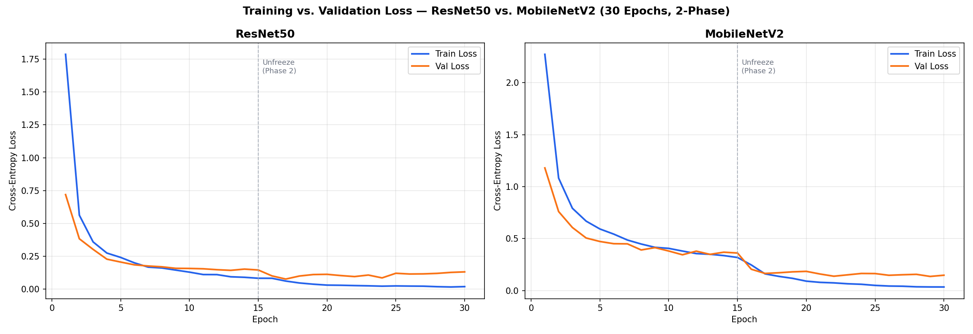
TRAINING · LOSS CURVES
Both models trained 30 epochs — 2-phase strategy
Phase 1 (epochs 1–15): backbone frozen, only classifier head trained · Phase 2 (epoch 15+): full fine-tuning, all layers unfrozen

Slide 13
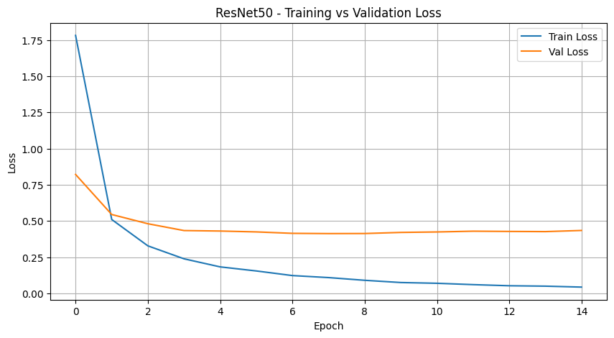
RESULTS · CONFUSION MATRIX
Near-perfect diagonal across 69 classes
Misclassifications cluster around visually similar breeds: Golden Retriever ↔ Labrador, similar Terrier varieties.

Slide 14
SPRINT 4 · DEMO APP
Pluto's Repawsitory
1
Scan View
Upload or drag-and-drop a dog photo. Animated neural scan overlay runs while the model processes. Returns top 3 breed predictions with confidence scores.
2
Breed Library
69 breed cards with real dog photos pulled live from the Dog CEO API. Filter by group (Herding, Hound, Sporting, Terrier, Toy, Working, and more) or search by name.
3
Breed Modal
Slide-up detail sheet for each breed: hero photo, classification group, breed story, and animated base stat bars (Loyalty, Intelligence, Energy, Fluffiness, Trainability, Friendliness).
4
Tech Stack
FastAPI backend · PyTorch MobileNetV2 · Vanilla JS frontend · Docker ready for Hugging Face Spaces deployment

Slide 15
LIVE
DEMO
localhost:8000 · Upload any dog photo · Watch the model identify the breed

Slide 16
THE TEAM
Group 2 — The Knowledge House
Dre Handley
Cameron Bridgwater
Manuela Chalen
Ozor Moya
GROUP LEAD
DATA ENGINEER
ML ENGINEER
ML ENGINEER
· FastAPI backend architecture
· Full pipeline ERD diagram
· Preprocessing pipeline
· Class imbalance solution (WeightedRandomSampler)
· SQLite metadata database
· Data cleaning and label fixes
· Augmentation strategy
· Loss curves and training visualization
· Frontend: scan + library + modal UI
· Training loop implementation
· Model evaluation and metrics
· Model export (.pt file)
· Project structure and GitHub management
· Integration testing
· Performance summary analysis
· ResNet50 Colab training run

Slide 17
WHAT'S NEXT
Where this goes from here.
01
Fine-tune ResNet50
Unfreeze deeper layers for additional accuracy gains — ResNet50 at 97.51% has room to improve with a longer training schedule and learning rate warmup.
02
Mixed-breed identification
Current model assumes purebred. A multi-label classification head could return probability distributions across parent breeds.
03
Shelter deployment
Package as a containerized tool shelters can self-host. Add CSV export of intake predictions for database integration.
04
Expand breed coverage
Current dataset covers 69 breeds. Stanford Dogs Dataset (120 breeds) would significantly expand real-world coverage.

Slide 18
Thank you.
Pluto's Repawsitory · Group 2 · The Knowledge House Data Science Fellowship, Phase 3
Dre Handley · Cameron Bridgwater · Manuela Chalen · Ozor Moya
MODEL
MobileNetV2 · 95.75% accuracy · 69 breeds · 9.1 MB
DATASET
Kaggle: gpiosenka / 70-dog-breedsimage-data-set
APP
FastAPI + PyTorch · localhost:8000

