Slide 1
RStudio
Catching up with R

Slide 2
Before the next class
Read Ch. 1-3 for next class
See article “Installing Course Software” in D2L/Content/Course_Documents

Slide 3
What is R? What is RStudio?
R is a programming language, and RStudio is an Integrated Development Environment (IDE) designed to work with R.
See “What is an IDE?” in D2L content section for this class

Slide 4
RStudio Layout (the four panes)
Console
Where commands can be entered, one line at a time, to be executed by the computer
Environment
Keeps a list of objects that you have created in your R session
Plots
Displays the visualizations created by a command run in the console
Script Editor
Where you can build your program

Slide 5
R Syntax (rules for writing commands)
Example data in D2L Content
Objects
Vectors
Data frames
Operators
Logical
Evaluating whether a statement is TRUE or FALSE
Mathematical
Performing mathematical operations on numerical objects
Data Types (classes)
Numeric (or integer)
Character (or factor)
Logical
Indexing
2-D object (data frame)
Object[rows, columns]
1-D object (vector)
Object[rows]
Can index by numbers or logic
Functions
Preset recipes for operations (e.g. mean(vector), arrange(vector), …)
(lists)

Slide 6
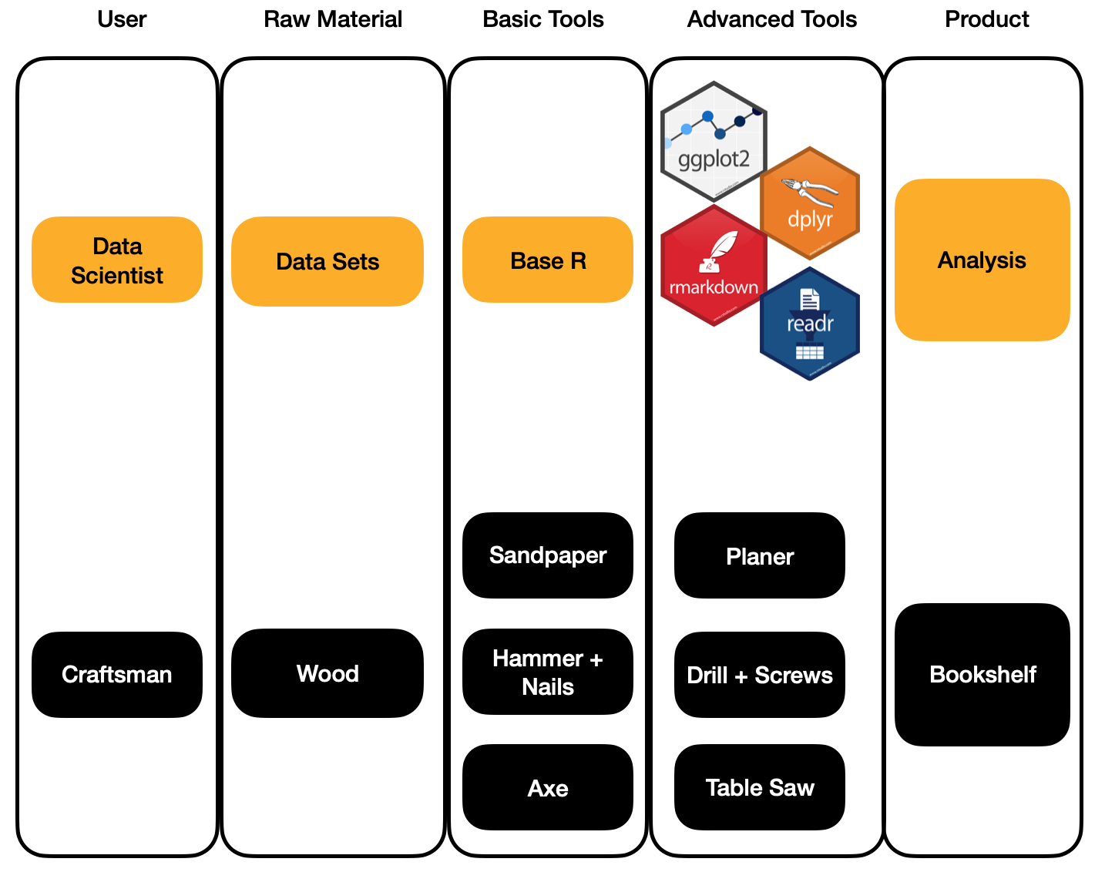
Packages (libraries)
Packages are libraries of R functions
Anyone can contribute
No packages for excel (open-source vs. closed-source)

