Slide 1
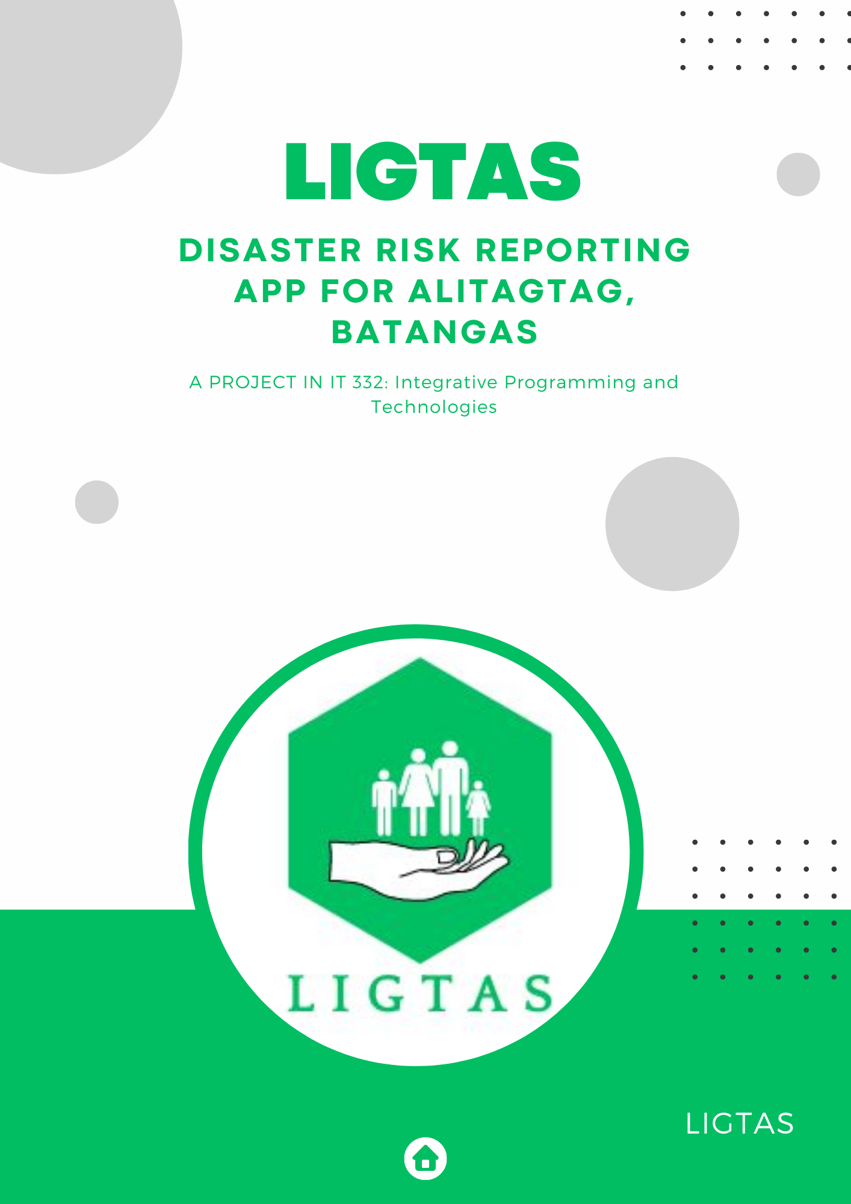
LIGTAS : A DISASTER RISK REPORTING APP

Slide 2
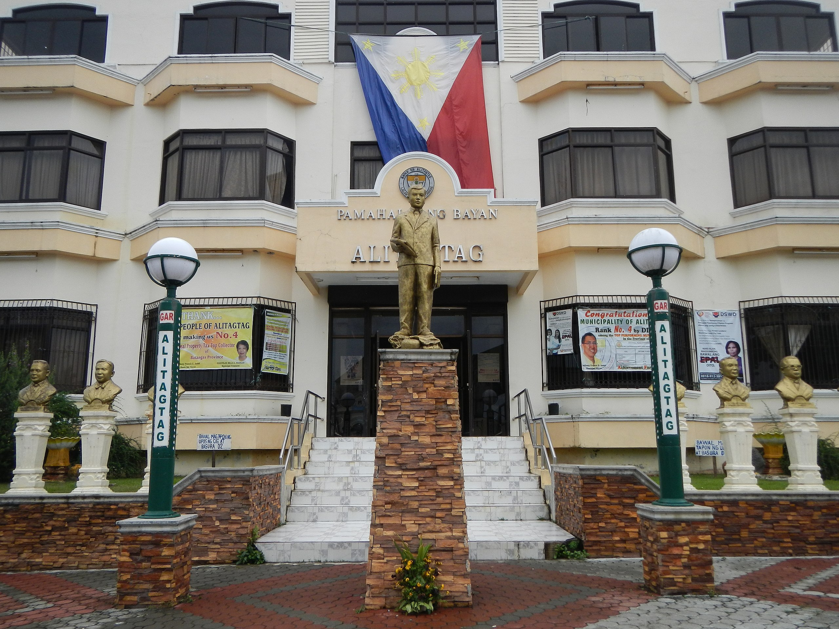

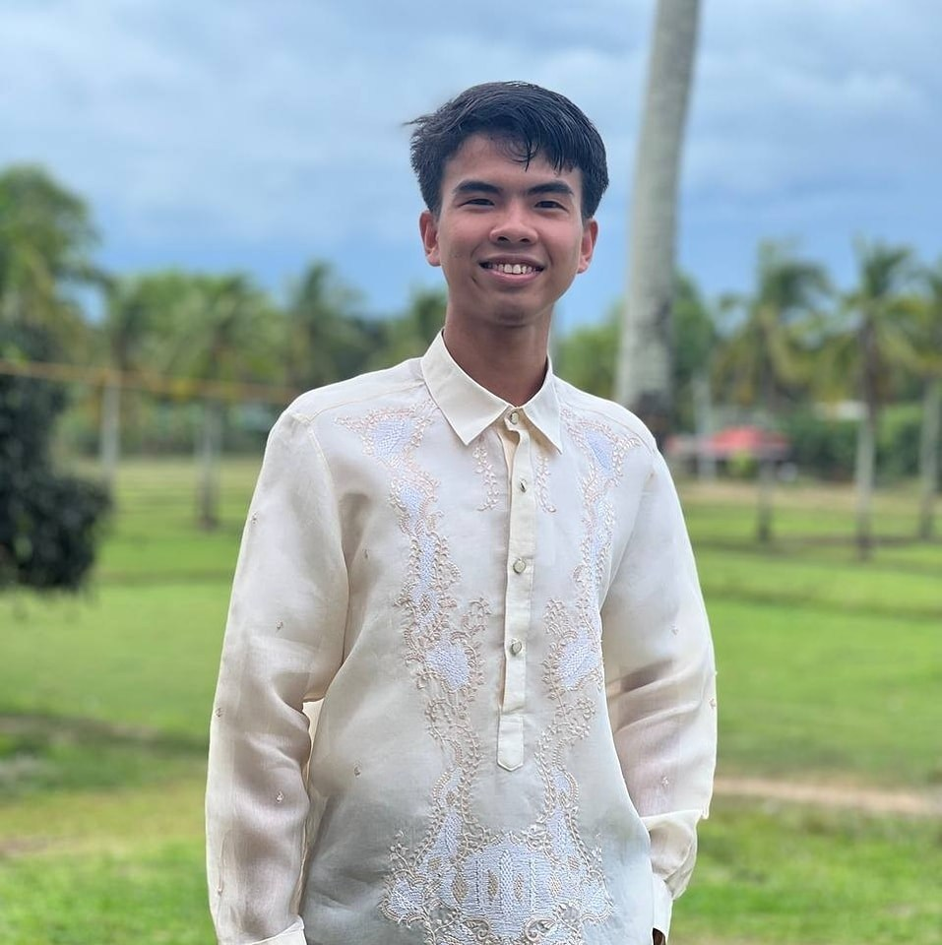

GROUP MEMBERS
De las Alas , Ysrael P.

Slide 3
GROUP MEMBERS
Manalo, Jemuel V.

Slide 4
GROUP MEMBERS
Estole, James Andreison A.
IT - 3304

Slide 5
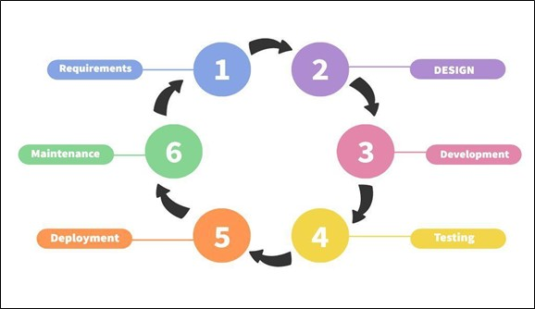
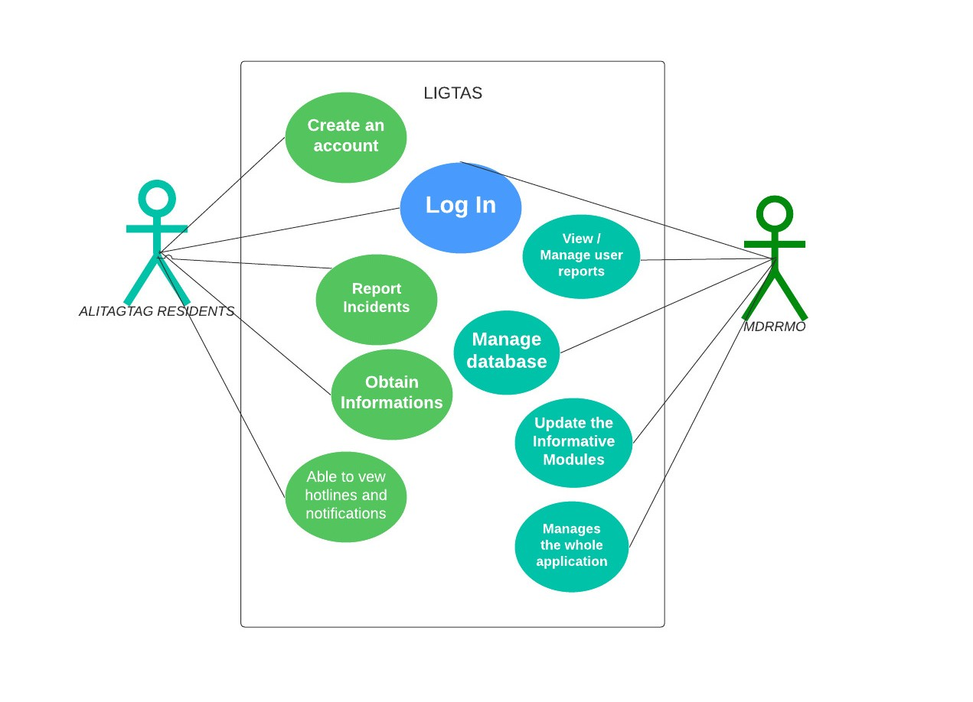
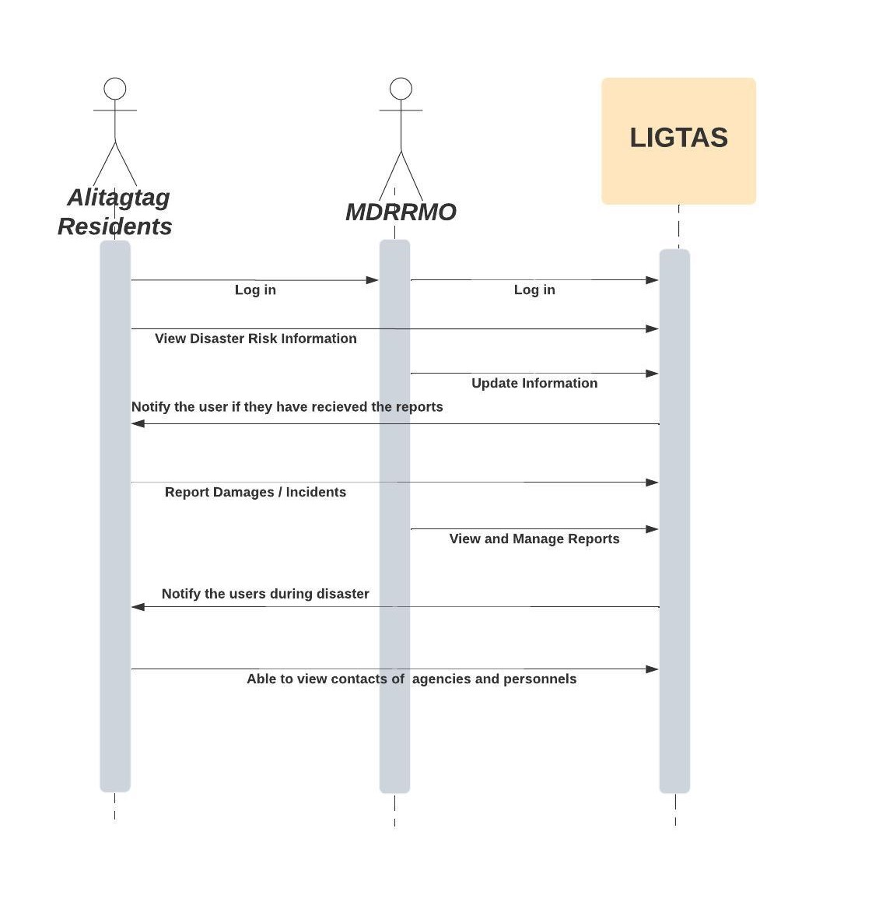
Introduction

Slide 6
Development Model
In the development of the system, the researchers will use agile methodology as shown in Figure above. The agile methodology will help with the development of the system by making it more efficient and effective. It also ensures that the project will be completed within the specific time given. Furthermore, it helps proponents make changes easily and quickly while keeping the overall project timeline consistent. The following various phases are:

Slide 7
USE CASE DIAGRAM
As shown in the diagram, both the residents and the MDRRMO are required to log in. Further, the residents of Alitagtag can view disaster risk management information, such as a disaster preparedness guide on how to prepare for different types of disasters, and disaster emergency hotlines. They can also report damaged properties, man-made disasters and accidents, Meanwhile, for admin use cases, the MDRRMO can view the reports that came from the residents, edit and update disaster risk management information, manage databases, notify residents during times of emergency.

Slide 8
SEQUENCE DIAGRAM
The figure shows the system sequence diagram and presents the process interactions on how they work together. As shown in the figure, it shows how the residents and MDRRMO navigate the system. Further, the diagram shows the two main actors of the system, which are the residents and the MDRRMO, together with their sequence messages.

