Slide 1
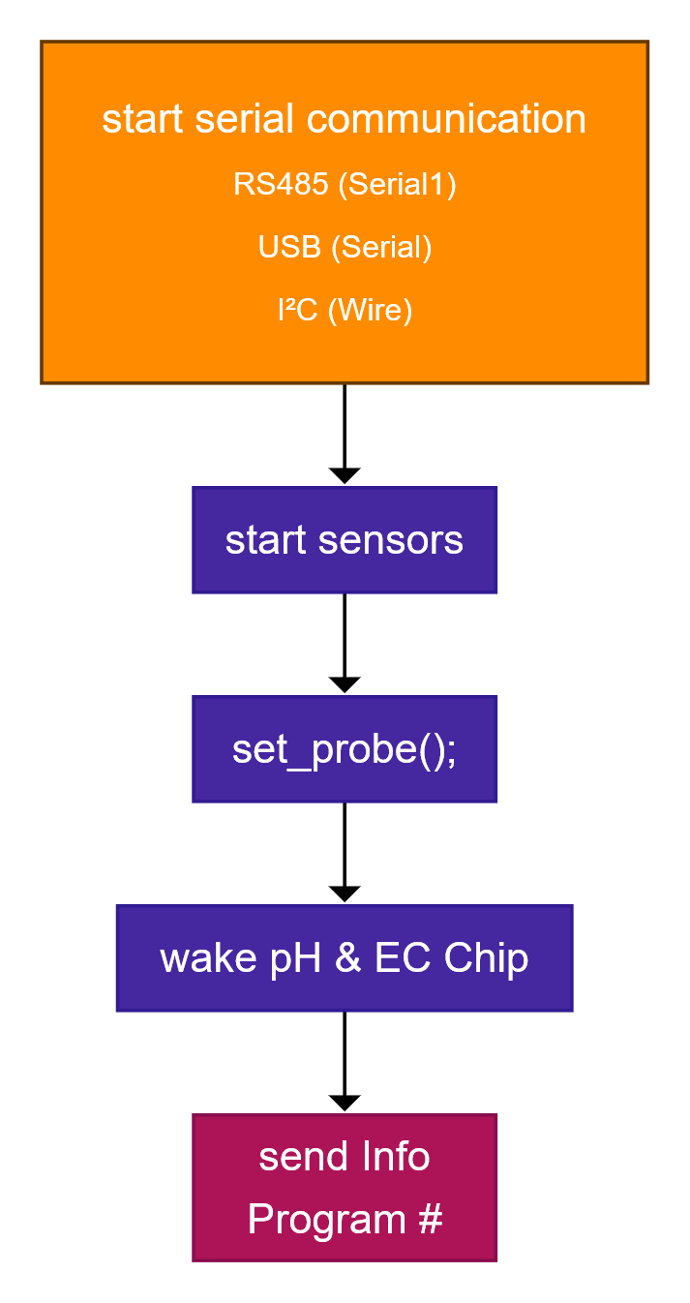
setup
Serial1 ➔ RS485
Serial ➔USB (Debug)
Wire ➔ I²C
Restlicher Code (intern)

Slide 2
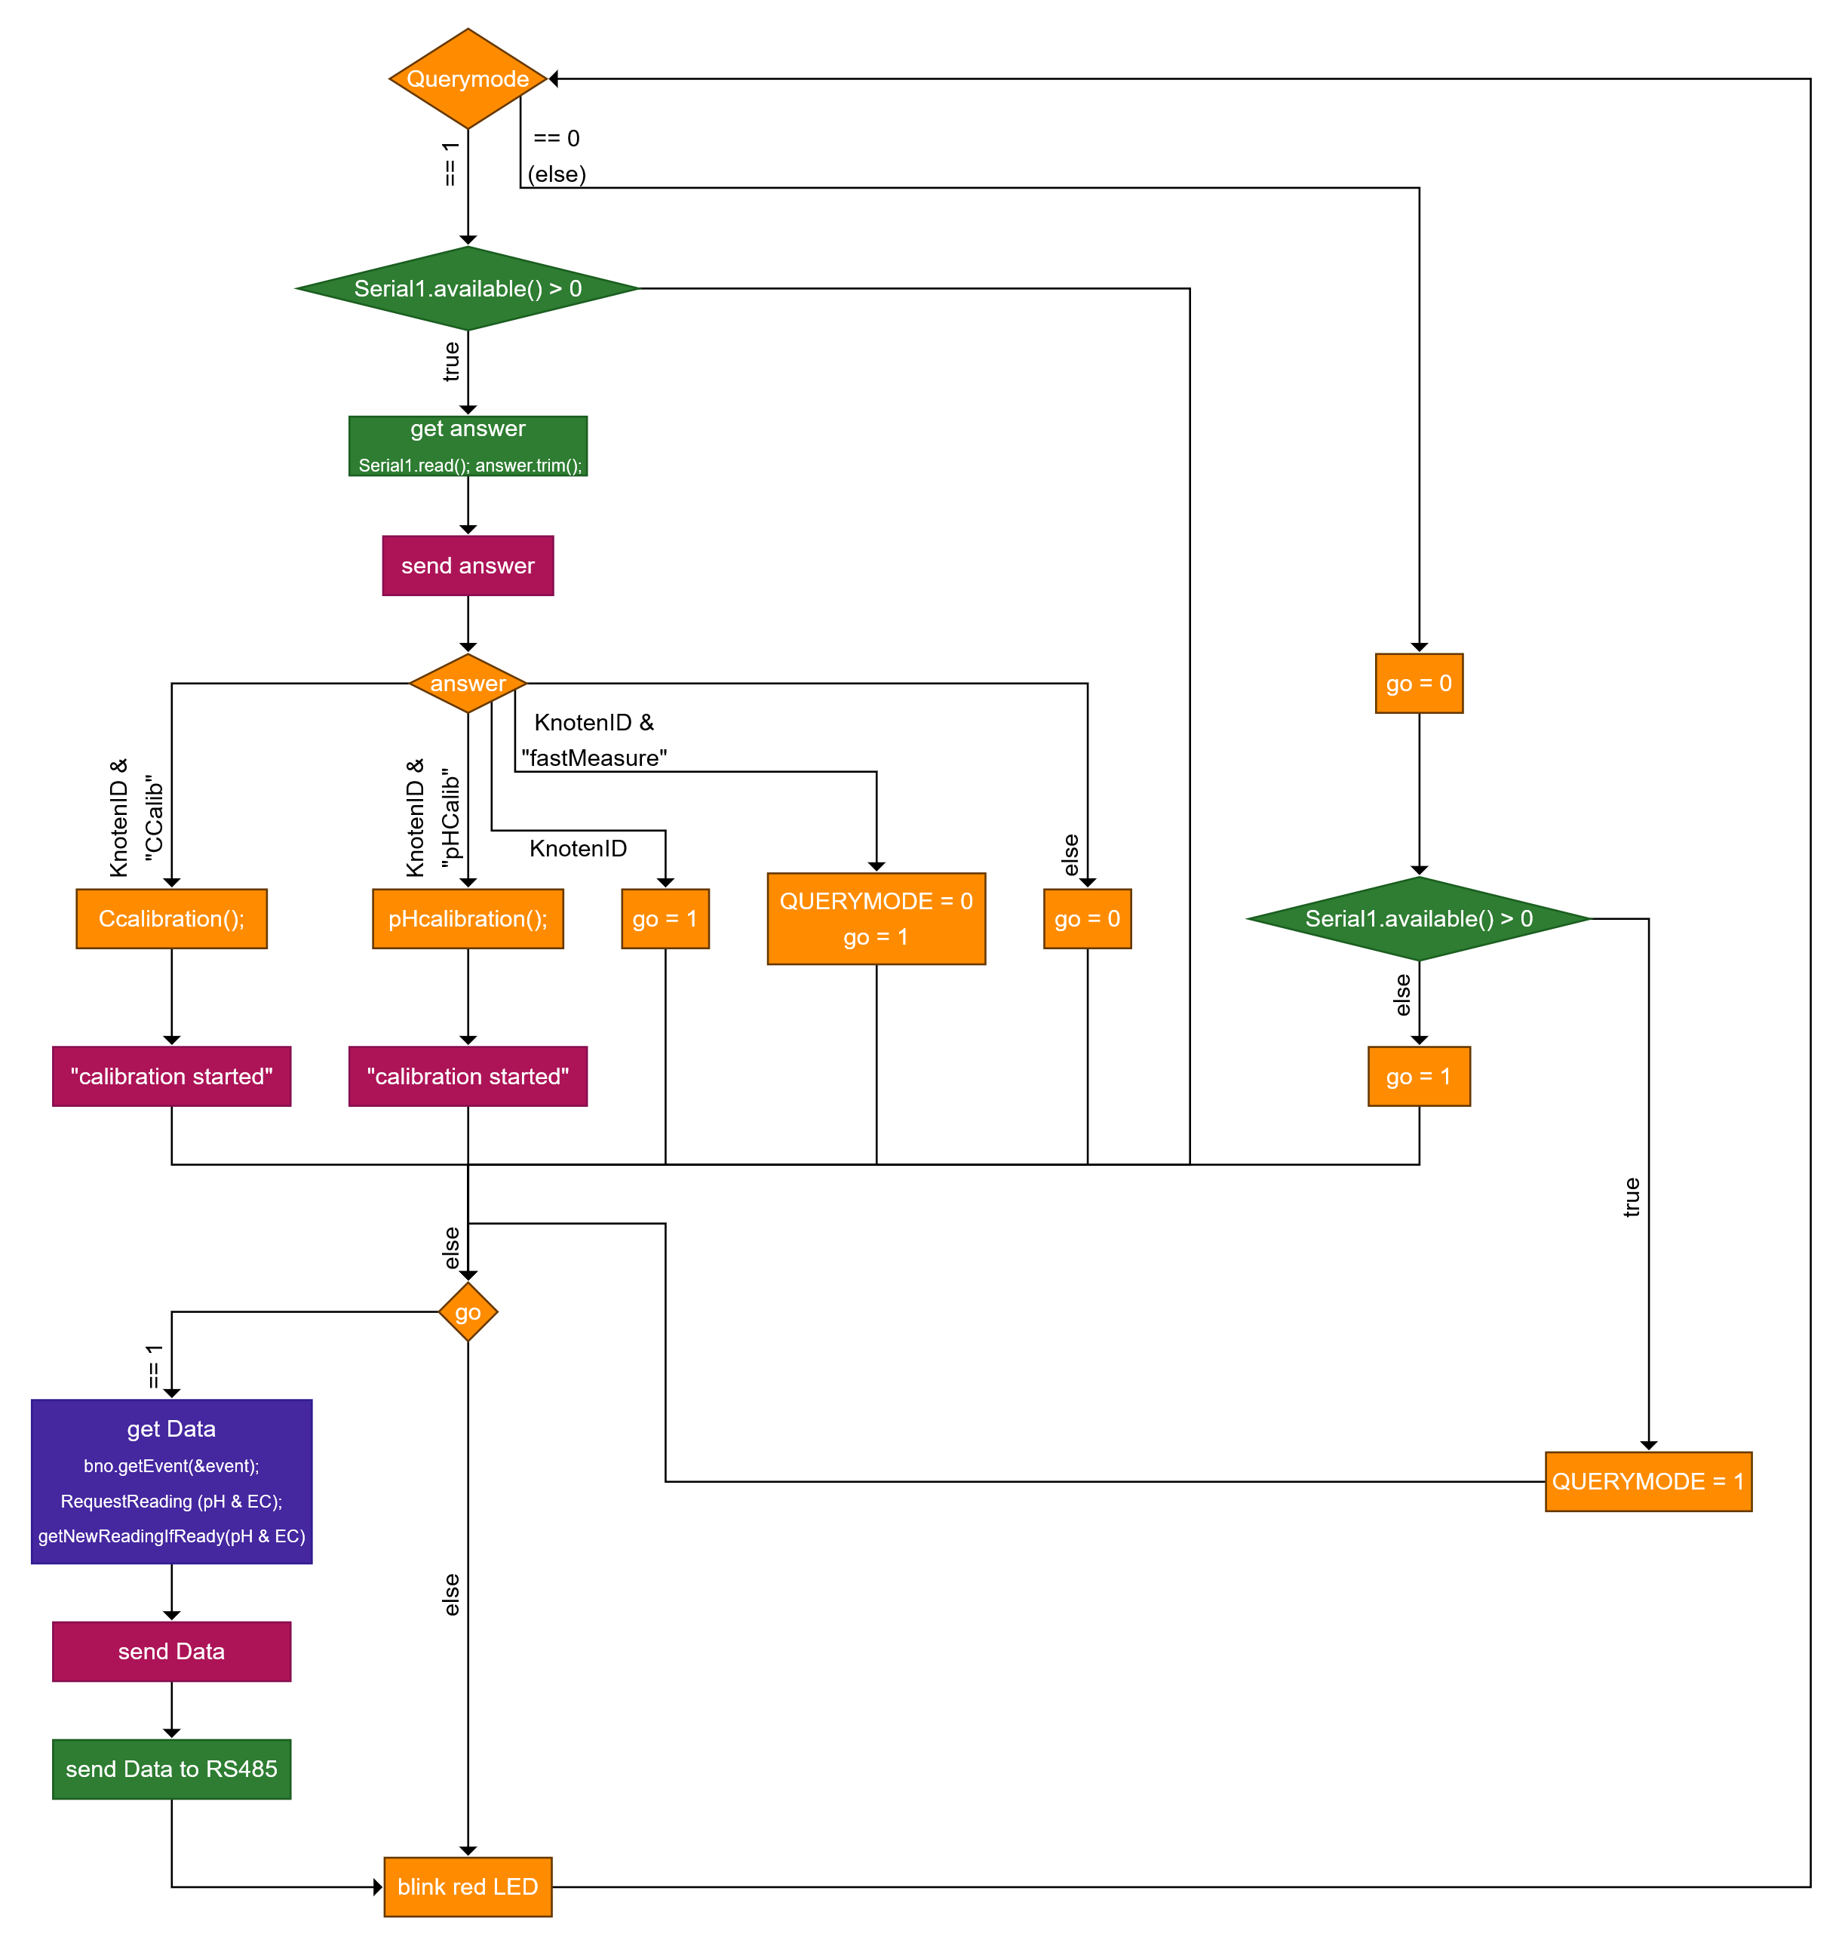
loop()
Serial1 ➔ RS485
Serial ➔USB (Debug)
Wire ➔ I²C
Restlicher Code (intern)

Slide 3
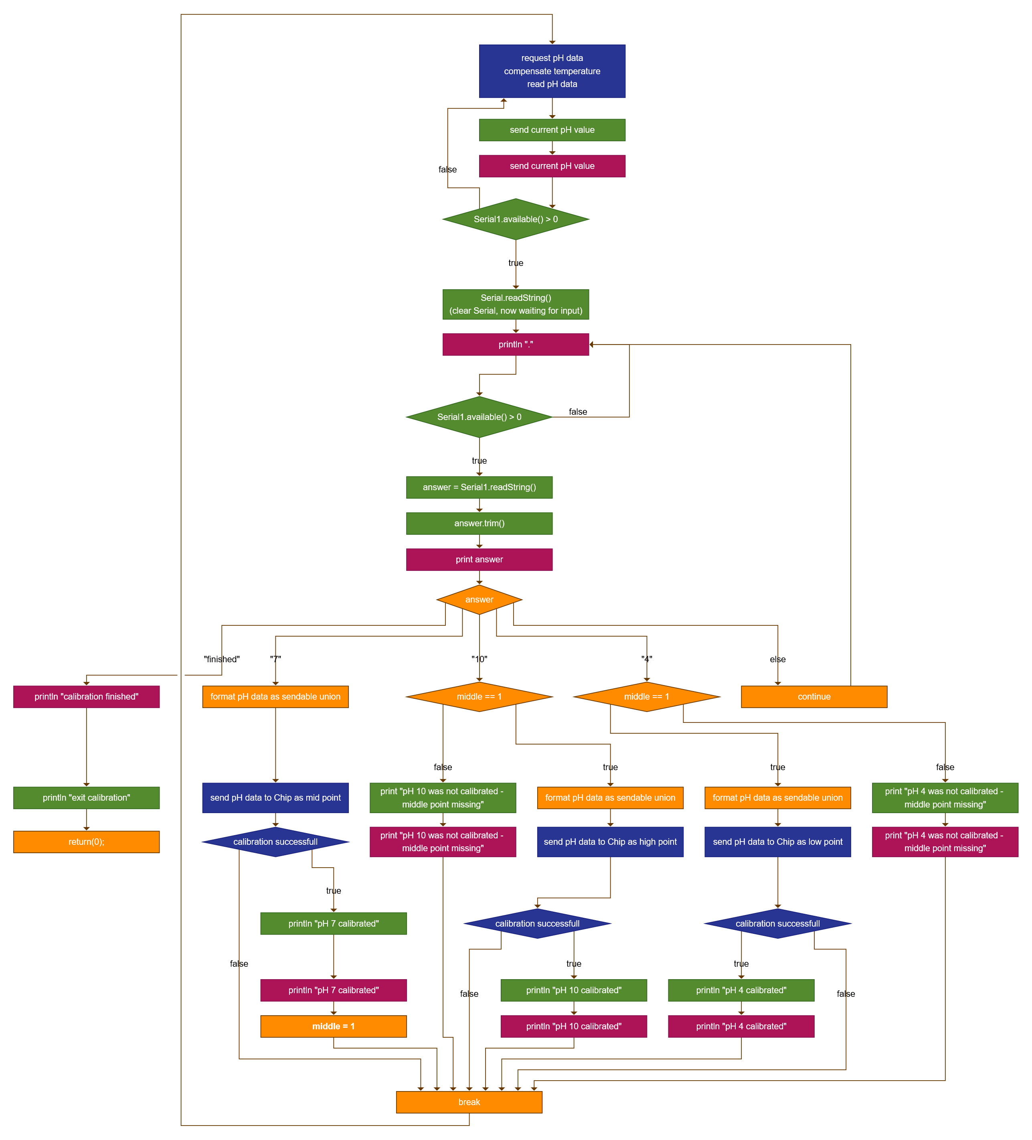
pHcalibration()
Serial1 ➔ RS485
Serial ➔USB (Debug)
Wire ➔ I²C
Restlicher Code (intern)

Slide 4
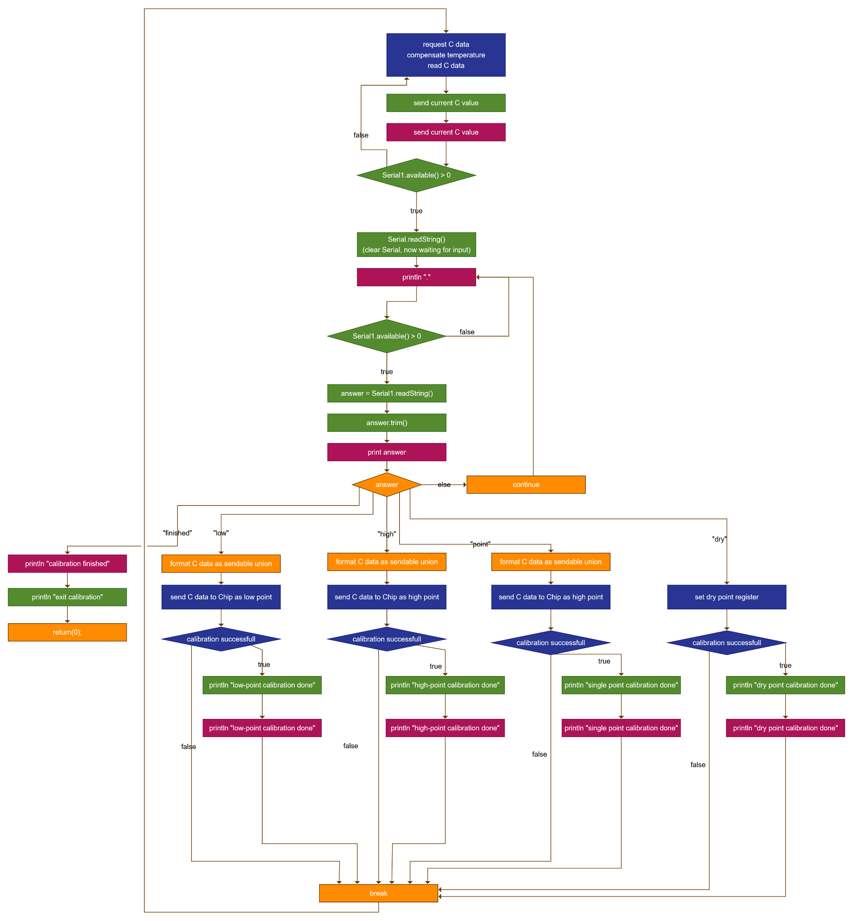
Ccalibration()
Serial1 ➔ RS485
Serial ➔USB (Debug)
Wire ➔ I²C
Restlicher Code (intern)

