Slide 1
FOREVER GOLD Sound Effects

Slide 2

Sound Bed.mp3

Slide 3

Button Click.mp3

Slide 4
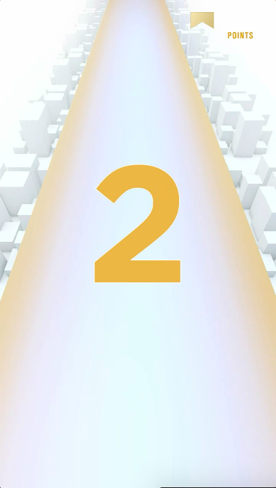
Countdown.mp3

Slide 5
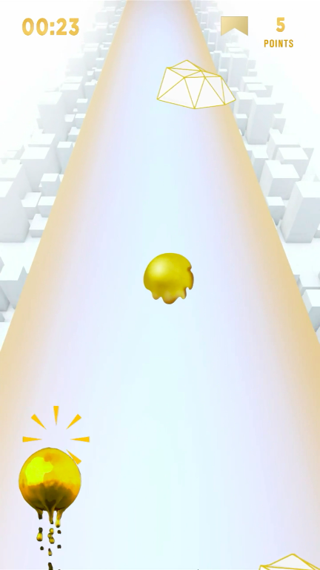
Points earn.mp3

Slide 6
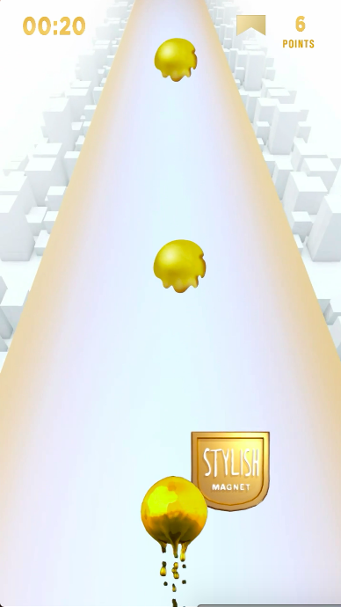
Power Up.mp3

Slide 7
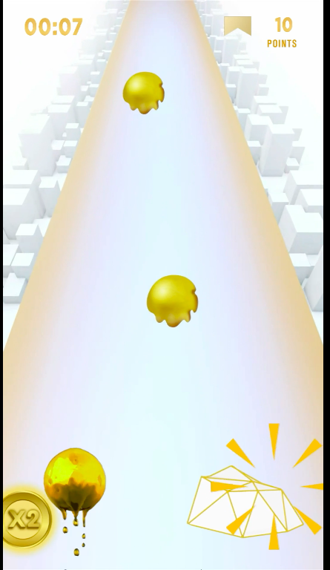
Obstacle Bump.mp3

Slide 8
Game over.mp3

Slide 9
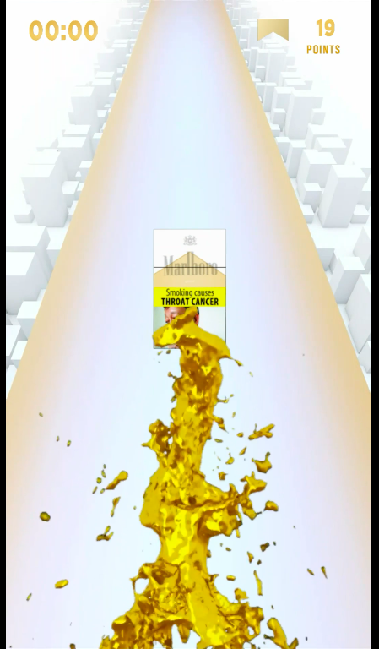
Gold Splash.mp3

Slide 10


