Slide 1


Test Case 1: IEC 62232 Panel Antenna
2021-06-07
Notes:
Welcome guests.

Slide 2
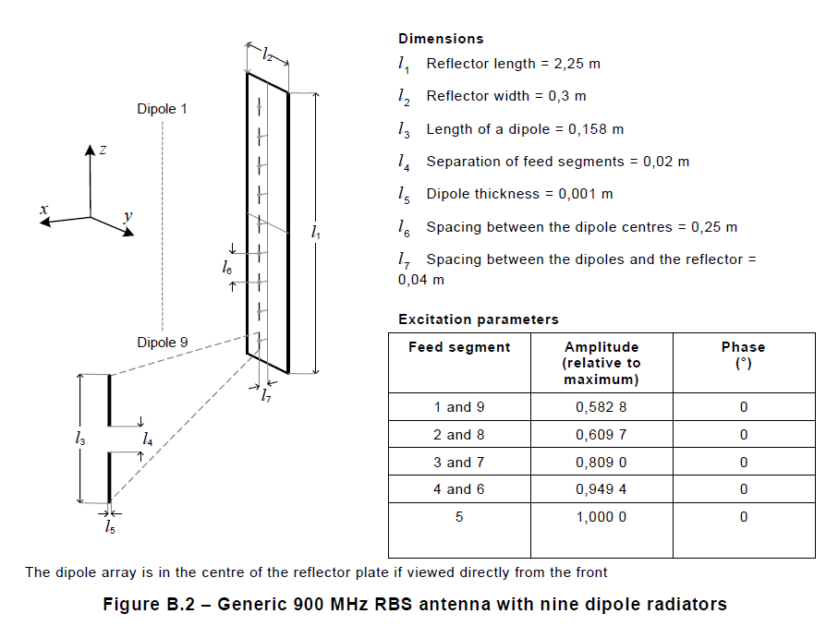
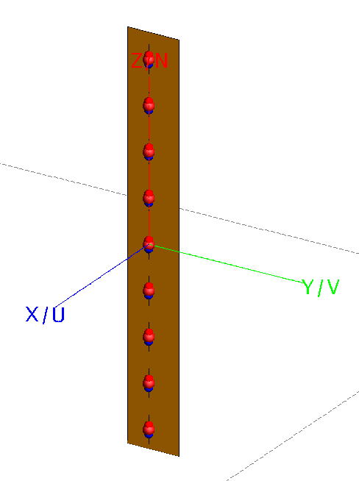
Overview
Using the generic 900 MHz RBS panel antenna with nine vertical dipole radiators as described in section B.4.4.2.6.2 of the CDV draft (June 2016) of the IEC 62232 standard.
FEKO model

Slide 3
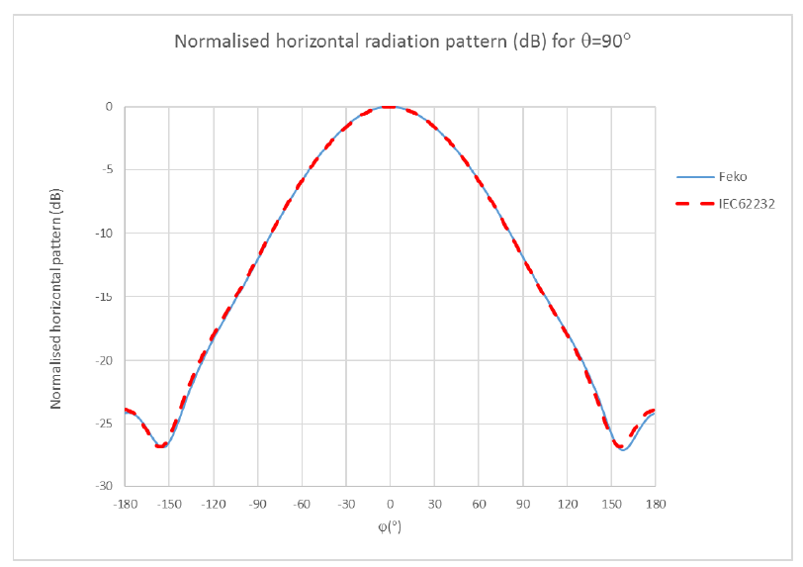
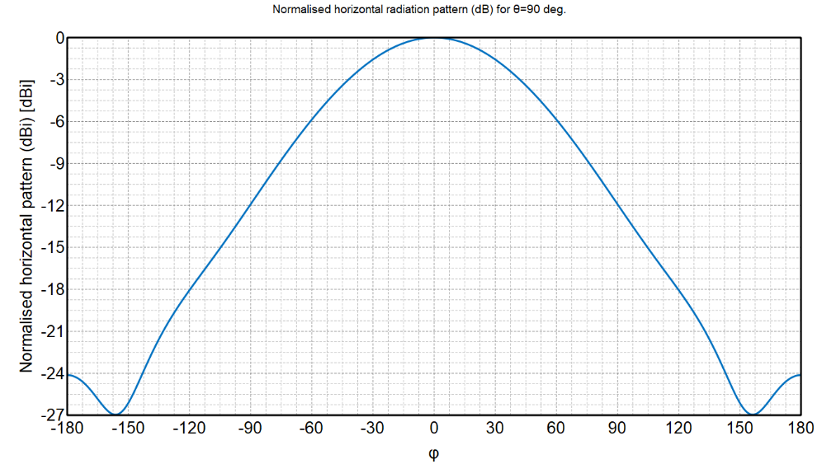
Validation of simulation results (far field, horizontal cut)
Normalised far field patterns were available from a previous study by Vitas (Pavg = 200W)

Slide 4
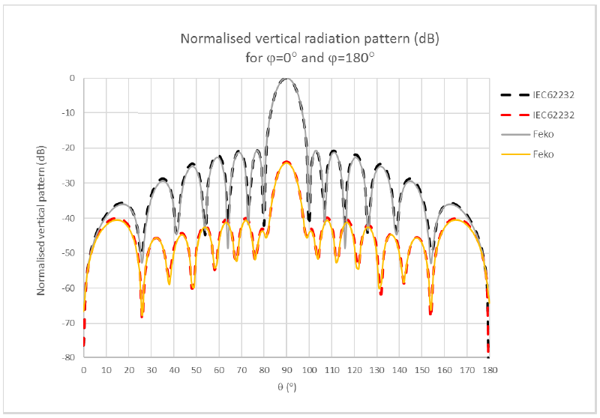
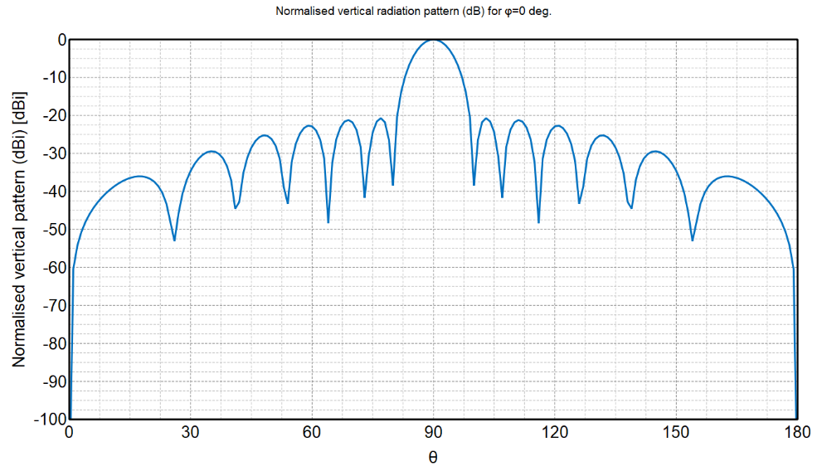
Validation of simulation results (far field, vertical cut)
Normalised far field patterns were available from a previous study by Vitas

Slide 5
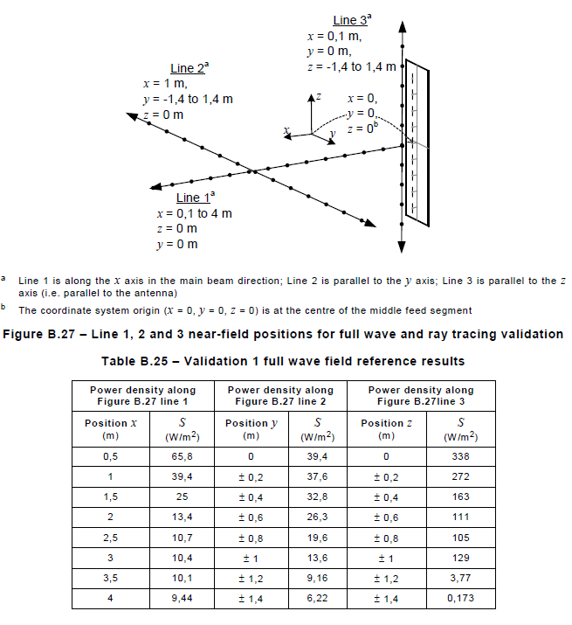
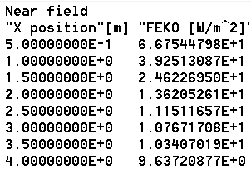
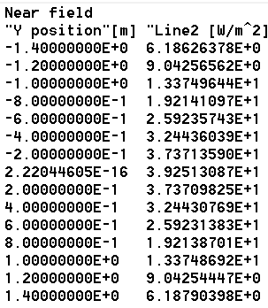
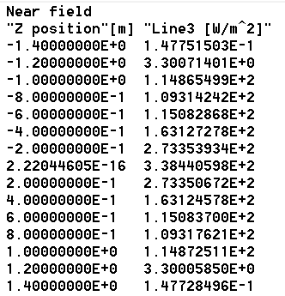
Validation of simulation results (near-field power density)
Normalised far field patterns were available from a previous study by Vitas
Line 1 (FEKO)
Line 2 (FEKO)
Line 3 (FEKO)

Slide 6
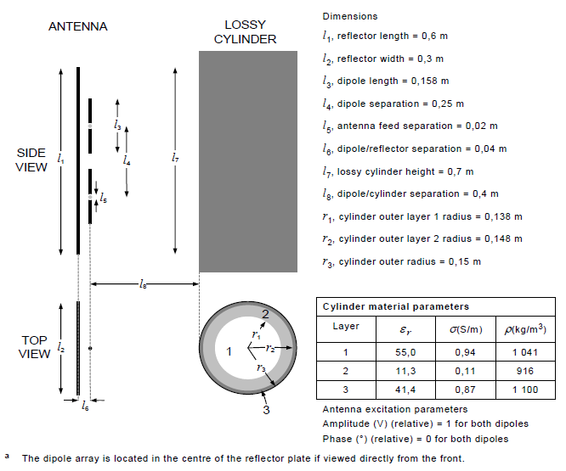
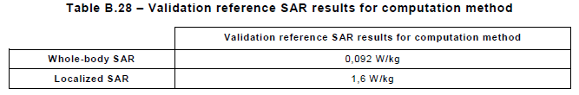
Introducing SAR models – validation (To be done … )
In the IEC 62232 (B.4.4.3.6) the validation of the SAR analysis is discussed via a validation example consisting of a simplified RBS antenna placed in front of a lossy, circular cylinder with 3 layers
Analysis done with Pavg = 20W at 900 MHz

Slide 7
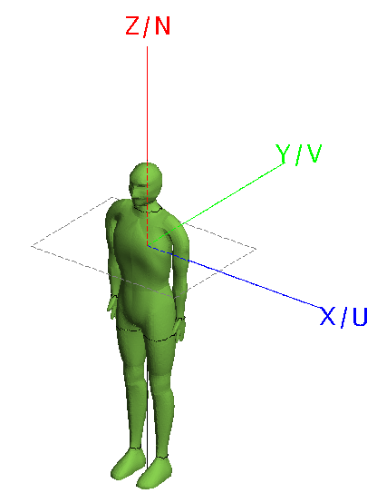
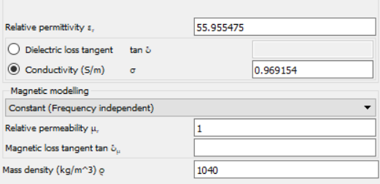
Human phantoms (Model A : Articulated human in air-box using FEM/MoM)
The Articulated human is a full length model of a homogeneous human.
Model consists of 8 mm tetrahederals and can be used for runs up to 1 GHz.
FEKO analysis based on the FEM/MoM technique.
Total of 334733 tetrahederals.
The dielectric properties of the phantom are set to average muscle at 900 MHz. (See https://www.fcc.gov/general/body-tissue-dielectric-parameters for human tissue properties).
Airbox placed around the model, required by FEM analysis.
~ 1.85m

Slide 8
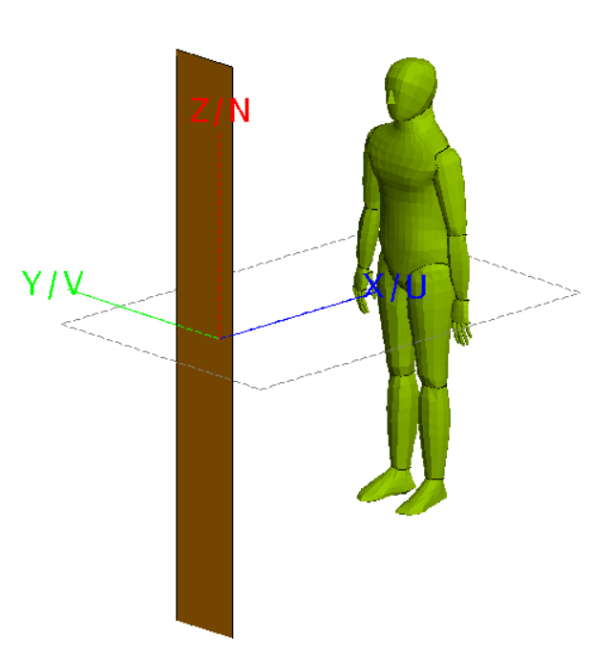
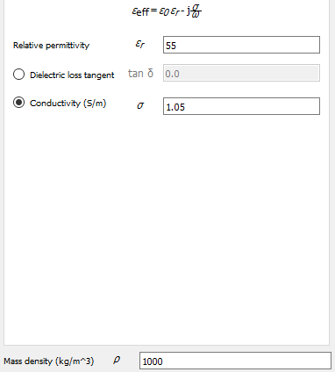
Human phantoms (Model B : MoM-SEP model obtained by Steve Iskra)
Used in previous SAR analysis for RBS reference antenna
Uses surface equivalence principle (SEP) to model the dielectric – full wave MoM analysis
~ 1.8m

