Slide 1
HAL900
Open Source Days
15:30-16:25
... nominally

Slide 2
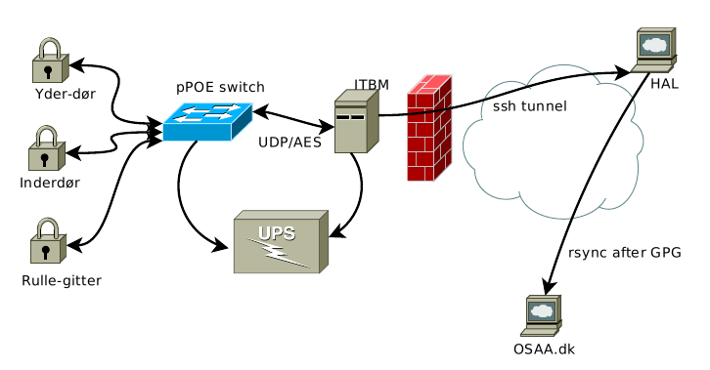
HAL900 overview

Slide 3
HAL.osaa.dk
Member database (register/select subscription level, select pin code).
Accounting system using double-entry-bookkeeping, with imports from the bank statements and management of member accounts.
Manages access via the door locks.
142k DKK and 1150 transactions.

Slide 4
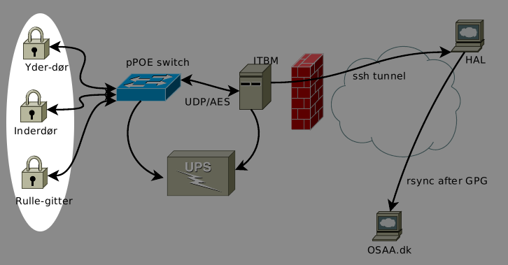
DoorCtrl

Slide 5
HAL900
Started out with 30 paying members
... and 2 sets of keys.
... and no way of getting more :(
SO: DIY all the way, FAST (2 weeks)

Slide 6
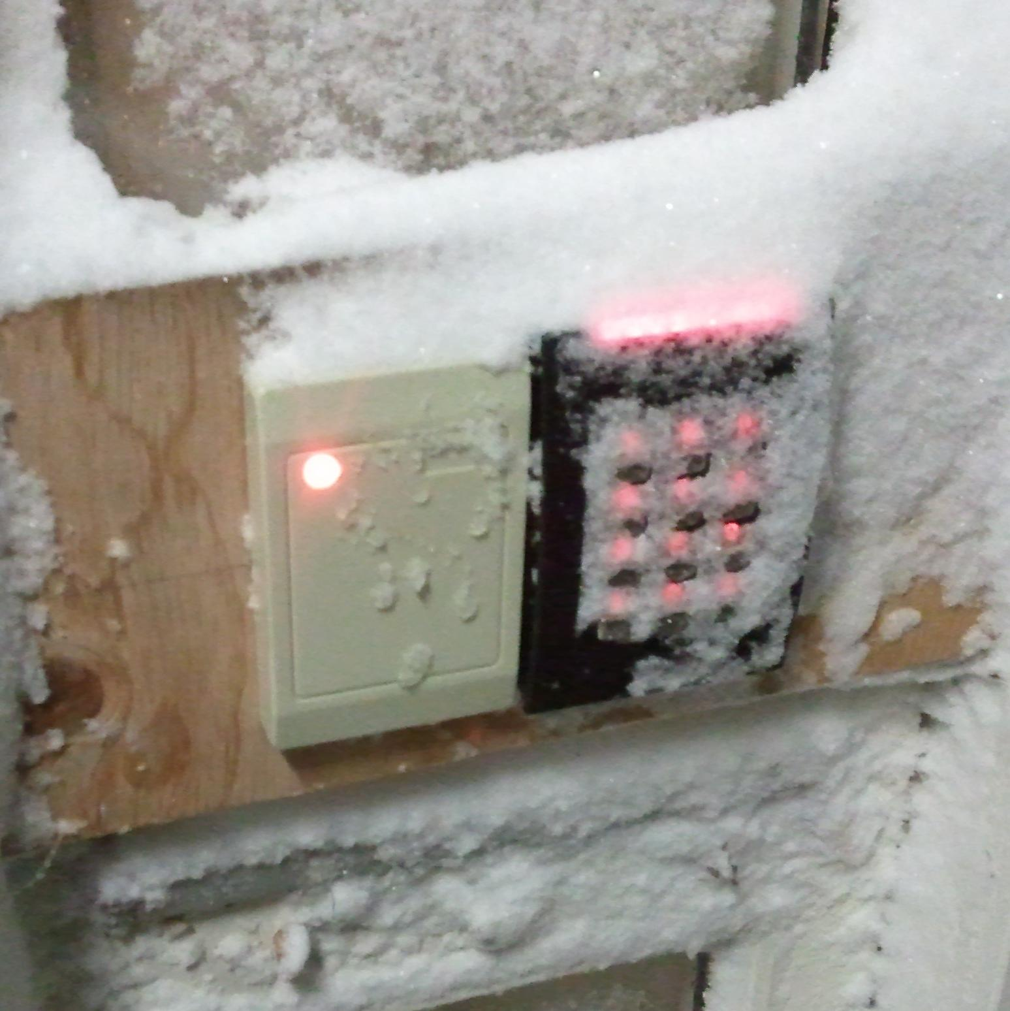
User Interface
This is why we use RFID
It's locked...

Slide 7
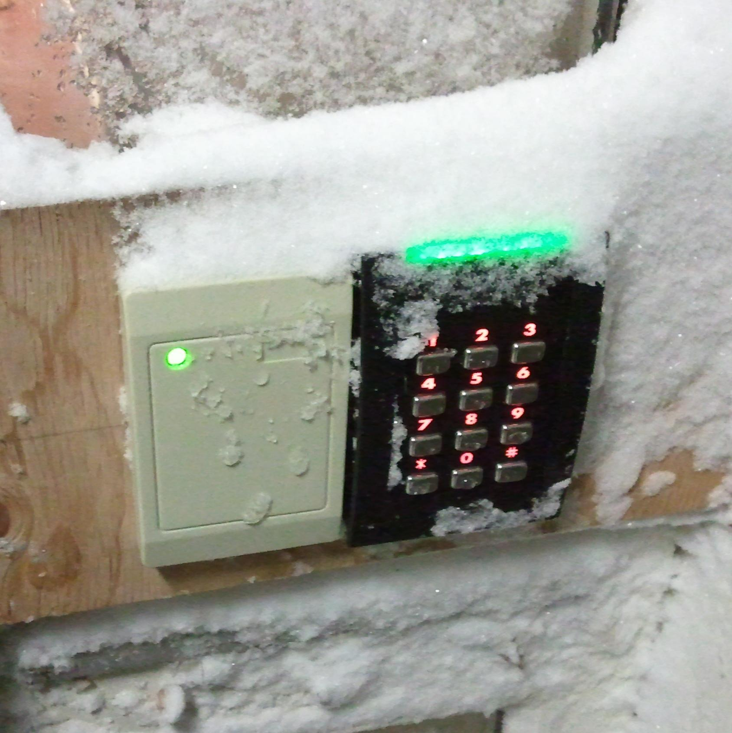
User Interface
Unlocked, yay!

Slide 8
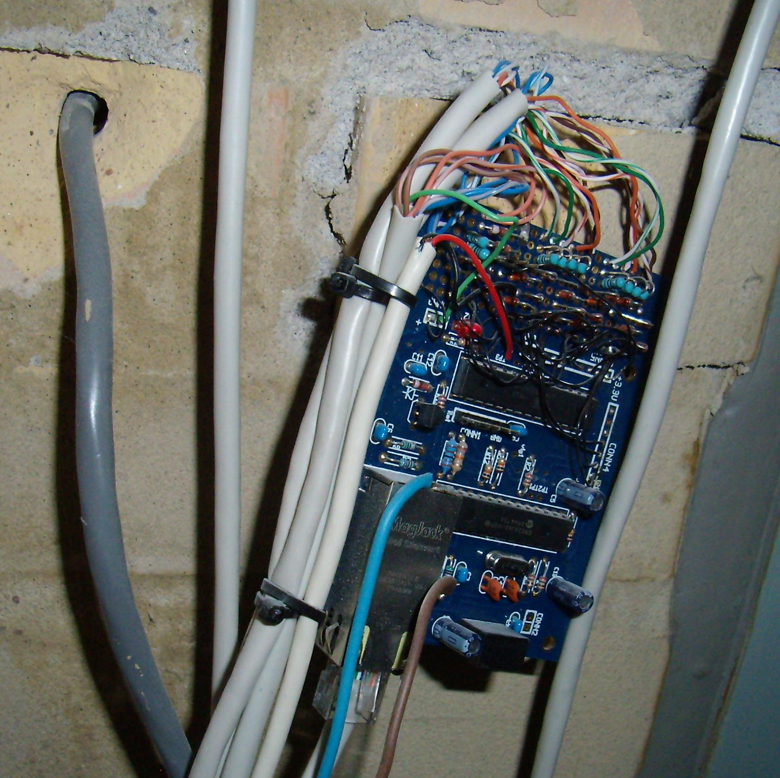
... but it went ugly
TUXWeb proto board
With over 9000! wires and hacks.
Expensive too!
... but it works.

Slide 9
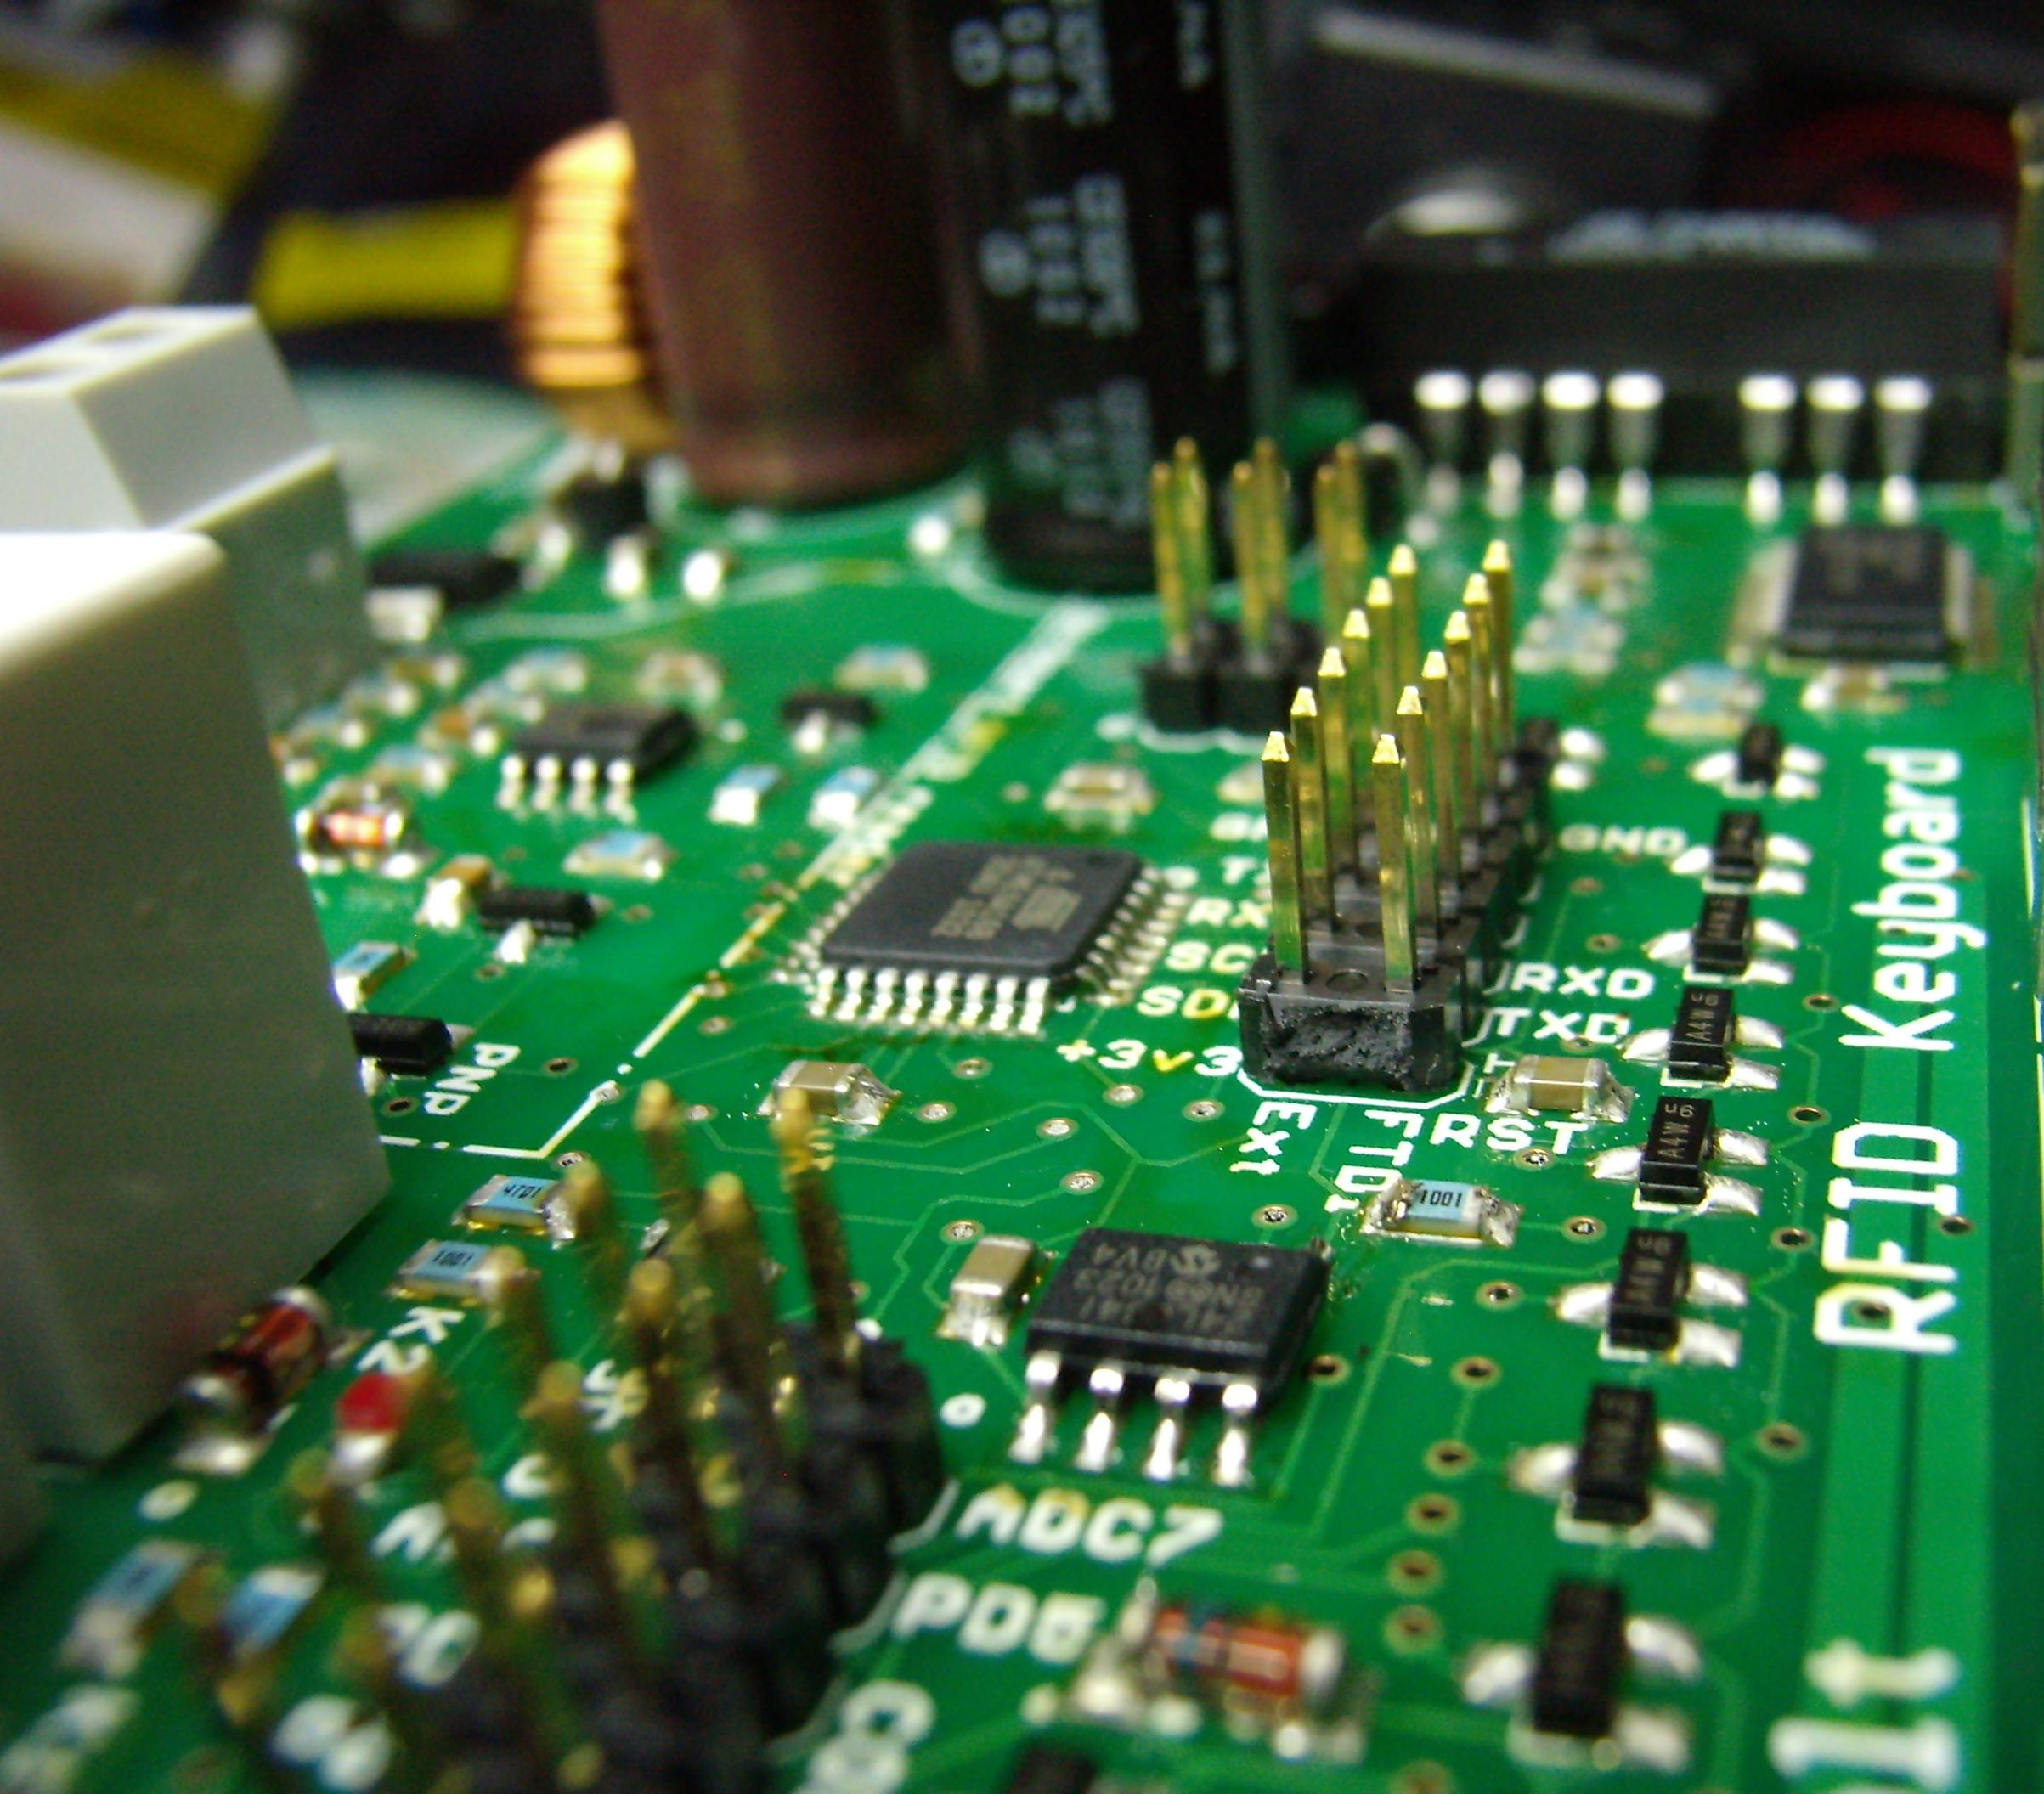
Version 2
Ethernet
On-board RFID
12V switchmode
2x relays
8k EEPROM
Somewhat cheaper 200 DKK

Slide 10
Roles
Extensible design to allow many future versions, even with the same PCB version, serial and GPIO headers allow:
Front door (2x wiegand + 12V latch)
Inner door (2x wiegand + TTL bolt + 12V)
Rolling gate (1x wiegand + RFID + 230V)
Beer dispenser (No clue).
Cash register (RFID + I2C coin rejector)

Slide 11
V2 design choices
Keep size under 10x8 cm (EAGLE limitation)
Duplicate some of the tuxgraphics board.
Add in external EEPROM
Use the more common ATMega168, because ATMega328 is made of cocaine laced with unobtainium.

Slide 12
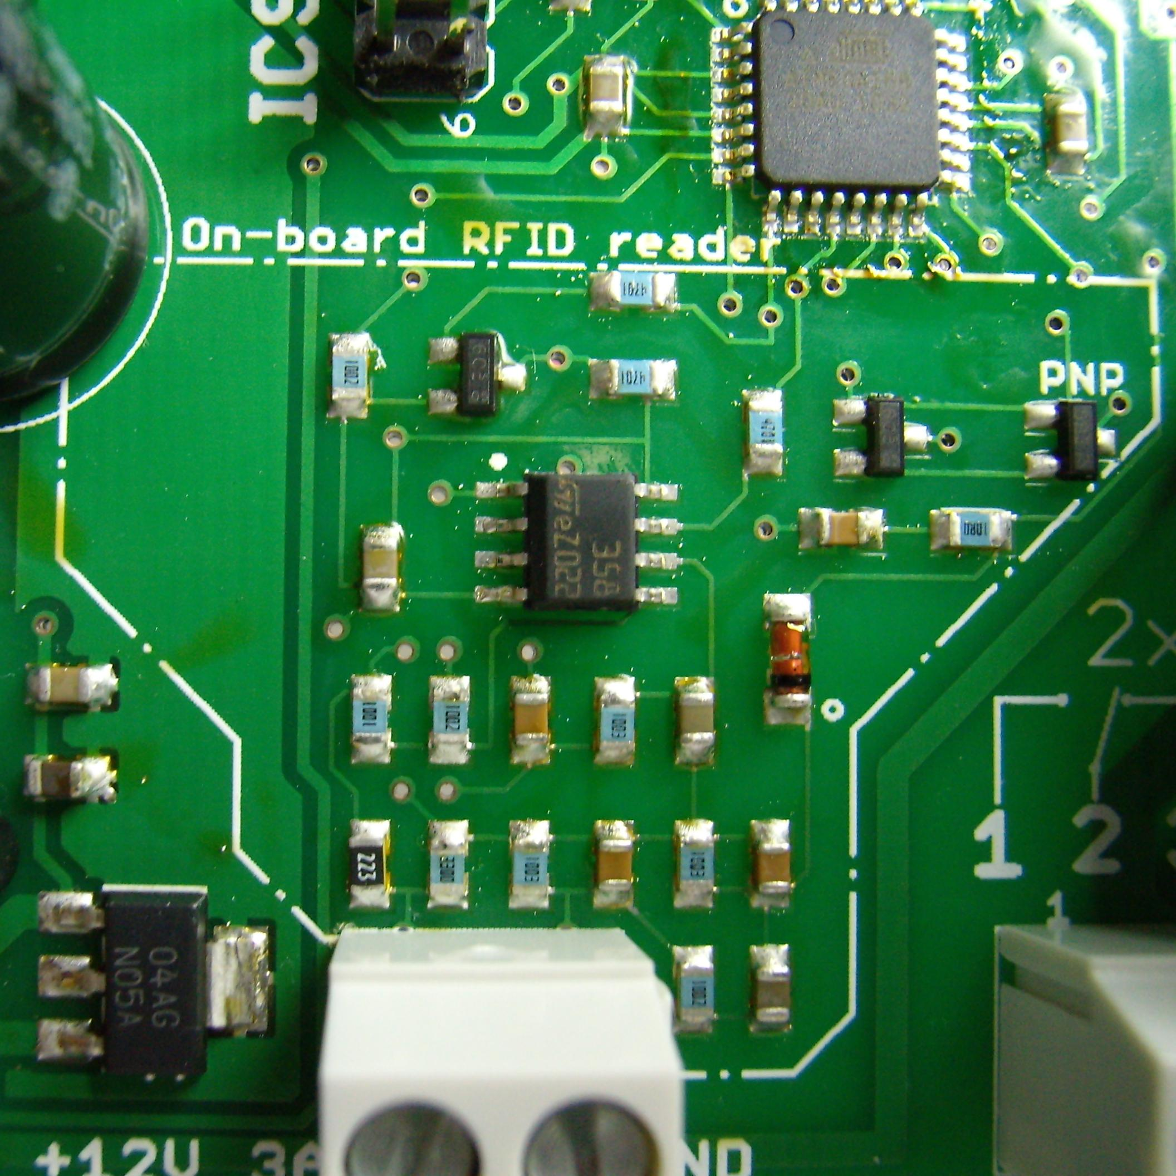
.cn sourcing FTW
PCB from ITEAD studios: 17 DKK a piece.
RJ45 connectors from ebay 0.5 USD
Total saving: 50 DKK

Slide 13
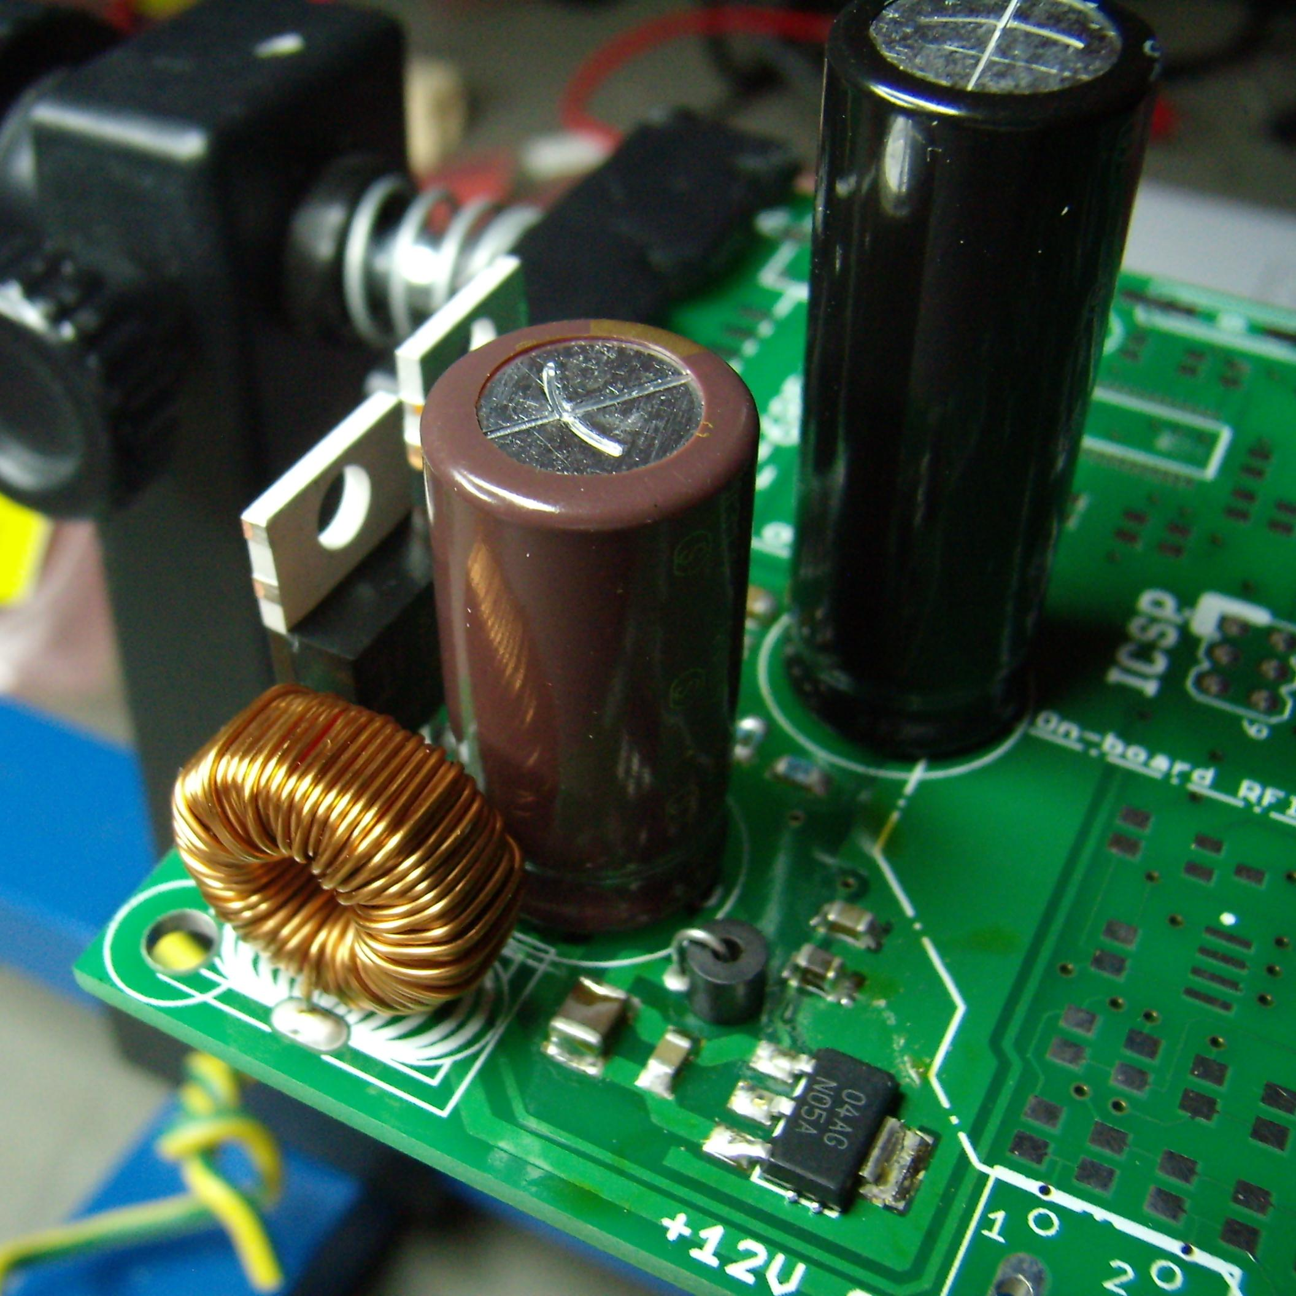
... but it was buggy
ENC28J60 uses gobs of power.
3.3V regulator drops 2W: 85°C
Expensive: 60 DKK.

Slide 14
H2 Scalability
... or save money by leaving out crap you don't need, optional parts:
Base cost: 250 kr @ ELFA
Ebay saving: 45 kr (RJ45, trafo)
Relays and their transistors: 31kr.
RFID reader: 10kr
PoE switchmode (6-12 V): 40 kr.
Ethernet (seriously, WTF?): 60 kr.

Slide 15
PCB production
My new favorite chinese shop:
http://iteadstudio.com/
Does 10x PCBs of 10x10 cm max size for 31 USD (168 kr), including shipping to .dk.
Time from Gerbers to product in my hands: 17 days.

Slide 16
PCB production
Specs:
Min feature size: 6 mil (0.1524 mm)
Min drill: 0.3 mm
Routing to border, so funny shapes: OK.
Double sided, Through hole.
Top and bottom solder mask and silk screen.

Slide 17
Changes for V4
There is no V3.
ATMega324 in stead of '328 which is out of stock everywhere.
Use Kicad and make a 10x10 cm pcb
Add RS485 to allow cheaper networking.

Slide 18
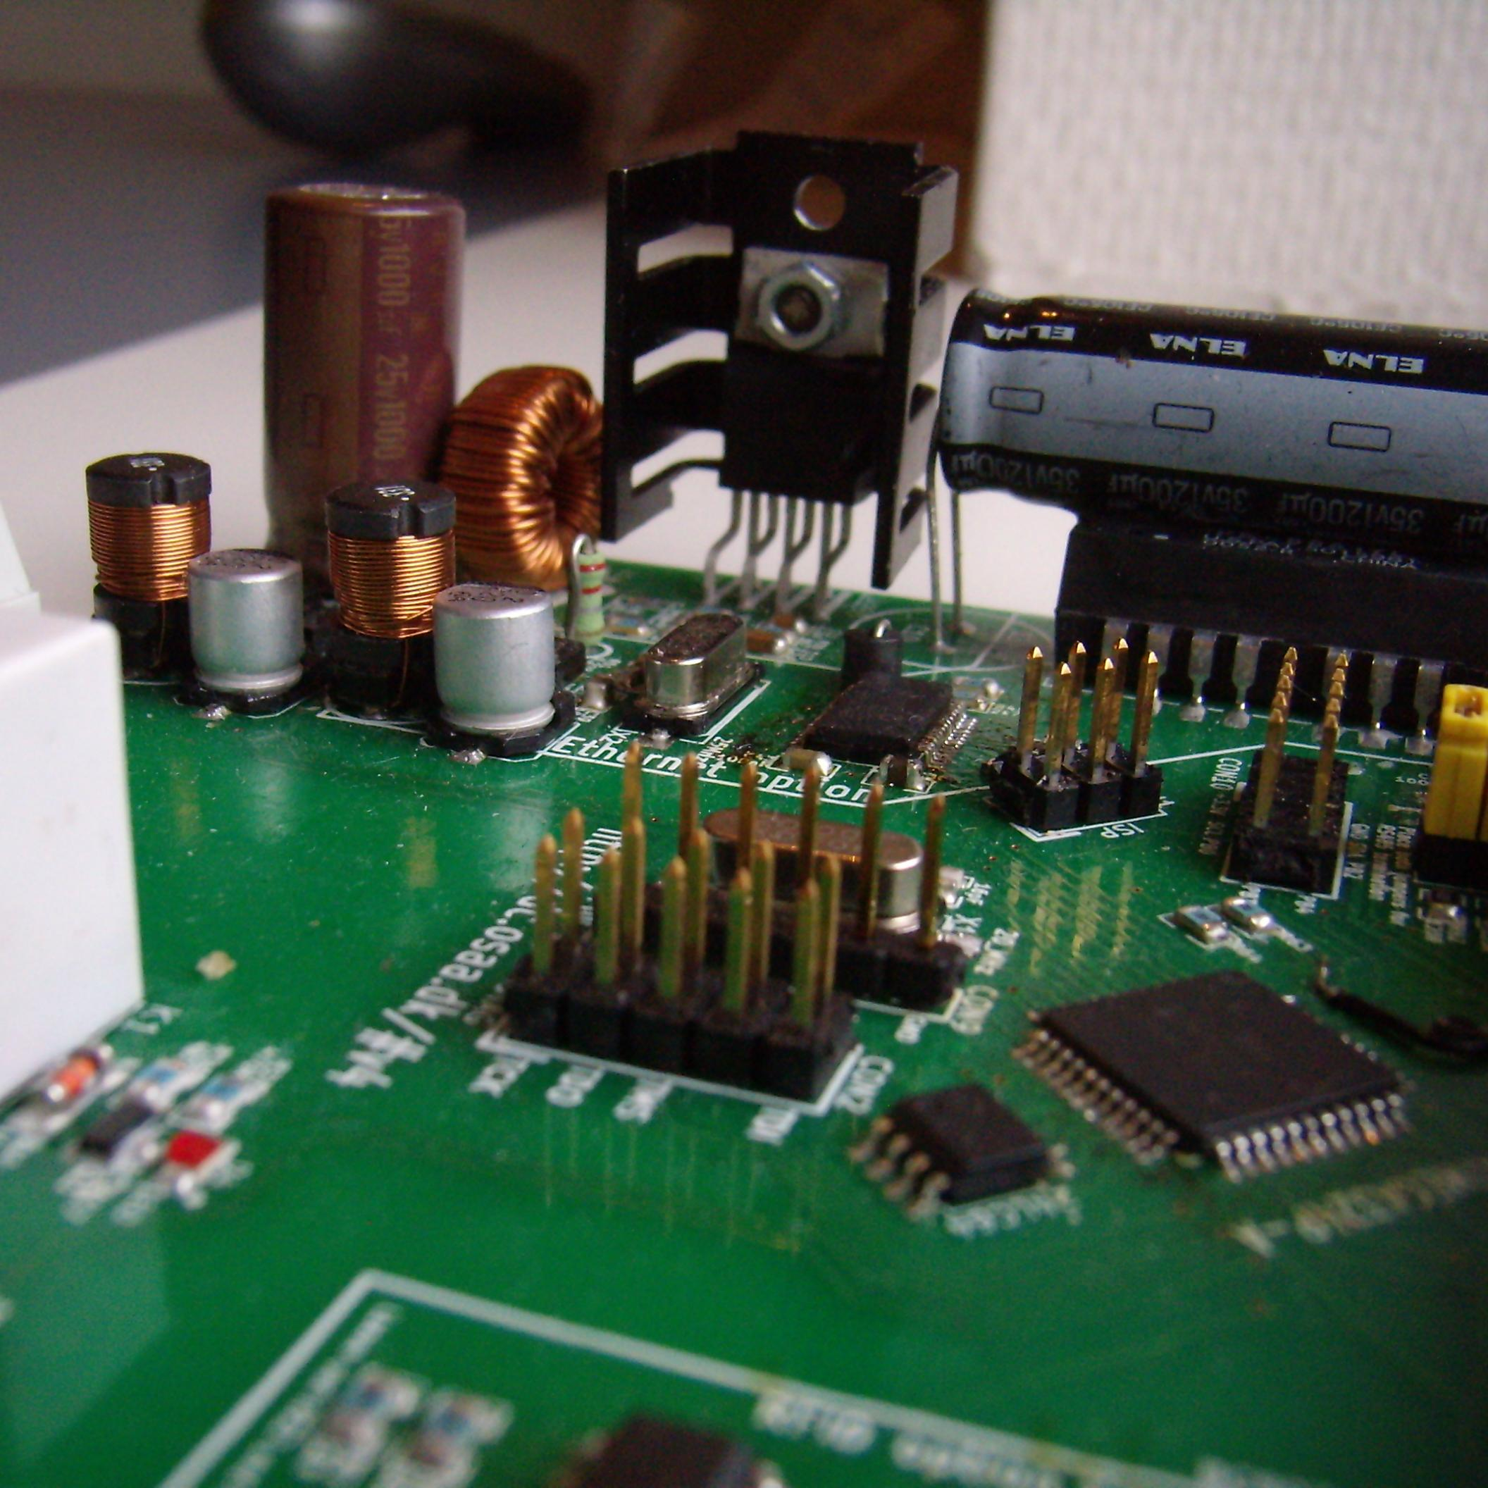
V4 PSU changes
V4 PSU changes
3.3V & 5V switchmode regulators based on MC34063, for efficiency.

Slide 19
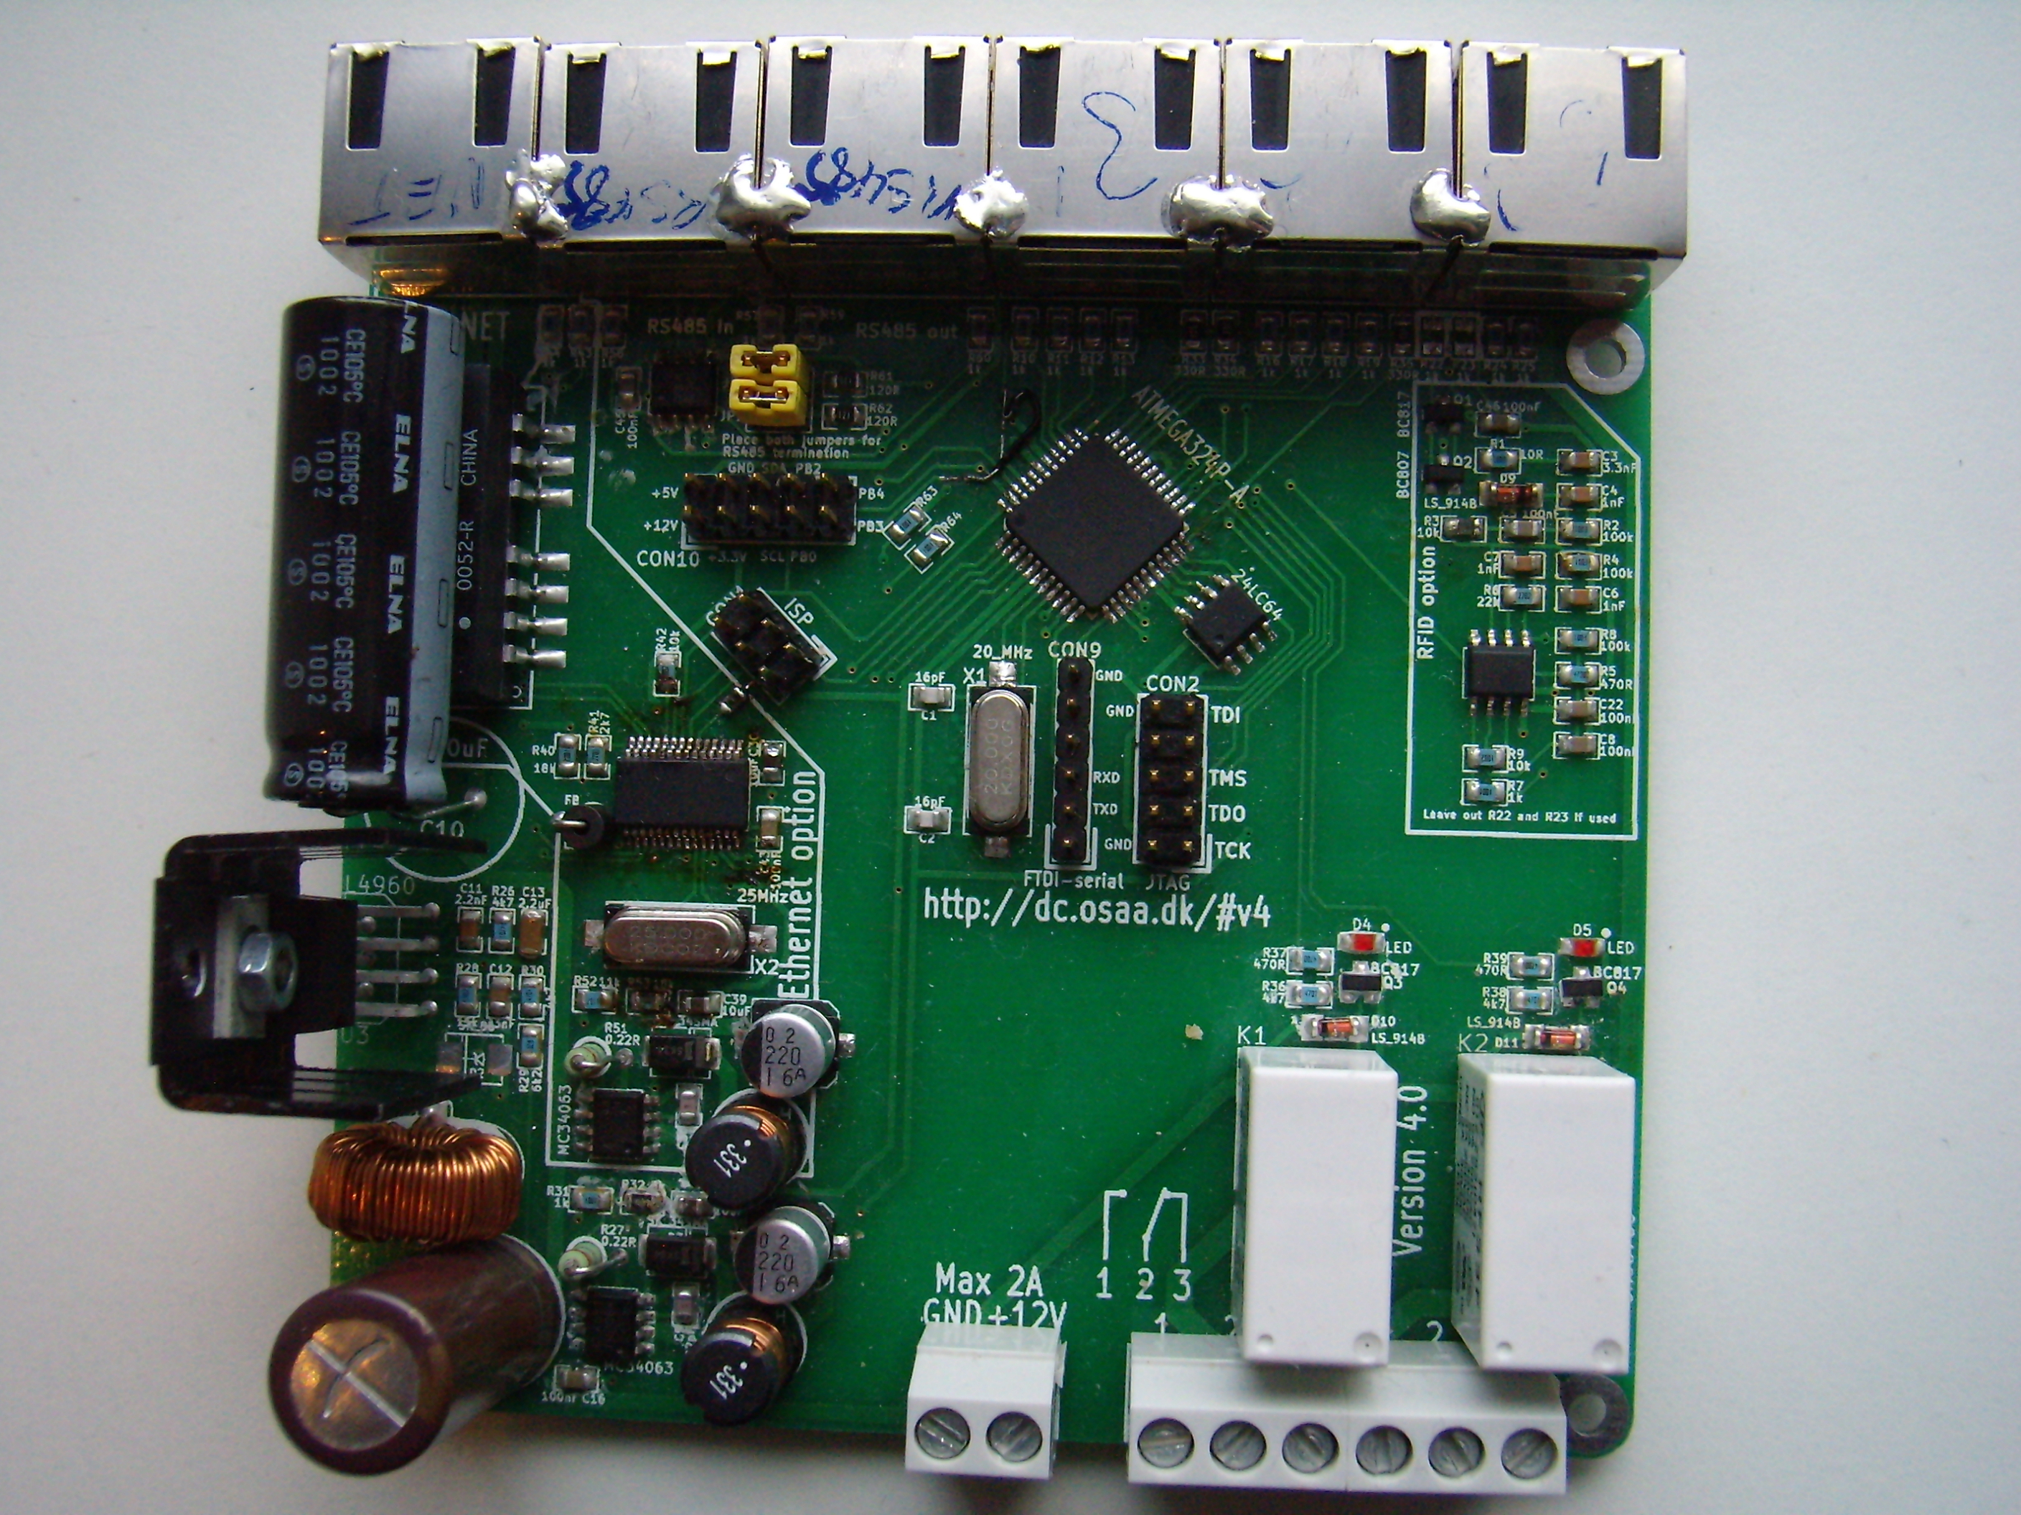
Questions?
http://dc.osaa.dk

