Slide 1
Door-ctrl H2
Problems in need of solutions
Features
Design
Cheap analog RFID frontend
Sourcing parts from ELFA & Ebay
PCB production at ITead Studios

Slide 2
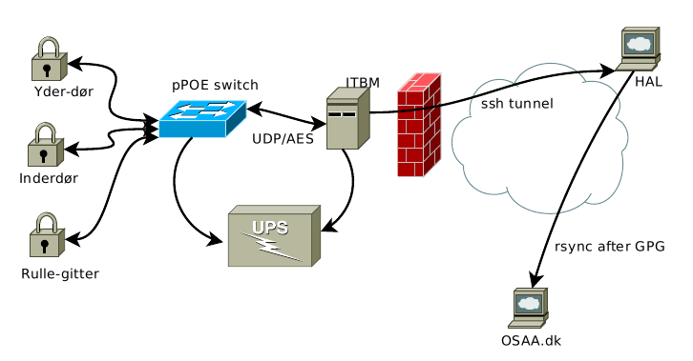
HAL/doorctrl overview

Slide 3
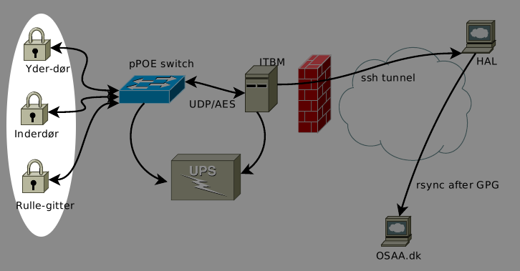
HAL/Cerberus overview

Slide 4
H2 roles
Extensible design to allow many future versions, even with the same PCB version, serial and GPIO headers allow:
Front door (2x wiegand + 12V latch)
Inner door (2x wiegand + TTL bolt + 12V)
Rolling gate (1x wiegand + RFID + 230V)
Cash register (RFID + I²C coin rejector)
Beer dispenser (No clue).

Slide 5
H1 problems
Fixed supply voltage
Voltage drop & UPS difficult
Ugly as sin
Expensive (230 kr)
Troublesome (lots of soldering)
Limited EEPROM storage
Needs external RFID reader.

Slide 6
H2 Features
Wide input PoE (15-30 VDC)
12V DC output @ 2 A peak
2x relays for 230V/3A control of rolling gate.
LEDs for the relays (yay! blinkenlights)
Oodles of EEPROM
Cheap 125 kHz RFID reader onboard.

Slide 7
More H2 Features
RJ45 connectors and screw terminals
Each RJ45 has 2 LEDS, 4 protected GPIO, GND and Vout (3.3V or 5V)
Standard 6 pin ICSP header
1x6 pin FTDI serial header (with reset)
1x6 Serial header with I²C, rx/tx, 3.3V
GPIO header with +12V, +5V, +3.3V, 2x Analog inputs, 4 GPIO & RFID coil.

Slide 8
H2 Design Choices
Keep size under 10x8 cm (EAGLE limitation)
Duplicate some of the tuxgraphics board.
Add in external EEPROM
Use the more common ATMega168, because ATMega328 is made of cocaine laced with unobtainium.

Slide 9
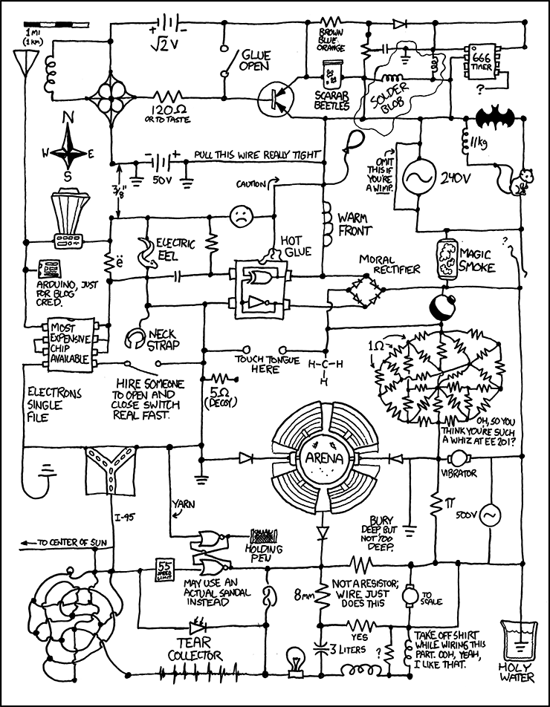
H2 Design, moar!
Make it Arduino compatible, for blog-cred.
No special parts, must be easy to reproduce.

Slide 10
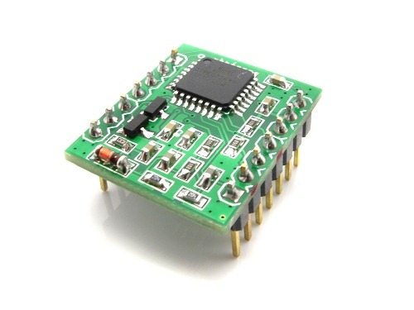
RFID Reader
We want an onboard RFID reader built entirely from cheap, obtainable parts. ITead did it, so how hard can it be?

Slide 11
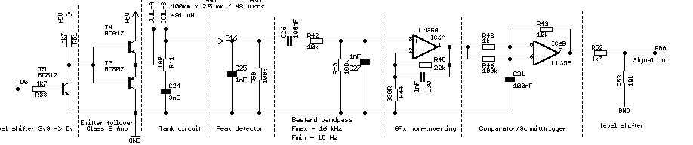
... but it sucked, so I redesigned it:
This is all you need:
13 Resistors, 6 capacitors, 2 NPN transistors, 1 PNP transistor
1 LM358, a bog-standard OP-AMP that goes down to GND.
No "special" parts!
Total cost: 10.03 kr including VAT (aka. moms) at ELFA + a bit a wire for a coil + 2 timers in an AVR.

Slide 12
... and rewrote it
The Sniffer nano firmware sucked hard (ugly and used more than 256 bytes of RAM), optimized it down to 32 bytes of buffer, then rewrote it from scratch to 7 bytes.
Completely interrupt driven, detects RFIDs in real time, yay.

Slide 13
Sourcing expensive parts
Sourcing parts from ELFA is nice, but even with the massive OSAA member rebate, some parts are still very expensive:
Ethernet transformer: 26.25kr vs. 5.5 kr
RJ45 connector: 12.28kr vs. 2.63kr
PCB: OVER 9000!!! vs. 16.9 kr @ ITEAD
Total

Slide 14
H2 Scalability
... or save money by leaving out crap you don't need, optional parts:
Base cost: 250 kr @ ELFA
Ebay saving: 45 kr (RJ45, trafo)
Relays and their transistors: 31kr.
RFID reader: 10kr
PoE switchmode (6-12 V): 40 kr.
Ethernet (seriously, WTF?): 60 kr.

Slide 15
PCB production @ ITEAD
My new favorite chinese shop:
http://iteadstudio.com/
Does 10x PCBs of 10x10 cm max size for 31 USD (168 kr), including shipping to .dk.
Time from Gerbers to product in my hands: 17 days.

Slide 16
PCB production @ ITEAD
Specs:
Min feature size: 6 mil (0.1524 mm)
Min drill: 0.3 mm
Routing to border, so funny shapes: OK.
Double sided, Through hole.
Top and bottom solder mask and silk screen.

Slide 17
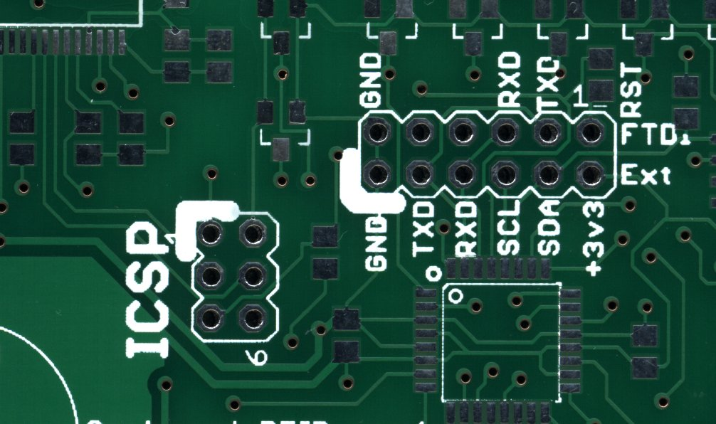
PCB production @ ITEAD

Slide 18
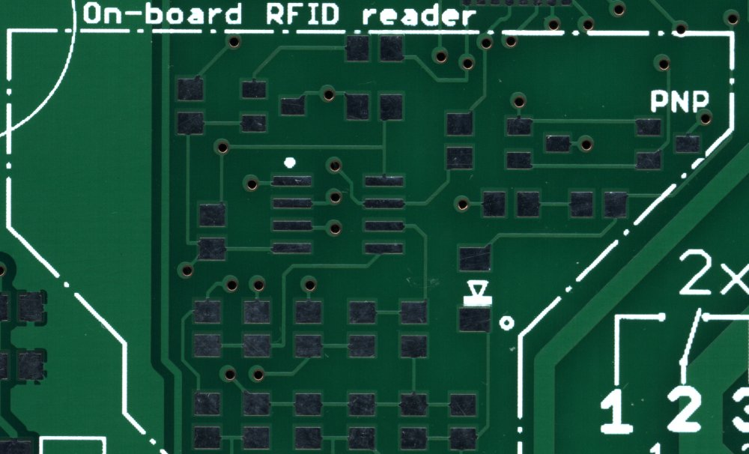
PCB production @ ITEAD

Slide 19
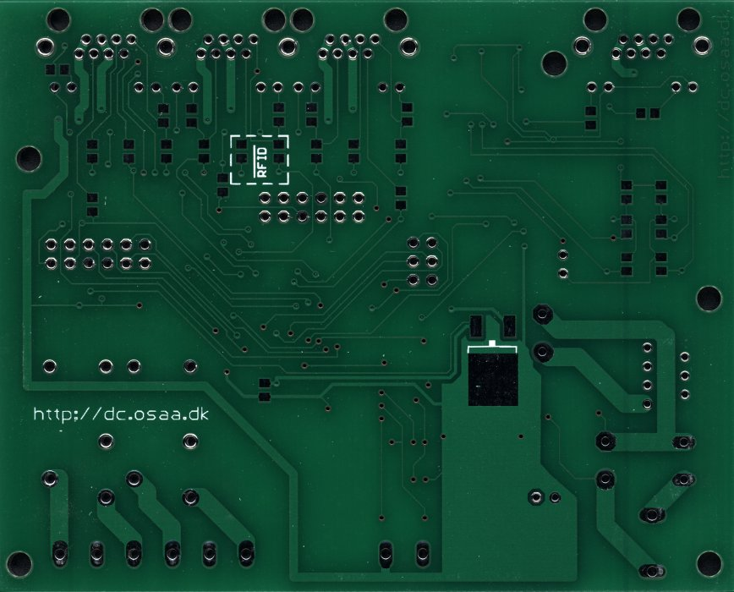
PCB production @ ITEAD

Slide 20
