Slide 1
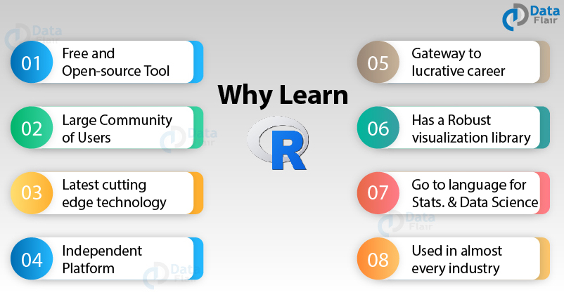
Lecture #2
The R language and environment
https://data-flair.training/blogs/why-learn-r/

Slide 2
Outline
What is R?
Basic syntax rules
Math operators
Vectors, Matrices, and Data frames
Logical operators
Casting data types
Read/Write
Iteration
Packages
Libraries/Functions
Plotting commands
Par command
Data sets in R

Slide 3
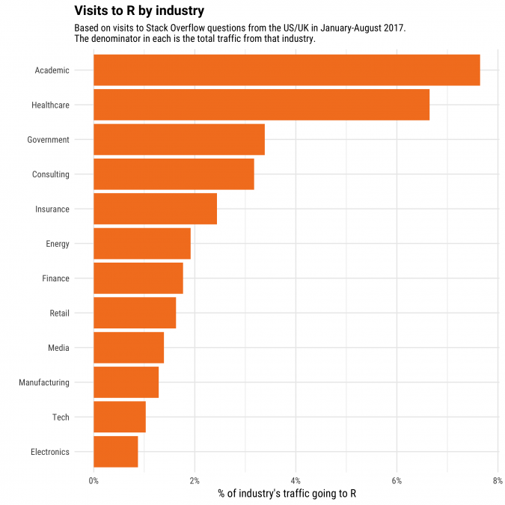
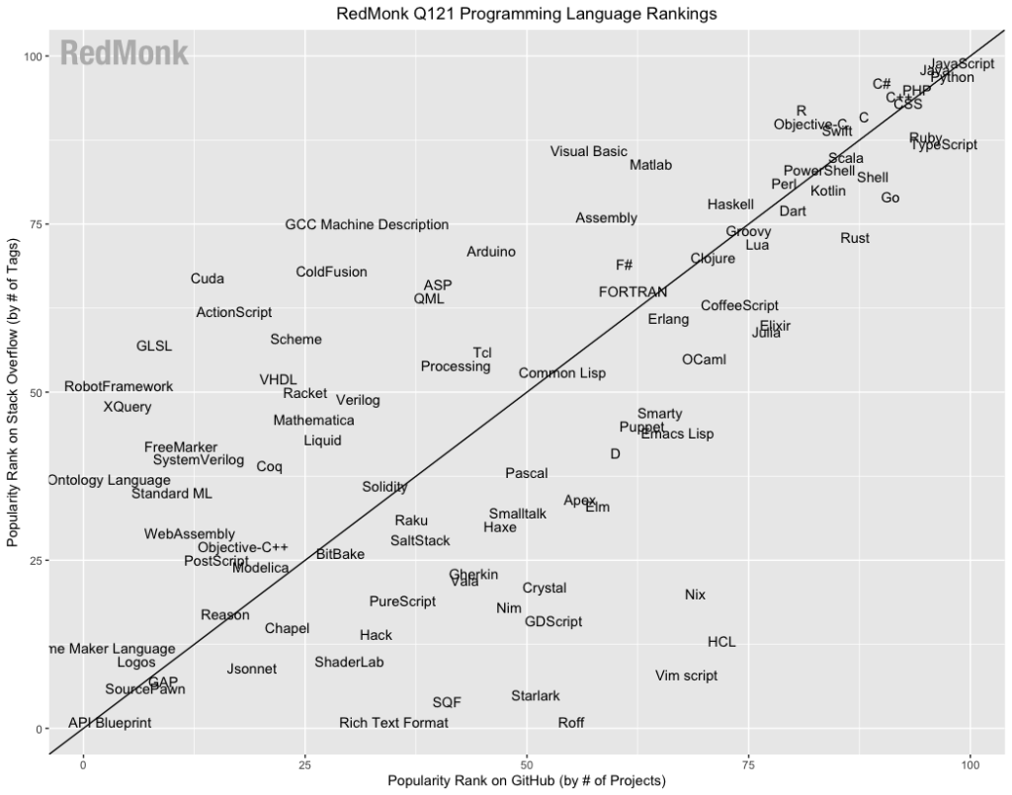
R applications and popularity
https://redmonk.com/sogrady/2021/03/01/language-rankings-1-21/

Slide 4
What is R?
R is both a language and environment for statistical and computational analysis
Where does the name come from?
  Authors: Robert Gentleman and Ross Ihaka and S language play-on words
The language is similar to that of Splus, which gets its roots from S
  Developed by Bell Labs
R was developed as a collaborative project from multiple contributors (CRAN)
  You can readily download and contribute “packages” to R
R software is available free, however there is no support

Slide 5
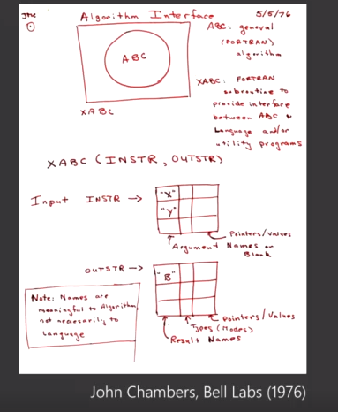
History of R
Early description of would soon become the R language
Idea of maintaining statistical libraries (mostly written in FORTRAN) that can be called
John Chambers description in 1976 when working at Bell Labs
https://www.infoq.com/presentations/r-framework-ai-apps

Slide 6
Basic syntax rules
Procedures in R are implemented as functions
  “()” syntax
  i.e. c(4,5,6) means to concatenate the three numbers into a vector
R processes are best handled as objects
  If you run any function, assign it to a variable (object) so you can manipulate the attributes in the object
Numerical objects are interpreted best in formats of matrices, vectors, data frames, or lists
  Statistical language vs. computer language
!To get help with any function in R, use the help function!
  help(mean)
  ?mean
To quit out of R, use the quit function
  q()
Variable assignment is “=“ or “<-”

Slide 7
Basic syntax rules (cont.)
Annotation syntax is “#” (R will not read comments that start with this symbol)
To view the objects in the database
  ls()
Remove an object in the database
  rm()
Concatenate/combine multiple numbers/objects together
  c()
Calculate a mean and variance
  mean()
  var()
View current memory size and set memory limits
  memory.size(T)
  memory.limit()

Slide 8
Mathematical calculations
General math operators
  > 5 + 5
  > 10 – 2
  > 10 * 10
  > 25 / 5
  > 3 ^ 2
  > exp(2)
  > log(10)
  > logb(10,2)

Slide 9
Mathematical functions on vectors
> mean(c(2,5,7))
> median(c(2,5,7))
> quantile(c(3,5,6,8,9),probs=0.25)
> summary(c(3,5,6,8,9))
> max(c(3,5,6,7,8))
> min(c(3,5,6,7,8))
> scale(c(3,5,6,7,8))
> sum(c(3,5,6,7,8))

Slide 10
Vectors
Vector syntax
  Create a vector
    > x <- c(2,4,6,3,4,6)
    > y <- c(5,6,7,8,8,0)
  Specify certain elements of the vector
    > x[1:3]
    [1] 2 4 6
  Remove an element from the vector
    > x[-2]
    [1] 2 6 3 4 6
  Bind 2 vectors together (must be same length)
    > x.y.bound <- cbind(x,y) # cbind means column bind

Slide 11
Misc. vector operations
Intersect elements of 2 vectors
  > intersect(x,y)
  [1] 6
Diff 2 vectors
  > setdiff(x,y)# what is in x that is not in y?
  [1] 2 4 3
Find length of x vector
  > length(x)
  [1] 6

Slide 12
Matrices
Matrix syntax
  Create a matrix
    > x.matrix <- matrix(data=x,nrow=3,ncol=2)
    > x.matrix
    [,1] [,2]
    [1,] 2 3
    [2,] 4 4
    [3,] 6 6
  Look at matrix dimensions
    > dim(x.matrix)
    [1] 3 2
  Specify elements in the matrix
    > x.matrix[1:2,2] # rows 1 and 2 of column 2
    [1] 3 4
    > x.matrix[1,] # rows 1, all columns
    [1] 2 3
  Transpose the matrix
    > x.matrix.t <- t(x.matrix)
    > x.matrix.t
    [,1] [,2] [,3]
    [1,] 2 4 6
    [2,] 3 4 6

Slide 13
Data frames
Similar syntax to matrices, but have row and column names
  Create a data frame
    > x.df <- data.frame(x,y)
    > x.df
    x y
    1 2 5
    2 4 6
    3 6 7
    4 3 8
    5 4 8
    6 6 0 # has row names (1-6) and column names (x and y)
  Look at row names
    > dimnames(x.df)[[1]]
    [1] "1" "2" "3" "4" "5" "6“
    OR rownames(x.df)
  Look at column names
    > dimnames(x.df)[[2]]
    [1] “x” “y”
    OR colnames(x.df)

Slide 14
Logical Operators
R works very well with boolean logic
  Look for values greater than 4 in x.matrix
    > x.matrix.g4 <- x.matrix>4
    > x.matrix.g4
    [,1] [,2]
    [1,] FALSE FALSE
    [2,] FALSE FALSE
    [3,] TRUE TRUE
  Print only those values out
    > x.matrix[x.matrix.g4]
    [1] 6 6

Slide 15
Casting
Casting is basically changing the data-type from one type to another
  i.e. data is in matrix format and you wish to convert it to a vector:
  use the as. syntax followed by the desired data-type
    > x.vector <- as.vector(x.matrix) # change to vector
    > x.vector
    [1] 2 4 6 3 4 6
    > x.df <- as.data.frame(x.matrix) # change to dataframe
    > x.df
    V1 V2
    1 2 3
    2 4 4
    3 6 6
    > x.char <- as.character(x.vector) # change to character
    > x.char
    [1] "2" "4" "6" "3" "4" "6"
Can also check type of data object with mode and class functions

Slide 16
Read in/Write out
Multiple ways to read a data file in
  > read.table(file=“C:\\Class\\data.txt”,header=T)
    must use “\\” instead of “\” for path
  > scan(file=“C:\\Class\\data.txt”)
    must use “\\” instead of “\” for path
    best for vectors or lists (not best for 2D data)
  > readLines(file=“C:\\Class\\data.txt”)
    very memory efficient, but requires formatting input
Writing data out to a file
  > write.table(x.matrix,file=“dataFile.txt”,sep=“\t”)
  > write(x.matrix,file=“dataFile.txt”,ncolumns=2)

Slide 17
Iteration & if functions
Loops are not optimized in R
  They are possible, but not memory favorable
Loop syntax
  > for(i in 1:6) {} # for loop
  > while(i < 7) {} # while loop
apply functions
  Inherent looping mechanism
  Much more memory efficient
  > apply(x.matrix,1,mean)
    Will calculate a mean on each row in x.matrix
  > apply(x.matrix,2,mean)
    Will calculate a mean on each column in x.matrix
  > lapply(x,max)
    Calculates maximum for each list element
  > future_apply(x.matrix,2,mean)
    Can parallelize the apply function
if statements are fairly well implemented
  if(x[1]>5) {x[1]=6} # simple if command
  ifelse(x[1]>5,x[1]=6,x[1]=9) # combine if and else into one statement

Slide 18
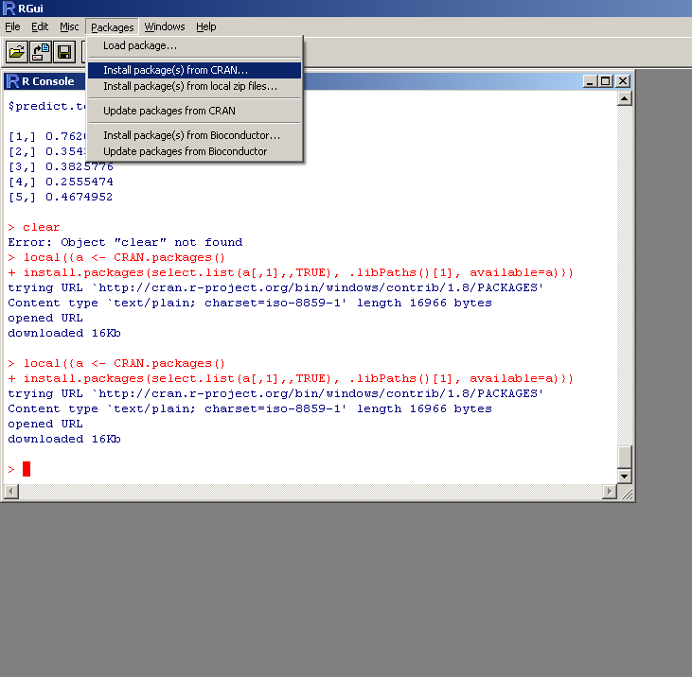
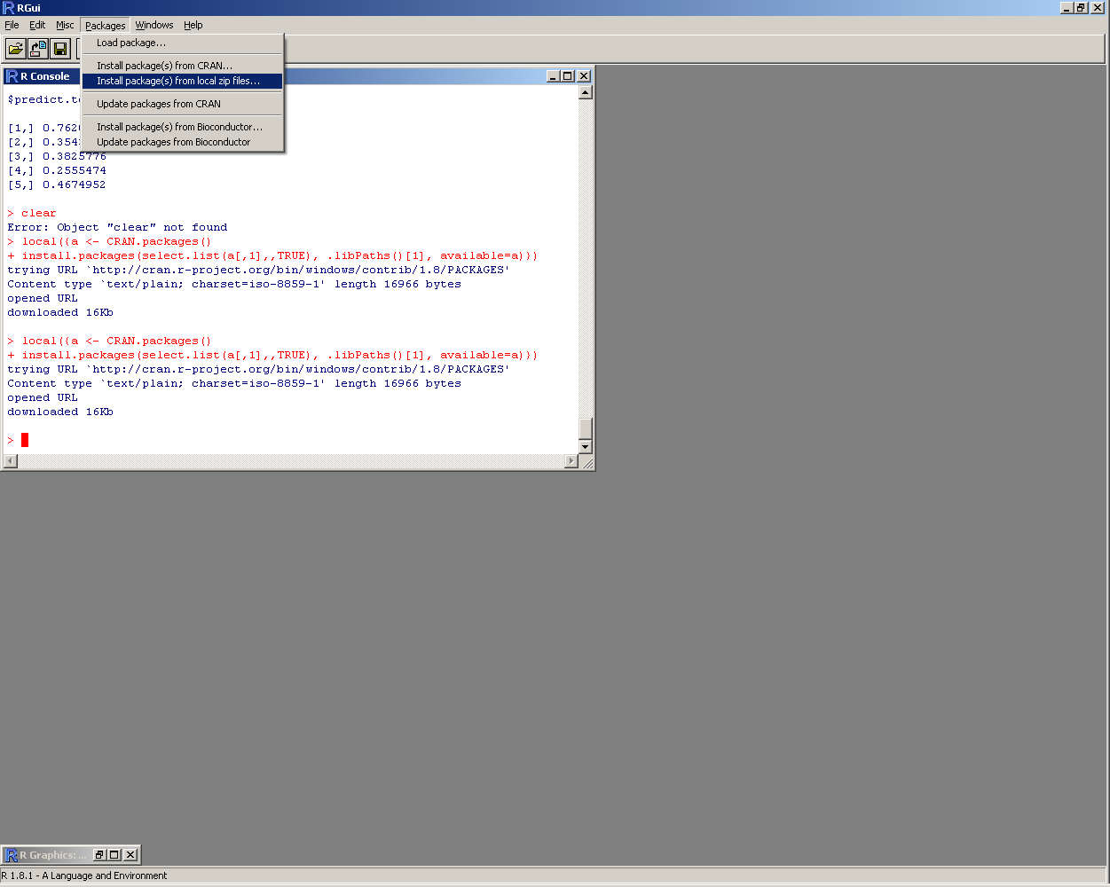
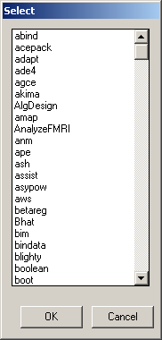
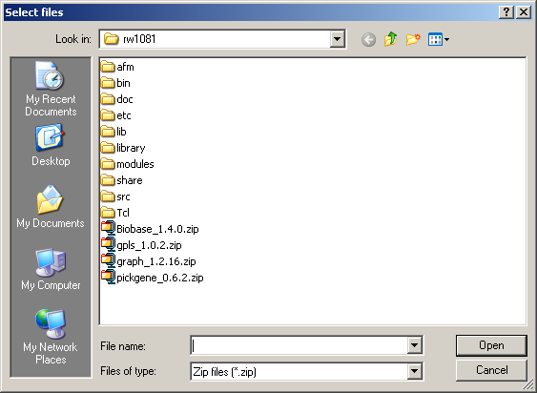
Packages
Binary files that build library access structure
  Allow specific functions to be accessible
  If you know the package name, you can simply type: install.packages("tree")
    “tree” is the example package in this case
Can install packages from CRAN or Bioconductor
Can install packages from local drive (if saved zip file is on local drive)

Slide 19
Libraries & Functions
Once package has been installed, library can be accessed
Libraries include many functions
  > library(base) # implements base library
  Allows access to functions inside the library
Data sets internal to R can also be accessed and utilized
  > data(iris)# allows access to famous iris flower data set
Functions
  Handled well in R
  Similar to a subroutine in other languages (packaged operation that is called)
  > square <- function(x=num1,y=num2) {
    r1 <- x^2
    r2 <- y^2
    output <- c(r1,r2)
    return(output)
    }
  > square(x=4,y=2) # call square function
  [1] 16 4

Slide 20
Packages & Libraries
You can view the complete list of installed packages
  > .packages(all = TRUE)
Also view the list of current attached packages
  > (.packages())
Can set the path for R to look for the libraries
  > .libPaths("C:/PROGRA~1/R/RW2000~1/library")
Remove package from session
  > detach(“package:stats”)
View package contents (e.g. functions, author, date, version, description, etc.)
  > library(help=odesolve)

Slide 21
Plotting commands
There are many optional commands available in R for plotting data
  Only a few of the main commands are necessary
Scatter plot
  > plot(x,y) # x and y must be same length and numeric
  Labels
    xlab=‘x vector’ # x-axis label
    ylab=‘y vector’ # y-axis label
    main=‘Scatter plot’ # title for plot
  Points, size, and colors
    pch=‘*’ # symbol to plot
    cex=1.5 # size of symbol
    col=‘red’ # color of points

Slide 22
Plotting commands (steps)
Plotting function can be given in subsequent commands for modifications to the graph
Scatter plot options
  Plot without points/lines
    type=‘n’ # no points or lines are not drawn
    type=‘b’ # lines and points drawn together
    type=‘p’ # only points are draw
    type=‘l’ # only lines are drawn
  Points only
    points(x,y,col=‘blue’)
  Lines only
    lines(x,y,col=‘yellow’)
    lwd(2) # line width
    lty(3) # line pattern

Slide 23
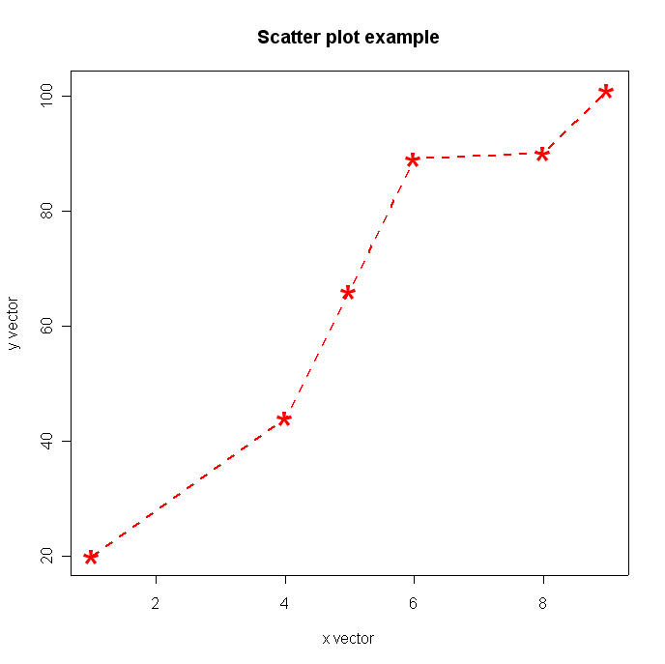
Plot example
> x <- c(1,4,5,6,8,9)
> y <- c(20,44,66,89,90,101)
> plot(x,y,type='n',xlab='x vector',ylab='y vector',main='Scatter plot example')
> points(x,y,col='red',pch='*',cex=3)
> lines(x,y,col='red',lwd=2,lty=2)

Slide 24
Other plotting functions
barplot() # barplot
boxplot() # box and whisker plot
stripchart() # boxplot with just the points
heatmap() # two-dimensional clustering color gradient
image() # color gradient plot
pie() # pie graph
dotchart() # dot plot
hist() # histogram

Slide 25
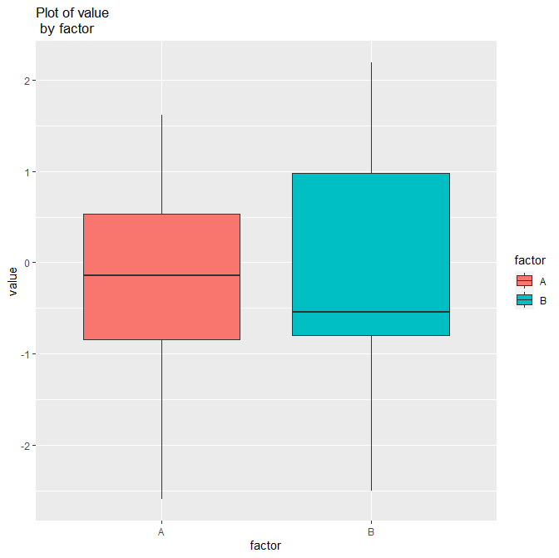
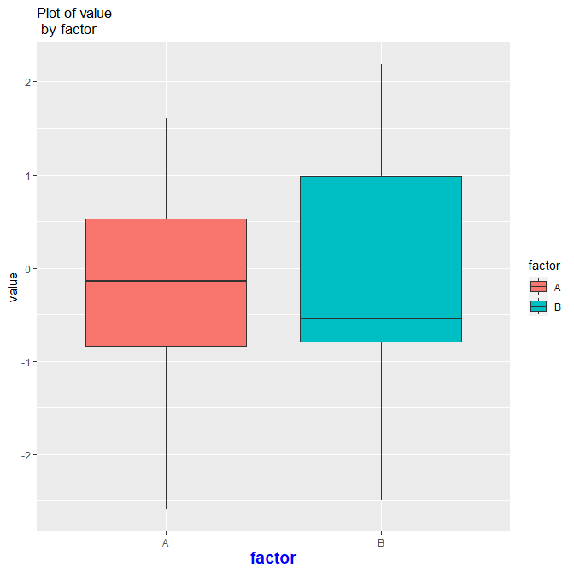
R package ggplot2
Alternative method to plotting data
Generally requires flat file format of data
Then can build on graph object
  > p + theme(axis.title.x=element_text(color= "blue", size=14, face="bold"))
Can be a powerful method to customize graphs
  > dat <-data.frame(rnorm(20),c(rep(“A”,10),rep(“B”,10)))
  > colnames(dat) <- c(“value”,”factor”)
  > p <- ggplot(dat,aes(x=factor,y=value,fill=factor))+
  ggtitle("Plot of value \n by factor") +
  geom_boxplot()
  > p

Slide 26
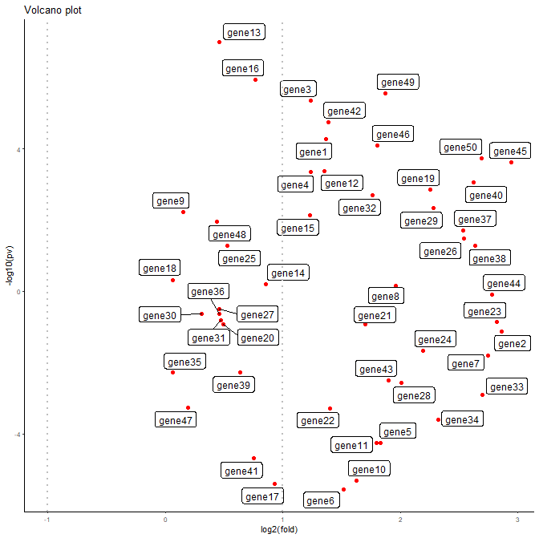
R package ggplot2
Can use to avoid overplotting labels in graphs
  > fc.pv <- data.frame(runif(50,min=0,max=3),runif(50,-7,7))
  > colnames(fc.pv) <- c(“x”,”y”)
  > rownames(fc.pv) <- paste(“gene”,c(1:50),sep=“”)
  > p <- ggplot(fc.pv, aes(x,y, label = rownames(fc.pv))) +
  geom_point(color = 'red') +
  geom_label_repel(size=3) +
  labs(x = "log2(fold)", y = "-log10(pv)",size=5) +
  geom_vline(xintercept = 1, linetype="dotted", color = "grey", size=1) +
  geom_vline(xintercept = -1, linetype="dotted", color = "grey", size=1) +
  ggtitle("Volcano plot") +
  theme_classic(base_size = 8)
  > p

Slide 27
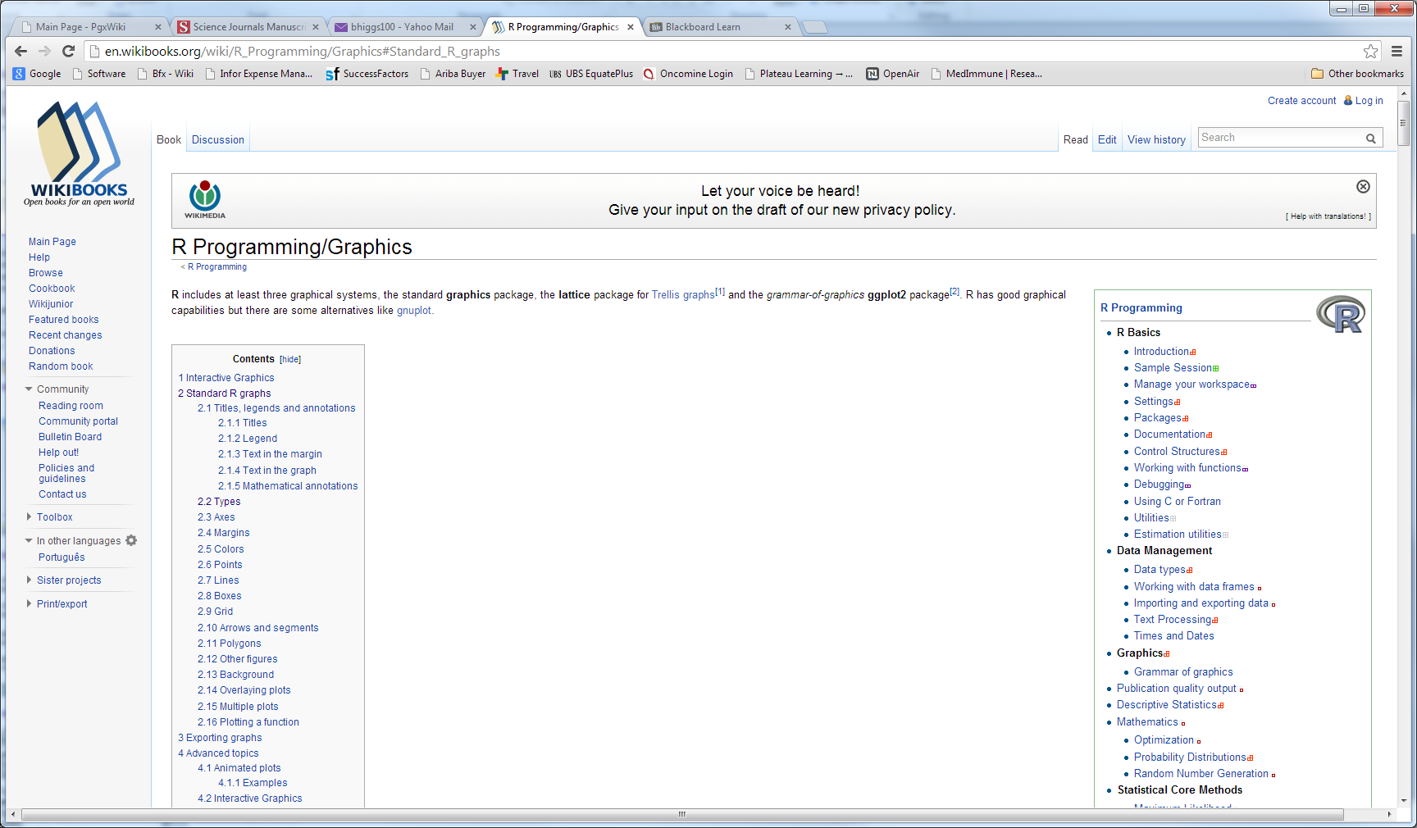
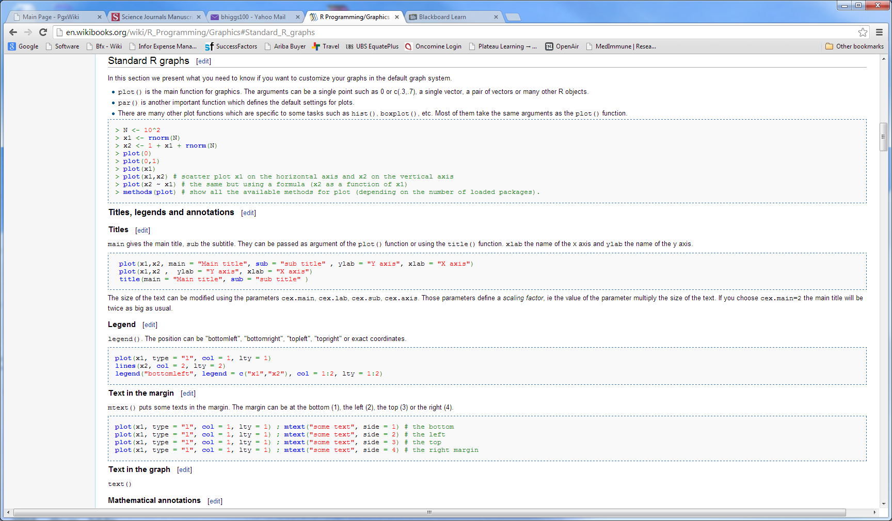
Wiki site for R graphics
http://en.wikibooks.org/wiki/R_Programming/Graphics#Standard_R_graphs

Slide 28
Par commands
Page formatting to add more than 1 plot per page
  > par(mfrow=c(2,3)) # 6 total plots (2 rows & 3 columns)
Page formatting to add margin sizes
  > par(oma=c(2,4,2,4)) #order is bottom, left, top, right
Plot sizes
  > par(pin=c(2,2))
Multiple other page format options
  See help section for par

Slide 29
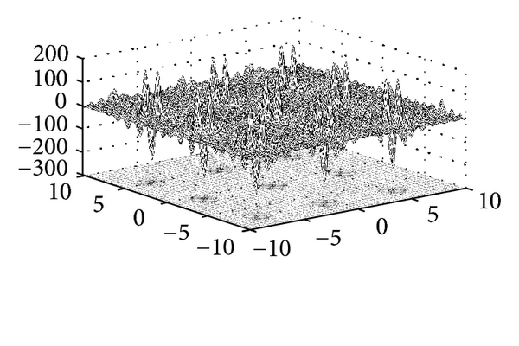
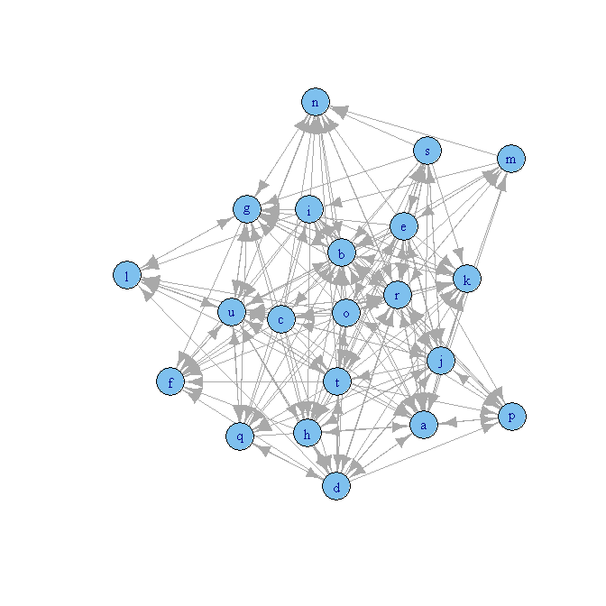
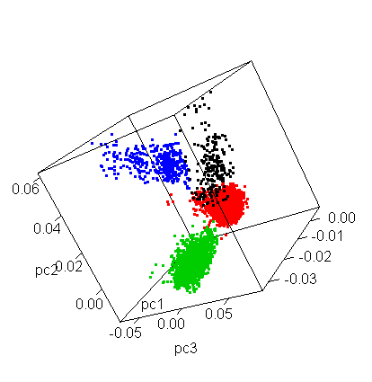
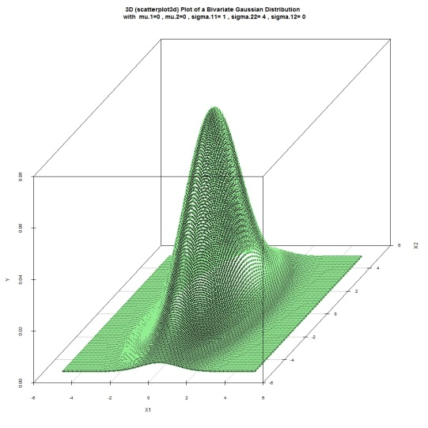

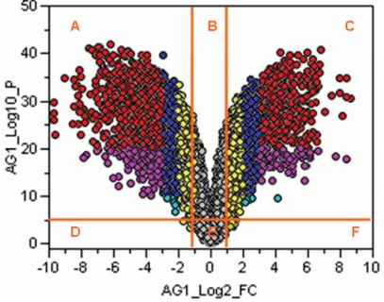
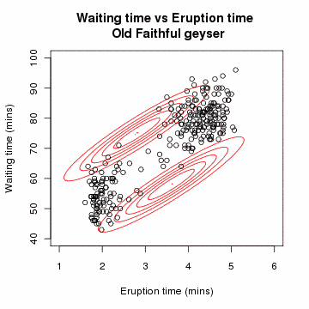
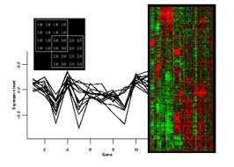
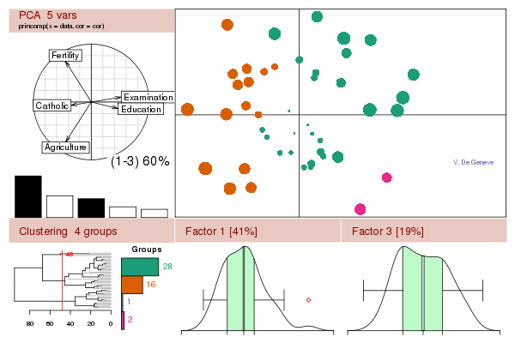
Example graphics using R

Slide 30
Data sets in R
Using packages in Bioconductor, multiple microarray data sets are available
  library(Biobase);
  library(annotate);
  library(golubEsets);
library(multtest);
Golub et al. AML/ALL Affy data set (training set and test set are separate)
data(golubTrain);
data(golubTest)
dat.train <- exprs(golubTrain) (7129 genes x 38 samples)
data(golubTest)
dat.test <- exprs(golubTest) (7129 genes x 34 samples)
clas <- pData(phenoData(golubTrain)) (class labels for training set samples)
or
data(golub)
smallgd<-golub (7129 genes x 38 samples)
classlabel<-golub.cl # class labels for training set samples
Alon et al. colon cancer Affy data set
library(colonCA)
data(colonCA)
dat <- exprs(colonCA) (2000 genes x 62 samples)
classlabel <- colonCA$class # class labels for samples
Some unidentified Affy data set
data(geneData)
dat <- geneData (500 genes x 26 samples)

Slide 31
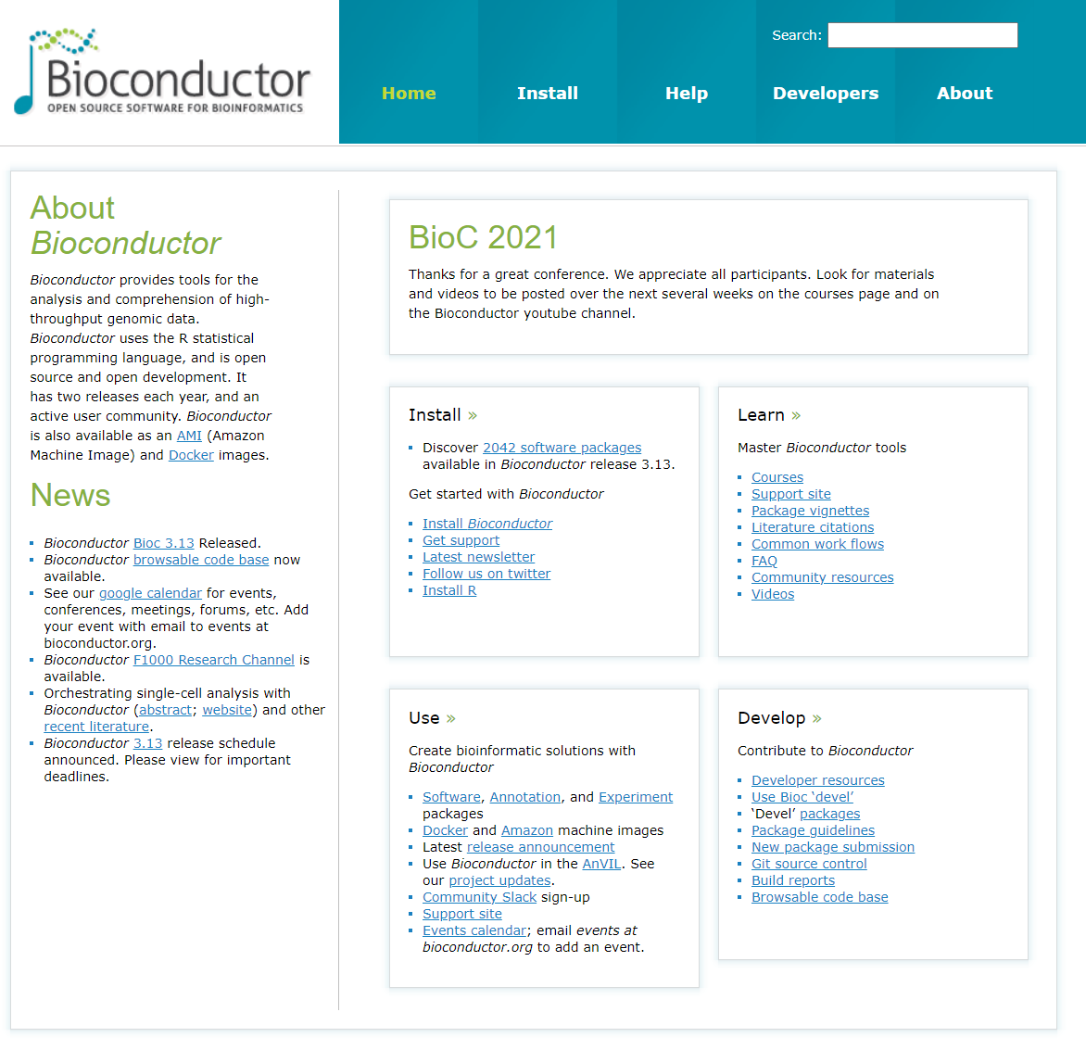
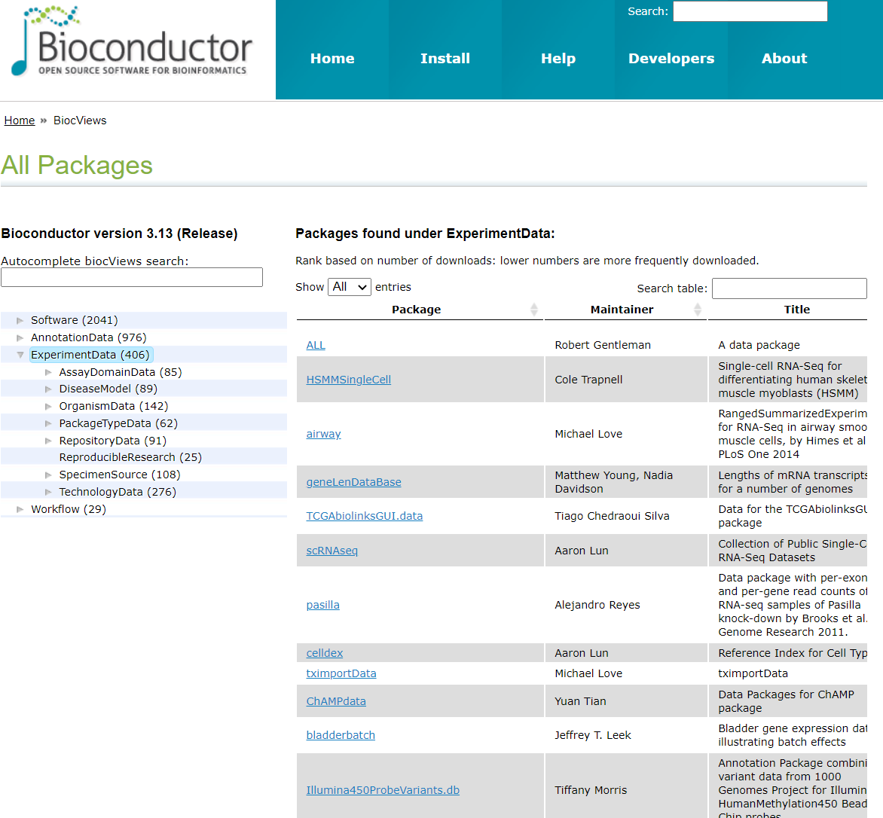
Getting data sets from Bioconductor

Slide 32
Getting data sets from Bioconductor (cont.)
Once the zip file has been downloaded to a local directory, go into R and use package instructions to install zip file from local directory
Then,
access data from data object as follows:
# load package from local drive
> library(Biobase)
> library(annotate)
> library(colonCA)
> data(colonCA)
> dat <- exprs(colonCA) # expression data
> ann.dat <- colonCA$class # annotations for samples

Slide 33
References
R Primer: http://www.r-project.org
Introductory Statistics with R, Peter Dalgaard
http://en.wikibooks.org/wiki/R_Programming/Graphics#Standard_R_graphs
https://www.stat.auckland.ac.nz/~paul/RG2e/

