Slide 1
Lecture #1
Introduction to gene expression technologies

Slide 2
Microarrays

Slide 3
Purpose of microarrays
Understand the processes and associations within and between genes (functional genomics)
  Biological mechanism
  Pathogen detection
  Biomarkers
    Prognostic
    Diagnostic
    Surrogate endpoint
    Pharmacodynamic
    Patient selection
Gene interactions are complex in nature, such that it is necessary to assay many simultaneously to understand dependencies in expression patterns
Requires high-throughput technology

Slide 4
Some definitions
Microarray: chip, genechip, array
Transcript: message, mRNA
Gene expression: number of mRNA molecules
Signal intensity: measure of the number of mRNAs present in a sample
Probe: DNA sequence (usually) that is fixed to the microarray and used to measure the target; also known as ‘reporter’
Target: sequence from sample that is labeled with some dye method
Sample: patient/subject, animal, cell, array
Feature: the (x,y) location of probes on an array

Slide 5
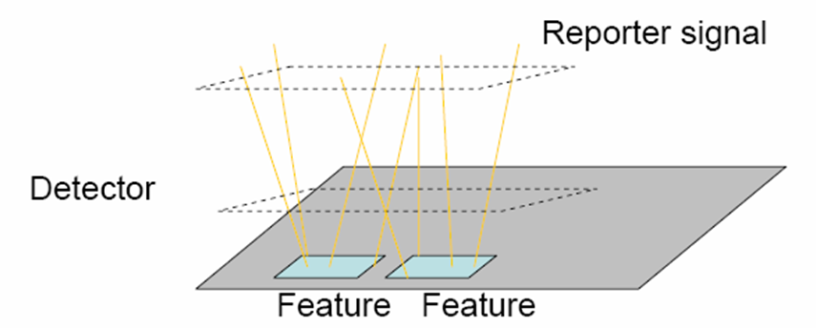
What is a microarray?
At the most general level, a microarray is a flat surface on which one molecule interacts with another
  Location and signal produced provide characteristics about the interacting partners
  Probe: relatively short sequence of DNA fixed to the surface
  Target: the sequence entity that we are measuring (typically labeled)

Slide 6
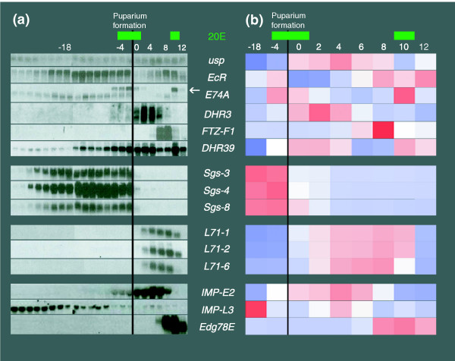
Microarray concept
Quantitative measure of mRNA
  Since most changes in cell states are associated with mRNA
Similar to a Blot
  Intensity-based measurement generated from some label is used to represent amount of material present within a sample
http://genomebiology.com/content/figures

Slide 7

Basic experimental process
1) Select or design an appropriate microarray
2) Collect sample, extract and purify the target (DNA or RNA)
3) Label the target with some dye and fragment
4) Hybridize the target to the array; target sequences specific to the probes hybridize
5) Remove non-hybridized material using some wash condition
6) Laser is applied to labeled target (in a duplex with the probe) which fluoresces at a specific wavelength (dependent upon the dye used), proving a quantitative intensity value
7) Collect the signal, process, normalize, and proceed to analysis
http://www1.istockphoto.com/
The signal intensity is assumed to correlate with the amount of mRNA in the sample

Slide 8
Where are microarrays used?
Anywhere to better understand the associations both within and between genes
  Disease mechanism: identify genes that are differentially regulated in a disease state
  Pathogen detection: one of multiple methods currently used by DHS (and other agencies) to detect the presence of certain pathogens (‘Biosensing’)
  Biomarker discovery: identify genes that are 1) regulated in response to drug treatment, 2) predictive of a patient’s prognosis, 3) diagnostic for a patient’s condition
  Genetics: identify chromosomal structural deletions or amplifications (i.e. copy number variations)
  Many more purposes…

Slide 9
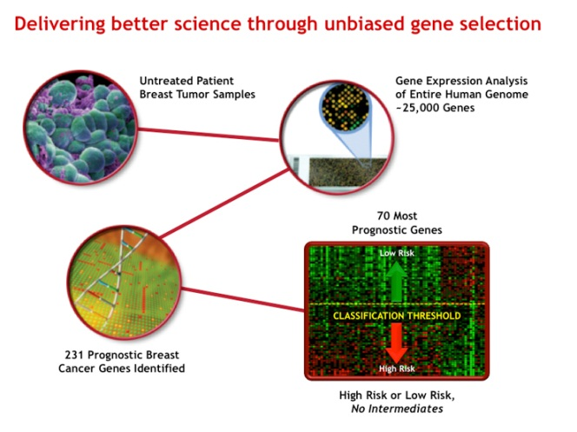
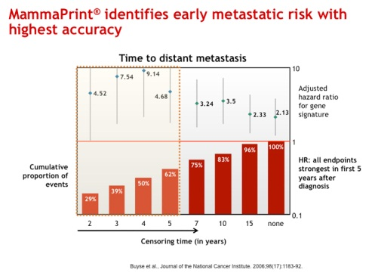
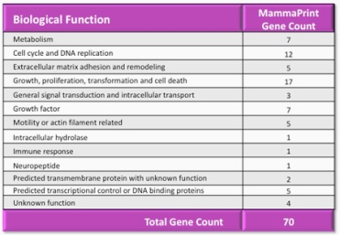
Examples in practice: Mammaprint®
Mammaprint®: an IVDMIA 70-Gene Profile of Breast Cancer for Metastatic Risk
Identifies high or low outcome risk for distant metastases in patients with invasive breast cancer
FDA cleared test for breast cancer
http://www.agendia.com/pages/70_genes_cover_the_metastatic_cascade/44.php
http://www.agendia.com/filebin/AGE594_US_Mamma_over61_highV2_UPDATED.pdf

Slide 10
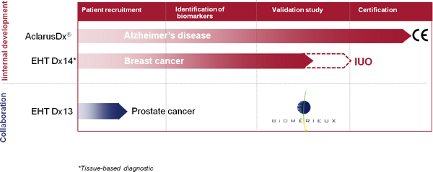
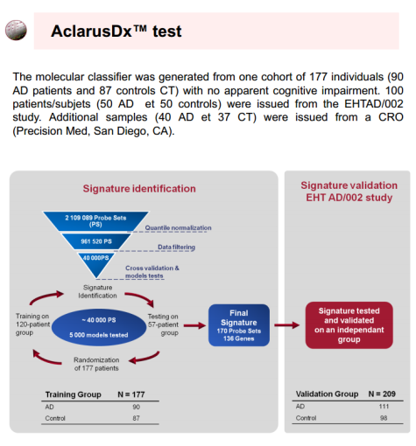
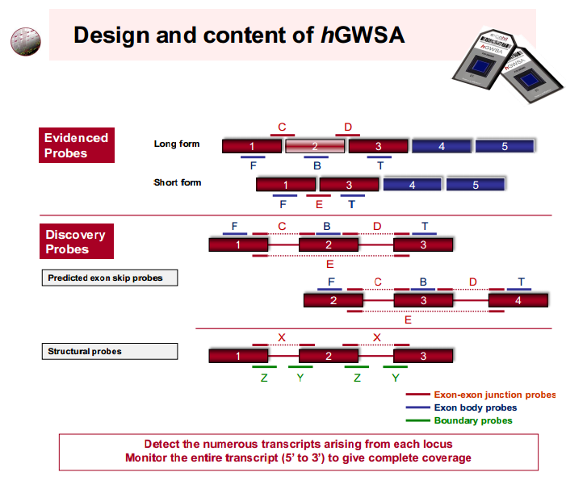
Examples in practice: AclarusDx®
AclarusDx®: A blood-based test using an exon array for early diagnosis of Alzheimer’s disease
Has obtained CE marking
http://www.exonhit.com/diagnostics/pipeline#Internal_Development

Slide 11
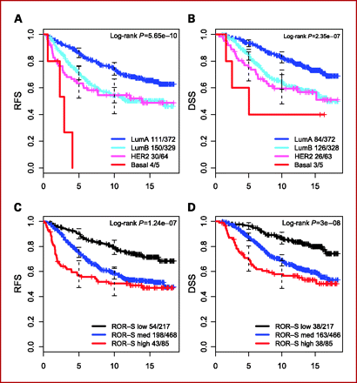
Examples in practice: PAM50 Breast Cancer Intrinsic Classifier™
Developed using microarrays, but actual test is an RT-qPCR assay that measures the expression of 50 genes
Identifies the intrinsic breast cancer subtypes known as Luminal A, Luminal B, HER2-enriched and Basal-like
Still a laboratory developed test (LDT)
http://clincancerres.aacrjournals.org/content/16/21/5222.long
http://www.news-medical.net/news/20110118/PAM50-test-is-now-available-to-classify-breast-cancer-subtypes.aspx

Slide 12
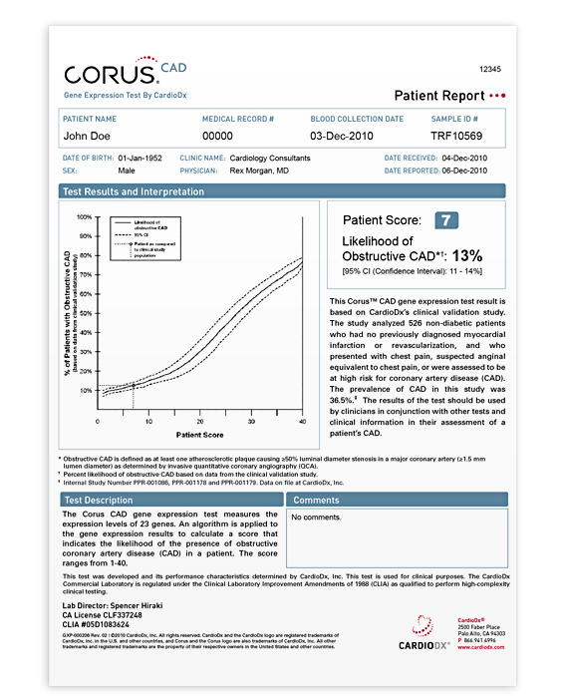
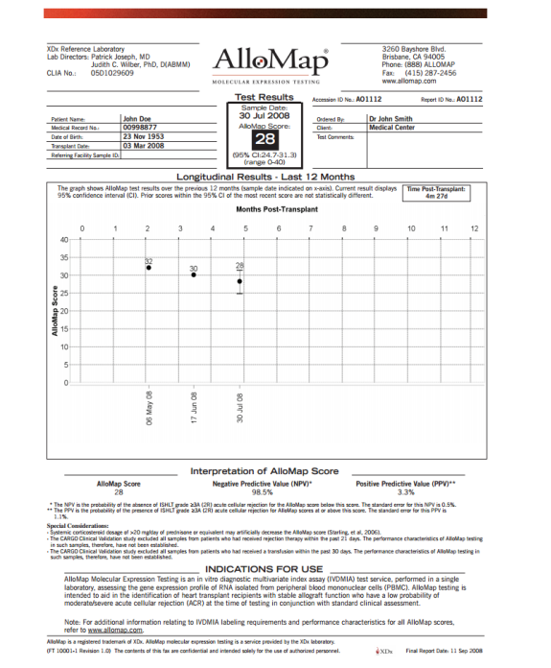
Other examples that utilized microarrays to develop a gene signature
http://www.allomap.com/documents/XDx_LabServicesGuideFINAL3electronicversion.pdf
http://www.cardiodx.com/for-patients/corus-cad-overview

Slide 13
Probe selection for array design
I will not go into too many details here, but probes are selected based on numerous characteristics
  Specificity to target sequence
  Melting temperature (T_{m})
  Propensity to not form secondary structure (free energy of folding)
  3’ bias for complement to target sequence (tends to be more unique)
  Length and uniqueness
  Minimal homology to other targets in a gene family

Slide 14
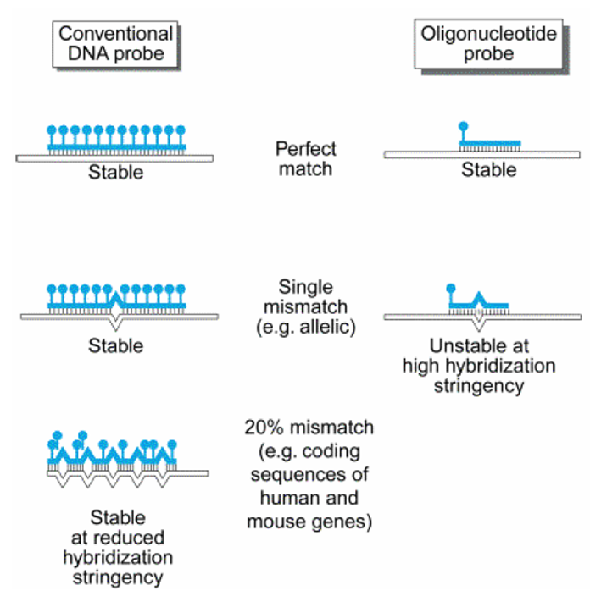
Two primary microarray designs
cDNA/two channel arrays
  50-70 bp probes
  Two-color hybridization used for each probe
  Poor specificity due to mismatch tolerance
Oligonucleotide arrays
  8-60 bp probes
  Single color hybridization used for each probe
  Good specificity but poor sensitivity

Slide 15
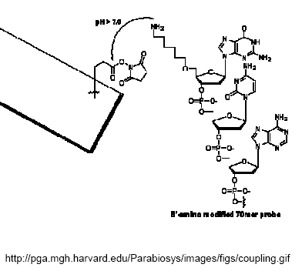
cDNA/Two channel arrays
cDNA/two channel arrays
  Less expensive technology
  Complete sequence is attached to chip (probe)
  Two-color hybridization used for each probe
    Internal control
    cDNA is PCR’d with random 6mer primers and dCTP-dye conjugates
      Cy5 abs=650 nm; emm=667 nm
      Cy3 abs=552 nm; emm=568 nm
cDNA/two channel array probe spotting
  Utilizes spotting technology to attach probes to chip (printer robots)
  A solution is picked up with a pin and this touches the array surface, depositing the probe solution

Slide 16
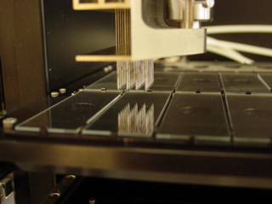
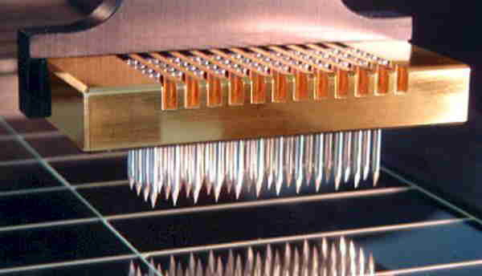
cDNA array technology
A glass slide, membrane, or polymer that has been spotted with
non-labeled DNA probes designed to hybridize specific complementary
DNA’s of interest (cDNA).
http://array.mc.vanderbilt.edu/services/custom.fgsr
http://www.arrayit.com/Products/Microarray_Printing/Microarray_Pins_Stealth_Techno/microarray_pins_stealth_technology.html

Slide 17
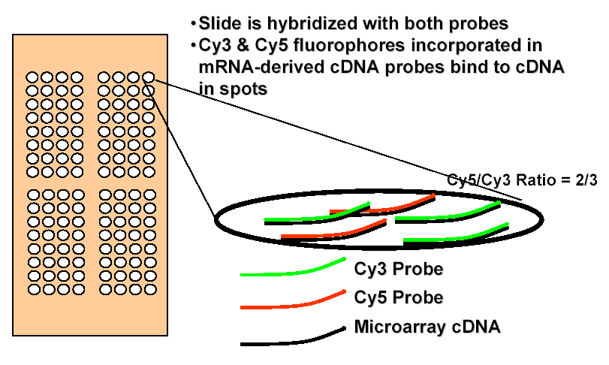
cDNA array technology (cont.)
Samples are prepared from both an experimental sample, (e.g., malignant tumor) and a control sample, (e.g., normal tissue) and are then overlaid on the array and allowed to hybridize to
each spotted probe:

Slide 18
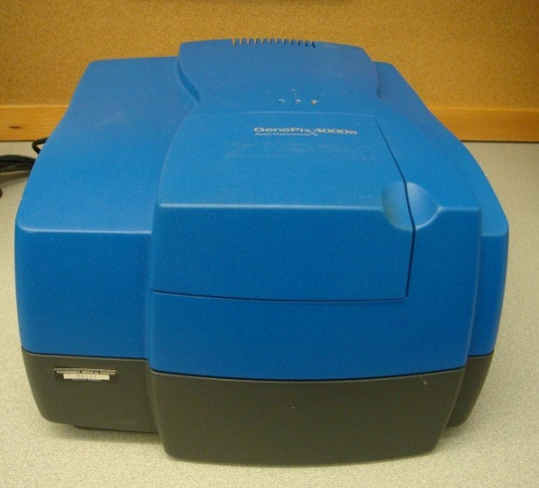
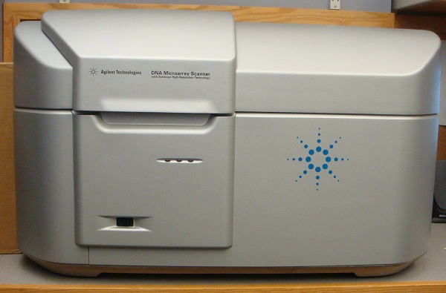
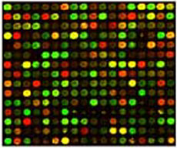
cDNA array technology (cont.)
Following hybridization, the array is scanned and the
resulting gene expression information for each spotted
probe on the array is reported
A green intensity = control Only expressed gene
A red intensity = experiment Only expressed gene
A mixed color = gene expressed in both control & experiment

Slide 19
cDNA array technology (cont.)
The gene expression information that is actually
reported are ratios of the amount of experiment sample to
control sample that has hybridized to each spotted probe
on the array
Amount of experiment sample hybridized
Amount of control sample hybridized
Probe 1
= Probe 1 Expression Ratio
Amount of experiment sample hybridized
Amount of control sample hybridized
Probe 2
= Probe 2 Expression Ratio
Amount of experiment sample hybridized
Amount of control sample hybridized
Probe n
= Probe n Expression Ratio

Slide 20
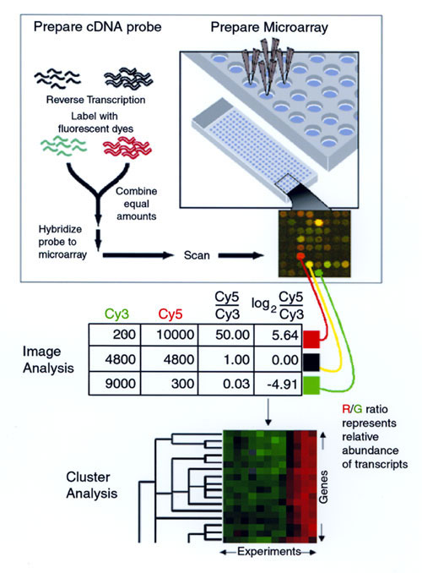
cDNA microarray: from array to data
http://wwwnc.cdc.gov/eid/article/6/5/00-0511-f1.htm

Slide 21
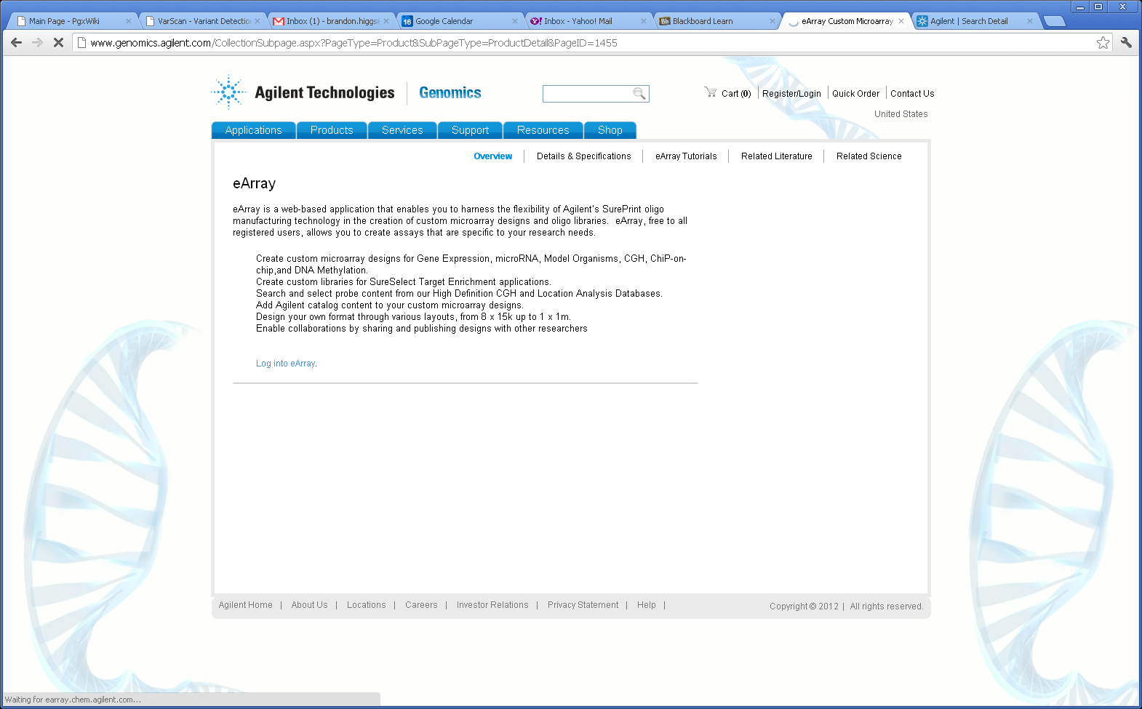
Web-based custom array design by Agilent
http://www.genomics.agilent.com/CollectionSubpage.aspx?PageType=Product&SubPageType=ProductDetail&PageID=1455

Slide 22
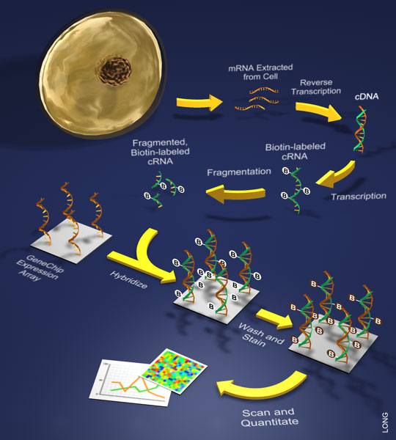
Oligonucleotide Arrays
Oligonucleotide array – e.g. Affymetrix
  More expensive technology
  Small (11-25 mers) or large (50-70 mers) sequence is attached to chip (probe)²
  Allows for non-repetitive or unique probe design for a particular gene
  Multiple probes represent same gene/EST with overlap method
  Each probe has a mismatch complement with single bp mutation
    Cross-hybridization
    Background correction
  Utilizes photolithography technology to attach probes to chip

Slide 23
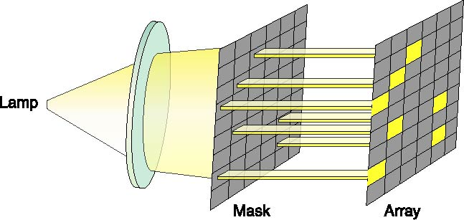
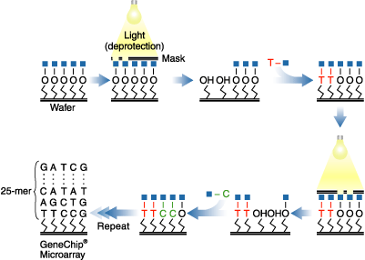
Oligonucleotide array design
In situ synthesis is used to build probes bp-by-bp using synthetic organic chemistry
  Mask is designed for each array type (e.g. species) once
  Affymetrix example shown on the right and described in next few slides
  Photolithography technology (attachment using light)
http://www.affymetrix.com/corporate/media/image_library/low_res/photolitography.jpg
http://www.affymetrix.com/technology/manufacturing/index.affx

Slide 24
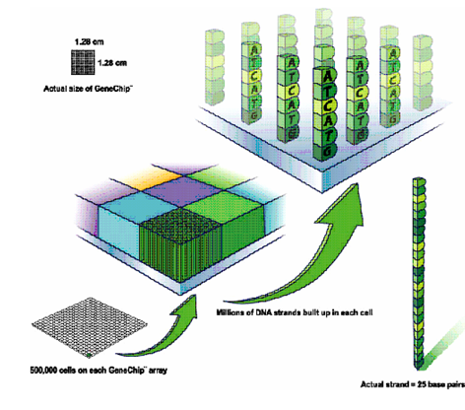
Oligonucleotide technology
Every microarray has up to 500,000 individual probe-cells, each 18µm across and containing millions of identical DNA molecules.²
The human U133A array, for example contains over 260,000 different probes that together measure the expression of 22,283 different transcripts at once. ²
Chips exist for a variety of organisms including human, mouse, yeast, arabidopsis, and rat

Slide 25
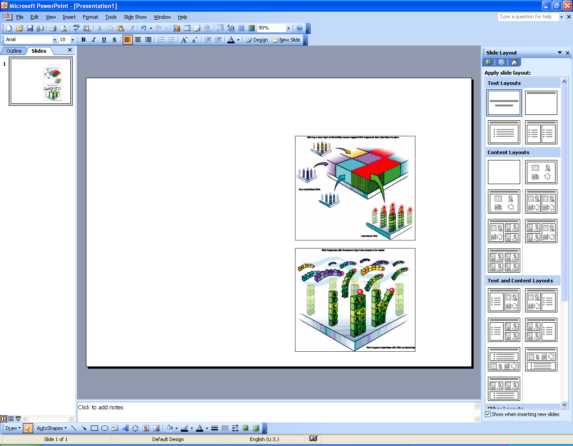
Oligonucleotide technology
Fragmented RNA is labeled with a fluorescent tag and run over the chip
Wherever there is a complementary probe sequence on the chip, the RNA can hybridize to it. ²
Since there are millions of oligos for each probe-sequence, the amount of labeled RNA that sticks corresponds to the amount in solution. ²
When the chip is scanned by a laser, the tagged fragments fluoresce, producing spots with a brightness proportional to the amount of RNA that has hybridized. ²
This is recorded by a camera and the array image processed by computer to produce expression levels for the different genes. ²

Slide 26
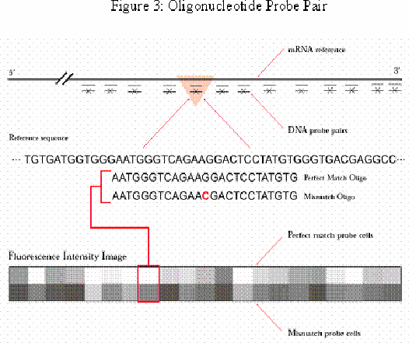
Oligonucleotide technology
The chips are designed so that every transcript is represented by between 11 to 20 probes that match different parts of the 3' end of the mRNA sequence.²
Every chip probe consists of a pair 25 base oligos, one a perfect match (PM) to the transcript, the other a mismatch (MM) in which the middle residue has been changed.²
This probe-pairing strategy helps minimize the effects of non-specific hybridization and background signal.²

Slide 27
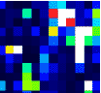
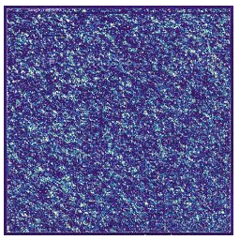
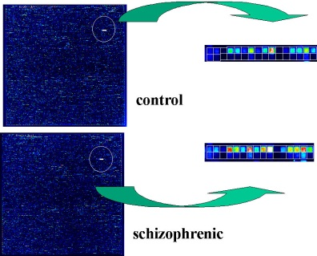
Oligonucleotide array
Once the probe has hybridized, chips are scanned to generate an image (dat file).²
Each spot, or feature, is ~ 20µm square and is scanned at a resolution of 3µm - giving an average of 49 pixels per spot.²
The array analysis software identifies individual features and overlays a grid separating each spot from its neighbors. ²
The expression level for a gene is calculated by subtracting the MM from the PM probes.²

Slide 28
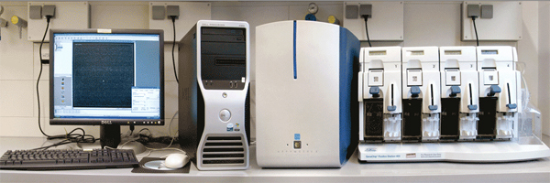
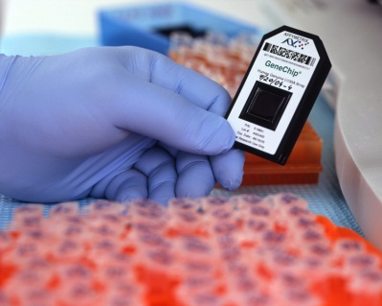
Oligo technology instruments
Fluidics machine, scanner, and software
An Affymetrix chip
http://commons.wikimedia.org/wiki/File:Affymetrix_GeneChip.jpg
http://www.mpibpc.mpg.de/microarray

Slide 29
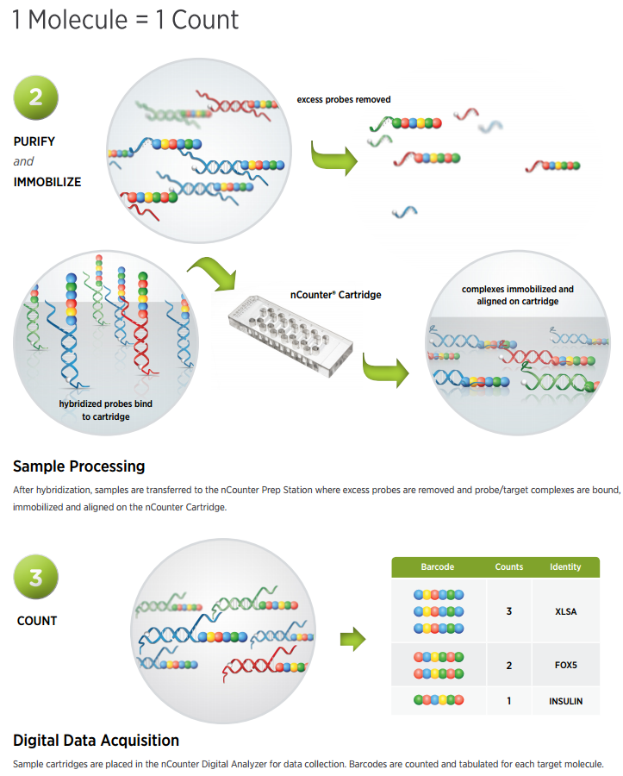
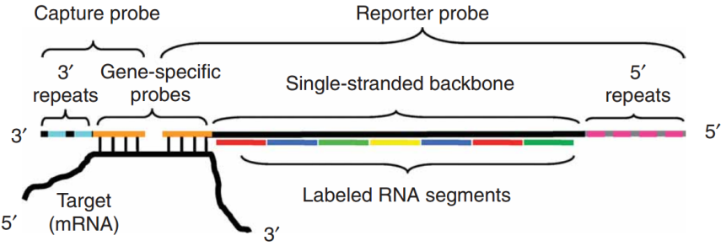
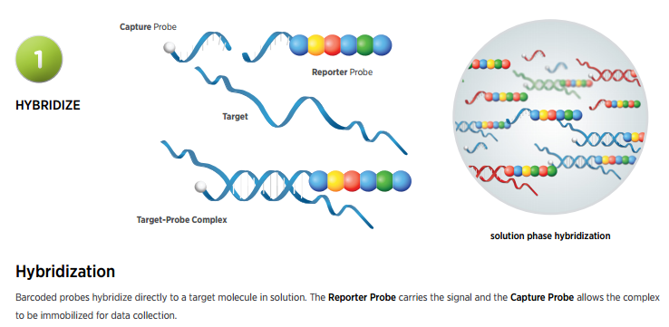
Nanostring
mRNA hybridization to a capture probe and a reporter probe that are photo captured and then counted (no RNA amplification)

Slide 30
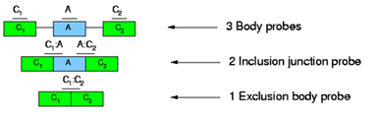
Exons and splice variants
We know from molecular biology, that RNA undergoes processing prior to determining a final form
  Intragenic regions can be spliced out, while exon regions are combined
  These recombined transcripts are known as splice variants

Slide 31
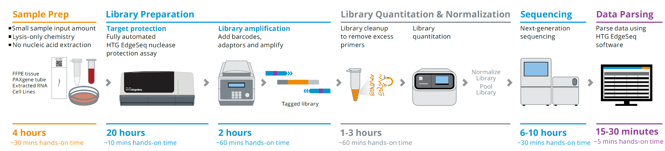
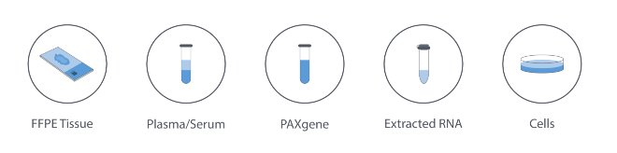
HTG EdgeSeq for rapid RNA analysis of FFPE slides
Commercialized in 2013 but based on well established nuclease protection assay
Sample Types
Courtesy of Omar Jabado

Slide 32
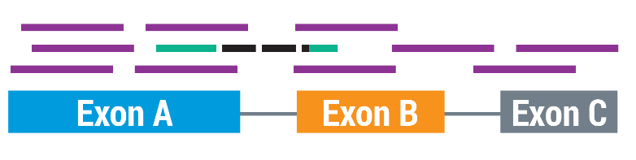

Tradeoff for Speed and Sensitivity is Lower Data Complexity
RNASeq
EdgeSeq
Unbiased sequencing of all parts of a gene
Rich dataset for analyzing splicing and mutations
~40M reads needed per sample
A “liquid microarray”
One probe per gene
RNA is not sequenced, it’s the DNA probe
Sensitive to PCR artifacts, alternative splicing and SNPs
~1.5M reads needed per sample with 3,000 gene panel (3.75% of RNAseq)
Courtesy of Omar Jabado

Slide 33
Exons and splice variants
Why bother with looking for expression patterns in splice variants?
  Many genes are products of splice variants
  They can be strong indicators of certain diseases as well as specific drug response
  Within a population, a specific gene may show high differential expression due to a disease condition
  However, within a small subpopulation, those members that have an alternatively spliced version of the gene show not differential expression from the disease condition

Slide 34
Exon arrays
Typical microarrays are designed with probes to target the 3’ end of the gene
This type of design only measures the abundance of mRNA molecules that hybridize to the probe at the terminal region
Such design does not take into account splice variants that can result from alternative splicing patterns
  Requires probes that are complementary to multiple regions along the gene to measure possible splice variants
  Requires information about known splice variant sequences to design probes for possible combinations of splice events

Slide 35
Differences in array platforms
Consistent comparisons across different array platforms have been difficult to make
  Differences in vendors (e.g. Affymetrix and Agilent)
  Differences between versions of an array from the same vendor (Affymetrix u95 vs u133 series arrays)
Results have been shown to vary when comparing different array platforms
    Different sensitivities in array technologies
    Different probe selection designs
    Different signal intensity normalization methods

Slide 36
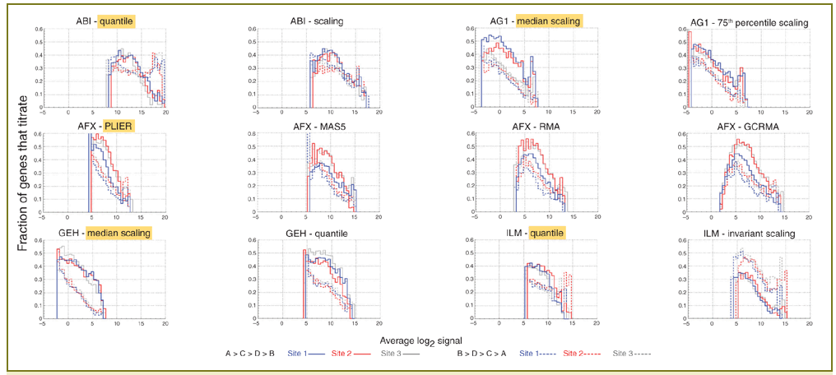
Differences in array platforms
The MicroArray Quality Control I (MAQC)³
  A community led by the FDA to understand the use of microarray technology in clinical and regulatory settings
  Published a series of studies to compare array platforms both to each other and quantitative results (RT-PCR)
  Provide some guidance on methods that perform most consistently across platforms and identify those factors that do not tend to vary

Slide 37
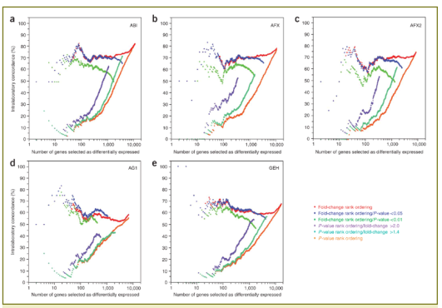
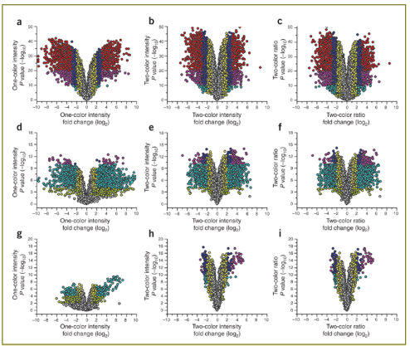
Differences in array platforms
Studies published by MAQC sought to assess:
  Comparison of microarray data to quantitative gene expression
  Comparison of normalization methods
  Use of external controls
  One channel vs. two channel microarrays
    One channel platforms: Affymetrix, Applied Biosystems, Eppendorf, GE Healthcare, Illumina
    Two channel platforms: Agilent, TeleChem, CapitalBio
  Intraplatform reproducibility
  Analytical consistency across platforms

Slide 38
Standards in the microarray community
Minimal Information About a Microarray Experiment (MIAME)
  Organization set up to provide standards in microarray experiments and analysis
  Provide guidelines on the minimal necessary information for interpretable results
  Encourage depositing data into public standard repositories
    Journals and funding agencies
    Most journals now require depositing data prior to publication
Guideline examples
  Experimental design
  Array design
  Samples
  Hybridization parameters
  Normalization methods

Slide 39
Interpreting the biology
Hybridization kinetics
  Ideally, the probe that minimizes hybridization free energy is the optimal one to represent a gene
    However, we cannot currently compute the free energy from the sequence alone
  The hybridization free energy for a gene depends on the concentration of that gene
    The less expressed gene with higher free energy can give a greater signal than the more expressed gene, if it is given in greater concentration
mRNA expression vs. protein expression
  Gene interactions sometimes do, but can also have minimal similarity to protein interactions
    Kinases, Receptor-ligand binding, Protein docking, etc.
    Half-lives of mRNA and its protein are not always proportional
All gene expression events do not result in mRNA transcripts
  tRNA, rRNAm snRNA
Splice variants

Slide 40
RNA sequencing

Slide 41
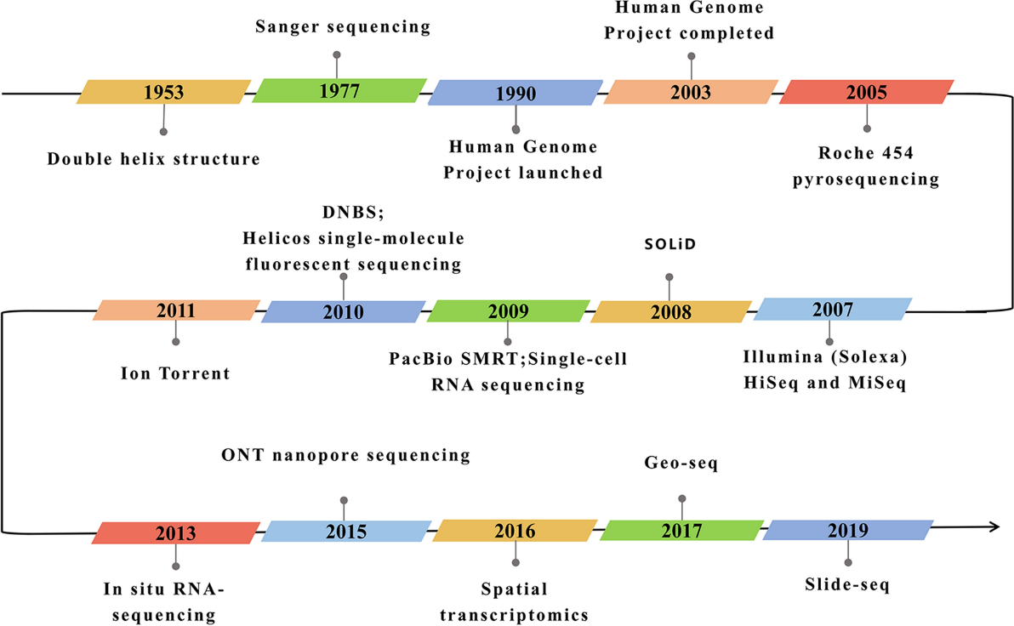
RNA sequencing evolution
Hong et al, 2020

Slide 42
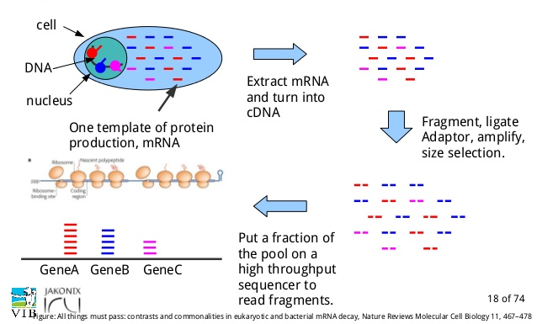
RNA sequencing process flow

Slide 43
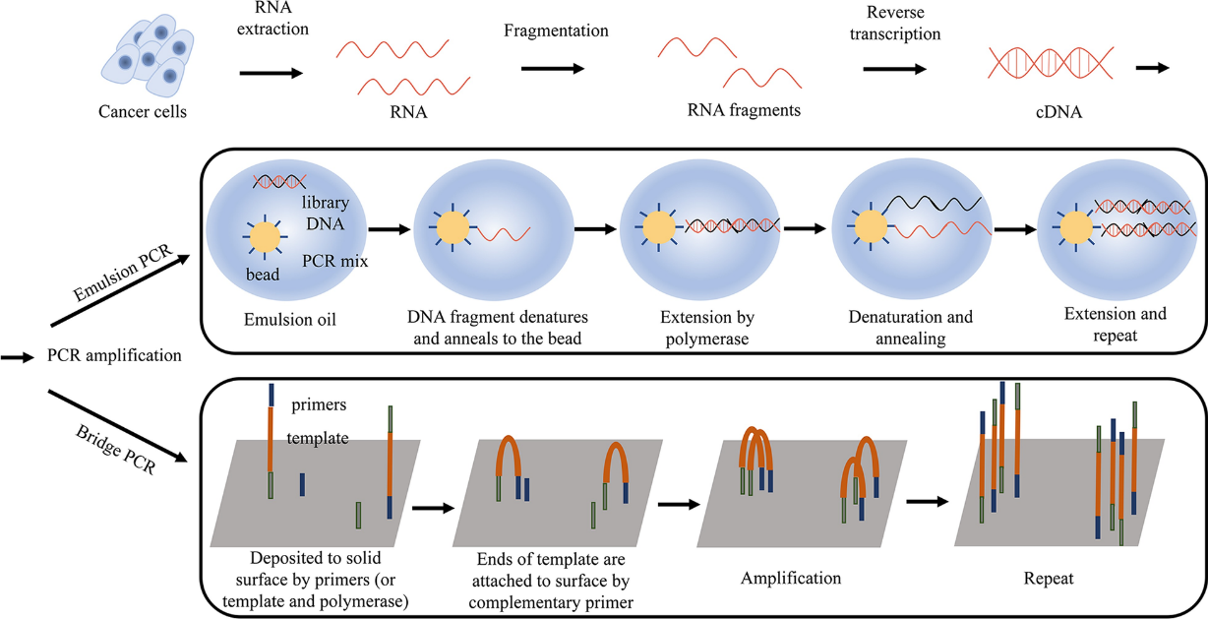
RNA extraction and template preparation
Hong et al, 2020

Slide 44
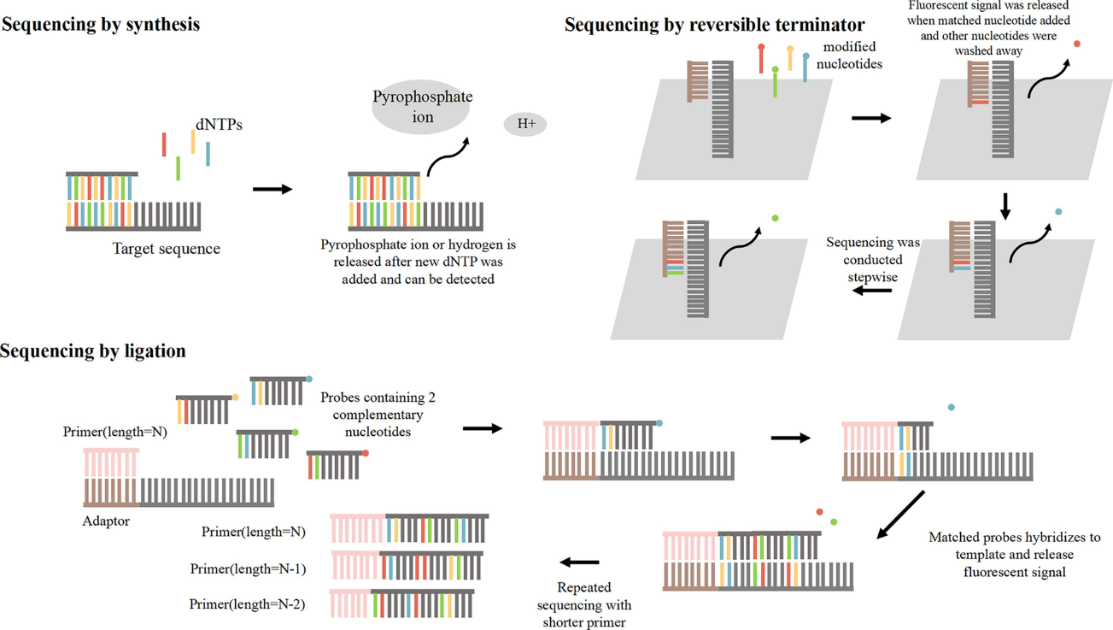
Three types of sequencing approaches
Hong et al, 2020

Slide 45
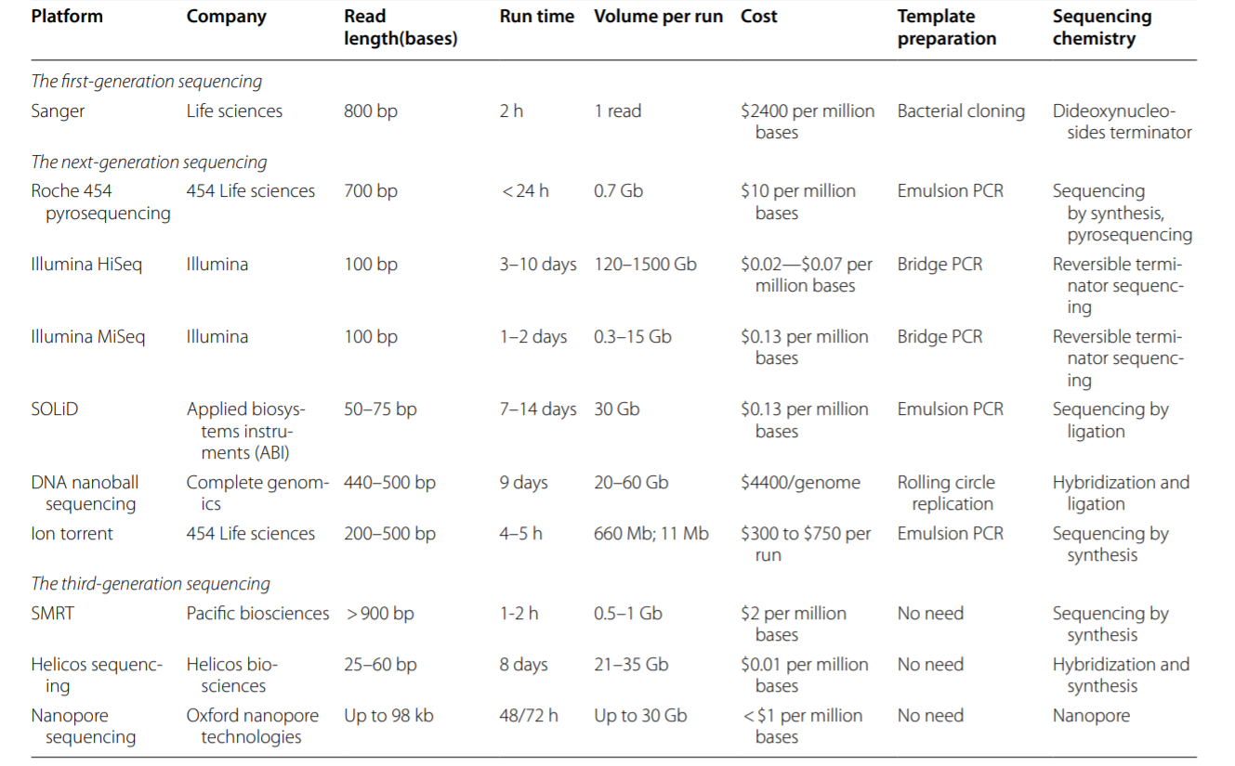
Comparison of different RNA sequencing platforms
Hong et al, 2020

Slide 46
RNA sequencing advantages
Improved sensitivity to array platforms
No prior knowledge of transcripts required
Can detect novel transcripts
No prior knowledge of species content (if reference transcriptome not available)
Has become more cost effective than array platforms in many cases

Slide 47
Single cell RNA sequencing

Slide 48
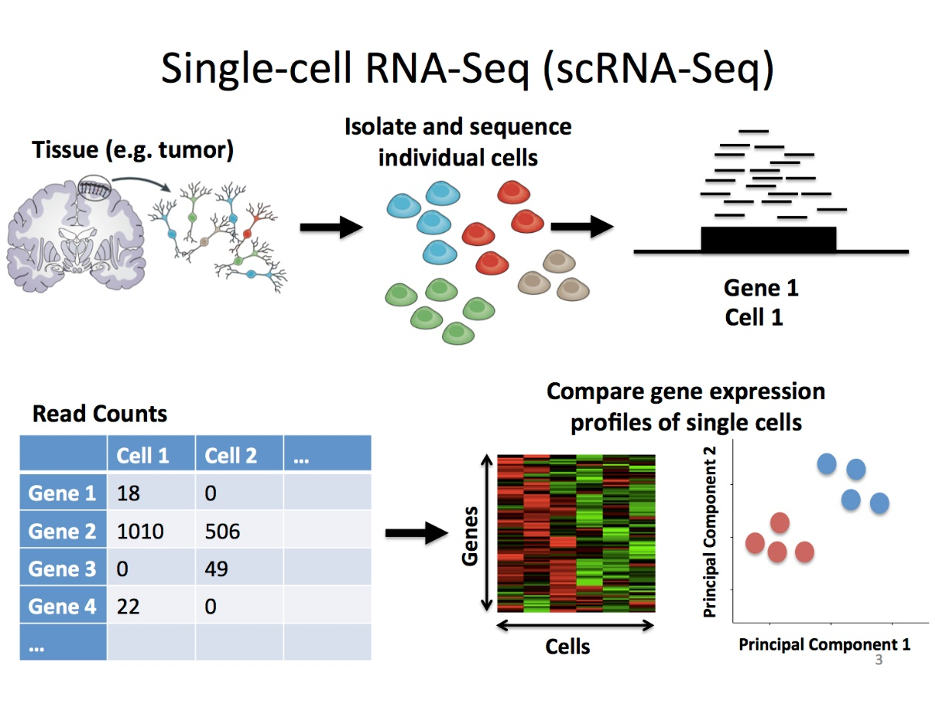
General process flow
https://learn.gencore.bio.nyu.edu/single-cell-rnaseq/

Slide 49
Bulk versus single cell RNA sequencing
Bulk RNA sequencing measures the average expression levels of transcripts from multiple cells within a specimen
Single cell RNA sequencing measures the expression levels of transcripts at a single cell level
  Addresses expression differences due to cell heterogeneity within a specimen
  Allows identification of new cell populations

Slide 50
scRNAseq general steps
Isolation of single cell specimens
  Digestion of tissue
Library construction
  Intracellular mRNA is captured
  RT to cDNA, amplification
  Incorporation of unique molecular identifiers (UMIs) or barcodes (depending on protocol)
Libraries are pooled for sequencing
  Reads are created
Demultiplexing of reads, QC, and downstream analysis
https://www.embopress.org/doi/full/10.15252/msb.20188746

Slide 51
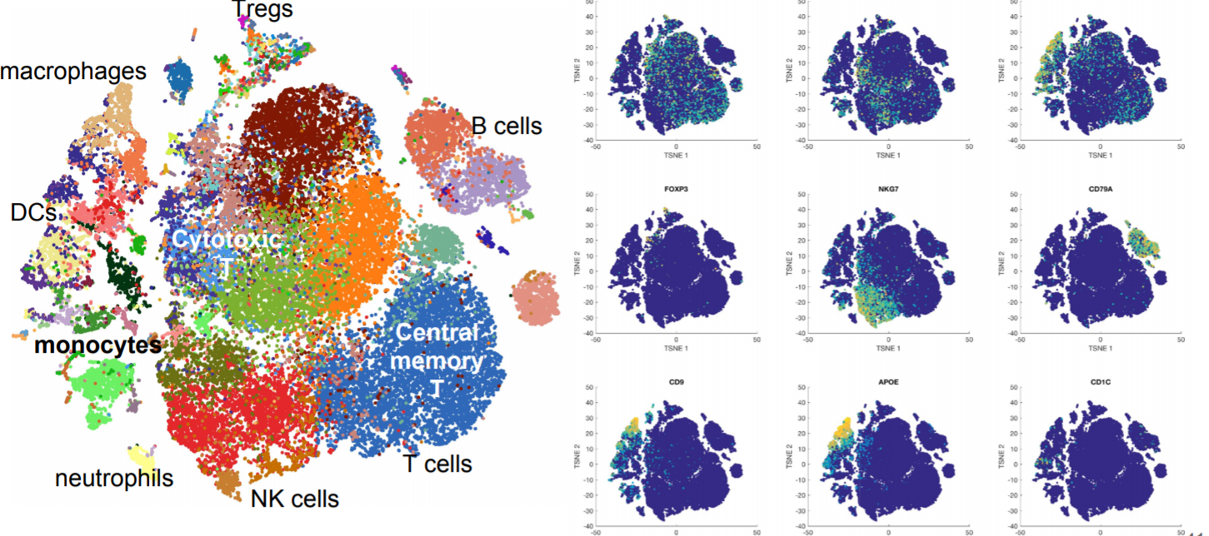
scRNAseq downstream analysis
Data are QC’d, normalized, and analyzed for cell-specific patterns
Clustering and dimensionality reduction are often performed to visualize cell-specific expression
Cell-specific genes are used to associate clusters with cell identities, when known
https://www.bioconductor.org/help/course-materials/2017/BioC2017/Day2/InvitedSpeakers/Biscuit_Azizi.pdf

Slide 52
References
1) Li Fugen, Stormo D Gary,. (2001) Selection of optimal DNA oligos for gene expression arrays. Bioinformatics. 17,1067-1076.
2) The Paterson Institute: Onco-Informatics group
  http://bioinformatics.picr.man.ac.uk/mbcf/overview_ma.jsp
3) Shi et al., (2006) The MicroArray Quality Control (MAQC) project shows inter- and intraplatform reproducibility of gene expression measurements. Nature Biotech. 24:1151-1161.
4) Yang Y, Dudoit S, Luu P, and Speed T. Normalization for cDNA Microarray Data. (2000) UC Berkeley Tech Report.
5) Irizarry R, Bolstad B, Collin F, Cope L, Hobbs B, and Speed T. (2003) Summaries of Affymetrix GeneChip probe level data. Nucleic Acid Research. 31.
6) Dudoit, S., Gentleman, R., Irizarry, R., and Yang, Y. (2002) Pre-processing in DNA microarray experiments. Bioconductor short course.
7) Bolstad BM, Irizarry RA, Astrand M, and Speed T. A comparison of normalization methods for high density oligonucleotide array based on variance bias. Technical Report.

