Slide 1
Lecture #8
Dimensionality Reduction

Slide 2
Outline
Purpose
Methods
  Linear
    Principal components analysis (PCA)
    Partial least squares regression (PLS)
    Multidimensional scaling (MDS)
      Non-metric
      Metric (classical)
  Nonlinear
    Kernel PCA
    The weighted graph Laplacian (spectral method)
    Isometric feature mapping (ISOMAP)
Which method to use?
  Nonlinear example

Slide 3
Dimensionality in transcriptomic data
Transcriptomic data most often has a format that includes n genes by s samples, where n >> s
  Curse of dimensionality: an estimator converges to the true value of a function defined on a high dimensional space very slowly
  In other terms: We require many observations to get an accurate estimate of the variables that we are measuring
With so many variables, it is often difficult to see patterns that may exist in the data
Dimensionality reduction techniques “attempt to examine the underlying patterns or relationships for a large number of variables and determine whether the information can be better summarized in a few factors or components.”
  i.e. Latent variables, Components, Factors

Slide 4
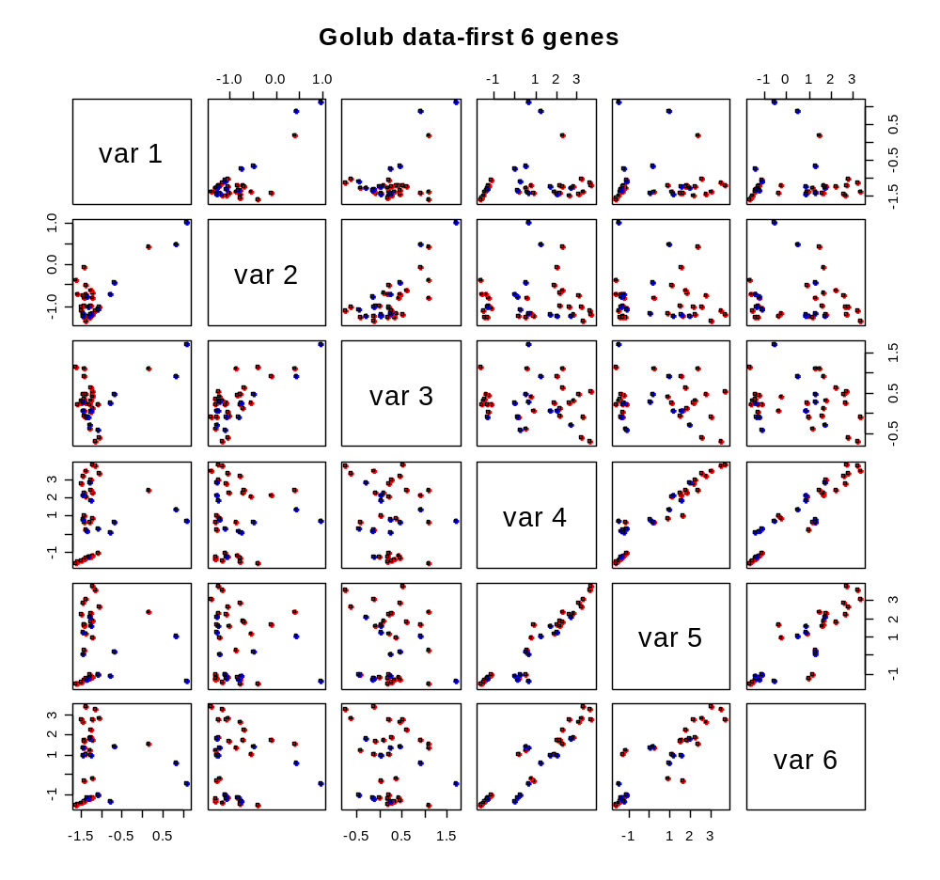
Only top 6 genes
Can only visualize so many genes or gene interactions in 2 dimensions

Slide 5
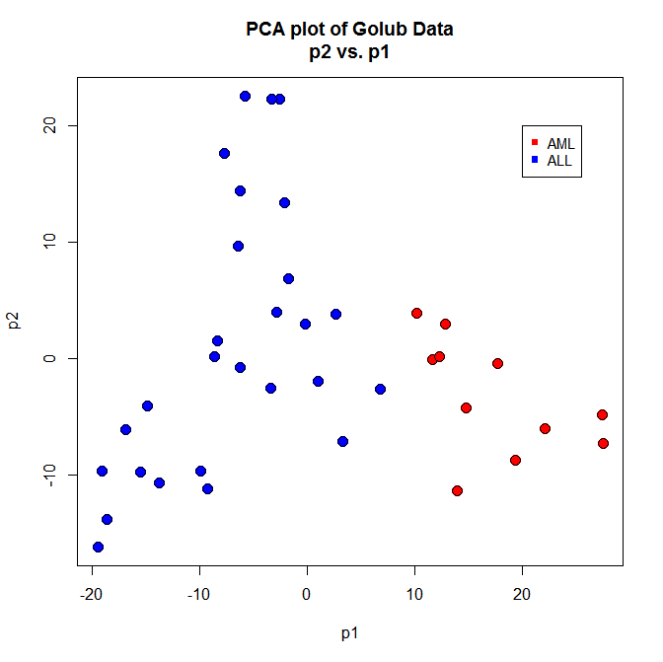
First 2 components in PCA space
With dimensionality reduction, you can see gross patterns between samples in 2-dimensions

Slide 6
Principal components analysis (PCA)
One of the most utilized methods to view transcriptomic data today
Principal components
  Linear combinations of the original variables chosen such that the first principal component explains the largest variance of any linear combinations, the second explains the next largest variance, which is uncorrelated with the first, and so on
What is a linear combination?
  A linear equation of coefficients, such that each gene/sample is weighted according to its contribution to the sum
  y = x₁c₁ + x₂ c₂ - x₃c₃ + x₄c₄ …
Why should one calculate linear combinations instead of using the actual variables?
  Need to reduce the dimensionality, while maintaining the inherent structure
  The data might not have been measured in the most appropriate units, so linear combinations of the original variables give more suitable units

Slide 7
PCA general methodology
We start with either the covariance matrix Σ or the correlation matrix ρ of X₁, X₂,…X_{p}
  Note: bold text represents vector or matrix notation, while non-bold text represents scalar notation
The random vector X’=[X₁, X₂,…X_{p}] has the covariance matrix Σ with eigenvalues λ₁≥λ₂≥…λ_{p}≥ 0 and eigenvectors e₁, e₂,…e_{p}
What are eigenvalues and eigenvectors?
  Σ=PλP’, where λ is a diagonal matrix of λ_{i} eigenvalues on the diagonal and P is an orthogonal matrix of [e₁,e₂,…,e_{p}], so PP’=P’P=I
Then the ith principal components is given by:
  Y_{i}=e’_{i}X=e_{i1}X₁+e_{i2}X₂+…e_{ip}X_{p}; i=1,2,…,p and e’_{i}e_{i}=1
  With choices that Var(Y_{i})=e’_{i}Σe_{i}=λ_{i}; i=1,2,…,p and
  Cov(Y_{i},Y_{k})=e’_{i}Σe_{k}=0; i!=k
The principal components are the uncorrelated linear combinations Y₁,Y₂,…,Y_{p} with variances as large as possible, and each successive component explaining less and less variability²

Slide 8
PCA loadings plot interpretation
Since the eigenvalues that we calculate from PCA are cumulative in explained variance, and we can only really view data in 2 or 3 dimensions, the loadings for the first two or three components are usually plotted against each other
This allows us to identify a particular trend associated with within the data
  Example will better illustrate this point

Slide 9
PCA variance explained
While reducing the dimensionality in the data, we hope to capture the most variance in the fewest components
  Since the first eigenvalue explains the largest amount of variance, the second explains the second largest variance, etc.
We can visualize this variance with a plot of the variance vs. the number of components
  Scree plot
This plot depicts how the variance is distributed across the n components, so we can see how much to weight each component
We look for an elbow in the scree plot to where the variance has reached a plateau

Slide 10
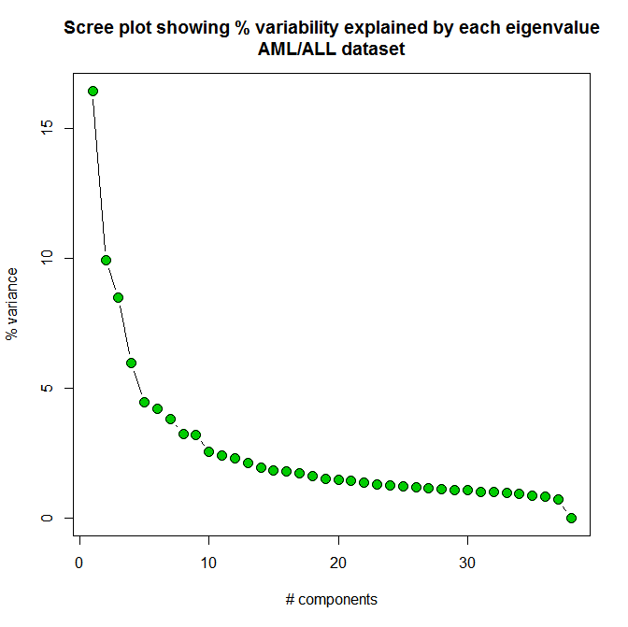
PCA example with AML/ALL data – number of components to retain

Slide 11
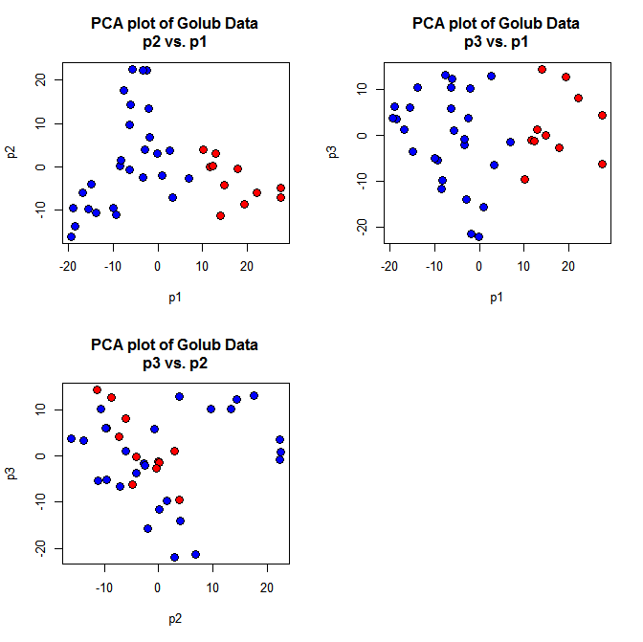
PCA example with AML/ALL data – loadings plot (first 3 components)

Slide 12
PCA example with AML/ALL data – loadings plot (first 2 components)
p1=Difference between AML/ALL

Slide 13
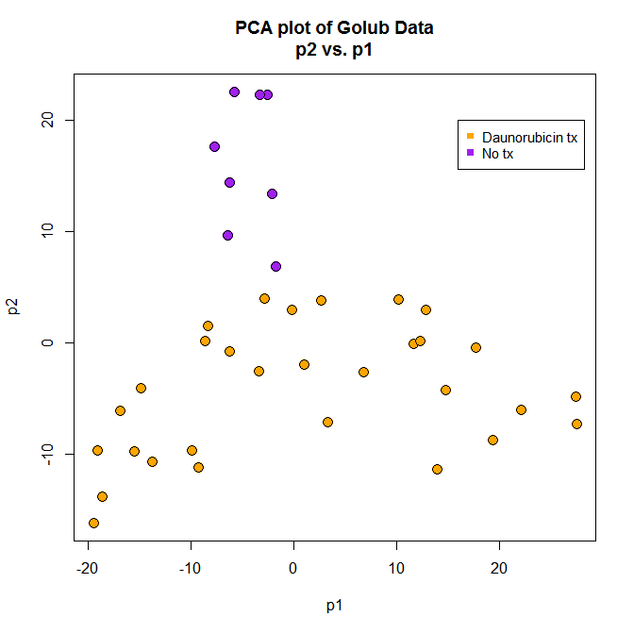
PCA example with AML/ALL data – loadings plot (first 2 components)
p2=Difference between chemo tx/no chemo tx

Slide 14
Partial least squares regression (PLS)
PLS is a multivariate regression method
Very generally, PLS, like PCA works to maximize the variability of a matrix by calculating linear combinations of the original variables
However, PCA maximizes this variability between the samples/genes, while PLS relates the data matrix, X to a response, Y
  X is this example is a matrix of genes by samples
  Y in this example is the expected continuous response or class membership

Slide 15
PLS general methodology
Regression model
  Y is the response and X is the predictor matrix
Factor score matrix is calculated by factor extraction
  W is a weight matrix
The new model is considered using T from above and Q as a loading vector of T
  Q is a loading matrix
Once Q is solved for, the coefficient vector, B is calculated
The predictor matrix, X, is multiplied by the coefficient vector, B, to get the expected response values
Y = XB + E
T = XW
Y = TQ + E
B = WQ
Y = XB + E

Slide 16
PLS (cont.)
Similar to PCA, in PLS the number of components to use in the model are also evaluated for variance explained
  Scree plot depicts the variance for each component
Also similar to PCA, the loading values can be viewed in 2 or 3 dimensional plots to see patterns in the data
Unlike PCA, however, the dimensionality reduction is conducted to maximize the predictor and response variables
  PCA does not evaluate a response (e.g. class membership or continuous value) in the dimension reduction
  PLS can be used for classification (coming in lecture #10)

Slide 17
Multidimensional scaling (MDS)
A method to “fit the original data into a low-dimensional coordinate system, such that any distortion caused by dimension reduction is minimized” ²
MDS attempts to use the distances or similarities between genes or samples in representing the proximities in few dimensions, while nearly matching the original distances or similarities
The measure used to determine how close the low dimensional space matches the high dimensional space is called the stress

Slide 18
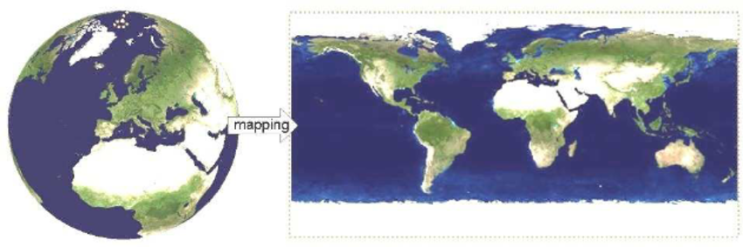
How to map distances from a 3D sphere to a 2D map?

Slide 19
MDS scaling methods
Nonmetric multidimensional scaling
  Determine the distance or similarity values between all pairs of genes/samples
  Arrange the N items in low-dimensional space using only the rank orders of the distances/similarities
Metric (classical) multidimensional scaling
  Determine the distance or similarity values between all pairs of genes/samples
  Arrange the N items in low-dimensional space using the actual magnitudes of the distances/similarities
  Also known as principal coordinate analysis

Slide 20
MDS stress calculation
For N gene/samples, calculate the M=N(N-1)/2 similarities between all pairs
Arrange the similarity values in ascending order
s_{i1k1} < s_{i2k2} < .. s_{iMkM}
“We want to determine a q-dimensional configuration of the N items, such that the distances, d_{ik}^{(q)} match the ordering” ²
To evaluate the degree of match between these, the stress is measured
  stress(q) = {∑ ∑ [ d_{ik}^{(q)} – d.hat_{ik}^{(q)} ]² / ∑ ∑ [d_{ik}^{(q)}]² }^{1/2}
  where d.hat_{ik}^{(q)} are numbers that match the similarity in the ordering
Kruskal recommends the following guidelines for stress values²
  stress Goodness of fit
  20% Poor
  10% Fair
  5% Good
  2.5% Excellent
  0% Perfect

Slide 21
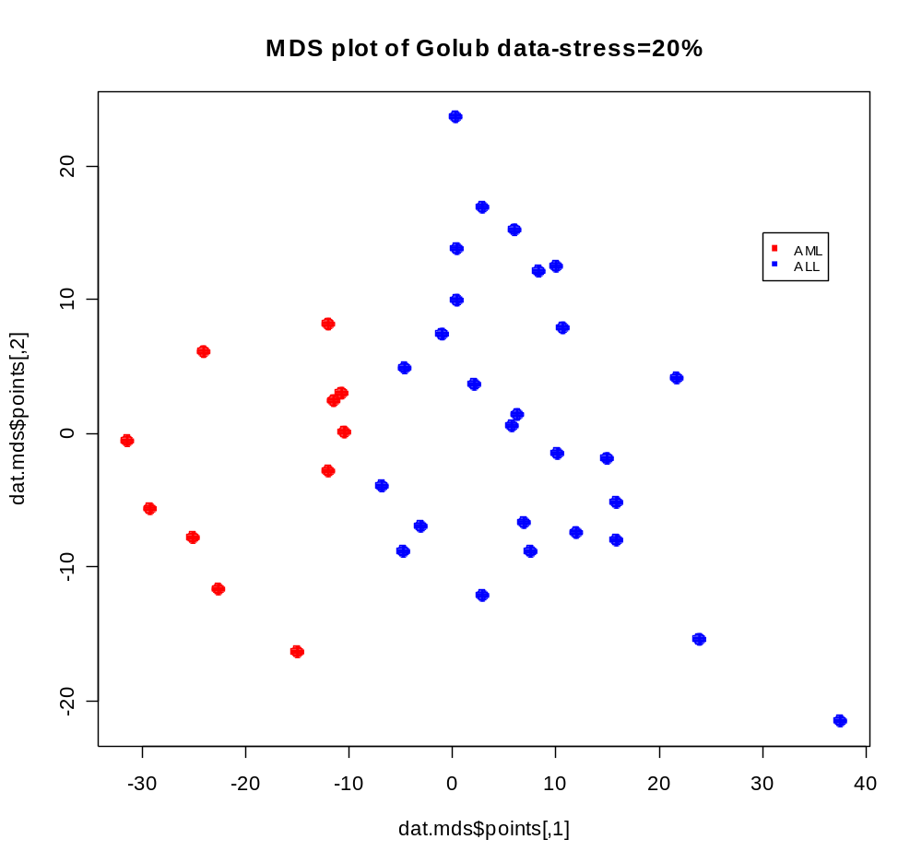
Nonmetric MDS plot

Slide 22
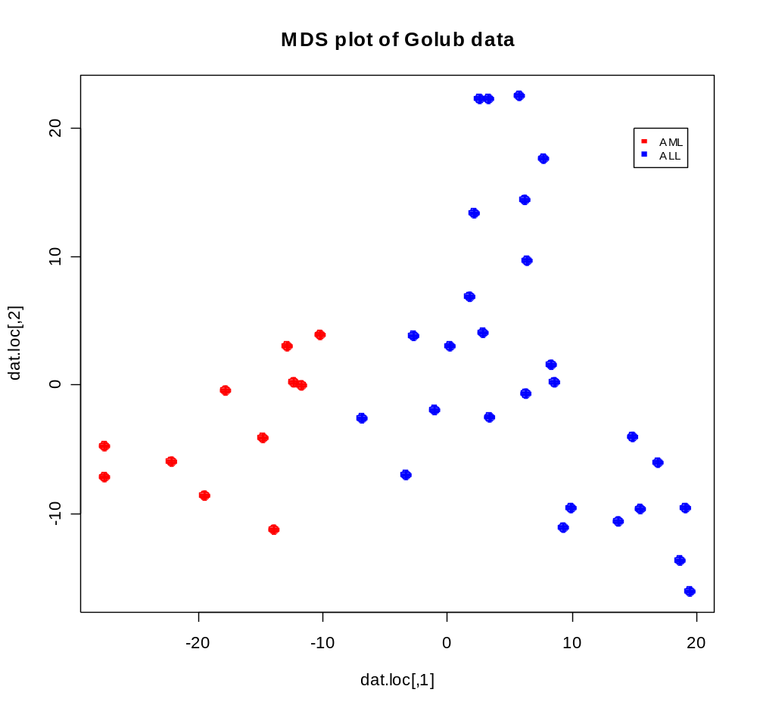
Metric MDS plot

Slide 23
Kernel PCA
Kernel PCA can be thought of a nonlinear transformation of PCA, where PCA is calculated on a feature space into which the data are mapped via a kernel function
In traditional PCA, the data are mapped into some vector space V, whereas kernel PCA considers a new feature space φ in the form [φ_{(xi)}, φ_{(xj)}]
The computations of kernel PCA are equivalent to traditional PCA but with the diagonalization of the positive semi-definite kernel (restricted to {x₁, x₂, ….x_{n}}) k(xi,xj)
This transformation from linear correlation to kernel space provides a nonlinear matrix, in which the definition of the primary direction in the data structure is modified; As a result, the definition of large distances is adjusted.
Kernels typically considered:
  Linear: k(x,y)=<x,y>
  Gaussian radial basis function: k(x,y)=e^{(-(||x-y|| ²)/(2ε²))}
  Polynomial: k(x,y)=(<x,y>+ ε1)^{ε2}
  Standardized polynomial: k(x,y)=(<x,y>/sqrt(<x,x><y,y>)+ε1)^{ε2}
  Inverse multi-quadratic: k(x,y)=1/sqrt(||x-y||²+ε1²)

Slide 24
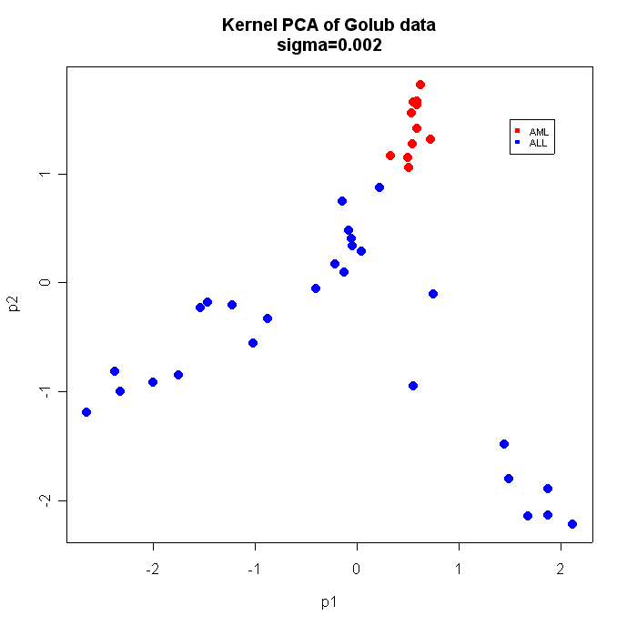
Kernel PCA plot

Slide 25
The weighted graph Laplacian
  First implemented as a edge detection method in image processing
  The weighted graph Laplacian is an operator on a weighted graph adjacency matrix
    Assume a graph G = (E,V) with edge weights E and vertices V
  Determines the subspace that best preserves local distances and minimizes large distances
    Does not calculate linear projections of the data (e.g. MDS & PCA)
  Distances are calculated between each pair of genes/samples
  A kernel is implemented to transform the distances to a predefined function (cells in adjacency matrix)
  The Laplacian decomposes the adjacency matrix

Slide 26

Laplacian of an image-used for edge detection
Original image
Laplacian filtered image

Slide 27
The Laplacian steps
  Given a set of points X = {x1, x2, ….xn} in ℜ^{q}, let G = (E,V) be a graph with edge weights E and vertices V
    Consistent with standard terminology from graph theory, we can construct a graph, where each pair of vertices (x_{i},x_{j} ∈ V(G)) is assigned a weight specific to the distance between them.
    These edge weights are represented as cells in the matrix A
  Then the adjacency matrix, K₁ is calculated from A by the kernel estimate K₁ = e ^{–(||xi – xj||² /ε)}
    where K₁ = K₁(G)
  The degree matrix D is a diagonal matrix calculated from the row sums of K₁ (D_{ii} = Σj K_{1ij})
  Then the normalized Laplacian is calculated as: L = D^{-1/2}*K₁*D^{-1/2}
  The eigenvectors are computed from the matrix L and placed as columns of matrix X. The rows of the matrix (X) are scaled to unit length into the matrix Y
    Y_{ij} = X_{ij} / (Σ_{j}X²_{ij})^{1/2}
  Utilizing the primary Φ columns of this Y matrix, the data can be embedded as points in ℜ^{Φ}
    Usually use first and second columns of matrix Y (Φ₁ and Φ₂)

Slide 28
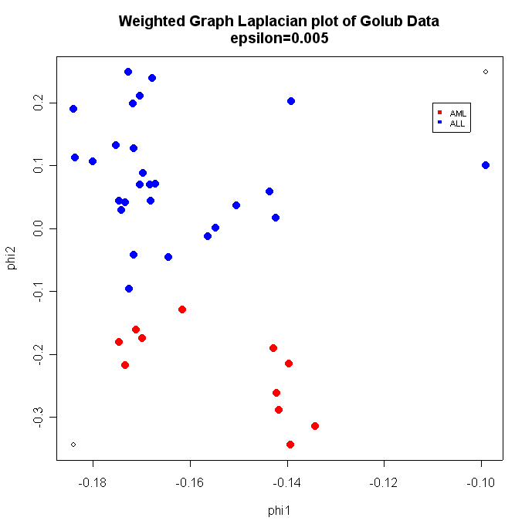
Weighted Graph Laplacian plot

Slide 29
Isometric feature mapping (ISOMAP)
  Isomap is a nonlinear mapping of distances between points
    Similar MDS, but assumes that data is not linear in structure
  Determined subspace that best preserves geodesic inter-point distances between genes/samples
    Geodesic distance: smallest distance between 2 points, where the path must use neighboring points
  Similarities or distances are calculated between each pair of genes/samples
  Points are connected using neighbor value (K) or radius (ε)
  New distance between points is calculated, based on path through neighboring points
  ISOMAP code is written in the kmethods package, but this is currently only available on the Linux/Unix OS

Slide 30
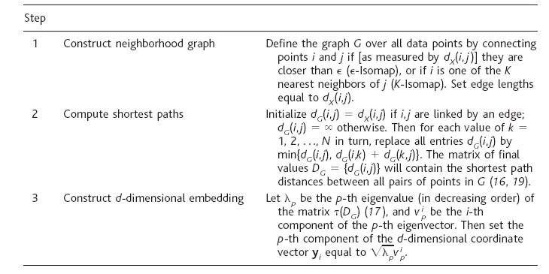
ISOMAP steps⁵

Slide 31
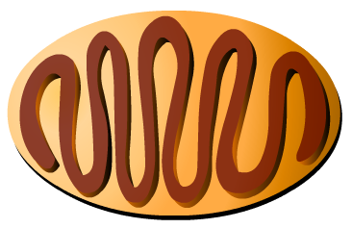
Nonlinear data example
A
B
The fastest path from A to B is along the yellow line, however, if the data is best explained by the coil structure, much of the information is lost
Instead of linear distance, use geodesic distance

Slide 32
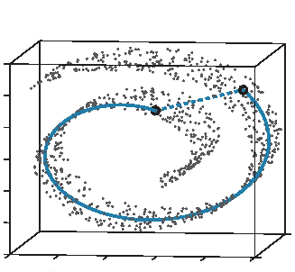
Nonlinear data-Swiss roll example
B
A
The Euclidean distance between the two points (dashed line) may not reflect the true distance inherent in the data⁵

Slide 33
Which method to use when?
The appropriate method of dimensionality entirely depends on the data structure analyzed
It can be argued that nonlinear data structures are best rendered into a lower dimensional space with nonlinear methods of dimensionality reduction
  Curved surfaces
  Wave patterns
  A nonlinear example follows on next few slides
Typically, the method that explains the most variance in fewest number of dimensions is ideal
  Can use a scree plot to determine this
Or alternatively, if classification or error patterns are known, the method that best preserves the known structure can be the most appropriate
  Must have prior information to assess this

Slide 34
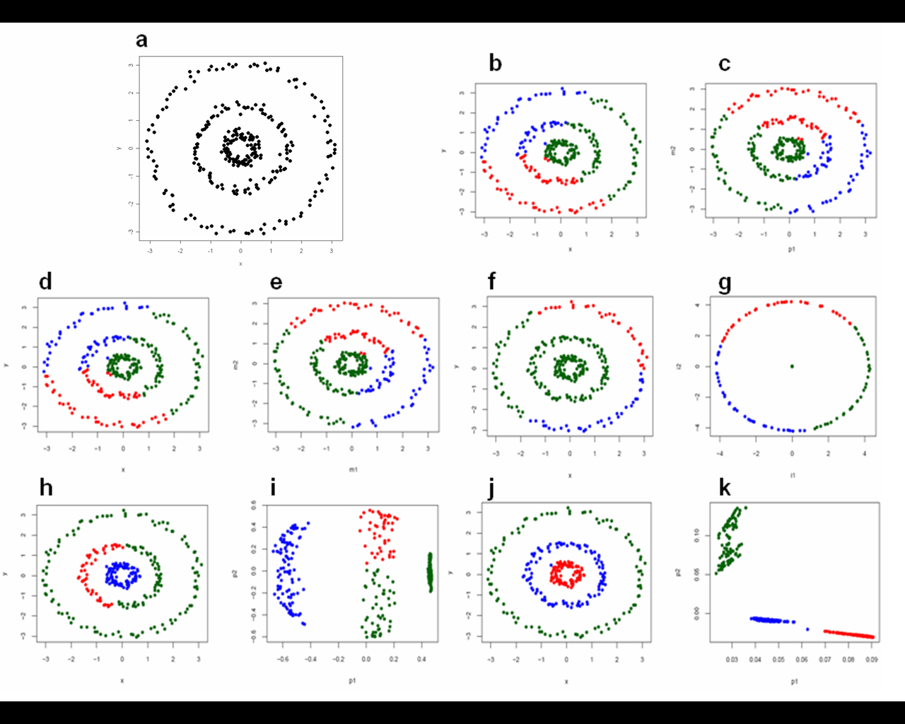
Example problem
The raw structure below is only represented in 2 dimensions so we can visualize the patterns
We want to group the 3 concentric circles into 3 groups (one for each circle)
We can use multiple methods of dimensionality reduction to essentially embed this into 2 dimensions and then cluster (k-means) on this subspace embedding
  Obviously we don’t gain a lot in reducing an original 2-dimensional structure into 2 dimensions, but this example helps to compare how each method will embed the data
  For k-means clustering, k=3; one for each circle

Slide 35
Example problem-embeddings
For each method, 2 plots are provided: the left plot is the raw data structure and the right plot is the embedding generated from the specific method of dimensionality reduction
Coloring is determined from the k-means classified on the embedding space
PCA and metric/classical MDS
ISOMAP
Both PCA and MDS perform the same, so only one coupled plot is represented for both methods. This linear method cannot separate the 3 circles appropriately.
ISOMAP embeds the structure into a big circle where k-means clustering attempts to partition the space into 3 groups. This method is also unsuccessful.
Kernel PCA (Gaussian)
Spectral (Laplacian)
Kernel PCA almost partitions all 3 circles in the embedding, but k-means clustering does not classify them appropriately.
The spectral method (Laplacian) embeds the circles the best allowing k-means clustering to classify them appropriately

Slide 36
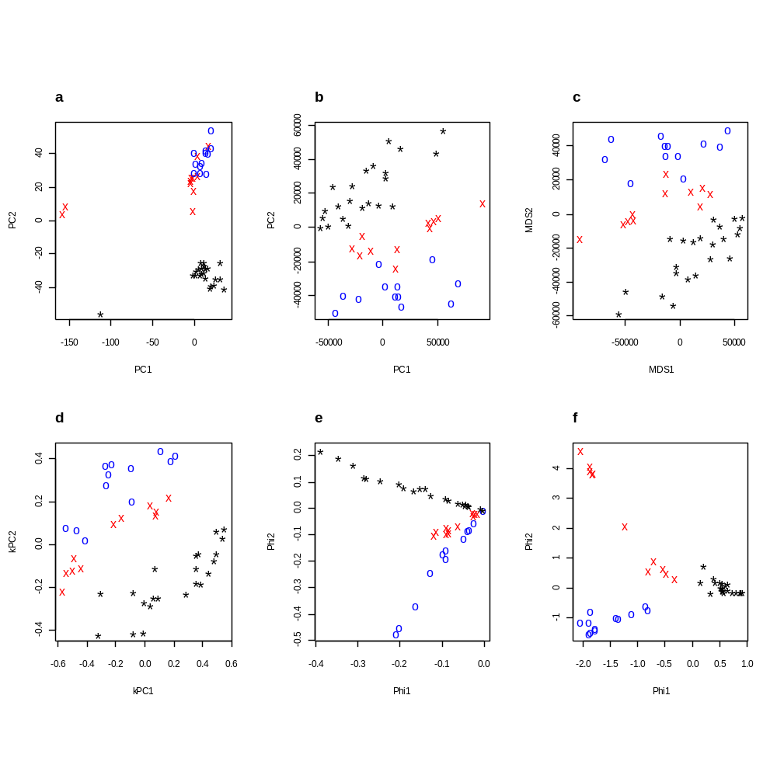
Comparison between embedding using different methods of dimensionality reduction (fibroblast dataset)⁶
Raw data structure is in ~12,000 dimensional space
Each symbol/color represents a separate species
This dataset is available in R-Bioconductor (fibroEsets)
PCA-correlation
PCA-covariance
Nonmetric MDS
Kernel PCA
Laplacian (Ng et al.)
Laplacian (Lafon)

Slide 37
References
¹Multivariate Data Analysis. Hair, Anderson, Tatham, and Black.
²Applied Multivariate Statistical Analysis. Johnson and Wichern.
³Raychaudhuri S, Stuart J, Altman R. Principal components analysis to summarize microarray experiments: application to sporulation time series.
⁴Johansson D, Lindgren P, and Berglund A. (2003) A multivariate approach to microarray data for identification of genes with cell cycle- coupled transcription. Bioinformatics. 19:467-473.
⁵Tenenbaum J, Silva V, and Langford J. (2000) A Global Geometric Framework for Nonlinear Dimensionality Reduction. Science. 290: 2319-2323.
⁶Higgs BW, Weller J, Solka JL. (2006) Spectral embedding finds meaningful (relevant) structure in image and microarray data. BMC Bioinformatics. 7:74.

Slide 38
R Code
# scatter plot matrix with Golub data
library(multtest)
data(golub);
dat <- golub[1:100,]
ann.dat2 <- golub.cl # class labels ALL=0; AML=1
pairs(t(dat[1:6,]), pch=21,bg = c("red", "blue")[as.factor(ann.dat2)],main=“Golub data-first 6 genes”)
# PCA plot #1 with Golub data
dat <- golub
dat.pca <- prcomp(t(dat),cor=F)
# plot all 3 components in 3 plots
dat.loadings <- dat.pca$x[,1:3]
par(mfrow=c(2,2))
plot(range(dat.loadings[,1]),range(dat.loadings[,2]),type="n",xlab='p1',ylab='p2',main='PCA plot of Golub Data\np2 vs. p1')
points(dat.loadings[,1][ann.dat2==1], dat.loadings[,2][ann.dat2==1],col=1,bg='red',pch=21,cex=1.5)
points(dat.loadings[,1][ann.dat2==0], dat.loadings[,2][ann.dat2==0],col=1,bg='blue',pch=21,cex=1.5)
plot(range(dat.loadings[,1]),range(dat.loadings[,3]),type="n",xlab='p1',ylab='p3',main='PCA plot of Golub Data\np3 vs. p1')
points(dat.loadings[,1][ann.dat2==1],dat.loadings[,3][ann.dat2==1],col=1,bg='red',pch=21,cex=1.5)
points(dat.loadings[,1][ann.dat2==0], dat.loadings[,3][ann.dat2==0],col=1,bg='blue',pch=21,cex=1.5)
plot(range(dat.loadings[,2]),range(dat.loadings[,3]),xlab='p2',type="n",ylab='p3',main='PCA plot of Golub Data\np3 vs. p2')
points(dat.loadings[,2][ann.dat2==1],dat.loadings[,3][ann.dat2==1],col=1,bg='red',pch=21,cex=1.5)
points(dat.loadings[,2][ann.dat2==0], dat.loadings[,3][ann.dat2==0],col=1,bg='blue',pch=21,cex=1.5)
# Scree plot of Golub data
dat.pca.var <- round(dat.pca$sdev^2 / sum(dat.pca$sdev^2)*100,2)
plot(c(1:length(dat.pca.var)),dat.pca.var,type="b",xlab="# components",ylab="% variance",pch=21,col=1,bg=3,cex=1.5)
title("Scree plot showing % variability explained by each eigenvalue\nAML/ALL dataset")

Slide 39
R Code
# only retain 2 components
plot(range(dat.loadings[,1]),range(dat.loadings[,2]),type="n",xlab='p1',ylab='p2',main='PCA plot of Golub Data\np2 vs. p1')
points(dat.loadings[,1][ann.dat2==1], dat.loadings[,2][ann.dat2==1],col=1,bg='red',pch=21,cex=1.5)
points(dat.loadings[,1][ann.dat2==0], dat.loadings[,2][ann.dat2==0],col=1,bg='blue',pch=21,cex=1.5)
legend(20,20,c("AML","ALL"),col=c("red","blue"),pch=15,cex=.9,horiz=F)
plot(range(dat.loadings[,1]),range(dat.loadings[,2]),type="n",xlab='p1',ylab='p2',main='PCA plot of Golub Data\np2 vs. p1')
points(dat.loadings[,1][dat.loadings[,2]>5], dat.loadings[,2][dat.loadings[,2]>5],col=1,bg='purple',pch=21,cex=1.5)
points(dat.loadings[,1][dat.loadings[,2]<=5], dat.loadings[,2][dat.loadings[,2]<=5],col=1,bg='orange',pch=21,cex=1.5)
legend(16,20,c("Daunorubicin tx","No tx"),col=c("orange","purple"),pch=15,cex=.9,horiz=F)
# PLS classifier code
library(gpls);
x <- matrix(rnorm(20),ncol=2)
y <- sample(0:1,10,TRUE)
x1 <- matrix(rnorm(10),ncol=2)
y1 <- sample(0:1,5,TRUE)
## no bias reduction
glpls1a.train.test.error(x,y,x1,y1,br=FALSE)
# weights for each gene is contribution to the response
glpls1a(x,y,br=TRUE)$coefficients[-1]

Slide 40
R Code
# Kruskal’s non-metric MDS on samples
library(MASS); library(multtest);
data(golub);
ann.dat2 <- golub.cl # class labels ALL=0; AML=1
dat <- golub
dat.dist <- dist(t(dat))
dat.mds <- isoMDS(dat.dist)
plot(dat.mds$points, type = "n")
points(dat.mds$points[,1][ann.dat2==1], dat.mds$points[,2][ann.dat2==1],col=‘red’,pch=16,cex=1.5)
points(dat.mds$points[,1][ann.dat2==0], dat.mds$points[,2][ann.dat2==0],col=‘blue’,pch=16,cex=1.5)
title(main=“MDS plot of Golub data-stress=20%”)
legend(30,15,c(“AML”,”ALL”),col=c(‘red’,’blue’),pch=15,cex=.7,horiz=F)
# classical metric MDS on samples (no stress value provided)
dat.loc <- cmdscale(dat.dist)
plot(dat.loc, type = "n")
points(dat.loc[,1][ann.dat2==1], dat.loc[,2][ann.dat2==1],col=‘red’,pch=16,cex=1.5)
points(dat.loc[,1][ann.dat2==0], dat.loc[,2][ann.dat2==0],col=‘blue’,pch=16,cex=1.5)
title(main=“MDS plot of Golub data”)
legend(15,20,c(“AML”,”ALL”),col=c(‘red’,’blue’),pch=15,cex=.7,horiz=F)

Slide 41
R Code
# The weighted graph Laplacian
k.speClust2 <- function (X, qnt=NULL) {
dist2full <- function(dis) {
n <- attr(dis, "Size")
full <- matrix(0, n, n)
full[lower.tri(full)] <- dis
full + t(full)
}
dat.dis <- dist(t(X),"euc")^2
if(!is.null(qnt)) {eps <- as.numeric(quantile(dat.dis,qnt))}
if(is.null(qnt)) {eps <- min(dat.dis[dat.dis!=0])}
kernal <- exp(-1 * dat.dis/(eps))
K1 <- dist2full(kernal)
diag(K1) <- 0
D = matrix(0,ncol=ncol(K1),nrow=ncol(K1))
tmpe <- apply(K1,1,sum)
tmpe[tmpe>0] <- 1/sqrt(tmpe[tmpe>0])
tmpe[tmpe<0] <- 0
diag(D) <- tmpe
L <- D%*% K1 %*% D
X <- svd(L)$u
Y <- X / sqrt(apply(X^2,1,sum))
}
phi <- k.speClust2(dat,qnt=0.005)
plot(range(phi[,1]),range(phi[,2]),xlab="phi1",ylab="phi2",main="Weighted Graph Laplacian plot of Golub Data\nepsilon=0.005")
points(phi[,1][ann.dat2==1],phi[,2][ann.dat2==1],col="red",pch=16,cex=1.5)
points(phi[,1][ann.dat2==0],phi[,2][ann.dat2==0],col="blue",pch=16,cex=1.5)
legend(-.11,.2,c("AML", "ALL"),col=c("red", "blue"),pch=15,cex=.7,horiz=F)

Slide 42
R Code
# Kernel PCA
library(kernlab)
# calculate PCA for first 2 PCs
dat.kpca <- kpca(t(dat),kernel="rbfdot", kpar=list(sigma=0.002),features=2)
# PCA plot
ann.dat2[ann.dat2==0] <- "blue"
ann.dat2[ann.dat2==1] <- "red"
plot(rotated(dat.kpca),col=ann.dat2,xlab="p1",ylab="p2",pch=16,cex=1.5,main="Kernel PCA of Golub data\nsigma=0.002")
legend(1.5,1.5,c("AML", "ALL"),col=c("red", "blue"),pch=15,cex=.7,horiz=F)

