Slide 1
Lecture #9
Cluster Analysis

Slide 2
What is clustering
Clustering is an unsupervised analysis technique used to group similar objects (genes or samples) together
Builds structure to help explain the relationships that may exist between the objects
  Dendrogram

Slide 3
Applications of clustering
Like many techniques in transcriptome analysis, clustering is not a new approach for identifying patterns in data
Clustering has been utilized in multiple applications
  Phylogenetics (taxonomy)
  Sociology (demographics)
  Linguistics (word usage)
  Business (money market)

Slide 4
Some clustering methods
There are multiple types of clustering methods
  Hierarchical (HCA)
  k-means
  Self-organizing maps (SOM)
  Clique partitioning

Slide 5
Some clustering methods
There are multiple types of clustering methods
  Hierarchical (HCA)
  k-means
  Self-organizing maps (SOM)
  Clique partitioning

Slide 6
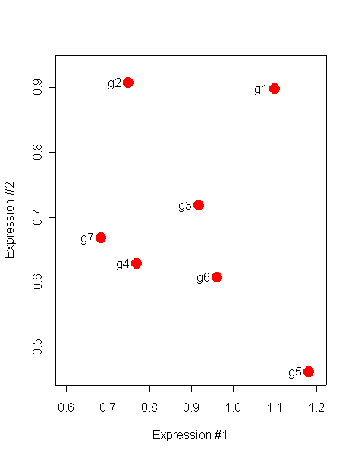
HCA Clustering Procedure (genes)
1.) Each gene begins as its own cluster
2.) Look for “closest” pair of clusters
3.) Merge them into their own cluster
4.) Evaluate all distances from this new cluster and the remaining clusters

Slide 7
HCA Clustering Procedure (genes)
1.) Each gene begins as its own cluster
2.) Look for “closest” pair of clusters
3.) Merge them into their own cluster
4.) Evaluate all distances from this new cluster and the remaining clusters
5.) Repeat until no clusters remain

Slide 8
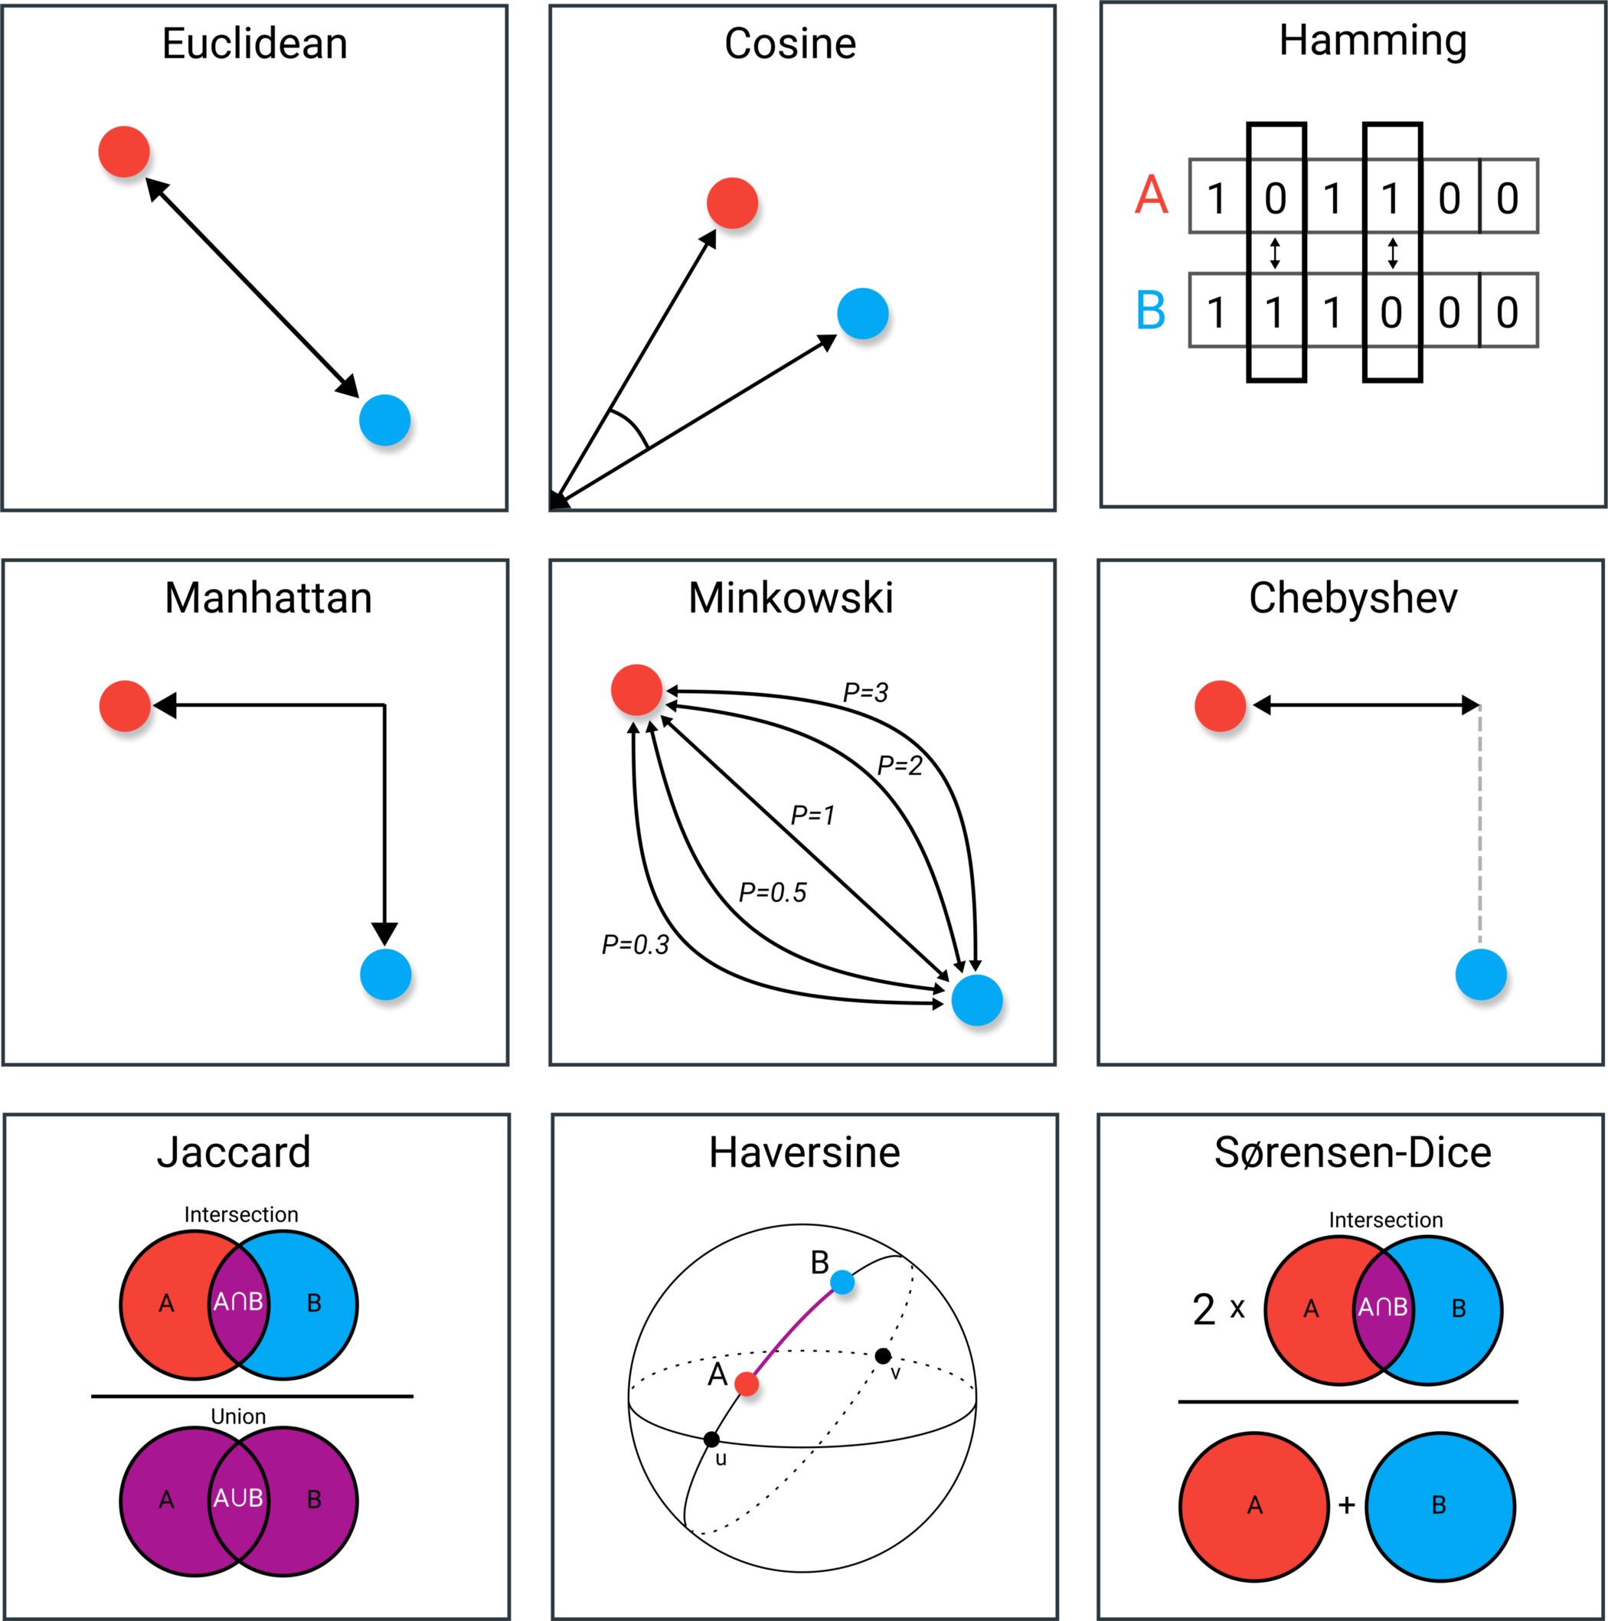
Distances and Similarities
The choice of distant or similarity metric can determine what we decide to be the closest, or most ‘like’ genes
https://towardsdatascience.com/9-distance-measures-in-data-science-918109d069fa

Slide 9
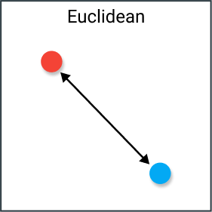
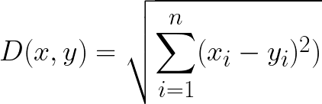
Euclidean Distance
Length of a segment connecting two points
Distance is calculated from the cartesian coordinates of the points using the Pythagorean theorem
Disadvantages:
  Typically need to normalize the data before using this distance measure
  Works well with low-dimensional data and the magnitude of the vectors is important to be measured
https://towardsdatascience.com/9-distance-measures-in-data-science-918109d069fa

Slide 10
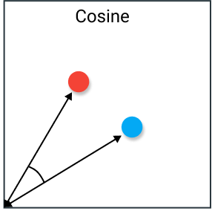

Cosine similarity
The cosine of the angle between two vectors
If vectors x and y are centered (i.e. have zero means), this is identical to Pearson’s correlation
Disadvantages:
  Magnitude of vectors is not taken into account, only their direction
  Perceived high correlations can be driven by extreme data values
https://towardsdatascience.com/9-distance-measures-in-data-science-918109d069fa

Slide 11
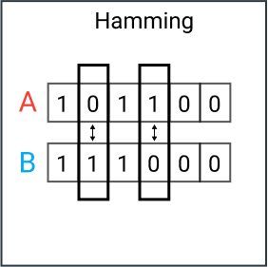
Hamming distance
A binary distance calculation
The number of values that are different between two vectors
Disadvantages:
  Does not take the actual value, just binary
https://towardsdatascience.com/9-distance-measures-in-data-science-918109d069fa

Slide 12
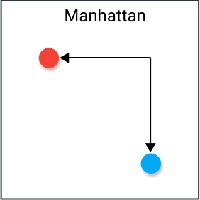
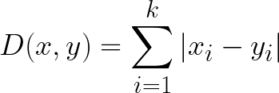
Manhattan distance
Also called city block distance: the distance between real-valued vectors
Distance between two vectors if one could only move right angles (i.e. no diagonal movements)
Disadvantages:
  More likely to give a higher distance value than Euclidean distance since it does not compute the shortest path possible
https://towardsdatascience.com/9-distance-measures-in-data-science-918109d069fa

Slide 13
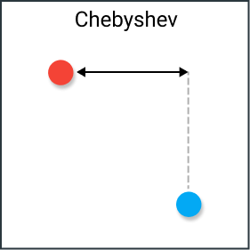

Chebyshev distance
The greatest of difference between two vectors along any coordinate dimension (i.e.maximum distance along one axis)
Also known as Chessboard distance
Distance between two vectors if one could only move right angles (i.e. no diagonal movements)
Disadvantages:
  Typically used in very specific use-cases, since movements are restricted to one square at-a-time
https://towardsdatascience.com/9-distance-measures-in-data-science-918109d069fa

Slide 14
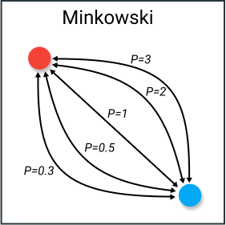
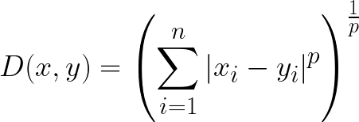
Minkowski distance
A metric used in normed vector space
This distance uses a parameter, p:
  p=1 — Manhattan distance
  p=2 — Euclidean distance
  p=∞ — Chebyshev distance
Disadvantages:
  Fitting the p parameter can be troublesome
https://towardsdatascience.com/9-distance-measures-in-data-science-918109d069fa

Slide 15
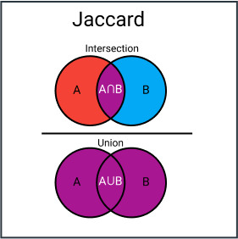

Jaccard index
Intersection over Union: he similarity and diversity of sample sets
The total number of similar entities between sets divided by the total number of entities
Disadvantages:
  Highly influenced by the size of the data
  Large datasets can have big impact on the index, as it could significantly increase the union while keeping the intersection similar
  Typically restricted to binary data
https://towardsdatascience.com/9-distance-measures-in-data-science-918109d069fa

Slide 16
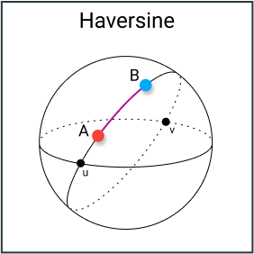
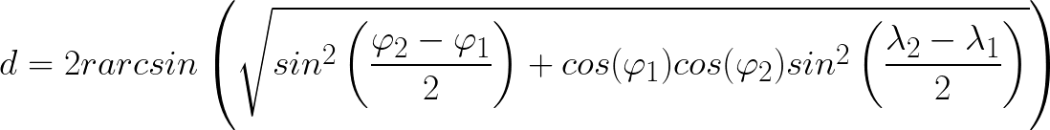
Haversine distance
Distance between two points on a sphere given their longitudes and latitudes
Similar to Euclidean distance in that it calculates the shortest line between two points, however no straight line is possible since the assumption here is that the two points are on a sphere
Disadvantages:
  It is assumed the points lie on a sphere
https://towardsdatascience.com/9-distance-measures-in-data-science-918109d069fa

Slide 17
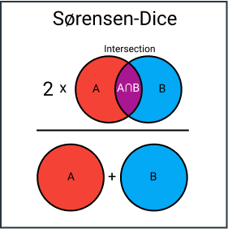

Sørensen-Dice Index
Similar to Jaccard index in that it measures the similarity and diversity of sample sets
Sørensen-Dice index is a bit more intuitive because it can be seen as the percentage of overlap between two sets
Disadvantages:
  Similar issues as Jaccard index
https://towardsdatascience.com/9-distance-measures-in-data-science-918109d069fa

Slide 18
Grouping metrics
The choice of grouping method can alter the cluster membership of the genes as they are partitioned
  Average linkage (UPGMA)
  Single linkage (nearest neighbor)
  Complete linkage (furthest neighbor)
  Ward’s method

Slide 19
Average Linkage
Calculate the distance between each point (gene) in a cluster and all other points (genes) in another cluster.
d₃
The two clusters with the lowest average distance are joined together to form the new cluster.
d₂
d₁

Slide 20
Average Linkage
Two clusters are grouped to form new cluster

Slide 21
Single Linkage
Calculate the distance between each point (gene) in a cluster and all other points (genes) in another cluster.
d₃
The two clusters with members having the least dissimilarity are joined together (nearest neighbors).
  d_{j} = min (p_{i} - p_{k})
d₂
d₁

Slide 22
Single Linkage
Two clusters are grouped to form new cluster

Slide 23
Complete Linkage
Calculate the distance between each point (gene) in a cluster and all other points (genes) in another cluster.
d₃
The two clusters with members having the maximum dissimilarity are joined together (furthest neighbors).
  d_{j} = max (p_{i} - p_{k})
d₂
d₁

Slide 24
Complete Linkage
Two clusters are grouped to form new cluster

Slide 25
Ward’s Method
Determine mean of each cluster from average linkage
Calculate total sum of squared deviations from the mean of each cluster
e₃
e₂
e₁
The two clusters with the smallest increase in error sum of squares are joined together
  e_{j} = ∑ (p_{µ} - p_{i})²

Slide 26
Ward’s Method
Two clusters are grouped to form new cluster

Slide 27
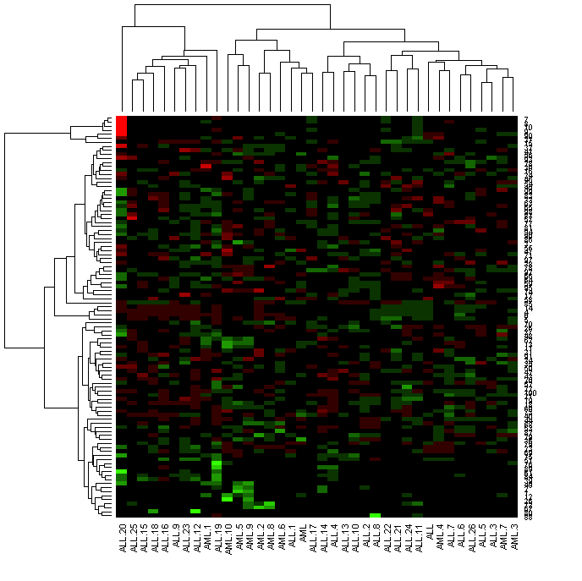
Dendrogram Example

Slide 28
HCA pros and cons
Advantages
  Provides an informative display of ordered objects
  Sub-clusters may provide to be useful in discovery
  Relatively simple to implement
Disadvantages
  Early groupings are nested in later result groupings
  Grouping metrics can provide inconsistent results
  Tree structure is dynamic (i.e. not model-based)

Slide 29
Some clustering methods
There are multiple types of clustering methods
  Hierarchical (HCA)
  k-means
  Self-organizing maps (SOM)
  Clique partitioning

Slide 30
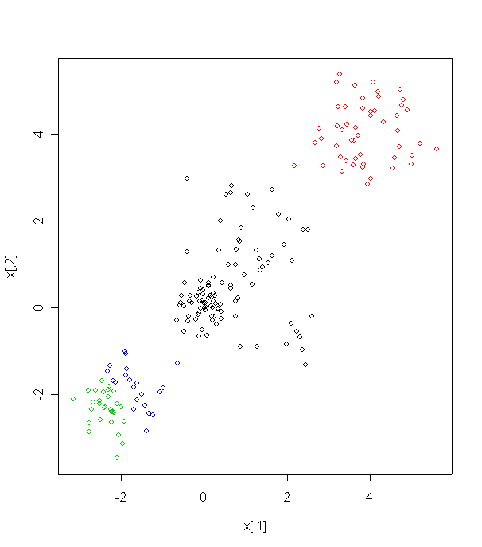
k-means procedure
Start with a user-defined number of clusters (k-value)

Slide 31
k-means procedure
Start with a user-defined number of clusters (k-value)
k points are projected into space to estimate the center of k separate clusters
*
*
*
*

Slide 32
k-means procedure
Start with a user-defined number of clusters (k-value)
k points are projected into space to estimate the center of k separate clusters
The distances from each point to all k clusters are calculated to determine which points are closest to which cluster centers
*
*
*
*

Slide 33
k-means procedure
Start with a user-defined number of clusters (k-value)
k points are projected into space to estimate the center of k separate clusters
The distances from each point to all k clusters are calculated to determine which points are closest to which cluster centers
The n-dimensional space is then partitioned into k regions of points
*
*
*
*

Slide 34
k-means procedure
Start with a user-defined number of clusters (k-value)
k points are projected into space to estimate the center of k separate clusters
The distances from each point to all k clusters are calculated to determine which points are closest to which cluster centers
The n-dimensional space is then partitioned into k regions of points
The k cluster centers are adjusted to where the middle point (centroid) of the partitioned space is located
*
*
*
*

Slide 35
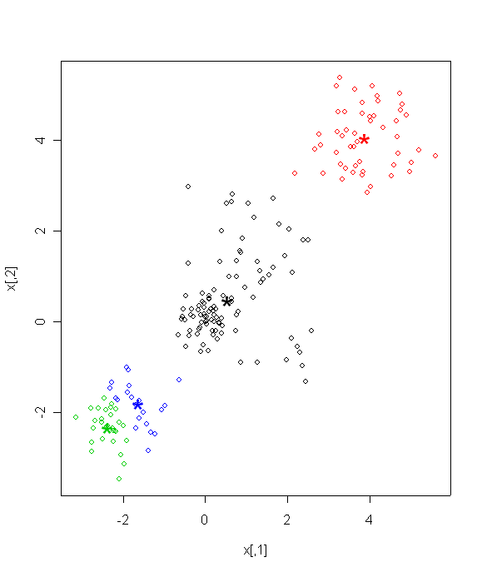
k-means procedure
Start with a user-defined number of clusters (k-value)
k points are projected into space to estimate the center of k separate clusters
The distances from each point to all k clusters are calculated to determine which points are closest to which cluster centers
The n-dimensional space is then partitioned into k regions of points
The k cluster centers are adjusted to where the middle point (centroid) of the partitioned space is located
This process is repeated n iterations or until convergence has occurred

Slide 36
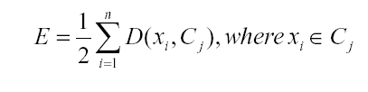
k-means clustering termination
When does the algorithm terminate?
  Minimization of distortion
  and where x_{i} is the ith point and C_{j} is the jth cluster center

Slide 37
k-means pros and cons
Advantages
  Good discovery tool
  Can alleviate fuzzy partitioning of genes/samples
    Specify k and algorithm will return k clusters
Disadvantages
  What is the appropriate number of clusters when the data structure is unknown?
  Number of iterations necessary for convergence can be computationally expensive
  The convergence criteria for k-means may only provide a local optima
  Starting point may alter termination points
  Robustness in distance algorithms (similar to HCA)

Slide 38
Some clustering methods
There are multiple types of clustering methods
  Hierarchical (HCA)
  k-means
  Self-organizing maps (SOM)
  Clique partitioning

Slide 39
SOMs
Self-organizing maps are an iterative fitting algorithm similar to k-means
The grid shape and size are the parameters that are user defined
  Similar to the k clusters from k-means
  Hexagonal, rectangular, etc.
  Dimensions (e.g. 3x4)

Slide 40
SOM procedure³
A initial grid type of n x m dimensions is specified

Slide 41
SOM procedure³
The cells in the grid are identified as nodes and each node is initialized with some random weight (vector of weights)
w₁
w₂
w₃
w₄
w₅
w₆
w₇
w₈
w₉
w₁₀
w₁₁
w₁₂
w₁₃
w₁₄
w₁₅
w₁₆
w₁₇
w₁₈
w₁₉
w₂₀

Slide 42
SOM procedure³
A vector is chosen at random and compared to the grid nodes to determine which weight is the most similar to the input vector
  Distance (such as Euclidean) is calculated between the input vector and all other node vectors
  The most similar node is referred as the best matching node (BMU)
w₁
w₂
w₃
w₄
w₅
w₆
w₇
w₈
v₁
w₉
w₁₀
w₁₁
w₁₂
w₁₃
w₁₄
w₁₅
w₁₆
w₁₇
w₁₈
w₁₉
w₂₀

Slide 43
SOM procedure³
All neighboring weights around the BMU node (and the BMU node) are adjusted according to similarity to the input vector
  Radius gets smaller and smaller each iteration by a decay function
w₁
w₂
w₃
w₄
w₅
w₆
w₇
w₈
w₉
w₁₀
w₁₁
w₁₂
w₁₃
w₁₄
w₁₅
w₁₆
w₁₇
w₁₈
w₁₉
w₂₀

Slide 44
SOM procedure³
This process is repeated N times, where N is genes
w₁
w₂
w₃
w₄
w₅
w'₆
w’₇
w'₈
v₂
w₉
w'₁₀
w’₁₁
w'₁₂
w₁₃
w'₁₄
w'₁₅
w'₁₆
w₁₇
w₁₈
w₁₉
w₂₀

Slide 45
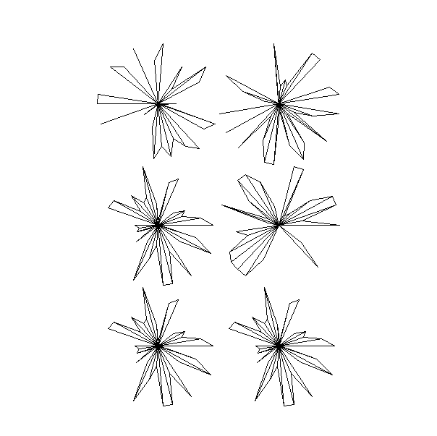
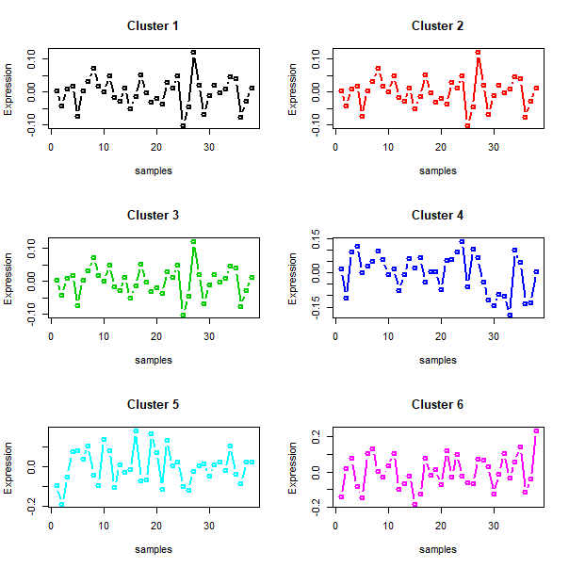
SOM example
Golub data with 3x2 rectangular grid
Produces 6 representative gene profiles
Radar plot
Gene profile plot

Slide 46
SOMs pros and cons
Advantages
  Good discovery tool
Disadvantages
  Can be computationally expensive
  Much of the partitioning is dependent upon the grid design

Slide 47
Some clustering methods
There are multiple types of clustering methods
  Hierarchical (HCA)
  k-means
  Self-organizing maps (SOM)
  Clique partitioning

Slide 48
Clique Partitioning
Method is based on linear programming
  Integer programming is explained here
Useful tool for building gene-to-gene interactions
  Network models
Gene interactions are estimated by maximizing a function consisting of weighted interactions, subject to various constraint parameters
  Weighted interactions are scores given to pair-wise gene-to-gene comparisons (e.g. covariance, correlation, distance measure, etc.)
Optimization function and constraint equations are decomposed as a matrix to solve for the pair-wise interactions

Slide 49
Clique Partitioning – triangle constraint inequalities
3
3
3
3
4
2
2
4
4
2
4
2
1
1
1
1
Maximization function =
  ∑wijxij = w₁₂x₁₂ + w₁₃x₁₃ + w₁₄x₁₄ + w₂₃x₂₃ + w₂₄x₂₄ + w₃₄x₃₄
  w = weighting
  x = edge connecting nodes
  i,j = nodes being connected
Triangular constraints implemented for first triangle:
w₁₂x₁₂ + w₁₃x₁₃ + w₁₄x₁₄ + w₂₃x₂₃ + w₂₄x₂₄ + w₃₄x₃₄
x₁₂ + x₁₃ + 0 - x₂₃ + 0 + 0 + y₁ = 1
x₁₂ - x₁₃ + 0 + x₂₃ + 0 + 0 + y₂ = 1
-x₁₂ + x₁₃ + 0 + x₂₃ + 0 + 0 + y₃ = 1
  y variables are “slack” variables and allow equalities to be made for the constraints rather than inequalities
One set of three constraint equations exists for each triangle

Slide 50
Clique Partitioning – Simplex method
Once we have a matrix consisting of constraints and an optimization function, we decompose the matrix to maximize the function using the Simplex method
Simplex decomposition methodology
  Find most negative value within matrix and set as pivot column.
  Find the maximum ratio of edge variable, xi, to pivot column variable.
  Decompose by Gaussian-Jordan elimination for the appropriate pivot column until a single value of 1 is retained for the pivot row/column
  Repeat steps 1-3 until maximization function weights are all non-negative.
Assess matrix for solution vector
  0 = No association between two genes
  1 = Association between two genes

Slide 51
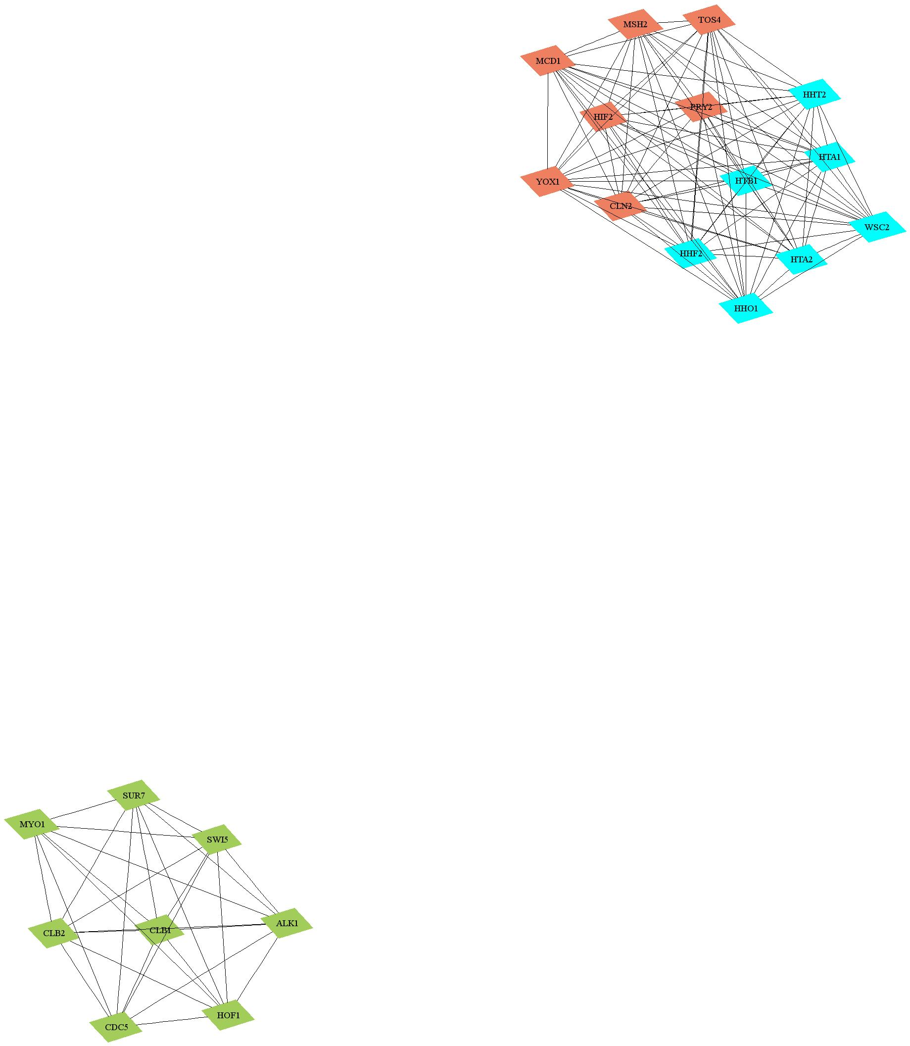
Clique Partitioning – Network visual (using select genes from Spellman et al. data set)
S-phase
M-phase
G1-phase

Slide 52
Clique Partitioning pros and cons
Advantages
  Good discovery tool
  Constraints can be modified to expect more than 3 gene interactions
  Gives a discrete binary result to interaction
Disadvantages
  Can be very computationally expensive for many genes
  Only binary solutions are predicted
    No continuous measure of association
    Connection or no connection

Slide 53
References
1) Alizadeh A, et. al. (2000) Distinct types of diffuse large B-cell lymphoma identified by gene expression profiling. Nature. 403, 503-511.
2) Datta S and Datta S. (2003) Comparison and validation of statistical clustering techniques for microarray gene expression data. Bioinformatics. 19, 459-466.
3) SOM tutorial
  http://www.ai-junkie.com/som1.html
4) Grootendorst M. 9 Distance Measures in Data Science: The advantages and pitfalls of common distance measures

Slide 54
R Code
# Load Golub et al. data
library(multtest)
data(golub);
dat <- golub
dat <- as.data.frame(dat)
ann.dat2 <- golub.cl # class labels ALL=0; AML=1
ann <- factor(c(rep(“ALL”,27),rep(“AML”,11)))
# HCA heat map of top 100 genes
# adjust colors for heat map
dat <- dat[1:100,] # only use top 100 genes for computational speed
hm.rg <- c("#FF0000","#CC0000","#990000","#660000","#330000","#000000","#000000","#0A3300","#146600","#1F9900","#29CC00","#33FF00")
names(dat) <- ann
heatmap(as.matrix(dat),col=hm.rg)
# kmeans clustering with random data
library(mva)
x <- rbind(matrix(rnorm(100, sd = 0.3),ncol=2),matrix(rnorm(100, mean = 1, sd = 0.9),ncol=2),matrix( rnorm(100, mean = 4, sd = 0.75),ncol=2),matrix(rnorm(100, mean = -2, sd = 0.5), ncol = 2))
cl <- kmeans(x, centers=4, iter.max=20)
plot(x, col = cl$cluster,cex=1)
points(cl$centers, col = 1:4, pch = “*”,cex=2.5)
# som clustering on Golub et al. samples
library(class)
dat <- t(scale(t(dat))) # scale data genes
colnames(dat) <- ann
gr <- somgrid(xdim=2,ydim=3,topo = "rectangular") # specify grid type and dimensions
dat.som <- SOM(dat,gr)

Slide 55
R Code
# plot representative patterns
# radar plot profiles where each spoke length indicates an AML/ALL sample
plot(dat.som)
# gene profiles
par(mfrow=c(3,2))
for(i in 1:6) {
plot(dat.som$codes[i,],type="b",xlab="samples",ylab="Expression",main=paste("Cluster",i),col=i,lwd=2)
}

