Slide 1
Lecture #10
Classification

Slide 2
Outline
Purpose of classification
General terminology
Methods
  Discriminant analysis (DA)
  Support vector machines (SVM)
  Classification and regression trees (CART)
  Partial least squares regression (PLS)
  k-nearest neighbors (KNN)
  Artificial neural networks (NN)
ROC curves
Validating results

Slide 3
Purpose for Classification
Classification analysis is used in all applications of genomics analysis
The utility in identifying which population a particular observation came from has great power in multiple research domains of gene expression
  Predicting patient response or survival (clinical outcome)
  Identifying unknown pathogens (Biosurveillance)
  Predict patient disease course (patient prognosis)
  Matching unidentified tissues/cells (QC)
  Modeling compound pharmacology or toxicity (toxicogenomics/pharmacogenomics)

Slide 4
Multiple classification methods
There are multiple methods to classify genes or samples, however, we will only focus on a few of the more common methods
  Discriminant analysis (DA)
  Support vector machines (SVM)
  Classification and regression trees (CART)
  Partial least squares regression (PLS)
  K-nearest neighbors (KNN)
  Artificial neural networks (ANN)
You will find that many of these methods share some mathematical components in each algorithm

Slide 5
Modeling terminology
Training set
  The data used to build the model
  Observations and features that the model has used to optimize the parameters for performance
Test set
  The data that the model has not been exposed to for training or ‘tuning’ parameters
  Also called ‘hold-out’ set
Parameters
  The variables that go into the modeling method
  Can be optimized and fit in the model training process
Over-fitting
  Optimizing the model to makes it too specific for a particular data example; not generalized to perform well across multiple disparate examples

Slide 6
Discriminant analysis
A multivariate technique concerned with separating distinct groups into different classes and allocating new observations to the previously identified groups³
This method is supervised in the sense that the training of the model (initial separating step) is optimized by providing class membership information
  The testing (applying model to new observations) does not require class membership information

Slide 7
Discriminant analysis theory³
If there are K populations with p dimensional observations in each population, we take x to be one observation from population P_{i}
  x is multivariate normal with mean µ_{i} and covariance matrix ∑_{i}
The probability that x came from P_{i} is
  e -1/2(x-µi)’∑i-1(x- µi) / [(2π)p/2|∑i|1/2]
  This is the probability density
So the way to classify an observation x to a particular P_{i} is to choose the P_{i} with the highest posterior probability, or where
  p_{i}|∑_{i}|^{-1/2} e^{{-1/2(x-µi)’∑i-1(x-µi)}} is the largest
  (this is the generalized squared distance)

Slide 8
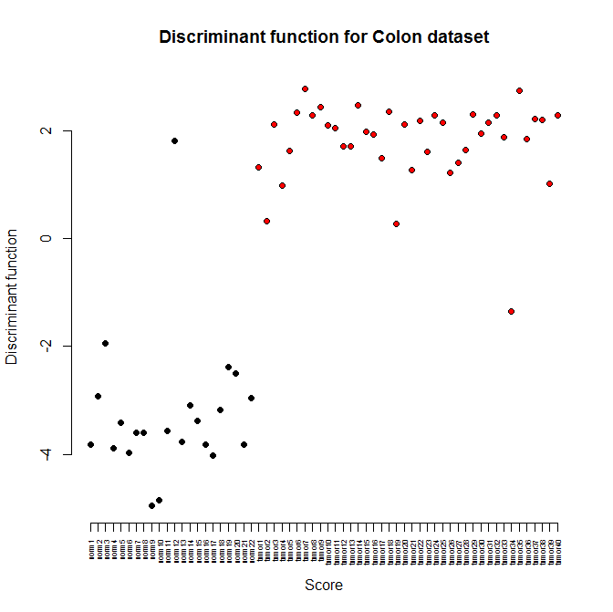
Discriminant analysis example
(linear )
 |  | Predicted Membership
 |  | Tumor | Normal | Total
Actual | Tumor | 39 | 1 | 40
Membership | Normal | 1 | 21 | 22
Confusion matrix from LDA

Slide 9
Support vector machines (SVMs)
One of the more popular supervised methods for classification and regression
SVMs apply a simple linear method to partition the data into classes, but does so in a high-dimensional feature space that is nonlinearly related to the input space⁶
Nonlinear partitioning relies on projecting the data into a feature space via a kernel function
  These different kernel function were also discussed in methods of dimensionality reduction

Slide 10
SVM theory
Suppose we have n points, (x_{i} i=1,…,n) in high-dimensional space defined as {(x₁,c₁), (x₂,c₂),…,(x_{n},c_{n})} and we want to separate them into their respective classes (c_{i} =1 or -1)
For a linear division, we can construct a dividing hyperplane to divide the classes of points defined by
  w · x + b = 0 [1]
  where the maximum separation between classes (i.e. margin) can be described by the parallel hyperplanes (for each class) as⁷:
  H₁: w · x_{i} + b = 1 and H₂: w · x_{i} + b = -1 [2]
So to maximize the partitioning between the parallel hyperplanes and the dividing hyperplane, we need to minimize |w| subject to the constraints of⁷
  c_{i}(w · x_{i} + b) - 1 ≥ 0; 1 ≤ i ≤ n [3]
  This is a quadratic programming problem
The methodology above can be generalized to the nonlinear case, by the application of a kernel function to the linear domain
  The dividing hyperplane then takes the form:
  <w,Φ(x)> + b = 0

Slide 11
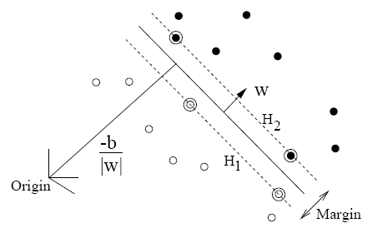
SVM illustration for two-dimensional example⁷
This is a two group partitioning problem with one group identified with filled circles and the other group identified with unfilled circles
The primary dividing hyperplane is the origin
Those points circled that lie on the hyperplanes (H₁ and H₂) are called support vectors

Slide 12
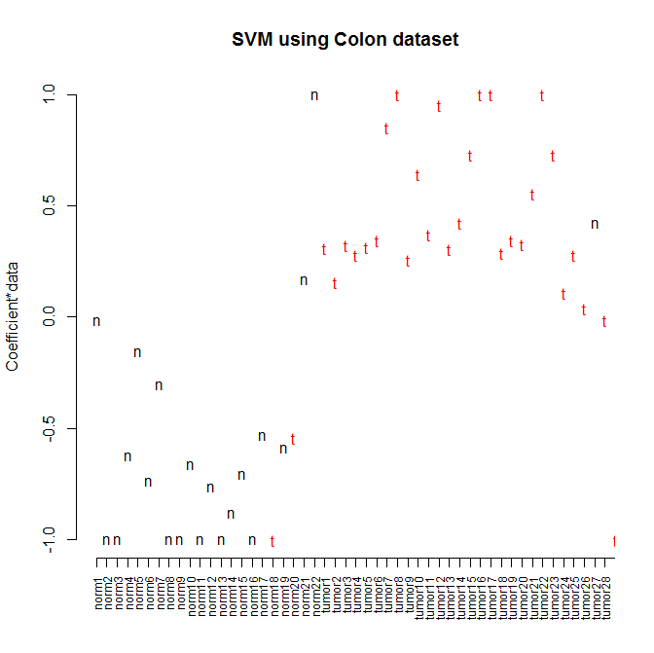
SVM example (Alon et al., colon cancer data)
 |  | Predicted Membership
 |  | Tumor | Normal | Total
Actual | Tumor | 38 | 2 | 40
Membership | Normal | 2 | 20 | 22
Confusion matrix from SVM

Slide 13
CART⁴
A method of using independent variables to predict either categorical or continuous dependent variables⁴
Using a series of if-then commands, the predictor variables are utilized to partition a classification for each dependent variable at various levels of a hierarchy⁴
The nodes on each level of the tree give the criteria used for each decision
The consistency of classification at a particular node is measured with multiple methods
  Entropy function, Gini measure of impurity, etc.
  g(t) = Σ_{j} p(j | t)p(i | t)
where p(j|t) is the prob. of category j at node t

Slide 14
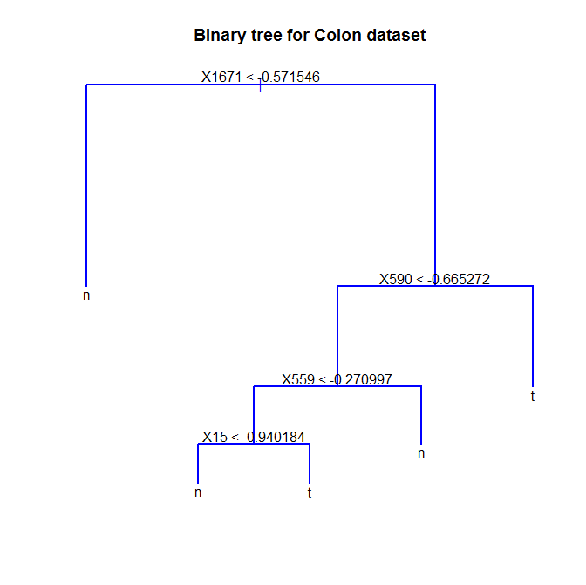
Binary Tree example Alon et al. colon cancer data
Gene 1671 is the primary bifurcation at a value of > 0.57
Gene 590 is the secondary bifurcation at a value of -0.67
Number of terminal nodes: 5
Residual mean deviance: 0.1181 = 6.73 / 57
Misclassification error rate: 0.03226 = 2 / 62

Slide 15
PLS – classification (review)
PLS is a multivariate regression method
  Discussed in lecture #8
Very generally, PLS, like PCA works to maximize the variability of a matrix by calculating linear combinations of the original variables
However, PCA maximizes this variability between the samples/genes, while PLS relates the data matrix, X to a response, Y
  X is this example is a matrix of genes by samples
  Y in this example is the expected continuous response or class membership
Supervised classification method
  Maximization between response and predictors is dependent upon class membership information

Slide 16
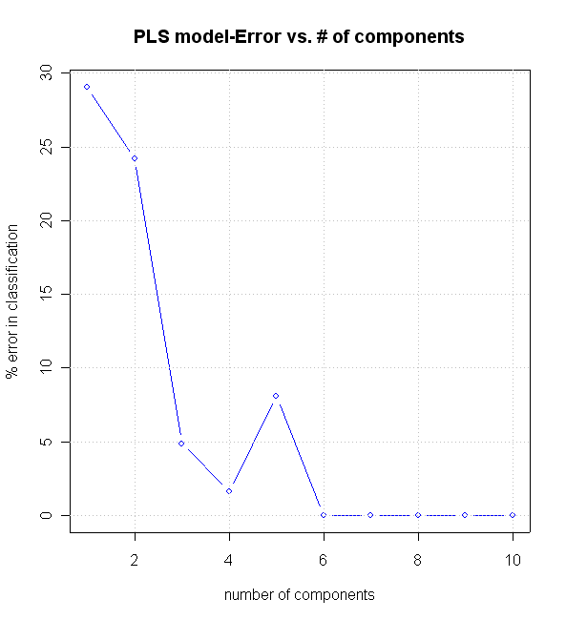
PLS - classification example Alon et al. colon cancer data

Slide 17
KNN
Classifies a point (gene/sample) by calculating the distances between all points and assigns the point to the class that is most common among its k-nearest neighbors
Spatial relationships between points in n-dimensional space determine class membership
The larger k that is specified, the larger the error rate
Non-supervised classification method
  No class structure is utilized for the algorithm
  Class membership is only utilized to count votes from neighboring points, not to optimize the classifier

Slide 18
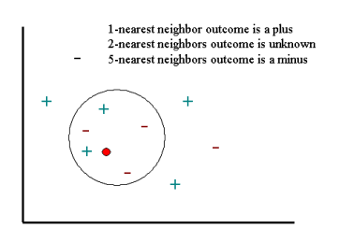
KNN methodology⁴

Slide 19
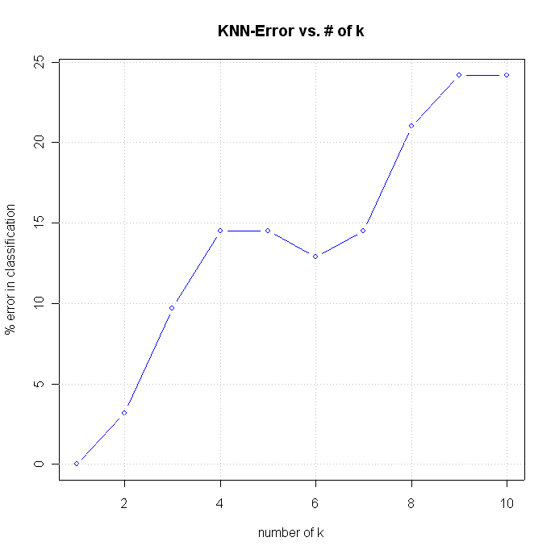
KNN - classification example Alon et al. colon cancer data

Slide 20
Neural Networks
Based on the principles underlying the information processing conducted by the brain neurons
  Attempts to simulate the logic process
Trains through processing multiple examples or observations to “learn” rules
  Connection weights are strengthened or weakened, consistent with the example data
Simple network models consist of an input layer (examples are presented), a middle layer (connections are adjusted), and an output layer (the outcome or answer is outputted)

Slide 21
Neural Network simple theory⁵
This particular simple model was developed by McCulloch and Pitts in 1943⁵
Model components
  Input set: x_{i} – discrete or continuous values fed into the network (gene vectors)
  Weights: w_{i} – determine the contribution of the input variables to the output result
  Threshold: u – a value that can be added or subtracted from the weighted sum
  Activation function: f – the function that calculates the output value, using the threshold as a paramter
  Output: y – solution to the function

Slide 22
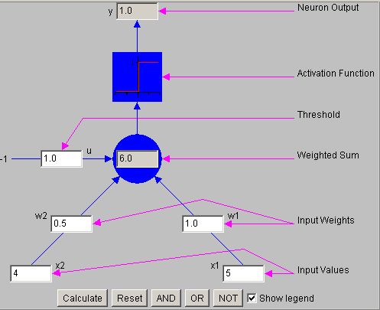
Artificial Neuron – visual⁵

Slide 23
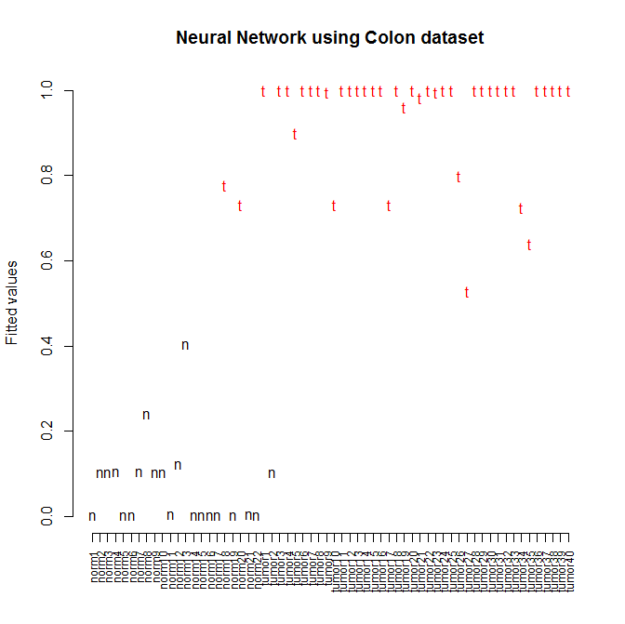
NN - classification example Alon et al. colon cancer data
A 4-layer neural network model
Confusion matrix
 | pNormal | pTumor
aNormal | 20 | 2
aTumor | 1 | 39

Slide 24
ROC curve evaluation
Receiver operator curves (ROC) are utilized to represent the sensitivity and the specificity of the model
  Sensitivity: probability of a positive test results, given the presence of the condition
    Also referred to as true-positive rate (TP rate)
  Specificity: probability of a negative test result given the absence of the condition
    Also referred to as true-negative rate (TN rate)
For model optimization, some parameter is iteratively adjusted and the model success is evaluated
  PCA: number of components
  KNN: number of k-neighbors
  Cut-points for a continuous score output
The plot usually contains a bend, where the optimal trade-off between sensitivity and specificity occurs

Slide 25
Sensitivity and Specificity
 |  |  | Condition
 |  | Present | Absent | Total
 | Positive | A | B | A + B
Test result | Negative | C | D | C + D
 | Total | A + C | B + D | N
Terminology
A / (A+C) = sensitivity
D / (B + D) = specificity
B / (B+D) = false positive
C / (C+A) = false negative

Slide 26
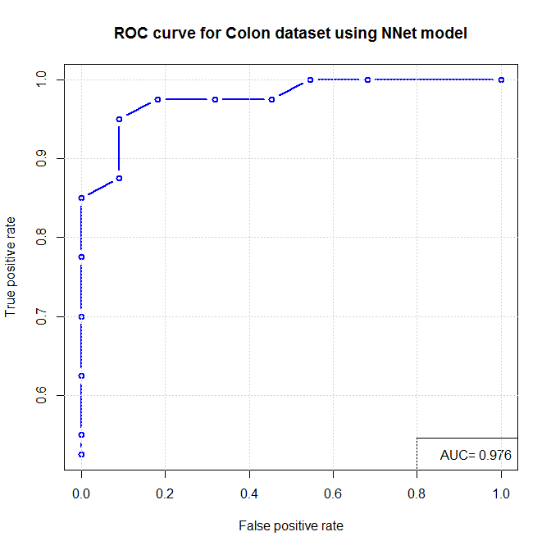
ROC curve example Alon et al. colon cancer data

Slide 27
Model Validation
Using the training data for prediction is seldom a good assessment of the model’s true success
  The parameters have been optimized for the training data, so this gives an over-optimistic accuracy
Multiple methods are used to get a more realistic sense of the model success
  Leave-one-out validation
    One sample is omitted from model build and predicted
  Data partitioning validation
    e.g. 60% training set:40% test set
  True external test data

Slide 28
References
1) Zhang H, Yu C, Singer B, and Xiong M. (2001) Recursive partitioning for tumor classification with gene expression microarray data. PNAS. 98, 6730-6735.
2) Olshen A and Jain A. (2002) Deriving quantitative conclusions from microarray expression data. Bioinformatics. 18, 961-970.
3) Applied Multivariate Statistical Analysis. Johnson and Wichern
4) Statsoft - http://www.statsoftinc.com
5) Artificial neuron applet - http://home.cc.umanitoba.ca/%7Eumcorbe9/neuron.html
6) Karatzoglou A et al., (2006) Support Vector Machines in R. Journal of Statistical Software. 15(9).
7) Burges C, (1998) A tutorial on support vector machines for pattern recognition. Data Mining and Knowledge Discovery. 2(2):212-167.

Slide 29
R Code
# get Alon et al. colon cancer data set
d <- read.table("C:\\Users\\higgsb\\Dropbox\\JHU\\Microarrays\\Data\\alon.txt",header=T,sep="\t",row.names=1)
clas <- names(d)
clas[grep("norm",clas)] <- rep("n",length(clas[grep("norm",clas)]))
clas[grep("tumor",clas)] <- rep("t",length(clas[grep("tumor",clas)]))
# conduct differential expression
## Wilcoxon-Mann_Whitney two sample test (non-parametric)
#sam: a vector of T/F values designating each group (must be equal in length to column in matrix)
wilcox.two <- function(x,sam) {
u <- wilcox.test(as.numeric(x[sam]),as.numeric(x[!sam]),alternative="two.sided")
o <- as.numeric(c(u$statistic,u$p.value))
names(o) <- c("test_statistic","pv")
o
}
pv <- t(apply(d,1,wilcox.two,sam=clas=="t"))[,2]
dat <- d[pv<.01,]
# discriminant analysis
library(MASS)
datx <- as.data.frame(t(dat))
datx <- data.frame(clas,datx)
dat.lda <- lda(clas~.,datx)
dat.pred <- predict(dat.lda,datx)
plot(dat.pred$x,bg=as.numeric(factor(clas)),pch=21,col=1,ylab="Discriminant function",axes=F,xlab="Score",main="Discriminant function for Colon dataset")
axis(1,at=c(1:62),names(d),las=2,cex.axis=0.5)
axis(2)
# add up correct classifications and incorrect ones
table(clas,dat.pred$class)

Slide 30
R Code
# CART code
library(tree)
dat <- scale(t(dat),center=T,scale=T)
dat.pca <- prcomp(dat)
dat.loads <- dat.pca$x[,1:10]
dat <- as.data.frame(dat.loads)
dat.c <- data.frame(clas,dat) # bind class labels to dataframe
dat.train.tree<-tree(clas~.,data=dat.c)
plot(dat.train.tree,col='blue',lwd=2)
text(dat.train.tree)
title(main="Binary tree for Colon dataset")
summary(dat.train.tree) # classification results
# PLS classifier code
library(gpls); library(colonCA);
data(colonCA)
dat <- exprs(colonCA)
clas <- as.character(colonCA$class)
clas[clas==“n”]<- 0
clas[clas==“t”]<- 1
clas <- as.numeric(clas)
# run PLS model with increasing # of components in a for loop
error.list <- NULL
for(i in 1:10) {
dat.pls <- glpls1a.train.test.error (t(dat),clas, t(dat),clas,K.prov=i,lmax=20,br=F)$error
dat.pls <- round(dat.pls*100,2)
error.list <- c(error.list,dat.pls)
}

Slide 31
R Code
#get sensitivity and specificity information for ROC curve using PLS model
train <- dat[,1:40] #training set
test <- dat[,41:62] #test set
model.pls <- glpls1a.train.test.error(t(train),clas[1:40], t(test),clas[41:62],K.prov=3,lmax=20,br=F)
preds <- model.pls$predict.test
tpf <- NULL #true positive fraction
fpf <- NULL #false positive fraction
test.class <- clas[41:62]
for(i in seq(from=0.03,to=0.94,by=0.01)) {
upper <- preds>i
conf.mtx <- table(as.numeric(upper),test.class)
tpf <- c(tpf, conf.mtx[2,2]/sum(conf.mtx[,2]))
fpf <- c(fpf, conf.mtx[2,1]/sum(conf.mtx[,1]))
}
library(ROC) #library to calculate the area under the curve (AUC)
auc <- trapezint(fpf,tpf,0,1)
#plot ROC curve
plot(c(0,1),c(0,1),type="n",xlab="False positive fraction",ylab="True positive fraction",main="ROC curve\nPLS model with 3 components")
lines(fpf,tpf,col="blue",lwd=2)
grid(col="grey")
text(0.5,0.7,paste("AUC=",round(auc,2),sep=""))

Slide 32
R Code
# plot classification error vs. # components in PLS model
plot(c(1:10),error.list,type=“b”,col=‘blue’,xlab=“number of components”,ylab=“% error in classification”,main=“PLS model-Error vs. # of components”)
grid(col="grey")
# run knn classifier with increasing # of k in a for loop
library(class)
error.list<-NULL
for(i in 1:10) {
dat.knn <- knn(t(dat),t(dat),clas,k=i,prob=T)
# error rates
er1 <- sum(dat.knn[clas=="n"]=="t") # number of incorrect normal classifications
er2 <- sum(dat.knn[clas=="t"]=="n") # number of correct tumor classifications
er.total <- sum(er1,er2)/ncol(dat)
er.total <- round(er.total*100,1)
# store in list
error.list <- c(error.list,er.total)
}
# plot classification error vs. k in knn classifier
plot(c(1:10),error.list,type="b",col="blue",xlab="number of k",ylab="% error in classification",main="KNN-Error vs. # of k")
grid(col="grey")

Slide 33
R Code
# neural network
library(nnet)
# define training samples by random
samp <- sample(c(1:ncol(dat)),30,replace=F)
sap <-
dat.n <- data.frame(dat.loads,clas)
dat.nn2 <- nnet(clas ~ ., data = dat.n, subset = c(1:nrow(dat)),size=4,rang=0.1,decay=5e-4,maxit=200)
# confusion matrix
pred <- predict(dat.nn2, dat.n, type = "class")
table(clas,pred)
# plot fitted values
plot(dat.nn2$fitted.values,type="n",ylab="Fitted values",xlab="",axes=F,main="Neural Network using Colon dataset")
text(c(1:62),dat.nn2$fitted.values,pred,col=as.numeric(factor(pred)))
axis(2)
axis(1,at=c(1:62),labels=dimnames(dat)[[1]],cex.axis=0.75,las=2)
# run KNN model with increasing # of k-neighbors
tp.list <- NULL
fp.list <- NULL
k.list <- c(1:35)
for(i in 2:length(k.list)) {
dat.knn <- knn(t(dat[1:10,]),t(dat[1:10,]),clas,k=k.list[i],prob=T)
# error rates
er1 <- sum(dat.knn[clas=="t"]=="t")/sum(clas=="t")*100 # true positive rate
er2 <- sum(dat.knn[clas=="n"]=="t")/sum(clas=="n")*100 # false positive rate
tp.list <- c(tp.list,er1)
fp.list <- c(fp.list,er2)
}

Slide 34
R Code
# ROC curve
#a is vector of test values
#b is vector of condition values
#bx is the list of character values for the condition values (true is first, false is second)
roc <- function(a,b,bx=c("1","0")) {
tp <- NULL
fp <- NULL
cut <- NULL
for (i in seq(0,1,by=.05)) {
# print(i)
qu <- quantile(a,i)
cut <- c(cut,as.numeric(qu))
ax <- a>=qu
con <- table(ax,b)
if(nrow(con)==1 & length(intersect(dimnames(con)[[1]],"FALSE"))==1) {
tp <- 0
fp <- 0
next
}
tp <- c(tp,con["TRUE",bx[1]]/sum(con[,bx[1]]))
fp <- c(fp,con["TRUE",bx[2]]/sum(con[,bx[2]]))
}
trap.rule <- function(x,y) {sum(diff(x)*(y[-1]+y[-length(y)]))/2}
auc <- abs(trap.rule(x=fp,y=tp))
return(list(cbind(tp,fp,cut),c(auc)))
}

Slide 35
R Code
# plot ROC curve of sensitivity vs. specificity using nnet output
rocx <- roc(a=dat.nn2$fitted.values,b=clas,bx=c("t","n"))
plot(rocx[[1]][,2],rocx[[1]][,1],type="b",col="blue",xlab="False positive rate",ylab="True positive rate",lwd=2)
title(main="ROC curve for Colon dataset using NNet model")
legend("bottomright",paste("AUC=",round(rocx[[2]],3)))
grid()
# Support vector machine
library(kernlab)
#dat.loads <- data.frame(dat.loads,clas)
svp <- ksvm(dat,clas,type="C-svc")
svp
# get fitted values
fit <- fitted(svp)
# demo of the plot function
plot(svp@coef[[1]],type="n",ylab="Coefficient*data",xlab="",axes=F,main="SVM using Colon dataset")
text(c(1:62),svp@coef[[1]],fit,col=as.numeric(factor(fit)))
axis(2)
axis(1,at=c(1:62),labels=dimnames(dat)[[1]],cex.axis=0.75,las=2)
# error rates
table(clas,fit)

