Slide 1
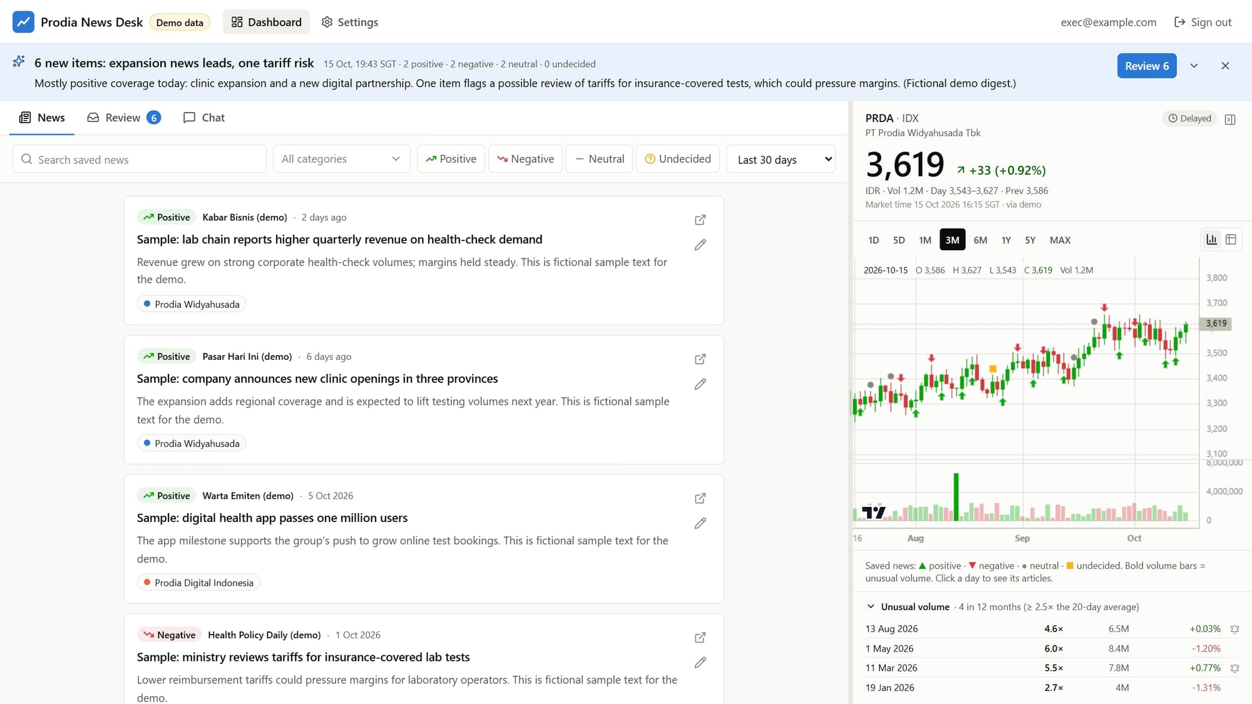
Prodia News Desk
16 OCTOBER 2026
Use case and overview of the implementation
Dashboard demo
Notes:
This deck explains how the Prodia News Desk works. Every slide has two layers: the plain idea on the left, and an “Under the hood” box that names the actual technology, for anyone who wants to go deeper. First comes an overview, then the frontend (what you see), then the backend (what runs in the cloud), then security, cost and status. The last three slides answer your questions: how the stock chart turns numbers into a picture, what open-weight and closed-weight AI models are, and how we could build our own model with open-source tools. All screenshots come from the public demo, which uses fictional data.

Slide 2






What the News Desk does
OVERVIEW
Four jobs on one screen, plus a Telegram message when something needs you.
News
Review
UNDER THE HOOD
Frontend: the web app you see, running in your browser on a computer or phone.
Backend: services in Amazon Web Services (AWS) that search, run the AI and store data.
AI: Claude models by default; each task can switch provider.
Telegram bot: only sends messages with a link; it cannot change anything.
Finds news about Prodia every morning and tags each article: its topic and likely share‑price effect.
Nothing is saved until you approve it. Save, skip or correct the AI’s tags in a click.
Chat
Stock
Ask questions in plain English. Answers cite your saved articles and PRDA prices.
PRDA price and volume, your saved news on the chart, and alerts for unusual trading.
Telegram: a digest after each run, plus alerts for unusual volume or failures.
Notes:
The News Desk does four jobs on one screen. News: every morning it searches for articles about Prodia and its group companies, and an AI model suggests topics and a likely effect on the PRDA share price. Review: nothing goes into the archive until you approve it, so you decide what counts as saved news. Chat: an assistant answers questions using only the saved articles and PRDA prices, and shows its sources. Stock: the right-hand panel shows PRDA price and volume, with your saved news plotted on the chart. Telegram ties it together: one short message after each daily run, and alerts when trading volume is unusual or a run fails.

Slide 3


A day with the News Desk
OVERVIEW
The routine runs itself: you spend a few minutes reviewing, and ask questions whenever you need to.
All times are Singapore time (SGT).
06:00
After the run
Morning
10:00–17:45
18:30
The daily run searches the news published since the last run.
Telegram digest, e.g. “6 new items: expansion news leads, one tariff risk”.
You review the new items: save, skip or correct the AI.
PRDA price every 15 minutes, with an alert if volume spikes.
End‑of‑day price refresh and volume check.
Any time: ask the chat about the saved news and PRDA prices.
UNDER THE HOOD
EventBridge Scheduler: AWS’s alarm clock. Price refreshes follow IDX hours in Jakarta.
Editable: change the daily run time in Settings; the schedule updates itself.
Telegram: the digest has an “Open review queue” button that opens the Review tab.
Notes:
A typical day, in Singapore time. At 06:00 the daily run starts on its own: it searches for news published since the last successful run, filters it and tags it. When it finishes, a short digest arrives on Telegram with a button that opens the Review tab. You review the new items in the morning: save, skip or correct the suggestions. On weekdays from 10:00 to 17:45, which covers the Indonesia Stock Exchange’s trading hours (09:00 to 16:45 in Jakarta), the PRDA price refreshes every 15 minutes; if trading volume reaches 2.5 times its 20-day average you get one alert that day. At 18:30 (17:30 in Jakarta) there is an end-of-day refresh. The chat is available any time. The 06:00 start is a default that you can change in Settings.

Slide 4







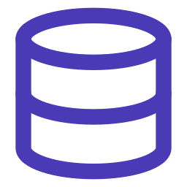
The big picture
OVERVIEW
Your browser shows the screen, our part of AWS does the work, and outside services supply news, prices and AI.
You
AWS Cloud
Outside services
UNDER THE HOOD
News
Google News, GDELT
Website: CloudFront and S3 serve the app files.
Login: Amazon Cognito, invite‑only.
Front door: API Gateway checks your login on every request.
Workers: AWS Lambda functions; Step Functions chains multi‑step jobs.
Scheduled jobs: EventBridge Scheduler.
Storage: DynamoDB, S3 and S3 Vectors; keys in Secrets Manager.
Website
Login
Prices
Yahoo Finance
Front door (API)
Workers
Browser or phone
AI models
Anthropic, OpenAI, Google
Scheduled jobs
Storage
Messages
Telegram
Notes:
The whole system in one picture. On the left is you, using a browser on a computer or a phone. In the middle is our part of Amazon Web Services: a website host, a login service, a front door that every request passes through, small worker programs that do the actual work, an alarm clock that starts scheduled jobs, and storage. On the right are the outside services we rely on: Google News and GDELT to find news, Yahoo Finance for prices, AI providers such as Anthropic for the language models, and Telegram for messages. Your browser never talks to those outside services directly; everything goes through our cloud. The box on the right maps each plain name to the AWS product behind it.

Slide 5




Frontend and backend
OVERVIEW
Think of a restaurant: the frontend is the dining room, the backend is the kitchen, and the API is the waiter.
The dining room
The waiter
The kitchen
= the frontend
= the API
= the backend
What you see and touch: the tabs, buttons and chart. It runs in your browser.
Carries each order to the kitchen and brings back the result, checking your pass every time.
Where the work happens: finding news, running the AI, storing everything. It runs in AWS.
Example: you open the News tab → the waiter asks the kitchen for “saved news, last 30 days” → the kitchen sends back a list → the dining room shows it as cards.
UNDER THE HOOD
React + TypeScript: the building blocks of the frontend; TypeScript is also used in the backend.
API, JSON, HTTPS: web addresses such as GET /news that return data as JSON text, always encrypted.
AWS CDK: the whole kitchen is written as code, so one command can rebuild it anywhere.
Notes:
A restaurant is a useful way to think about frontend and backend. The frontend is the dining room: everything you see and touch, such as the tabs, the buttons and the chart. It runs inside your browser. The backend is the kitchen: it finds the news, runs the AI, keeps the schedule and stores everything. It runs in AWS. The API is the waiter. It carries each order from the dining room to the kitchen and brings back the result, and it checks your login pass on every single order. For example, when you open the News tab, the browser asks the API for saved news from the last 30 days, the backend returns a list, and the screen turns that list into cards.

Slide 6
The screen, piece by piece
FRONTEND
One page: three tabs on the left, the PRDA panel on the right, and a divider you can drag between them.
1
Tabs: News, Review, Chat
6
2
Search and filters
1
2
5
3
Article card with source link
3
4
Divider: drag to resize
5
PRDA price, chart and volume
6
The latest digest
4
UNDER THE HOOD
React: each part of the page is a reusable component; Tailwind styles it.
Layout: panel sizes are remembered; on narrow screens Stock becomes a 4th tab.
Demo with fictional data
Notes:
The main screen, from the demo with fictional data. One: the tabs. News holds the articles you have saved, Review holds new items waiting for you, and Chat is the assistant. Two: search and filters for keywords, topics, sentiment and time range. Three: an article card with its sentiment badge, source, summary, topic chips and a link to the original article. Four: the divider; drag it to give more room to the news or to the chart, or collapse the stock panel completely. Five: the PRDA panel with the latest price, the chart and the unusual-volume list. Six: the digest banner with the latest summary and a button that jumps to Review. The page remembers your layout.

Slide 7




How the screen gets its data
FRONTEND
The app is downloaded once; after that, each tab fetches only small packets of data.
1
2
3
4
UNDER THE HOOD
Single‑page app: one download, then only data travels (built with Vite).
TanStack Query: caches answers and refreshes them in the background.
Sign‑in: OAuth 2.0 with PKCE; the pass is a signed token (JWT).
API Gateway: rejects any request without a valid pass.
config.json: lets one build run in test and production.
Open the link
Sign in
Ask for data
Show and keep
CloudFront sends the app from a nearby server, so it loads fast.
Cognito checks your password and gives the browser a digital pass.
Each tab asks the API, e.g. “saved news, last 30 days”, showing the pass.
The JSON answer is drawn on screen and kept, so tabs switch instantly.
What one saved article looks like as JSON
{ "title": "Ministry reviews tariffs for lab tests",
"sentiment": "negative",
"categories": ["Healthcare regulation"],
"source": "Health Policy Daily" }
Notes:
What happens when you open the dashboard. First, CloudFront, Amazon’s content delivery network, sends the app’s files from a server near you, so it loads quickly. Second, you sign in through Amazon Cognito. It checks your password, plus your authenticator code if you set one up, and gives the browser a digital pass: a signed token that expires after a while. Third, each tab asks the API for the data it needs and shows the pass; API Gateway refuses any request without a valid one. Fourth, the answer comes back as JSON, like the small example at the bottom, and the app draws it. It also keeps a copy, so switching tabs is instant, and refreshes it quietly in the background.

Slide 8
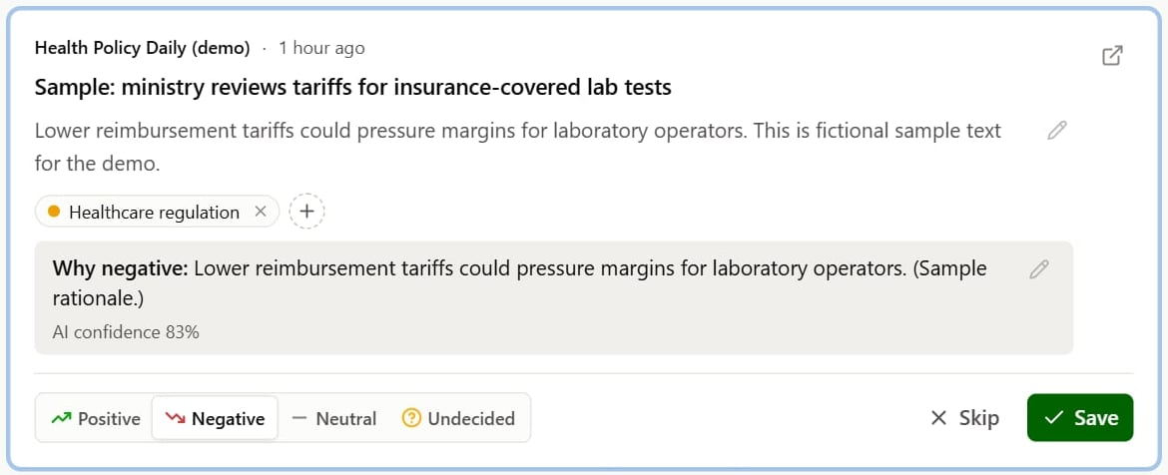

Reviewing news
FRONTEND
The AI proposes, you decide. Nothing reaches the archive without your approval.
UNDER THE HOOD
Shortcuts: J/K move, S saves, X skips, E opens details; “Save all as suggested” handles a batch.
Instant: each click sends PATCH /news/{id}; the screen updates at once and confirms in the background.
Feedback record: the AI’s suggestion, your final answer and which fields you changed.
Memory: skipped stories are remembered, so they never come back.
2
3
1
4
1
Pick the sentiment
2
Remove (×) or add (+) topics
3
Edit the reason; see the AI’s confidence
4
Save or Skip
A Save means it shows in News, the chat can find it, and it is kept as a training example.
Notes:
Review is where you stay in control. Each card shows the AI’s suggestion: topics, sentiment, a one-line reason and its confidence. One: change the sentiment with one click. Two: remove a topic with the cross or add one with the plus. Three: edit the reason or the summary in place; the AI’s confidence is shown underneath. Four: Save or Skip. Keyboard shortcuts make it fast: J and K move between cards, S saves and X skips, and “Save all as suggested” approves a whole batch. When you save, the article appears in News, the chat can find it, and your decision, including what you changed, is stored as a training example. Skipped articles never come back in later runs.

Slide 9





Serverless: no servers to look after
BACKEND
AWS runs our code only when there is work to do and bills by the millisecond: under $10 a month at this scale.
Workers
Front door
Conductor
Alarm clock
Login
AWS Lambda
API Gateway
Step Functions
EventBridge Scheduler
Amazon Cognito
Records
Files
Delivery
Key vault
Alarms
Amazon DynamoDB
Amazon S3
Amazon CloudFront
Secrets Manager
Amazon CloudWatch
A traditional server is on all day, paid 24/7, and someone must patch it. Serverless wakes up for each task, scales by itself, and costs almost nothing when idle.
UNDER THE HOOD
Pay per use: billed by the millisecond, so quiet days cost almost nothing.
AWS CDK: the setup is code; one command rebuilds it in any AWS account.
cdk‑nag: checks the setup against AWS security rules on every build.
Notes:
The backend is “serverless”. That does not mean there are no computers; it means AWS runs them for us. Instead of renting a server that is on all day and that we must patch and monitor, we give AWS small pieces of code. AWS runs each piece only when there is work, for example when you open a tab or when the 06:00 alarm fires, and bills by the millisecond. At this scale the AWS bill is under ten dollars a month. These are the ten building blocks, each with its plain role and its AWS name. The whole setup is written as code with the AWS CDK, so it can be rebuilt in another account or region with one command, and cdk-nag checks it against AWS security rules on every build.

Slide 10
The daily news run
BACKEND
Every morning a six‑step workflow turns hundreds of search hits into a short list for you to review.
1
Search
e.g. 300 hits
UNDER THE HOOD
Google News and GDELT, in Indonesian and English
Step Functions: runs the steps in order, with many searches in parallel.
Resilient: a failed search is skipped; a failed run is marked and you get a Telegram alert.
Backfill: when you add a topic, the same workflow searches past months, in windows of 7 to 30 days.
Sources: free Google News RSS feeds and the GDELT news database (last ~3 months).
2
Remove duplicates
120 new
The same article found twice, or seen or skipped before
3
Quick AI screen
30 relevant
Headlines only; obvious noise is set aside for 30 days
4
Read the article
30 read
Opens the publisher’s page and extracts the text
5
AI tagging
30 to review
Topics, sentiment, reason, summary and confidence
6
Digest
1 message
A short summary in the app and on Telegram
Notes:
What happens every morning, run by AWS Step Functions. One: search. For each topic, the run sends its search queries to Google News and to GDELT, in Indonesian and English, covering the time since the last successful run. Two: remove duplicates. The same article found by several searches is merged, and anything already seen or skipped before is dropped. Three: a quick AI screen reads only the headlines and sets obvious noise aside; you can still restore those items for 30 days. Four: for the rest, it opens the publisher’s page and extracts the article text. Five: the AI tags each article. Six: it writes a digest and sends it to Telegram. The numbers are only an example. When you add a topic, the same workflow runs over past months: the backfill.

Slide 11





How the AI tags an article
BACKEND
The AI gets clear instructions plus the article, and must answer in a fixed format that the app can check.
What the AI is given
What it must return
UNDER THE HOOD
About Prodia and its group
Your topic definitions
The sentiment rules
The article, marked as untrusted text
Topic: Healthcare regulation
Sentiment: Negative
Why: lower tariffs could pressure margins
Summary: one or two sentences
Confidence: 83%
Structured output: the answer must match a fixed JSON format, checked (with zod) before it is saved.
Untrusted text: the article is fenced off as data, so instructions hidden in a web page are ignored.
Fallback: one retry, then a backup model if the answer still fails.
Usage: tokens are counted per run, for cost tracking.
Learning: optionally, your recent corrections are shown as examples (Settings).
AI model
Positive
Negative
Neutral
Undecided
Likely to support the share price
Likely to pressure the share price
Relevant, but unlikely to move it
Could matter; the direction is unclear
Notes:
Tagging is one carefully instructed AI call per article. The model receives background about Prodia and its group companies, your topic definitions, the sentiment rules and the article text. The article is clearly marked as untrusted data, so if a web page contains hidden instructions, the model treats them as content, not commands. The model must answer in a fixed format: topics, sentiment, reason, summary and confidence. The app checks that format before saving anything, retries once if something goes wrong, and can fall back to a backup model. Positive and negative mean a likely effect on the share price. Neutral means relevant but unlikely to move it. Undecided means it could matter, but the direction is unclear.

Slide 12
Where the data lives
BACKEND
Four stores, each for one kind of data, all private and encrypted inside our AWS account.
DynamoDB · Records
S3 · Files
UNDER THE HOOD
Articles and tags, topics, runs, digests, prices, settings, your feedback.
Full article text, chat conversations, raw search results (kept 90 days).
Single table: one DynamoDB table; each item’s key says what it is (ART#…, STOCK#…, CATEGORY).
Auto‑expiry (TTL): temporary items delete themselves, e.g. 15‑minute price bars after 10 days.
Private: encrypted storage that only the app’s own functions can read.
Auto re‑index: saving or editing an article updates the meaning index (DynamoDB stream → indexer).
S3 Vectors · Meaning index
Secrets Manager · Key vault
Saved articles as lists of numbers, so the chat can search by meaning.
AI provider keys and the Telegram token, kept out of the code.
One trading day of PRDA, as stored in DynamoDB
PK (what) | SK (when) | open | high | low | close | volume
STOCK#PRDA.JK | D#2026-10-14 | 3,567 | 3,598 | 3,541 | 3,586 | 2.2M
Demo values. Slide 19 shows how rows like this become the chart.
Notes:
Data lives in four places, each suited to one kind of data. DynamoDB is a fast database of records: articles and their tags, topics, daily runs, digests, price candles, settings and your feedback. S3 stores larger files, such as the full text of each article and your chat conversations; raw search results are deleted automatically after 90 days. S3 Vectors holds the “meaning index” that lets the chat search by meaning instead of exact words. Secrets Manager is a vault for the API keys of the AI providers and the Telegram bot. At the bottom is one record in its stored format: a single trading day of PRDA prices. Slide 19 shows how rows like this become the chart.

Slide 13
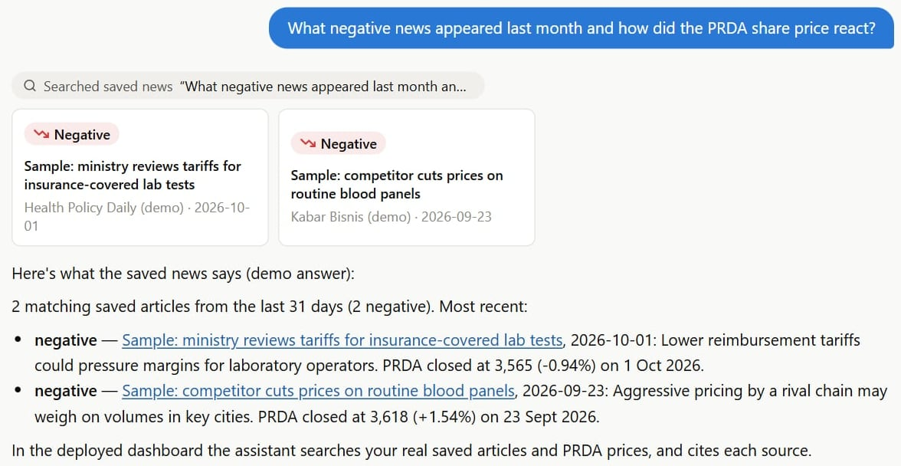
The chat assistant
BACKEND
It looks things up before it answers: it searches your saved news, checks prices, then replies with sources.
1
UNDER THE HOOD
2
Search by meaning: each article becomes 768 numbers that capture its meaning, so “tariff cut” also finds “lower BPJS reimbursement” (Gemini Embedding 2 in S3 Vectors).
Tool calling: the model asks for searchNews or getStockPrices; our code runs them and returns the results.
Read‑only: the assistant cannot change or delete anything.
Streaming: words appear as they are written; conversations are saved per user.
3
4
1
Your question
2
It searches the saved news
3
The articles it found
4
An answer that cites them
Notes:
The chat assistant does research before it answers. Take the question “What negative news appeared last month and how did the PRDA share price react?” The model decides which tools it needs. It searches your saved news by meaning, limited to last month and to negative items, and looks up PRDA prices for that period. Only then does it write the answer, citing the articles it used, and the text streams in as it is written. Search by meaning works because each saved article is turned into a list of 768 numbers that capture what it is about. Similar meanings get similar numbers, so a search for “tariff cut” can also find an article about lower BPJS reimbursement. The assistant can only read; it cannot change or delete anything.

Slide 14
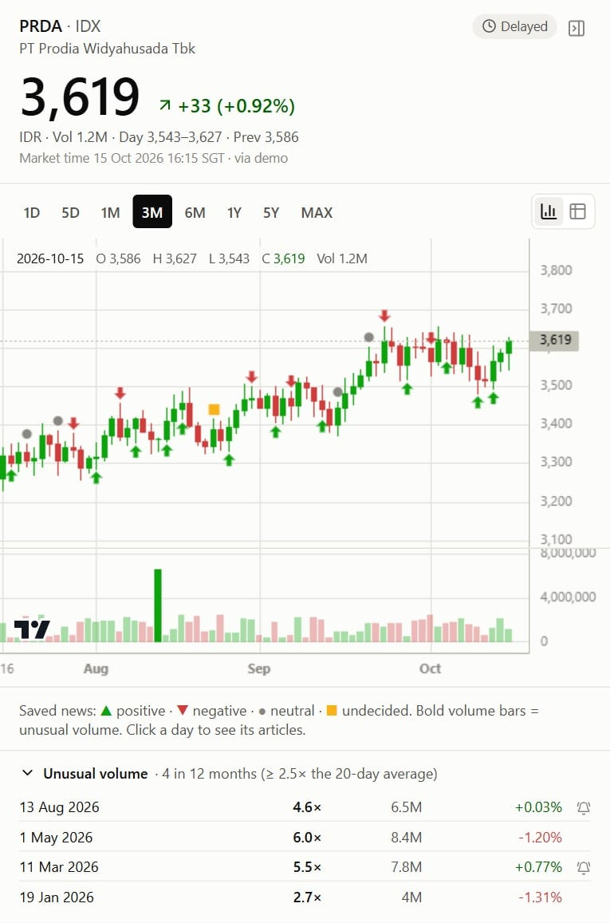


Stock prices and unusual volume
BACKEND
Prices refresh every 15 minutes during trading hours, and you get an alert when trading volume jumps.
When prices update (Mon–Fri, Singapore time)
UNDER THE HOOD
18:30
Source: Yahoo Finance through yahoo‑finance2: free but unofficial.
Stored: one DynamoDB record per trading day, plus 15‑minute bars kept for 10 days.
Safety net: after 3 failed refreshes, a “Not updating” badge and a Telegram alert.
Upgrade: one setting switches to EODHD, a paid feed ($19.99/month).
10:00
17:45
Every 15 minutes during the session (about 15 minutes delayed), then one end‑of‑day refresh at 18:30.
Unusual volume
2.5×
the 20‑day average volume, or more, triggers:
a bold bar on the chart
a line in the Unusual volume list
one Telegram alert that day
Stock panel (demo data)
Notes:
Prices come from Yahoo Finance, which is free but unofficial. On weekdays from 10:00 to 17:45 Singapore time, which is 09:00 to 16:45 in Jakarta where the exchange trades, the system fetches the PRDA price every 15 minutes; the data is about 15 minutes delayed. At 18:30 Singapore time an end-of-day refresh fills in the daily figures. The system also watches trading volume: if a day’s volume reaches 2.5 times the average of the previous 20 trading days, that bar is drawn in bold, the day is listed under Unusual volume, and you get one Telegram alert that day. If Yahoo fails three times in a row, the panel shows “Not updating” and you get an alert. If Yahoo becomes unreliable for good, one setting switches to EODHD, a paid data provider at about twenty dollars a month.

Slide 15
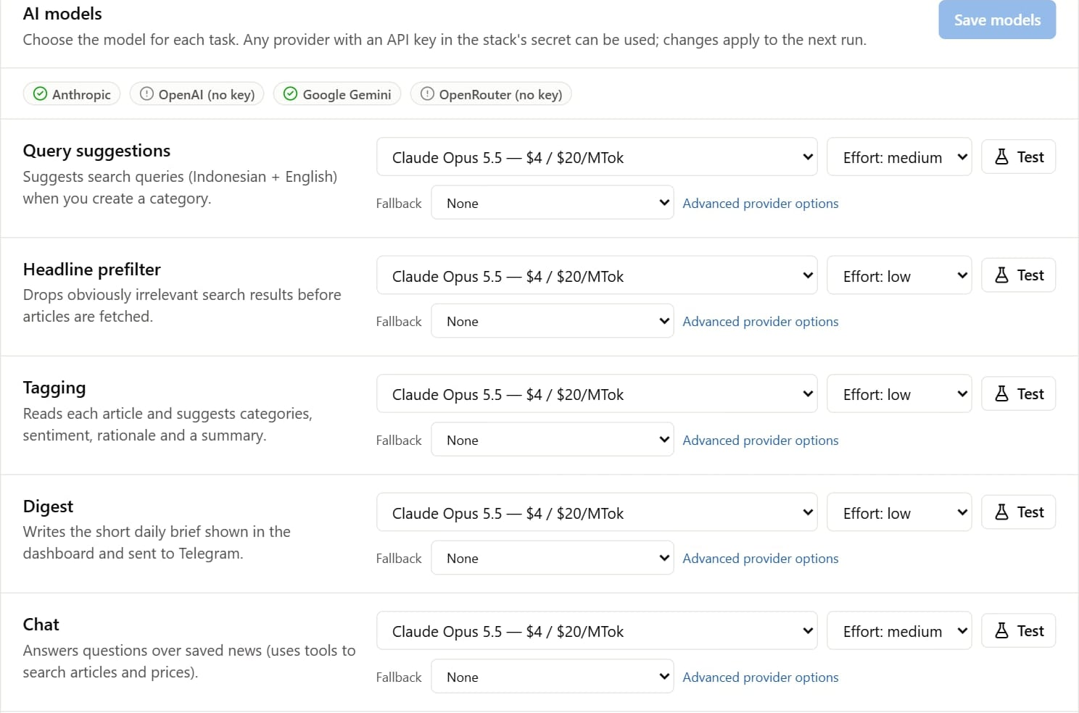
Choosing AI models
BACKEND
Not locked to one AI company: each task can use a different model, chosen in Settings.
UNDER THE HOOD
Vercel AI SDK: one programming interface for Anthropic, OpenAI, Google and OpenRouter (hundreds of models with one key).
Per task: a main model, a backup model, and how hard it should think (“effort”).
Before switching: the Test button checks a choice; eval:tagging scores a model against your past decisions.
Cost lever: tagging costs about $30–45 a month with Claude Opus, and about $1–3 with Claude Haiku.
Custom model id: any model a configured provider offers can be typed in, such as a brand‑new release.
Settings → AI models (demo). A green tick means that provider’s key is set.
Notes:
The AI layer is not tied to one company. Every AI task, from suggesting search queries to tagging, writing the digest and answering chat questions, has its own model setting. The default everywhere is Claude Opus 5.5 from Anthropic, but any task can switch to another Claude model, to OpenAI or Google models, or to hundreds of models through OpenRouter. Each task can also have a backup model and an “effort” level that controls how hard the model thinks. Before switching the tagging model, a script scores the candidate against your own past decisions, so the choice is based on evidence. Model choice is also the main cost lever: tagging costs roughly 30 to 45 dollars a month with Opus and 1 to 3 dollars with Haiku.

Slide 16






Security and privacy
OVERVIEW
Only invited people get in, every request is checked, and the AI can read your data but never change it.
Invite‑only
Every request checked
UNDER THE HOOD
No public sign‑up; optional authenticator‑app code.
Your login pass is verified on every API call.
Cognito authorizer: on every API route, verified by an automated test.
Least privilege: each function can reach only the data it needs.
cdk‑nag: AWS security rules checked on every build.
Origin Access Control: the website files can only be fetched through CloudFront.
Private and encrypted
Keys in a vault
Storage is private; data is encrypted in transit and at rest.
AI and Telegram keys live in Secrets Manager, not in code.
The AI only reads
Safe web fetching
Chat tools are read‑only; article text is treated as untrusted.
The article reader refuses internal network addresses.
Notes:
Security is built into every layer. Only invited users can sign in; there is no public sign-up, and you can add an authenticator app as a second factor. Every request to the API must carry a valid login pass, and an automated test checks that every route is protected. Storage is private and encrypted. API keys are kept in AWS Secrets Manager, never in the code. The chat assistant can only read data, and article text is treated as untrusted, so a malicious web page cannot instruct the AI to do anything. The article reader refuses to visit internal network addresses, which blocks a common attack. Each function has only the permissions it needs, and AWS security rules are checked on every build.

Slide 17
What it costs and what could break
OVERVIEW
Running costs are small; the main risk is that the free data sources are unofficial, and each one has a paid fallback.
Monthly running cost
What could break, and the fallback
< $10
AWS: hosting, database and workflows
Risk | What happens then | Paid fallback
Google News links are unofficial and can break | We keep the Google link; GDELT gives direct links | Serper: $50 per 50,000 searches
Yahoo Finance may block cloud servers | “Not updating” badge and a Telegram alert | EODHD: $19.99/month
GDELT only covers about 3 months | Older backfills rely on Google News | NewsData.io archive: from $199.99/month
$0
News and price data, and Telegram
$30–45
AI tagging with Claude Opus (Haiku: $1–3)
$0.10
Roughly, per chat question
Under the hood: token usage is recorded per run (Settings → Daily run). Prices as researched in October 2026.
Notes:
Running costs are small. AWS itself is under ten dollars a month at this scale. The news and price sources are free, and so is Telegram. The AI is the main cost: about 30 to 45 dollars a month for daily tagging with Claude Opus, which drops to 1 to 3 dollars with Claude Haiku, and roughly ten cents per chat question. The main risk is that the free sources are unofficial. Google News links are decoded with an unofficial method that can break; if it does, we keep the Google link, and GDELT already gives direct links. Yahoo may block cloud servers; the panel shows it and alerts you. GDELT only reaches back about three months. Each risk has a documented paid fallback; prices were checked in October 2026.

Slide 18



Where we are and what’s next
OVERVIEW
Built and tested, with a live demo on fictional data; going live on AWS is the next step.
Done
Next
Later ideas
Dashboard, news pipeline, chat and stock panel are built
96 automated tests and the AWS security checks pass
Live demo with fictional data:
news-desk-demo.vercel.app
Deploy to AWS Singapore
Add the AI and Telegram keys
Invite you as a user
Connect Telegram
Add the topics to follow
Let other AI tools query the archive (MCP)
Save or skip straight from Telegram
Group near‑duplicate stories
Watch IDX company disclosures
Going live is one command (npm run deploy) once the review is done.
Notes:
Where we are. The dashboard, the news pipeline, the chat assistant and the stock panel are built. 96 automated tests and the AWS security checks pass, and the public demo shows the whole interface with fictional data. Nothing runs on AWS yet: it is set up for the AWS Singapore region, close to you, and goes live after a final review. Going live takes one command, followed by a few setup steps: add the AI and Telegram keys, invite you as a user, connect Telegram, and add the topics to follow; each new topic automatically searches past news. Ideas for later: letting other AI tools query the archive through an MCP endpoint, saving or skipping directly from Telegram, grouping near-duplicate stories, and watching IDX company disclosures.

Slide 19
How the chart turns numbers into a picture
YOUR QUESTIONS
A CSV is just text. Excel shows it as a grid; our chart library draws it as candles.
1
As text: the CSV file
2
As a grid: what Excel shows
3
As a drawing: our chart
Date | Open | High | Low | Close | Vol.
9 Oct | 3,552 | 3,591 | 3,483 | 3,520 | 1.4M
12 Oct | 3,520 | 3,554 | 3,499 | 3,517 | 538K
13 Oct | 3,517 | 3,605 | 3,494 | 3,567 | 1.2M
14 Oct | 3,567 | 3,598 | 3,541 | 3,586 | 2.2M
↑ price
date,open,high,low,close,volume
2026-10-09,3552,3591,3483,3520,1400000
2026-10-12,3520,3554,3499,3517,537500
2026-10-13,3517,3605,3494,3567,1200000
2026-10-14,3567,3598,3541,3586,2200000
High 3,598
Close 3,586
Open 3,567
Low 3,541
What the file really contains: plain text. No columns, colors or chart; each program decides how to show it.
The same text shown as rows and columns. In the app, the stock panel’s table button shows exactly this view.
volume
9 Oct
12 Oct
13 Oct
14 Oct
time →
Body = open to close; wick = high to low. Green: it closed higher than it opened. Red: lower.
UNDER THE HOOD
Stored: one DynamoDB record per trading day; the chart stores nothing.
Drawn: by TradingView’s open‑source Lightweight Charts, on an HTML canvas.
Redrawn: on every zoom or hover; date → left‑right, price → height.
Notes:
You asked how the chart stores a CSV, and why it shows a chart instead of a grid like Excel. The key point: a CSV is just text, numbers separated by commas. It has no look of its own; every program decides how to show it, and Excel chooses a grid. Our app stores prices as one database record per trading day rather than as a CSV file, and sends them to your browser as JSON, but it is the same kind of data: date, open, high, low, close and volume. The chart library, TradingView Lightweight Charts, then draws each row. The date sets the horizontal position and the prices set the height. Open and close form the thick body, high and low the thin wick, green if the price closed higher than it opened and red if lower, with volume as a bar underneath. The chart stores nothing itself; it redraws from the data every time you zoom, drag or hover. The table button in the stock panel shows the same rows as a grid.

Slide 20



Open‑weight vs closed‑weight models
YOUR QUESTIONS
Weights are the billions of numbers a model learned in training. The difference is whether you can download them.
A model is a giant file of numbers (“weights”), set during training. Using the model means doing arithmetic with them.
70 billion numbers
≈ 140 GB file
UNDER THE HOOD
Open‑weight ≠ open source: usually only the weights are published, not the training data or code. A few are fully open, e.g. AI2’s OLMo.
In News Desk: defaults are closed Claude models; any task can switch to an open‑weight model through OpenRouter, e.g. openrouter:deepseek/deepseek-chat.
Self‑hosting: possible on AWS (SageMaker or Bedrock); it swaps per‑use fees for GPU costs and upkeep.
The math: at 16‑bit precision each number takes 2 bytes: 70 billion × 2 bytes ≈ 140 GB.
Closed‑weight
Open‑weight
e.g. Claude, GPT, Gemini
e.g. Llama, Qwen, DeepSeek, Mistral, Gemma, gpt‑oss
Used as a service: send text, get an answer back (API)
The company keeps the weights and runs the hardware
Pay per use; nothing to maintain
Usually the most capable models
Download the weights and run them on your own servers or cloud
Can be fine‑tuned on your own data, which stays in‑house
You pay for GPUs and upkeep instead
Each model has its own license
Notes:
An AI model is essentially a very large file of numbers called weights. Training sets those numbers; using the model means doing arithmetic with them. A model with 70 billion weights at 16-bit precision is about 140 gigabytes. Closed-weight models such as Claude, GPT and Gemini never leave the company that made them: you send text to their service and get an answer back, paying per use, and they handle the hardware and the improvements. Open-weight models such as Llama, Qwen, DeepSeek, Mistral, Gemma or OpenAI’s gpt-oss can be downloaded, run on your own servers or cloud, and fine-tuned on your data, which never leaves your control; but you pay for GPUs and upkeep, and licenses differ. Open-weight is not the same as open source. In News Desk the defaults are closed Claude models, but any task can switch to an open-weight model through OpenRouter.

Slide 21
Building our own model with open‑source tools
YOUR QUESTIONS
Nobody starts from scratch: you take an open‑weight model and teach it your task with your own examples, which the app already collects.
Four options; effort and cost rise to the right →
4 Train from scratch
UNDER THE HOOD
3 Fine‑tune an open model
Trillions of words and millions of dollars. Not sensible for us.
Tools: Hugging Face Transformers, PEFT (LoRA) and TRL; Unsloth or Axolotl to fine‑tune faster; scikit‑learn for a classic classifier.
Our data: every Save, Skip and edit is stored with the AI’s suggestion; npm run export:feedback exports it.
Yardstick: eval:tagging scores any model, including a home‑grown one, against your past decisions.
When: once a few hundred to a few thousand articles are reviewed, and a cheaper model with examples is not accurate enough.
2 Small classifier
Teach a small Llama or Qwen with LoRA on a rented GPU for a few hours, then host it.
1 Examples in the prompt
Turn articles into numbers and train a simple model on your decisions.
Today: the AI sees your recent corrections. No training.
Cost: ~$0 extra
Cost: low
Hosting a GPU: hundreds of $/month
Cost: millions
How a project would run
Collect
Clean & split
Train
Test vs. you
Plug in
Monitor
Notes:
We read this question as: how could we build our own AI model with open-source tools? Almost nobody trains a model from scratch; that takes trillions of words and millions of dollars. Instead you start from an existing open-weight model and teach it your task with your own examples. The good news is that the app already collects them: every save, skip and edit is stored next to the AI’s original suggestion. The options form a ladder. One: examples in the prompt, which the app can already do. Two: a small classifier trained on your decisions, cheap to run. Three: fine-tuning a small open-weight model with a technique called LoRA, a few hours on a rented GPU, after which we must host it, at hundreds of dollars a month. A project would collect, clean, train, test against your past decisions, plug the model in and keep monitoring it.

