Slide 1
Reach the Mobile Masses with ASP.NET MVC 4 and jQuery Mobile
Keith Burnell
Senior Software Engineer
Email: keith@dotnetdevdude.com
Twitter: keburnell
Blog: www.DotNetDevDude.com

Slide 2
Little about me
Senior Software Engineer at Skyline Technologies, a Microsoft Gold Partner.
Been developing software for ~15 years
Primary focus on the Microsoft stack.
Spend majority of time developing Web *stuff*.
Consulting for last 10 years.
Vice President of Fox Valley .NET UG.
INETA Speaker.
Blogger (DotNetDevDude.com)
@keburnell ∙ DotNetDevDude.com
Notes:
Scrum most popular.

Slide 3
Agenda
Statistics
Current state with vanilla MVC 3
Making things better with MVC 3
New mobile specific features in MVC 4
jQuery Mobile
@keburnell ∙ DotNetDevDude.com
Notes:
Scrum most popular.

Slide 4
Statistics
@keburnell ∙ DotNetDevDude.com
Notes:
Scrum most popular.

Slide 5
Stats – Mobile Broadband
1 billion active mobile-broadband subscriptions
Mobile-broadband subscriptions have grown 45% annually over the last 4 years
Currently twice as many mobile-broadband as fixed-broadband subscriptions
ICT 2011 Facts and Figures
http://www.itu.int/ITU-D/ict/facts/2011/material/ICTFactsFigures2011.pdf
@keburnell ∙ DotNetDevDude.com
Notes:
Scrum most popular.

Slide 6
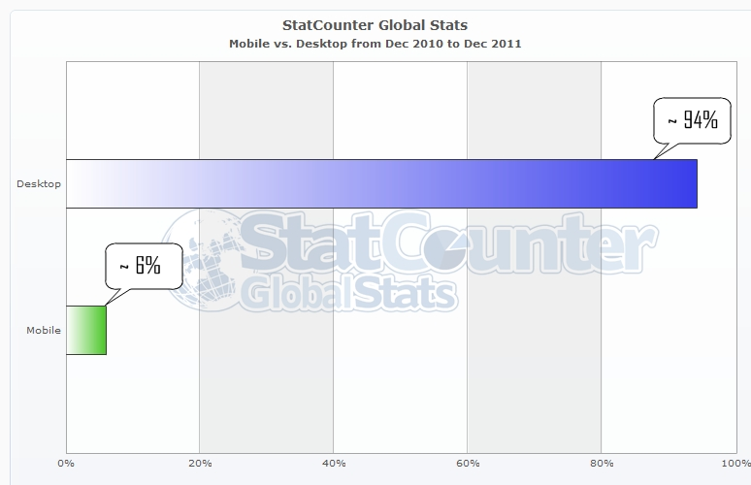
Stats – Mobile vs. Desktop
World Wide (~ 6.8 billion people)
@keburnell ∙ DotNetDevDude.com
Notes:
Scrum most popular.

Slide 7
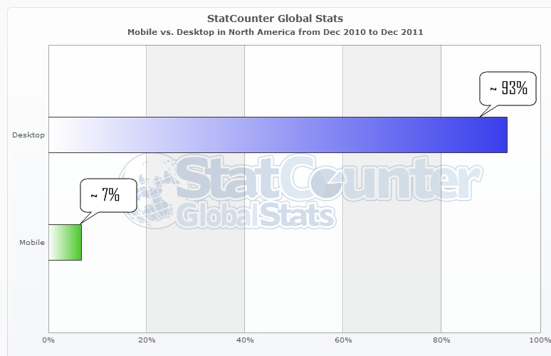
Stats – Mobile vs. Desktop
North America (~ 528 million people)
@keburnell ∙ DotNetDevDude.com
Notes:
Scrum most popular.

Slide 8
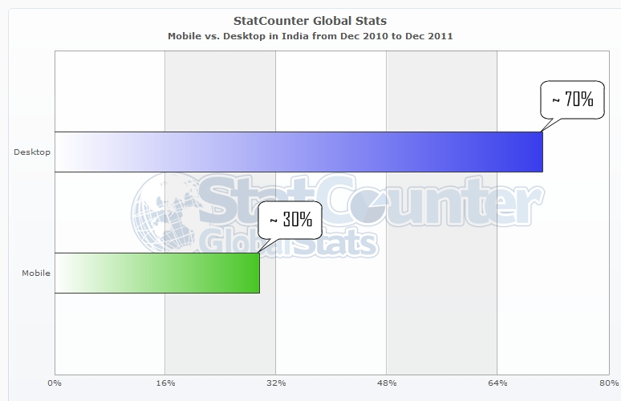
Stats – Mobile vs. Desktop
India (~ 1.7 billion people)
@keburnell ∙ DotNetDevDude.com
Notes:
Scrum most popular.

Slide 9
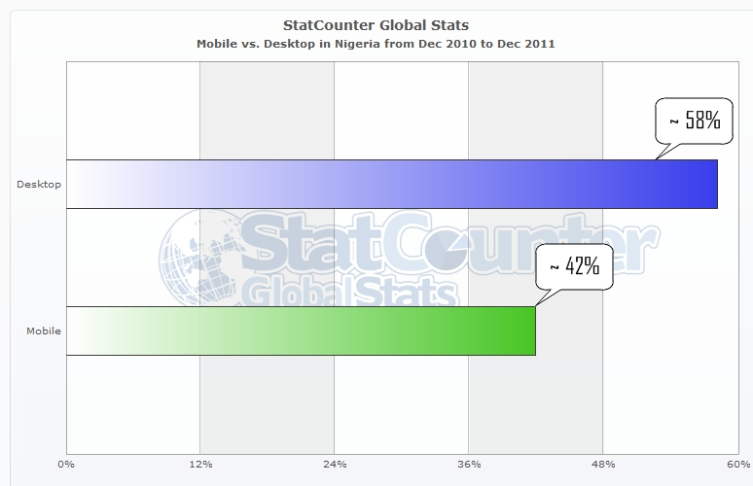
Stats – Mobile vs. Desktop
Nigeria (~ 1.6 million people)
@keburnell ∙ DotNetDevDude.com
Notes:
Scrum most popular.

Slide 10
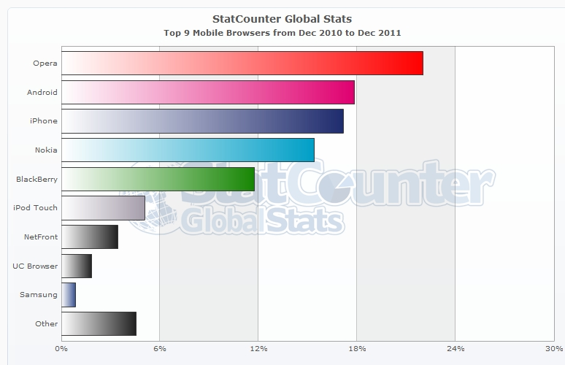
Stats – Mobile Browser Shares
@keburnell ∙ DotNetDevDude.com
Notes:
Scrum most popular.

Slide 11
But What Does It All Mean?
If your website does not display and/or function correctly on mobile devices you are not reaching your full audience.
Potentially millions of users and millions of dollars being lost!
@keburnell ∙ DotNetDevDude.com
Notes:
Scrum most popular.

Slide 12
Current State With Vanilla MVC3
@keburnell ∙ DotNetDevDude.com
Notes:
Scrum most popular.

Slide 13
Vanilla MVC 3 Issues
Android / Windows Phone 7
To make readable have to zoom way in
Once zoomed in required to be constantly panning left, right, up, and down
iPhone
Browser makes a noble attempt to render the page in what it perceives is a more usable view…and does a fairly good job (damn Apple!)
@keburnell ∙ DotNetDevDude.com
Notes:
Scrum most popular.

Slide 14
You can make things better with MVC3
@keburnell ∙ DotNetDevDude.com
Notes:
Scrum most popular.

Slide 15
If you do nothing else…
<meta name=“viewport” content=“width=d
@keburnell ∙ DotNetDevDude.com
Notes:
Scrum most popular.

Slide 16
…at least add a viewport meta tag!
<meta name=“viewport” content=“width=device-width” />
@keburnell ∙ DotNetDevDude.com
Notes:
Scrum most popular.

Slide 17
There is a lot more you can do
Implement view switching by creating a custom view engine.
Implement mobile specific views.
Use jQuery mobile, PhoneGap, Sencha Touch, etc. to give your site the Native feeling.
@keburnell ∙ DotNetDevDude.com
Notes:
Scrum most popular.

Slide 18
But we don’t have to do all the work thanks to ASP.NET MVC4
@keburnell ∙ DotNetDevDude.com
Notes:
Scrum most popular.

Slide 19
MVC4 : New mobile specific features
Mobile project template
Enhancements for adaptive rendering
Display Modes
@keburnell ∙ DotNetDevDude.com
Notes:
Scrum most popular.

Slide 20
Mobile Project Template
File -> New Project -> Web -> ….
Now you can choose a Mobile Application
Includes jQuery Mobile and the plumbing
@keburnell ∙ DotNetDevDude.com
Notes:
Scrum most popular.

Slide 21
Enhancements for Adaptive Rendering
Viewport meta tag included by default
CSS media queries
@keburnell ∙ DotNetDevDude.com

Slide 22
Display Modes
Lets an application select views depending on the browser making the request.
This concept is possible in MVC3 using a custom View Engine.
MVC4 implementation is clean and simple!
@keburnell ∙ DotNetDevDude.com
Notes:
Scrum most popular.

Slide 23
Display Modes: Mobile Specific Views
Lets you globally override view displayed when served to mobile devices in general
Built In – Out of the box
Uses Convention over Configuration
[viewName].mobile.cshtml
@keburnell ∙ DotNetDevDude.com
Notes:
Scrum most popular.

Slide 24
Display Modes: Mobile Browser Specific Views
Lets you globally override view displayed when served to mobile to specific mobile browsers
Requires minimal configuration
Uses Naming Convention
[viewName].iPhone.cshtml
@keburnell ∙ DotNetDevDude.com
Notes:
Scrum most popular.

Slide 25
Dial up the Wow Factor with jQuery Mobile
@keburnell ∙ DotNetDevDude.com
Notes:
Scrum most popular.

Slide 26
jQuery Mobile: Introduction
An open source library for building touch-optimized web UI’s.
Built on jQuery Core.
HTML5 Markup-driven configuration.
Progressive enhancement.
Accessibility features
Powerful theming support (ThemeRoller)
@keburnell ∙ DotNetDevDude.com
Notes:
Scrum most popular.

Slide 27
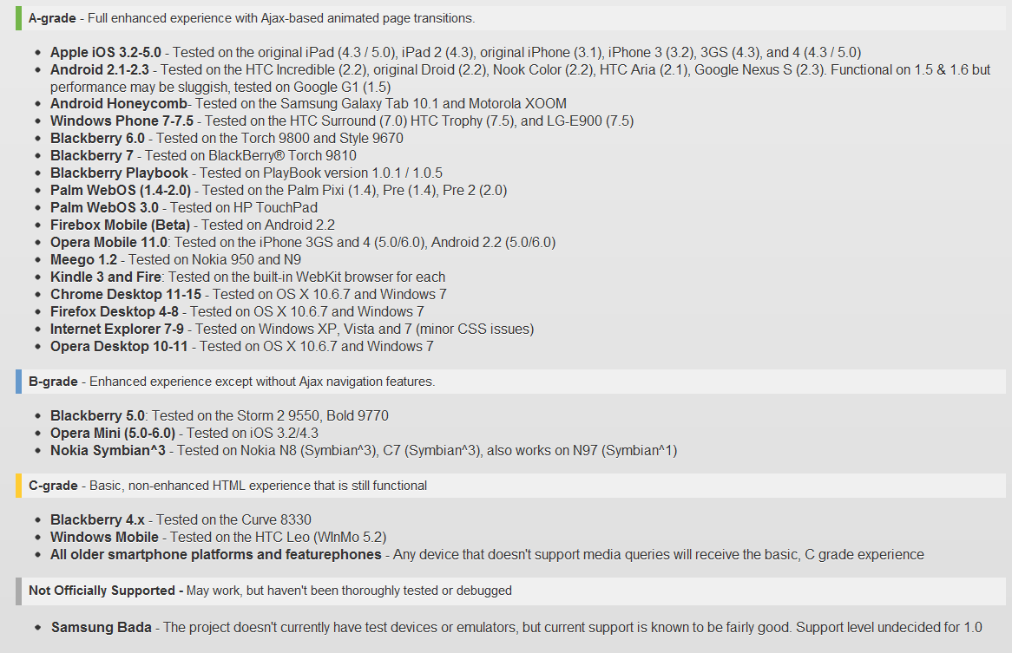
jQuery Mobile: Supported Platforms
@keburnell ∙ DotNetDevDude.com
Notes:
Scrum most popular.

Slide 28
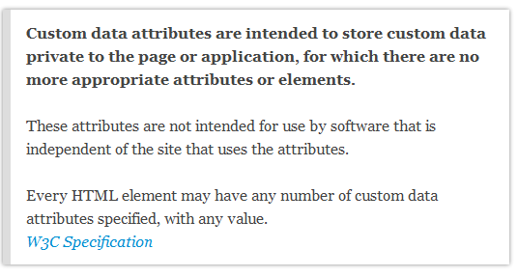
jQuery Mobile: The “data-” attribute
Key value pairs for storing data, where key is prefixed with data-.
Prefixing with data- ensures that the attributes will be ignored by the user agent.
@keburnell ∙ DotNetDevDude.com
Notes:
Scrum most popular.

Slide 29
jQuery Mobile: Page Anatomy
Must be HTML5 doctype
Top level element, typically a DIV tag, with data-role=“page”
Within the top level element any valid HTML can be used but the typical jQuery Mobile structure is.
<div data-role="page"> <div data-role="header">...</div> <div data-role="content">...</div> <div data-role="footer">...</div> </div>
@keburnell ∙ DotNetDevDude.com
Notes:
Scrum most popular.

Slide 30
jQuery Mobile: Installing
NuGet: package-install jquery.mobile
Wire up
Create _Layout.mobile.cshtml
Add script references in _Layout.mobile.cshtml
Add CSS references in _Layout.mobile.cshtml
Implement in your views
@keburnell ∙ DotNetDevDude.com
Notes:
Scrum most popular.

Slide 31
jQuery Mobile MVC (Quick Sidebar)
jQuery.Mobile.MVC
Includes jQuery Mobile and helper files
A jQuery Mobile based layout
Views\Shared\_Layout.mobile.cshtml
A view-switcher component
Allows switching between mobile & desktop views
Views/Shared/_ViewSwitcher.cshtml
Controllers/ViewSwitcherController.cs
Takes care of a lot of the plumbing
@keburnell ∙ DotNetDevDude.com
Notes:
Scrum most popular.

Slide 32
Coding Time! Making it all Come Together
@keburnell ∙ DotNetDevDude.com
Notes:
Scrum most popular.

Slide 33
Resources
Slides and Demo Code
https://github.com/KBurnell/MobileMasses and/or via my blog
ASP.NET MVC 4 Home Page
http://www.asp.net/MVC/MVC4
jQuery Mobile Home Page
http://www.jquerymobile.com
My Blog
http://www.dotnetdevdude
MSDN Magazine
Rachel Appel’s series on mobile development with MVC
What’s New in ASP.NET MVC 4 for Mobile
Being published in May issue, written by Me☺
@keburnell ∙ DotNetDevDude.com
Notes:
Scrum most popular.

Slide 34
Friday April 27th (all day)
Radisson Paper Valley Hotel (Appleton, WI)
Led by Clark Sell and Brian Prince
Hands on deep dive
Free
Lunch will be provided
Bring your own hardware
Register Now!
http://www.BootCamp.fvnug.org
@keburnell ∙ DotNetDevDude.com
Notes:
Scrum most popular.

Slide 35
Saturday April 28th (8:00 – 4:30)
Fox Valley Tech Commons area
Great speakers and content
Free
Lunch will be provided
Lots of Swag!
All attendees will get a free eBook from O’Reilly
Register Now!
http://www.DayOfDotNet.fvnug.org
@keburnell ∙ DotNetDevDude.com
Notes:
Scrum most popular.

Slide 36

@keburnell ∙ DotNetDevDude.com
Notes:
Scrum most popular.

Slide 37
Thank You!
Questions?
Twitter: @keburnell
Blog: DotNetDevDude.com
Email: keith@DotNetDevDude.com
@keburnell ∙ DotNetDevDude.com
Notes:
Scrum most popular.

