Slide 1
COURSE STRUCTURE
Session 3 — AI and Legal Tech (21/10/2026)
  Applications of AI to legal and compliance
  Law firm and compliance market
  Legal AI Business Strategy
  Group work: Legora expansion to French market
Session 4 — AI and the Legal Industry (22/10/2026)
  Preparation time group work
  Legora Guest Speaker: AI for the Legal Industry
  Group presentations

Slide 2
COURSE GRADING
Deliverable 1 (30%) – AI Compliance Case Study (Individual)
  Data and AI Case study slide-deck (Max. 5 slides)
  Including Case Risk Matrix (e.g. spidergram) of the case study
  Deadline: End of session 2
Deliverable 2 (70%) – LegalTech Market Strategy (By groups of 5)
  Compliance Assessment of case study – Deadline: end of session 2
  Pitch Presentation (5 minutes)
  Business Strategy per segment (12 slides max per group)
  Deadline: End of session 4

Slide 3
IN-COURSE EXERCISE
1
2
3
4
Identify a relevant use case
Prepare a slide deck with the presentation of the use case (5 slides max)
Evaluate Data & AI Compliance Risks
Design Risk Matrix
Phase 1
Phase 2
Phase 3
Phase 4

Slide 4


VALUE PROPOSITION OF DATA AND AI
Improve internal processes
Improve market success
Strategic optionality
Notes:
The most common uses of AI for business are to take better decisions, improve operations, and to enhance products and services—including innovation. The first two are an extension of business analytics and typically use machine learning (I called it here internal transparency)—
Source: https://hbr.org/2018/01/artificial-intelligence-for-the-real-world
Process automation.
Of the 152 projects we studied, the most common type was the automation of digital and physical tasks—typically back-office administrative and financial activities—using robotic process automation technologies. RPA is more advanced than earlier business-process automation tools, because the “robots” (that is, code on a server) act like a human inputting and consuming information from multiple IT systems. Tasks include:transferring data from e-mail and call center systems into systems of record—for example, updating customer files with address changes or service additions;
replacing lost credit or ATM cards, reaching into multiple systems to update records and handle customer communications;
reconciling failures to charge for services across billing systems by extracting information from multiple document types; and
“reading” legal and contractual documents to extract provisions using natural language processing.
Cognitive insight.
The second most common type of project in our study (38% of the total) used algorithms to detect patterns in vast volumes of data and interpret their meaning. Think of it as “analytics on steroids.” These machine-learning applications are being used to:
predict what a particular customer is likely to buy;
automate personalized targeting of digital ads;
identify credit fraud in real time and detect insurance claims fraud;
analyze warranty data to identify safety or quality problems in automobiles and other manufactured products;
provide insurers with more-accurate and detailed actuarial modeling.
Cognitive engagement.
Projects that engage employees and customers using natural language processing chatbots, intelligent agents, and machine learning were the least common type in our study (accounting for 16% of the total). This category includes:
intelligent agents that offer 24/7 customer service addressing a broad and growing array of issues from password requests to technical support questions—all in the customer’s natural language;
product and service recommendation systems for retailers that increase personalization, engagement, and sales—typically including rich language or images; and
internal sites for answering employee questions on topics including IT, employee benefits, and HR policy;
health treatment recommendation systems that help providers create customized care plans that take into account individual patients’ health status and previous treatments.

Slide 5
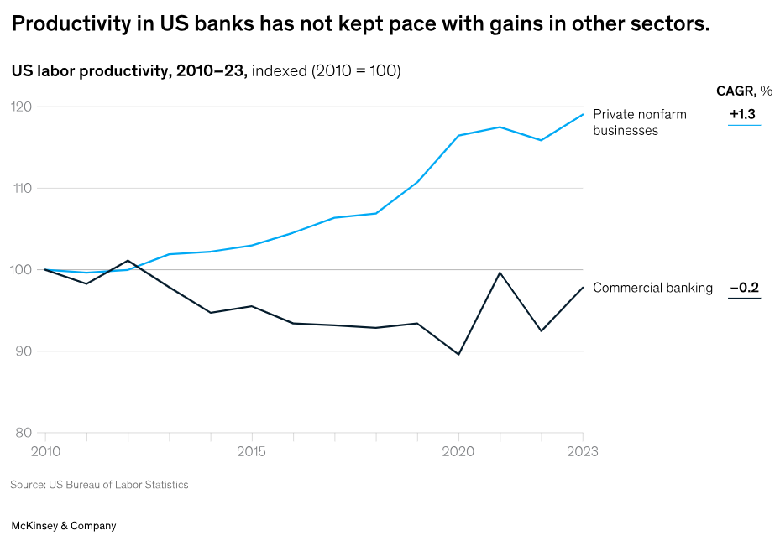
INWARDS LOOKING
Increase internal process efficiency and productivity
Faster and better execution of tasks by employees (text generation to coding)
Creating insights, e.g., real-time data dashboards for management and decision-makers
Automation, e.g., automatic filing of client book address based on emails, HR work-flows Spirit AeroSystems
Classification, e.g., classification of information to redirect customer’s complaints to the right services
Prediction, e.g., predictive models to anticipate the need for maintenance, fraud detection
Notes:
$1T in savings projected by 2030–2035 through AI in banking. 50% of savings expected from front-office functions.
AI reduces fraud, errors, and boosts automation & customer experience.
Online banks now hold 6.5% of loan market and rising.
71% of users prefer managing accounts via app or computer.

