Slide 1
The Sunset HTTP Header Field
HTTP API Building Blocks

Slide 2
The Sunset HTTP Header Field
Internet RFC 8594
Resources and APIs disappear at some point in time; the Sunset field allows to advertise that event to clients.
HTTP API Building Blocks

Slide 3
The Sunset HTTP Header Field
Why this Building Block?
When a resource or an API is about to be retired, it would be useful for consumers of that resource/API to be notified in advance. By using an HTTP field, this information can be conveyed in-band, instead of having to rely on out-of-band channels such as announcements that are published on Web pages or sent by email.
HTTP API Building Blocks

Slide 4
The Sunset HTTP Header Field
History
Erik Wilde, “The Sunset HTTP Header Field”, Internet RFC 8594, May 2019
HTTP API Building Blocks

Slide 5
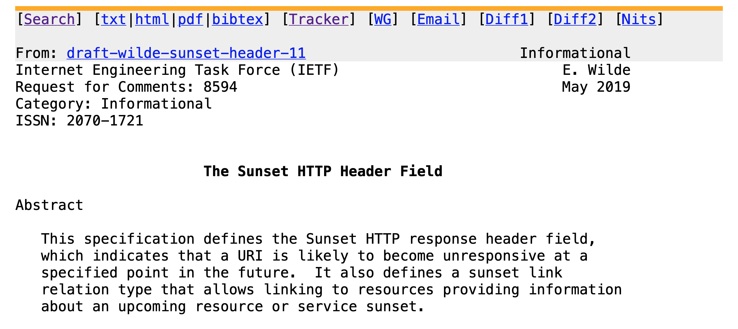
HTTP API Building Blocks

Slide 6
The Sunset HTTP Header Field
Simple Example
Sunset: Wed, 31 Dec 2025 23:59:59 GMT
HTTP API Building Blocks

Slide 7
The Sunset HTTP Header Field
Example in Context
HTTP/1.1 200 OK
Date: Mon, 27 Jul 2009 12:28:53 GMT
Server: Apache
Last-Modified: Wed, 22 Jul 2009 19:15:56 GMT
Sunset: Thu, 31 Dec 2009 23:59:59 GMT
Content-Length: 51
Content-Type: text/plain
HTTP API Building Blocks

