Slide 1
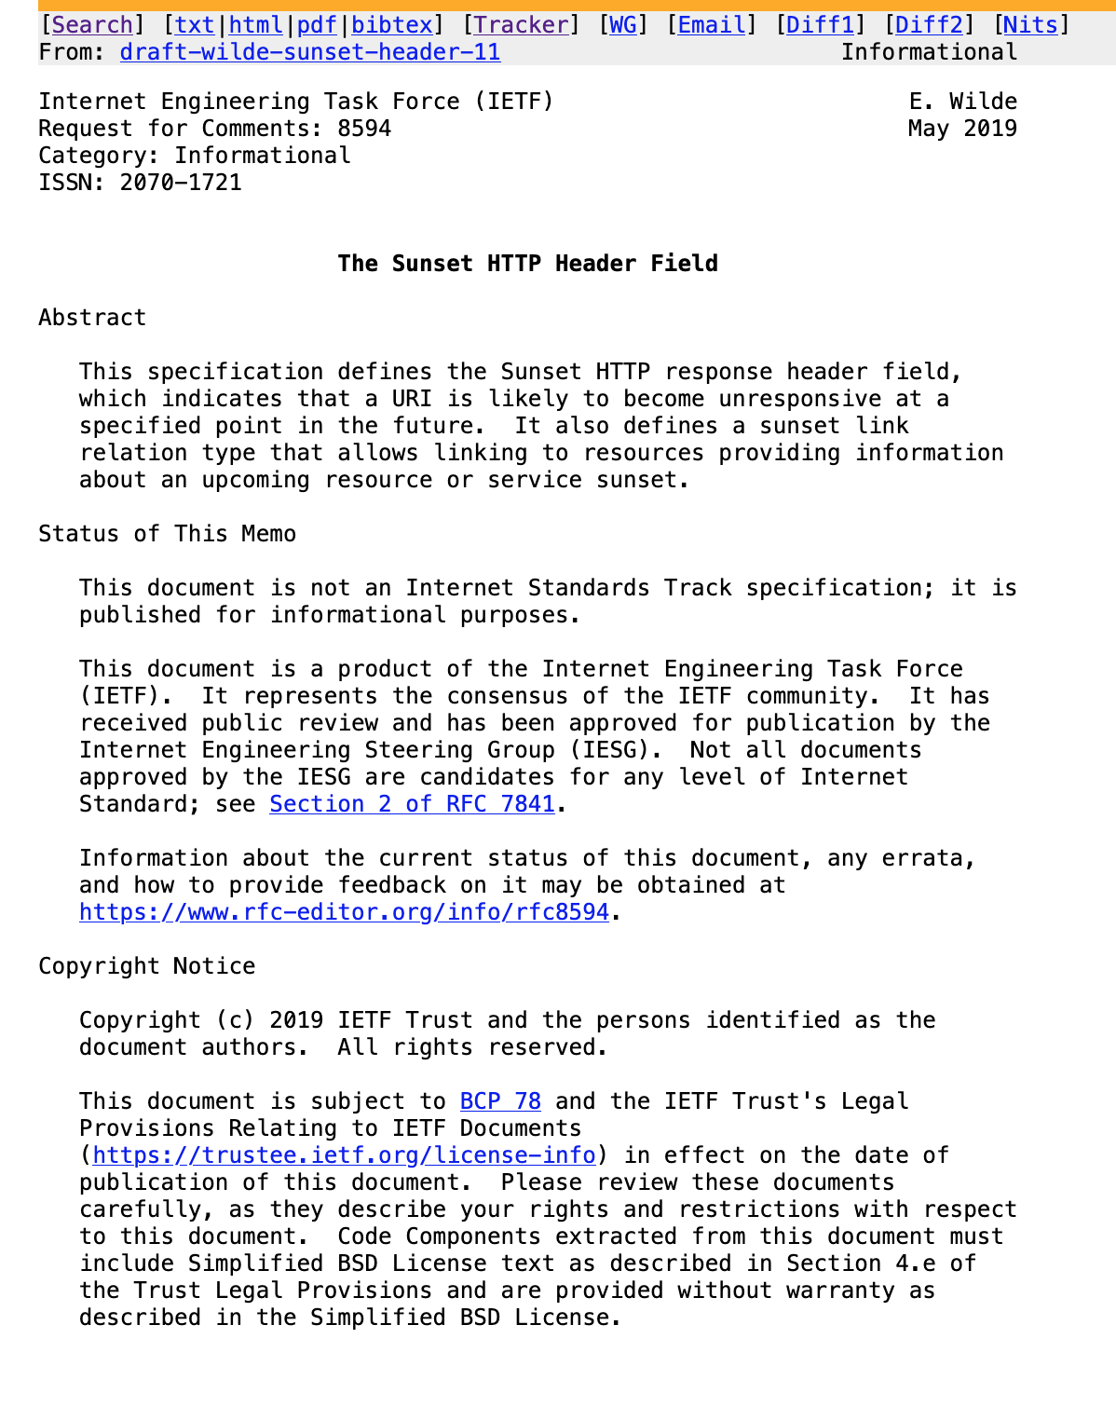
The Sunset HTTP Header Field
Building Blocks for HTTP APIs

Slide 2
The Sunset HTTP Header Field
Internet RFC 8594
Resources and APIs disappear at some point in time; the HTTP Sunset header field allows to advertise that event to clients.
Building Blocks for HTTP APIs

Slide 3
The Sunset HTTP Header Field
Why this Building Block?
When a resource or an API is about to be retired, it would be useful for consumers of that resource/API to be notified in advance. By using an HTTP header field, this information can be conveyed in-band, instead of having to rely on out-of-band channels such as announcements that are published on Web pages or sent by email.
Building Blocks for HTTP APIs

Slide 4
The Sunset HTTP Header Field
History
Erik Wilde, “The Sunset HTTP Header Field”, Internet RFC 8594, May 2019
Building Blocks for HTTP APIs

Slide 5
The Sunset HTTP Header Field
What does the Building Block do?
RFC 8594 defines the HTTP header field "Sunset" which is used to advertise the timestamp when a resource/API will become unavailable. Providers can use this header field to advertise the sunset when it is known. Consumers can use the header field to react to such an advertisement, for example by raising alarms or by writing information to a log.
Building Blocks for HTTP APIs

Slide 6
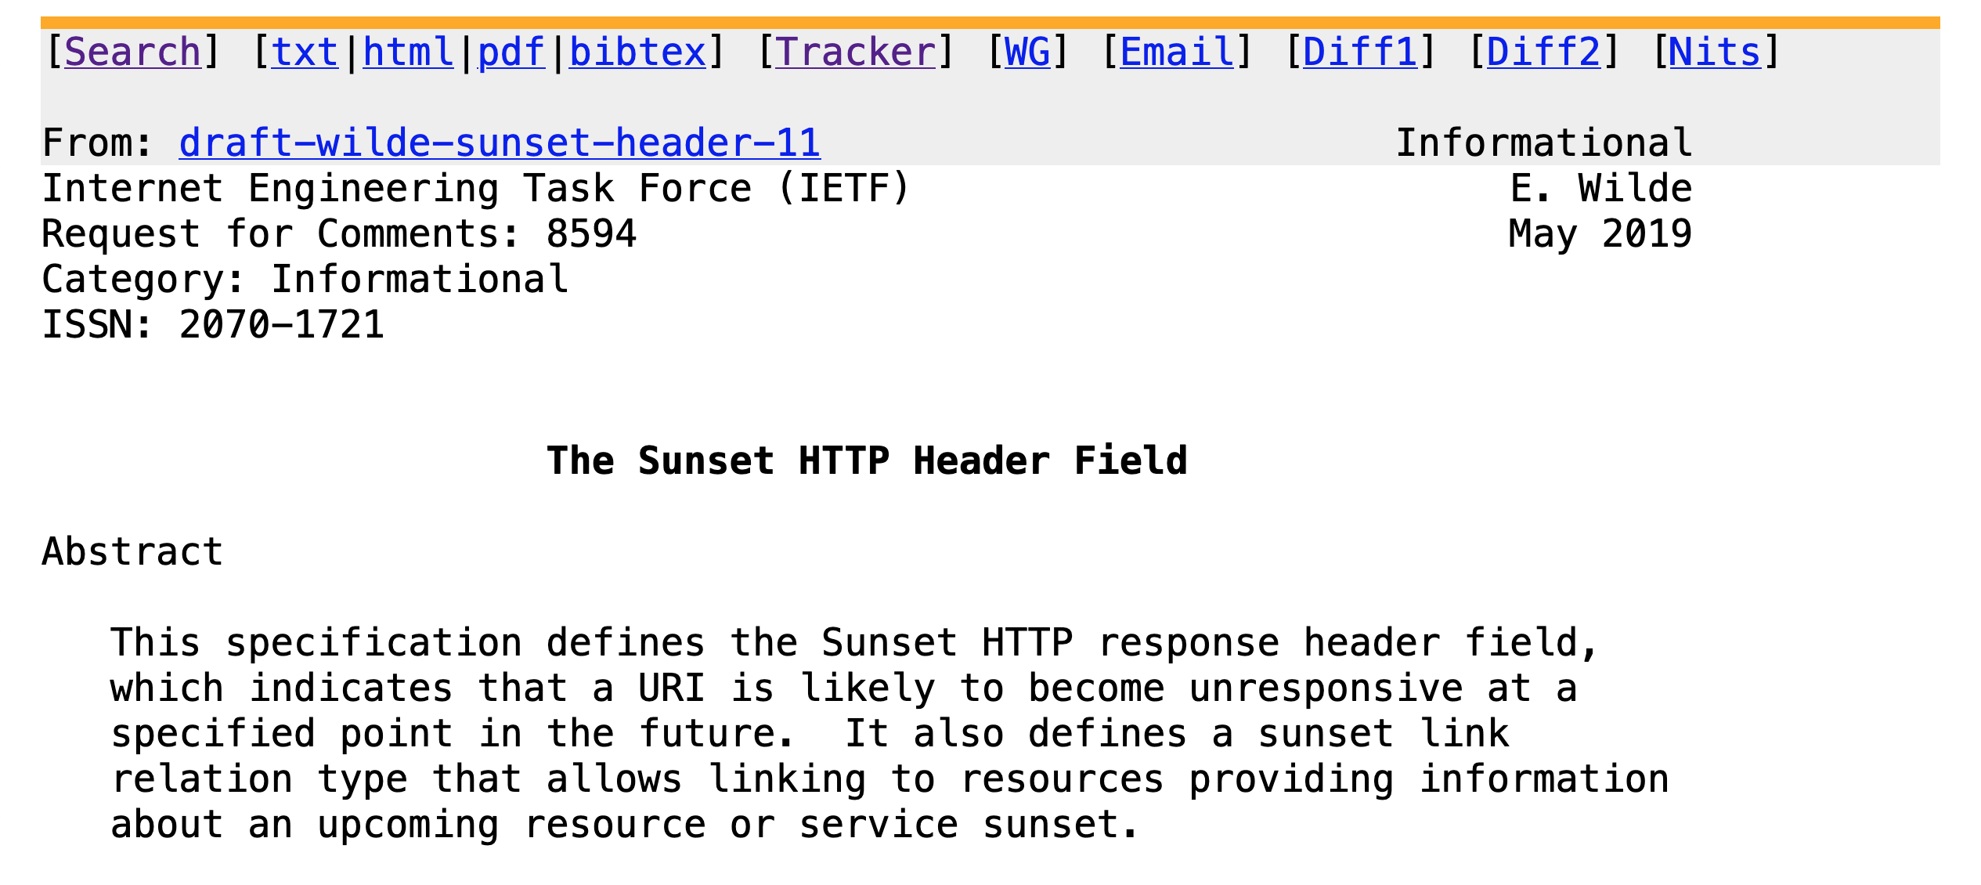
Building Blocks for HTTP APIs

Slide 7
The Sunset HTTP Header Field
Web Concepts:
HTTP Header Field: Sunset
Link Relation: Sunset
Building Blocks for HTTP APIs

Slide 8
The Sunset HTTP Header Field
Simple Example
Sunset: Wed, 31 Dec 2025 23:59:59 GMT
Building Blocks for HTTP APIs

Slide 9
The Sunset HTTP Header Field
Example in Context
HTTP/1.1 200 OK
Date: Mon, 27 Jul 2009 12:28:53 GMT
Server: Apache
Last-Modified: Wed, 22 Jul 2009 19:15:56 GMT
Sunset: Thu, 31 Dec 2009 23:59:59 GMT
Content-Length: 51
Content-Type: text/plain
Building Blocks for HTTP APIs

Slide 10
The Sunset HTTP Header Field
Internet RFC 8594
https://httpapis.info/RFC-8594-The-Sunset-HTTP-Header-Field
https://datatracker.ietf.org/doc/html/rfc8594
Building Blocks for HTTP APIs

