Slide 1
The Item and Collection Link Relations
HTTP API Building Blocks

Slide 2
The Item and Collection Link Relations
Internet RFC 6573
Defines a pair of reciprocal link relation types that may be used to express the relationship between a collection and its members.
HTTP API Building Blocks

Slide 3
The Item and Collection Link Relations
Why this Building Block?
Link relation values can be used to indicate _why_ an application would active a link or form. RFC6573 defines two possible reasons for activating (or following) links: to reach a `collection` or to view an `item` in a collection. Response representations that include these link relation values are identifying which links return collections and which links return items from a collection.
HTTP API Building Blocks

Slide 4
The Item and Collection Link Relations
History
Mike Amundsen, “The Item and Collection Link Relations”, Internet RFC 6573, April 2012
HTTP API Building Blocks

Slide 5
The Item and Collection Link Relations
What does the Building Block do?
This specification relies on RFC5988 which standardized a means of indicating the relationships between resources on the Web. This doc (RFC6573) defines a pair of reciprocal link relation types that may be used to express the relationship between a collection and its members. These link relation types can be applied to a wide range of use cases across multiple media types.
HTTP API Building Blocks

Slide 6
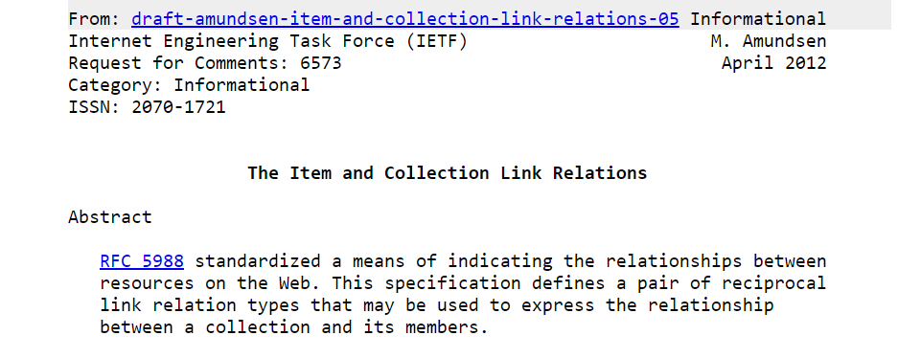
HTTP API Building Blocks

Slide 7
The Item and Collection Link Relations
Web Concepts:
https://webconcepts.info/specs/IETF/RFC/6573.html
https://webconcepts.info/concepts/link-relation/collection
https://webconcepts.info/concepts/link-relation/item
HTTP API Building Blocks

Slide 8
The Item and Collection Link Relations
Simple Example
Link: <...>; rel=“collection”; title=“Product List”
Link: <...>; rel=“item”; title=“View Product X001”
HTTP API Building Blocks

Slide 9
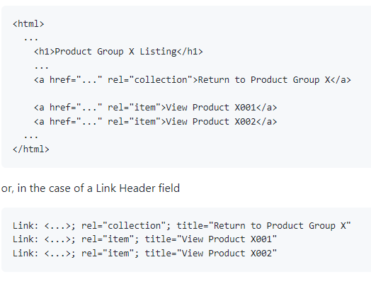
The Item and Collection Link Relation
Example in Context
HTTP API Building Blocks

Slide 10
The Item and Collection Link Relations
Internet RFC 6573
https://httpapis.info/RFC-6573-The-Item-And-Collection-Link-Relations
https://datatracker.ietf.org/doc/html/rfc6573
HTTP API Building Blocks

