Slide 1

The GitHub Network
Limingrui Wan
Danyu Zhang
Daniel Alonso

Slide 2
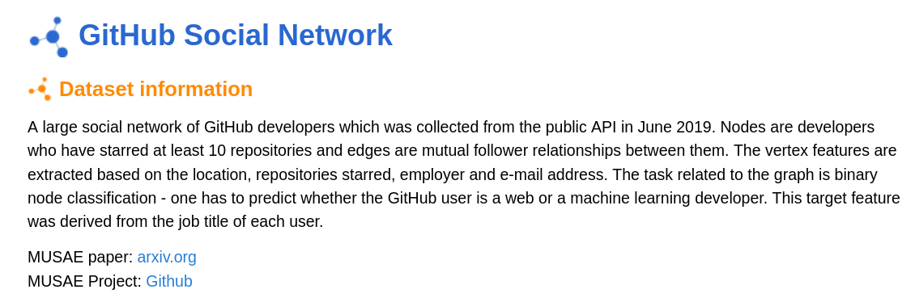
Description of the network and source

Slide 3
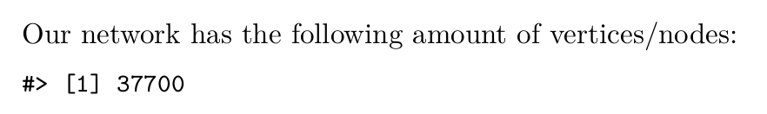
Vertices/Nodes

Slide 4
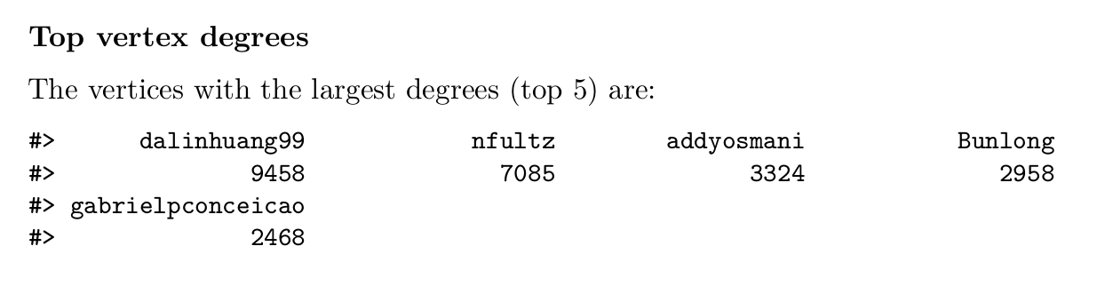
Vertices/Nodes’ Degrees

Slide 5
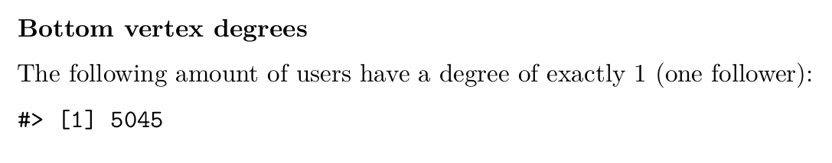
Vertices/Nodes’ Degrees

Slide 6
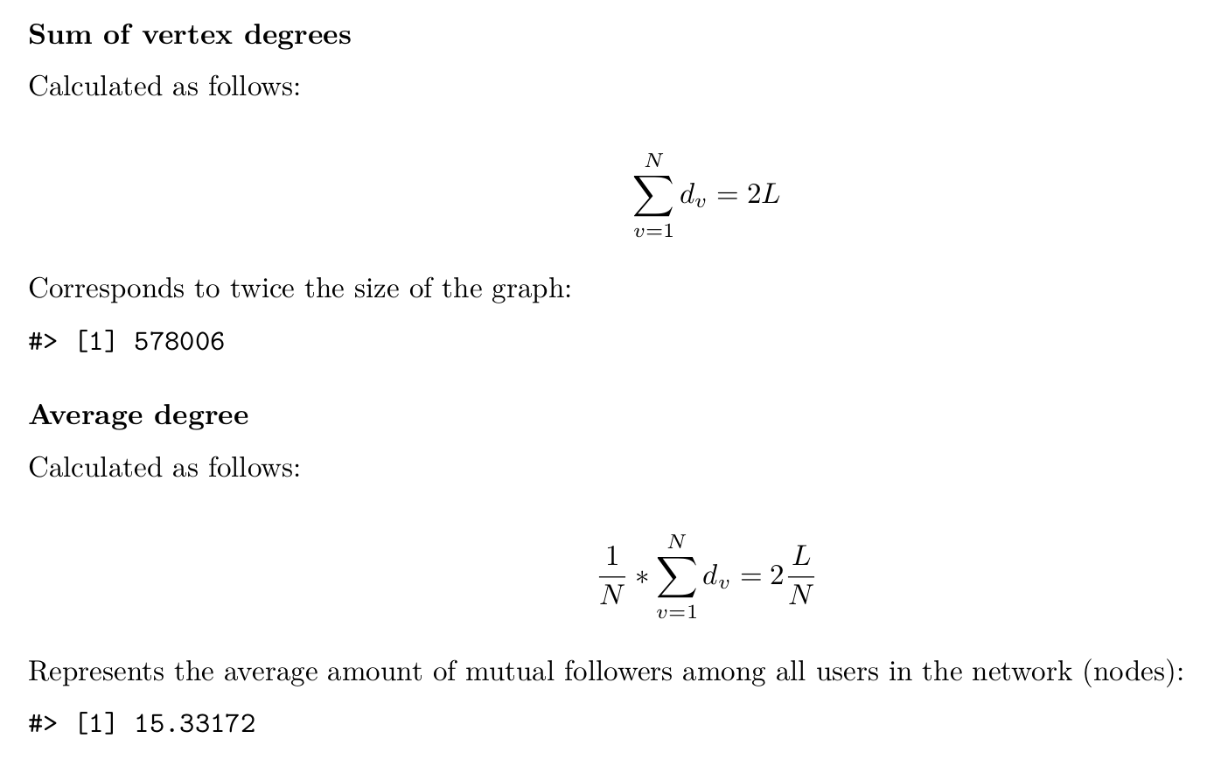
Vertices/Nodes’ Degrees

Slide 7
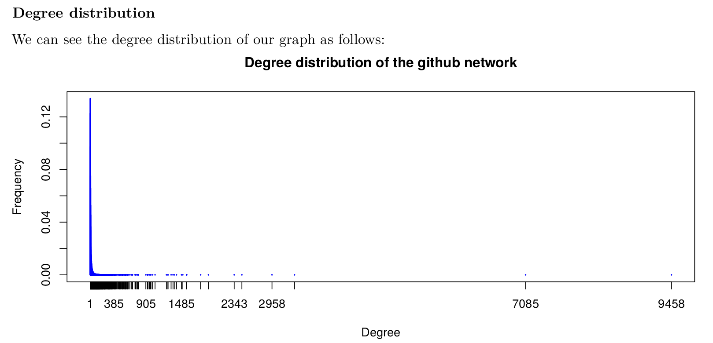
Vertices/Nodes’ Degrees

Slide 8
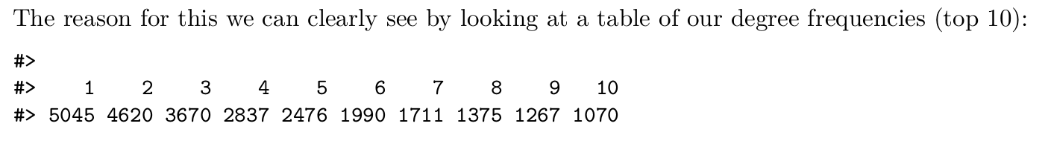
Vertices/Nodes’ Degrees

Slide 9
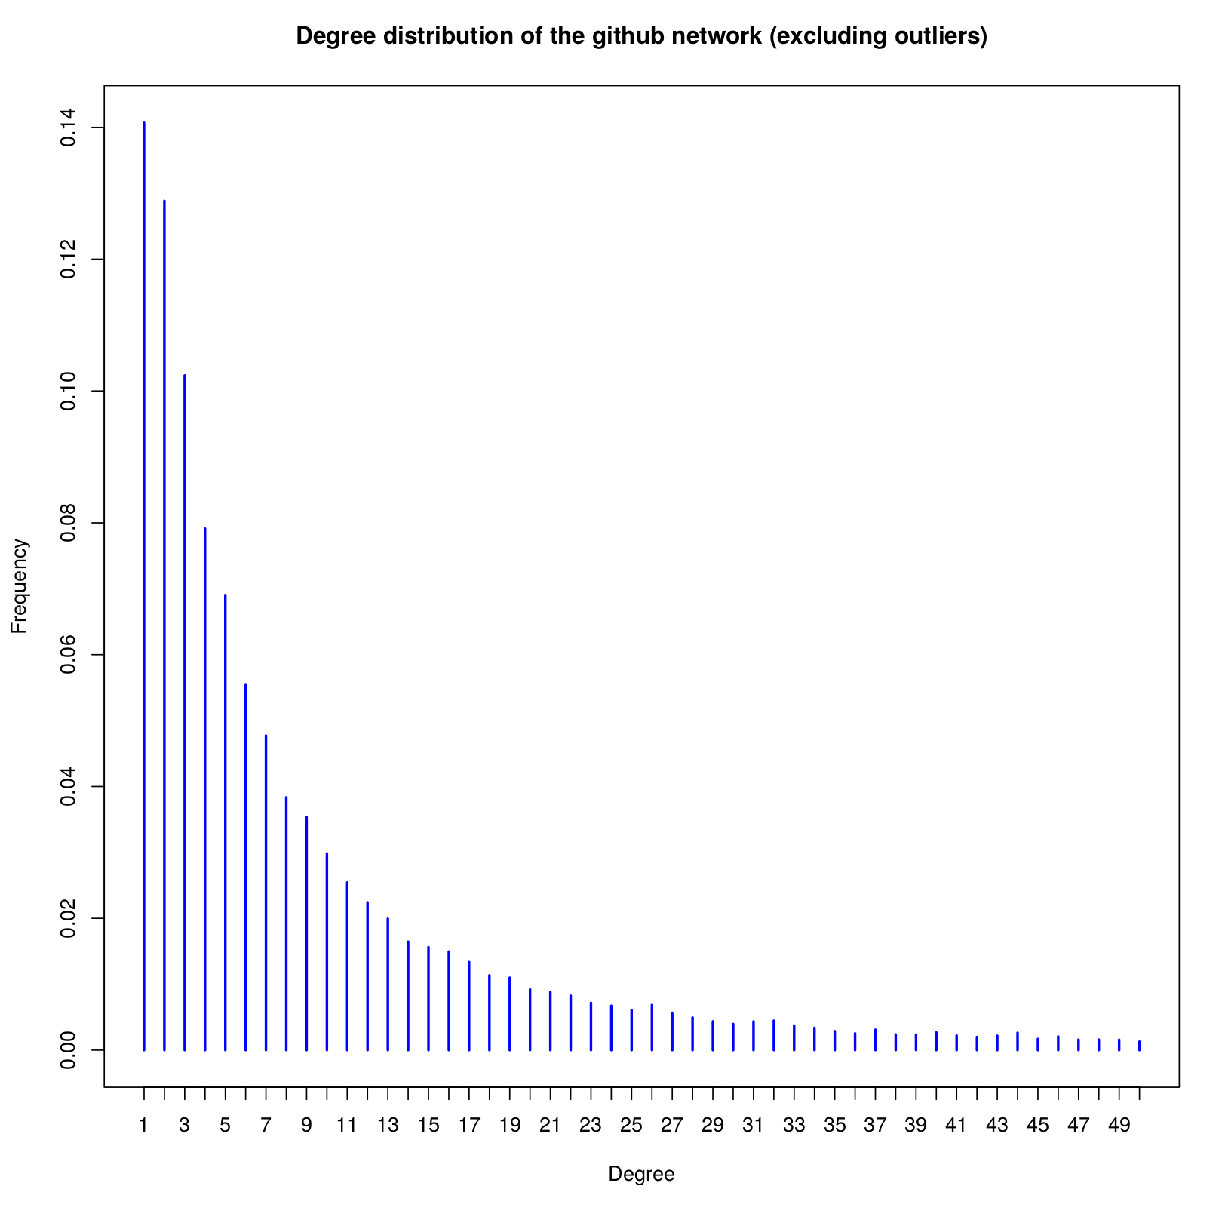
Vertices/Nodes’ Degrees

Slide 10
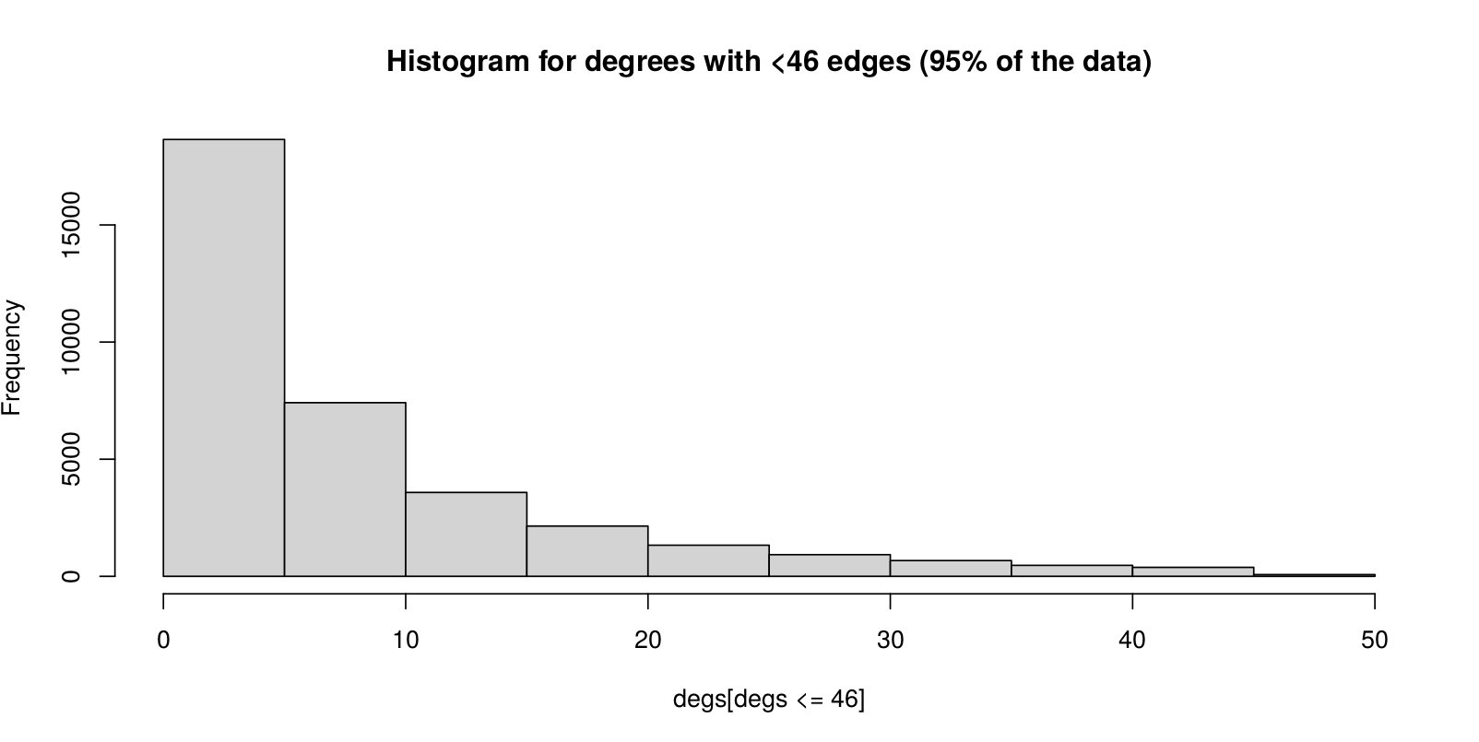
Vertices/Nodes’ Degrees

Slide 11
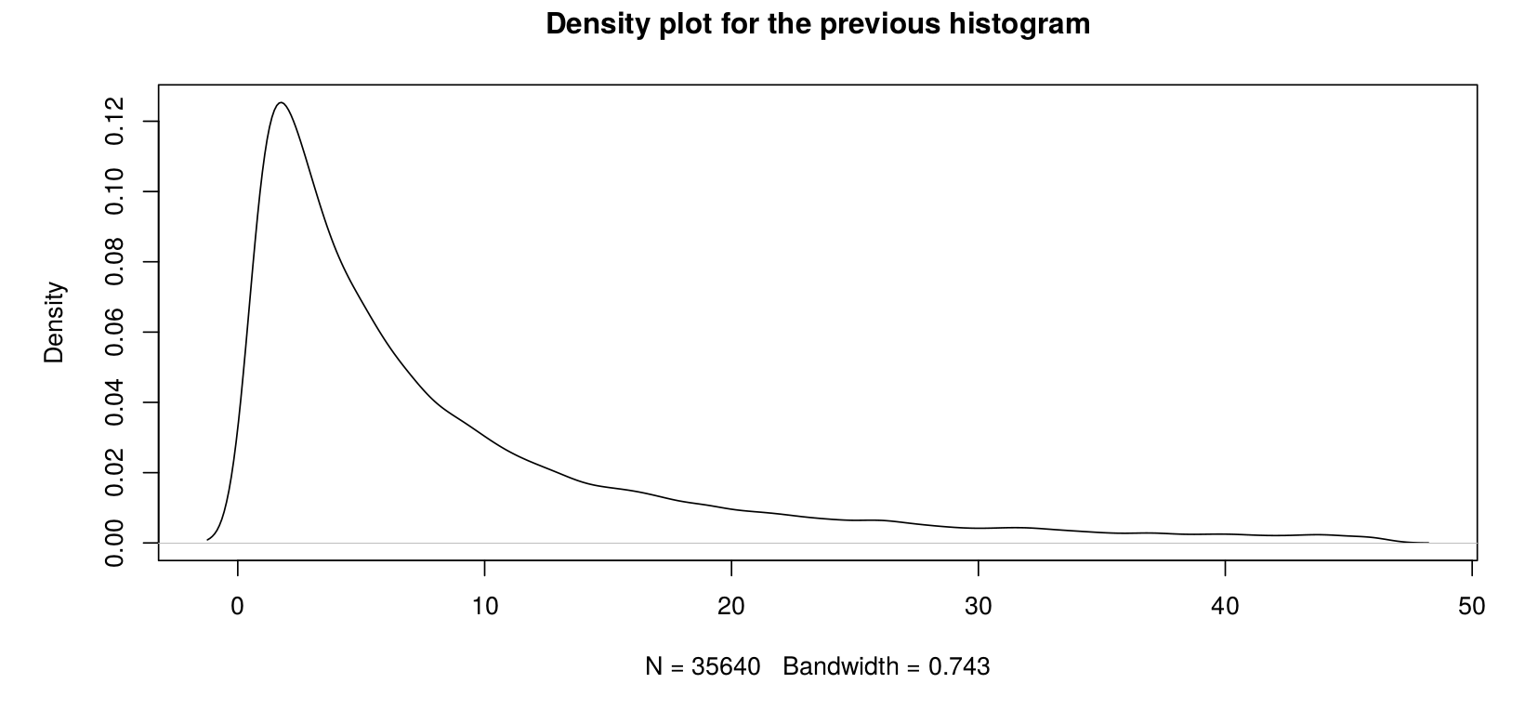
Vertices/Nodes’ Degrees

Slide 12
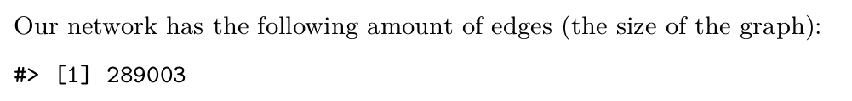
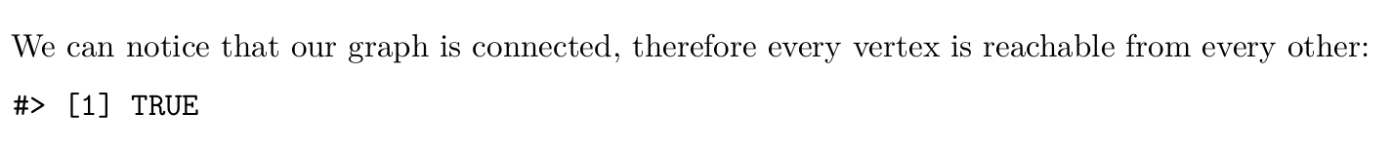
Edges/Links

Slide 13
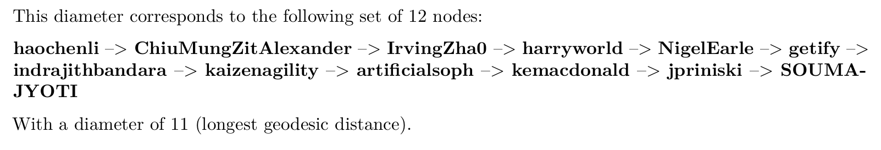
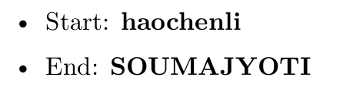
Diameter and farthest vertices

