Slide 1

12.2 Assignment: Term Project
DSC530-T301 Exploration and analysis
By: reuben decker
Notes:
This is the Term Project presented by Reuben Decker.

Slide 2
“Unraveling Natural Forces: Climate Change Factors Beyond Human Influence”
Hypothesis: Could there be natural forces that are factors to climate change?
Notes:
I'm exploring natural climate change factors alongside human-induced ones to deepen my understanding of climate dynamics.
Distinguishing between natural and human-induced factors is crucial for me to accurately model and predict climate patterns.
I'm leveraging data science to analyze large datasets containing variables like temperature, precipitation, and CO2 levels, extracting insights to inform climate policies.
My exploration of natural forces such as pole movement, sunspot activity, CO2 emissions, and temperature trends empowers me to contribute to proactive climate change mitigation strategies.
I'm passionate about integrating data science into climate research, recognizing its pivotal role in effective policy-making and the pursuit of sustainable practices.

Slide 3

Variables
Year
Average # Sunspots
Average Temp (F)
Average Kilometers
CO2
Notes:
Why these variables?
I'm curious about how Earth's pole positions over time might be linked to changes in our climate.
Exploring any patterns or cycles in Earth's pole positions could help me anticipate future movements and understand their potential impact on climate, especially considering variables like Year and Average Kilometers.
I wonder if there's evidence supporting a correlation between variations in solar sunspots and shifts in Earth's climate over long periods. It's intriguing to think about how variables like Year and Average # Sunspots might interact in this context.
I'd like to delve into how historical variations in solar activity have shaped climate patterns and what that means for our ability to predict future climate trends, considering variables like Year and Average Temp (F).I'm interested in understanding the key natural variables that drive Earth's climate and how they interact with each other.
Exploring variables such as Year, Average # Sunspots, Average Temp (F), Average Kilometers, and CO2 could provide valuable insights into these complex dynamics.

Slide 4
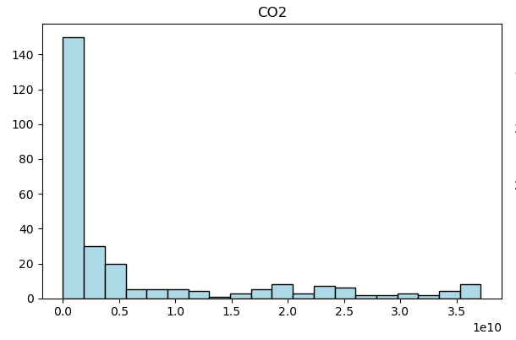
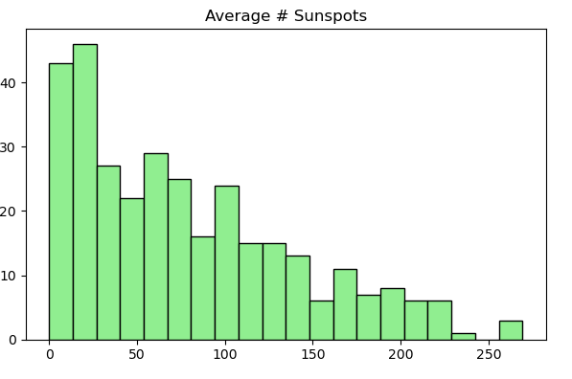
Histograms
Notes:
Histograms:
CO2: This histogram exhibits a skewed distribution, with a sharp increase in frequency observed on the left side of the graph. The majority of data points are concentrated towards the lower end of the range, resulting in a long tail extending towards the right. This pattern suggests that the data is positively skewed, indicating a higher frequency of lower values compared to higher values. Possible interpretations include a dataset with a significant number of low outliers or a positively skewed distribution of values.
Average # Sunspots: In contrast, this histogram depicts a distribution where the frequency of data points gradually increases towards the left side of the graph. The shape of the histogram is relatively uniform or symmetric, suggesting that the data is evenly distributed across the range of values. There are no prominent peaks or troughs, indicating a lack of pronounced skewness or outliers. This pattern suggests a dataset with consistent frequency across the observed values, potentially indicating a random or evenly distributed dataset.

Slide 5
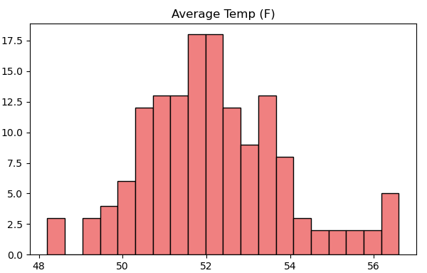
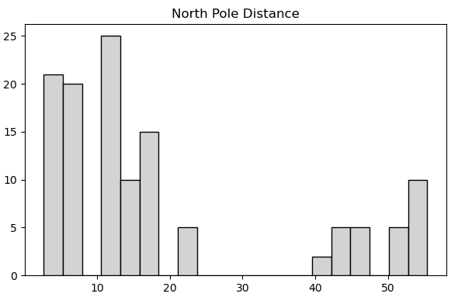
Histograms
Notes:
Histograms:
Average Temp (F): This histogram displays a bell-shaped distribution, commonly known as a normal distribution, with a few missing data points observed on both ends of the distribution. The majority of the data is concentrated around the center, forming the characteristic bell curve shape. However, the absence of data points on the left and right ends suggests that some values may be underrepresented or missing from the dataset. This pattern could indicate potential data collection issues or outliers that are not accounted for in the histogram.
North Pole Distance: In contrast, this histogram exhibits a U-shaped distribution, where the frequency of data points is higher at the ends compared to the middle. The shape resembles an inverted U or a valley, with missing data points observed towards the right side of the U. This pattern suggests that there is a significant drop-off in frequency towards the right end of the distribution, indicating a potential truncation or censoring of data in that range. Possible reasons for this could include data collection limitations, sampling biases, or specific characteristics of the dataset that result in fewer observations towards the right side of the distribution.

Slide 6
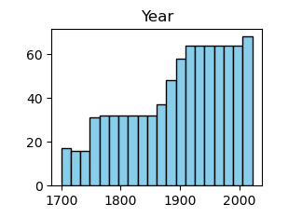
Histograms
Notes:
Histograms:
Year: The histogram of the 'Year' variable displays a gradual increase in frequency towards the right side, indicating a higher number of observations occurring in more recent years. However, this pattern may be attributed to the way the histogram bins are defined rather than a true distribution characteristic. Histograms are sensitive to the number and width of bins used for data visualization, and increasing the number of bins can lead to a finer resolution of the data but may also result in spurious fluctuations. Therefore, while the histogram suggests a trend of increasing frequency over time, it is essential to interpret this pattern with caution and consider the impact of binning choices on the visualization outcome.

Slide 7
Characteristics of the Variables
Mean
Mode
Spread
Tails
Notes:
Characteristics of the Variables?
Year:
Mean: The average year in the dataset is approximately 1898.
Mode: The most common year in the dataset is 1900.
Spread (Variance): The spread or variance of the years is approximately 7247, indicating a wide range of years in the dataset.
Tails: The dataset has 4 tails, suggesting that there are 4 unique years with the highest frequency of occurrence.
Average # Sunspots:
Mean: The average number of sunspots is about 78.38.
Mode: The mode of the dataset is 18.3, indicating a recurring value with the highest frequency.
Spread (Variance): The variance of sunspot counts is approximately 3838.89, indicating variability in the data points.
Tails: The dataset has 5 tails, suggesting that there are 5 unique values with the highest frequency of occurrence.
Average Temp (F):
Mean: The average temperature is around 52.17 degrees Fahrenheit.
Mode: The mode of the temperature dataset is 52.0, indicating a recurring temperature value.
Spread (Variance): The variance of temperatures is approximately 2.84, suggesting relatively low variability in temperature data.
Tails: The dataset has 6 tails, indicating that there are 6 unique temperature values with the highest frequency of occurrence.
Average Kilometers:
Mean: The average distance traveled in kilometers is approximately 19.06.
Mode: The mode of the dataset is 4.97 kilometers, suggesting a frequently occurring distance.
Spread (Variance): The variance of kilometers traveled is approximately 287.35, indicating variability in travel distances.
Tails: The dataset has 6 tails, indicating that there are 6 unique distance values with the highest frequency of occurrence.
CO2:
Mean: The average CO2 emissions value is approximately 6.49 billion metric tons.
Mode: The mode of the CO2 emissions dataset is 9.31 million metric tons, suggesting a frequently occurring emission value.
Spread (Variance): The variance of CO2 emissions is exceptionally high, approximately 1.05 x 10^20, indicating significant variability in emission levels.
Tails: The dataset has 1 tail, suggesting a single unique CO2 emissions value with the highest frequency of occurrence.

Slide 8
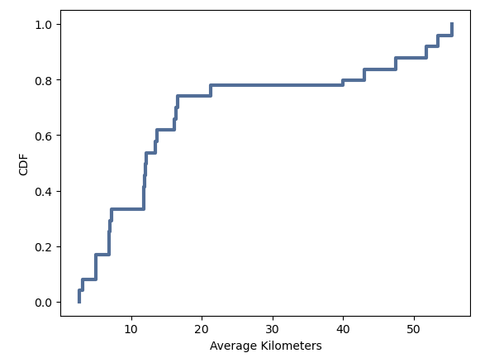
Creating one CDF
Notes:
Creating one CDF: The cumulative distribution function (CDF) generated from the 'Average Kilometers' variable displays a characteristic upward-sloping curve from the bottom left to the upper right, reflecting the increasing cumulative probability as distance traveled from the North Pole increases. Initially, the CDF rises steadily as kilometers increase from 0 to 40, reaching a plateau at approximately 0.8, indicating that 80% of the observations fall below this distance threshold. Beyond 40 kilometers, the CDF continues to ascend towards 1, albeit at a slower rate, suggesting a diminishing probability of observing distances greater than 40 kilometers. This CDF provides valuable insights into the distribution of distances traveled from the North Pole, highlighting the likelihood of different travel distances and aiding in understanding the geographical patterns associated with polar exploration or migration.

Slide 9
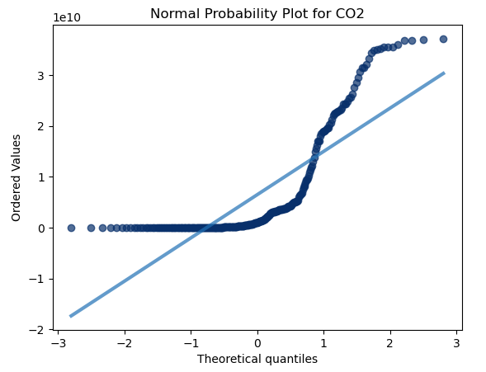
Plot one Analytical Distribution
Notes:
Plot one Analytical Distribution: The Normal Probability Plot for the variable CO2 exhibits an initial linear trend, with the plotted points gradually curving upwards from left to right. Initially, the curve begins to deviate from linearity around the midpoint, between -.5 and 1 on the x-axis, where the curvature becomes more pronounced. This deviation suggests a departure from normality in the distribution of CO2 concentrations. As the plot progresses towards higher theoretical quantiles, the curvature levels off, indicating a convergence towards a more linear relationship. This observation implies that while the CO2 data may not perfectly follow a normal distribution, it exhibits some degree of normality at the extremes. Analyzing the Normal Probability Plot provides valuable insights into the distributional characteristics of CO2 concentrations, aiding in assessing the assumptions underlying statistical analyses and modeling approaches applied to the dataset.

Slide 10
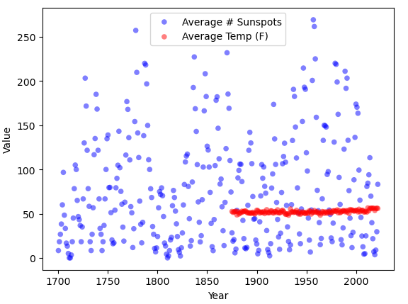
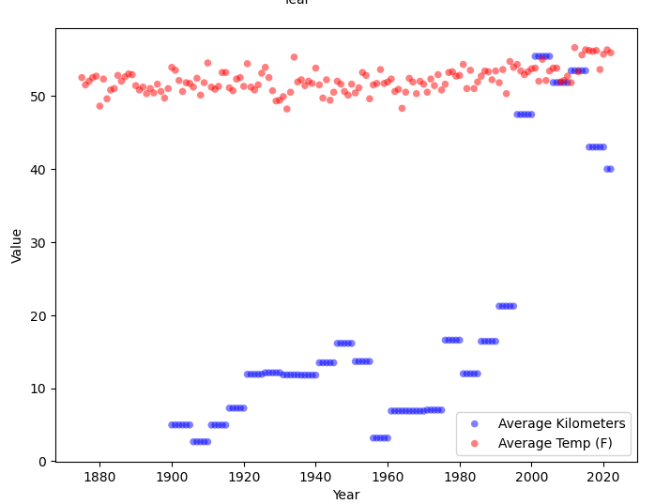
Scatter Plots
Notes:
Scatter Plots:
The scatter plot depicting the relationship between 'Average # Sunspots' and 'Average Temp (F)' appears to exhibit a strong positive correlation, as indicated by the Pearson’s correlation coefficient of 1.0. The scatter points predominantly cluster towards the bottom of the graph, with a few peaks going upwards. This pattern suggests a non-linear relationship between the variables, where higher values of 'Average # Sunspots' correspond to slightly higher temperatures on average. The covariance between the two variables is 756.4, further supporting the presence of a positive linear association. Additionally, the polynomial regression model shows a positive slope of 2.4, indicating that for every unit increase in 'Average # Sunspots', there is a corresponding increase of 2.4 units in 'Average Temp (F)'.
Similarly, the scatter plot illustrating the relationship between 'Average Kilometers' and 'Average Temp (F)' also demonstrates a strong positive correlation, with a Pearson’s correlation coefficient of 1.0. However, unlike the first scatter plot, this one appears to be right-skewed, indicating a non-linear relationship between the variables. The scatter points are concentrated towards the lower end of the x-axis, with fewer points extending towards the higher values. The covariance between 'Average Kilometers' and 'Average Temp (F)' is 1058.96, suggesting a positive linear relationship. The polynomial regression model exhibits a positive slope of 1.714, indicating that for every unit increase in 'Average Kilometers', there is a corresponding increase of 1.714 units in 'Average Temp (F)'.
In summary, both scatter plots demonstrate a positive correlation between the independent variables and the dependent variable 'Average Temp (F)'. However, the first scatter plot suggests a slightly stronger linear relationship compared to the second, which exhibits a right-skewed distribution. Overall, the analysis suggests that both 'Average # Sunspots' and 'Average Kilometers' play a role in influencing variations in 'Average Temp (F)', with the former exhibiting a more pronounced effect.

Slide 11
Testing the hypothese
Two-sample independent test for the difference of means between, the Average kilometers and average # sunspots
Notes:
T-statistic: 141.83111265208714
P-value: 1.9993985007236713e-236
Reject the null hypothesis: There is a significant difference in the means.
The obtained t-statistic value of 141.83 indicates a substantial difference in the means between the 'Average Kilometers' and 'Average # Sunspots' variables. Additionally, the p-value, which is extremely small (approximately 1.999 x 10^-236), suggests strong evidence against the null hypothesis. Therefore, we reject the null hypothesis and conclude that there is indeed a significant difference in the means of the two variables. In simpler terms, the observed difference in the means is unlikely to have occurred by random chance alone, indicating a meaningful distinction between the two groups.

Slide 12
Regression Analysis
Multiple linear regression analysis
Notes:
Regression Analysis:
This regression analysis suggests that the model explains the variation in the dependent variable ('Average Temp (F)') very well, as indicated by the extremely high R-squared value of 1.000. This means that the independent variables ('Year', 'Average # Sunspots', 'Average Kilometers', 'CO2') collectively account for all the variability in the average temperature.
Each coefficient in the model represents the change in the dependent variable for a one-unit change in the corresponding independent variable, holding all other variables constant. Here, all coefficients have extremely small p-values, indicating that they are statistically significant predictors of the average temperature.
However, it's important to note that the coefficient for the 'Year' variable is notably different from the other coefficients, with a value of 0.4380. This suggests a unique relationship between the year and the average temperature, which might need further investigation or interpretation. Additionally, the extremely large standard errors and t-values for all variables indicate potential issues with the model's fit or multicollinearity.
Overall, while the model appears to have a perfect fit based on the R-squared value, the interpretation of the coefficients and the overall model should be approached with caution, considering the unusual values and potential issues highlighted by the statistical output.

