Slide 1
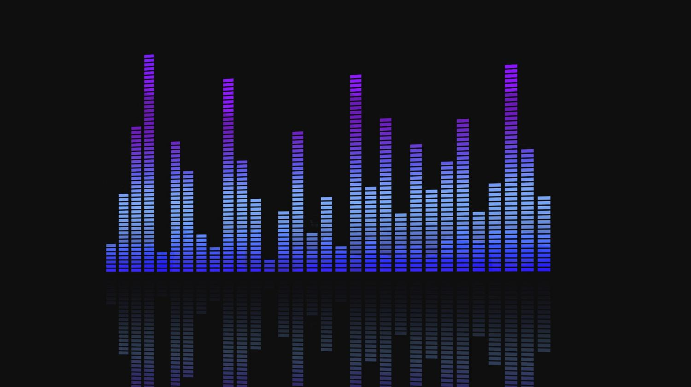
Resonance
Group 4: Drew Beaudry, Komi Yenkey, Jaron Bullock

Slide 2
Resonance Breakdown
Resonance is a web application focused on music
Reasons the database is important:
There’s a massive amount of data
The data is varied
Resonance utilizes user input as well as Last.FM API queries to categorize a variety of songs and artists. Based on this analysis of the data, Resonance is able to make music recommendations based upon genre, artist or tracks.

Slide 3
Resonance Implementation
Resonance consists of a PHP user interface hosted on an Apache web server, which performs queries to a MySQL database hosted on Amazon Web Services, as well as a Java-Hosted Vertx HTTP Endpoint
The Vertx HTTP Endpoint allows for HTTP GET requests via simple URL parameters. The endpoint then returns cleaned data from the Last.FM API

Slide 4
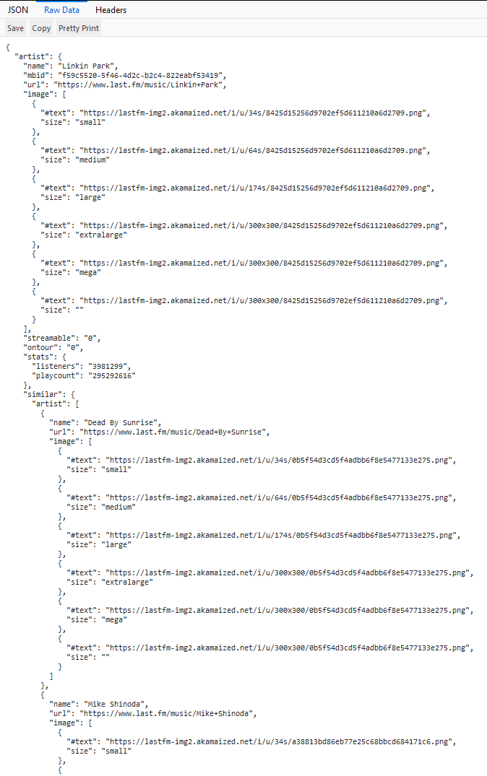
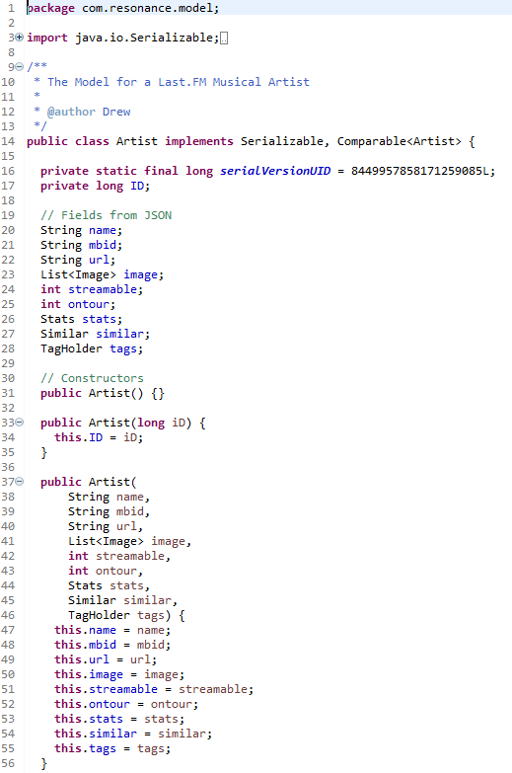
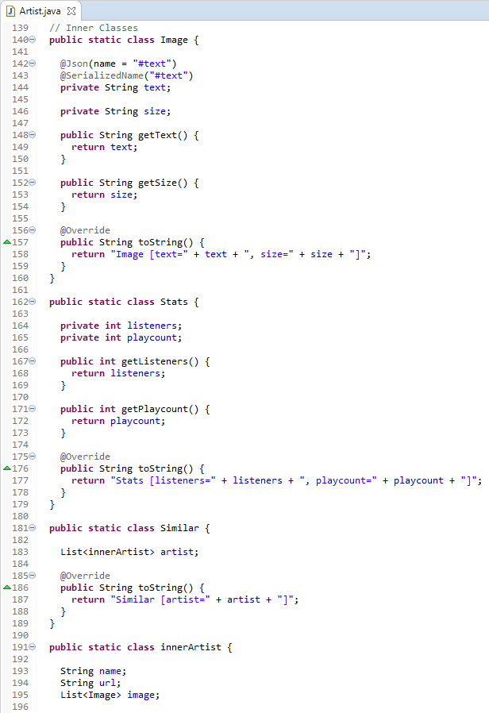
Java Backend – Pulling Data from the API

Slide 5
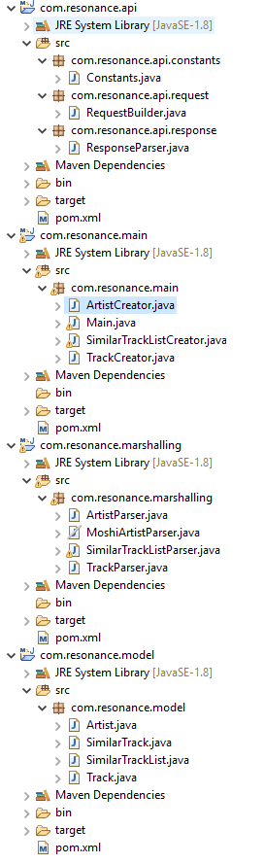
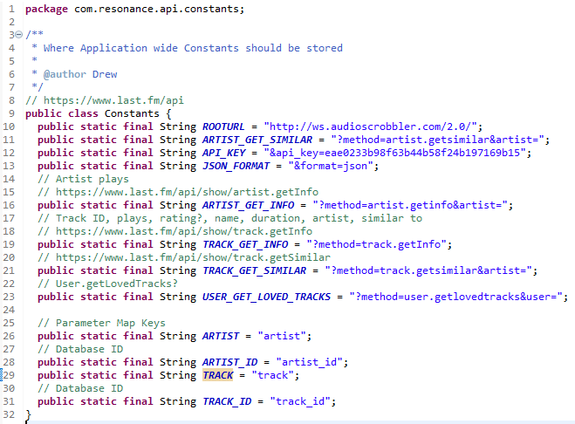
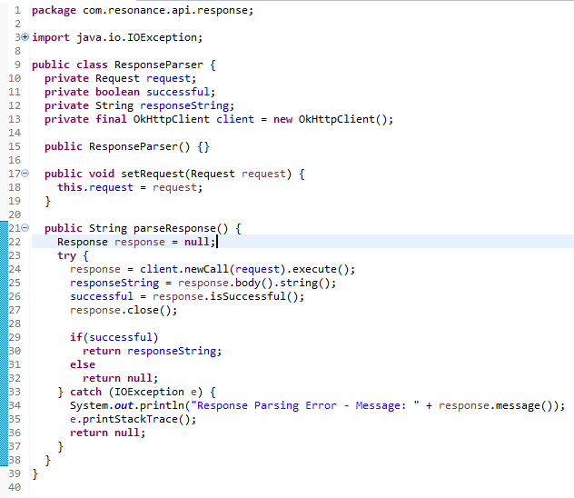
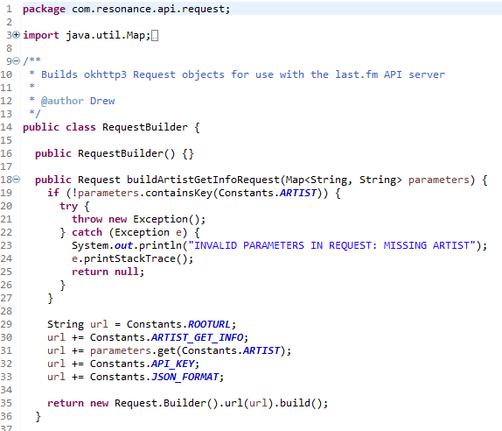
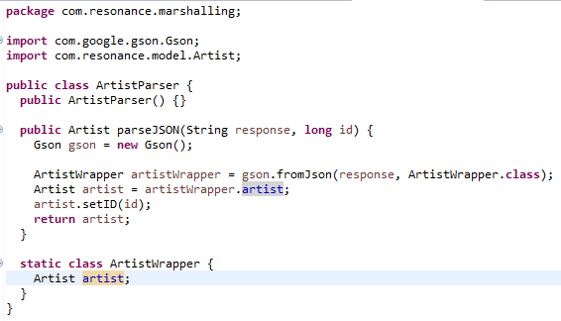
Java Backend – Pulling Data from the API

Slide 6
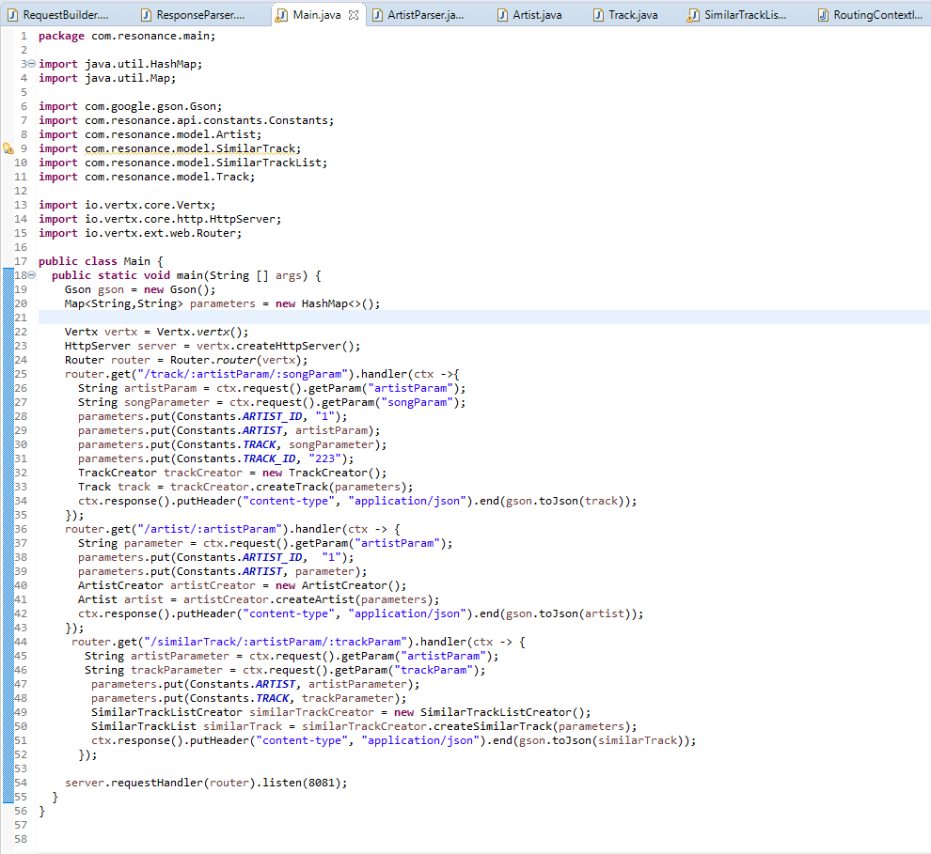
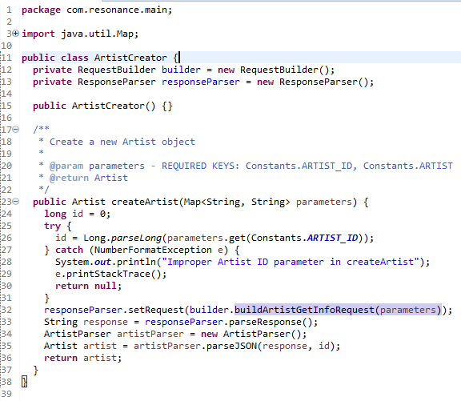
Java Backend – Pushing Data to the HTTP Endpoint

Slide 7
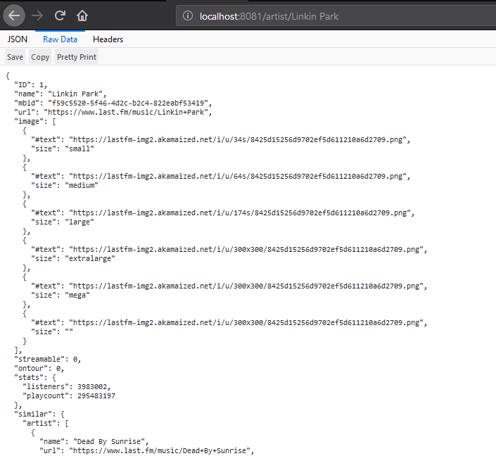
Java Backend – Pushing Data to the HTTP Endpoint

Slide 8
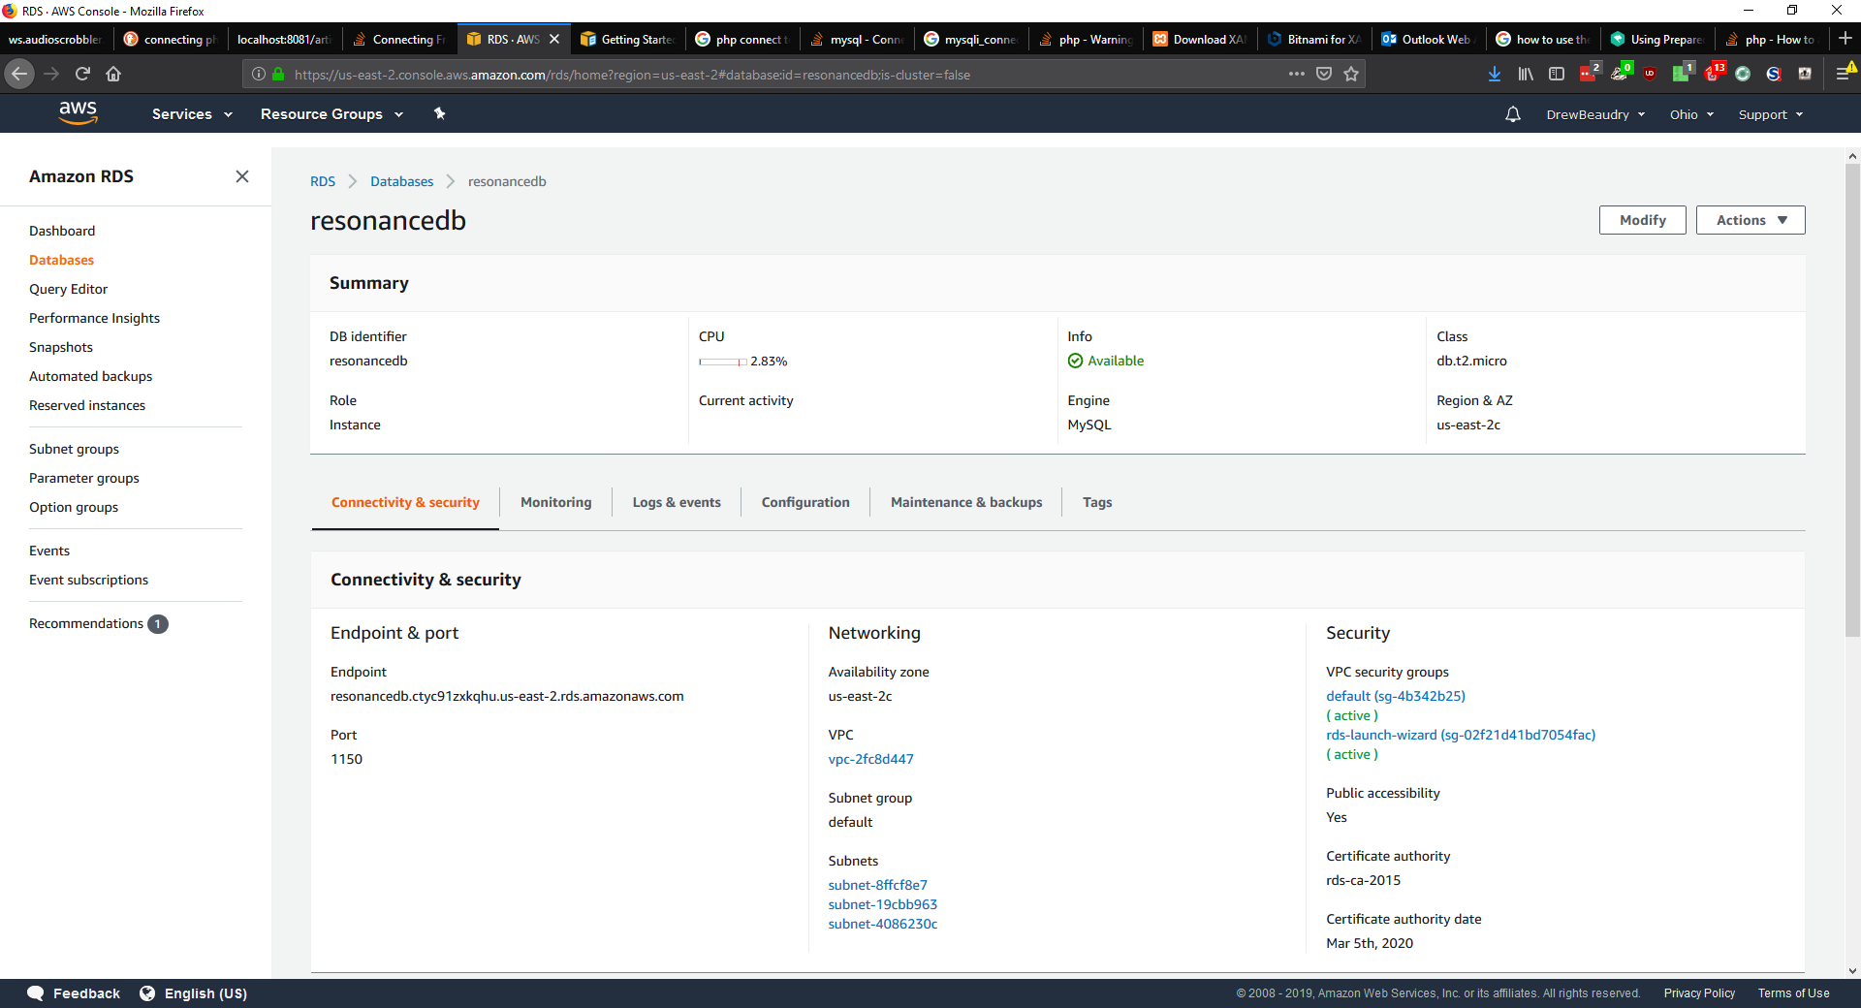
Amazon Web Services Relational Database Server

Slide 9
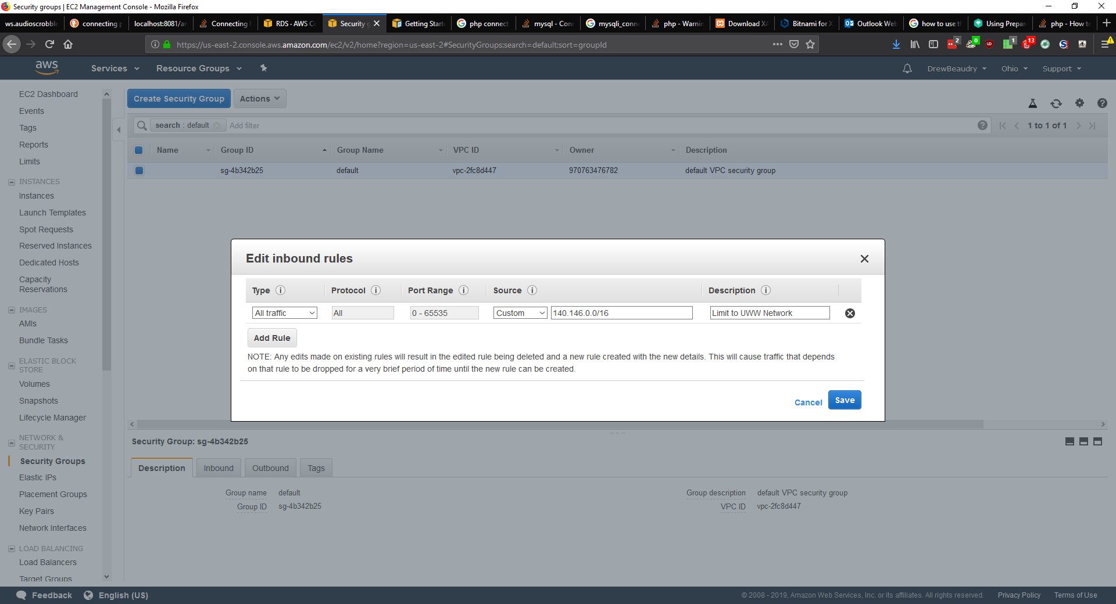
Amazon Web Services Relational Database Server

Slide 10
Data Set
Resonance utilizes a Last.FM dataset consisting of around 17,000 artists and 12,000 tags
It also supplements its data with live queries to the Last.FM

Slide 11
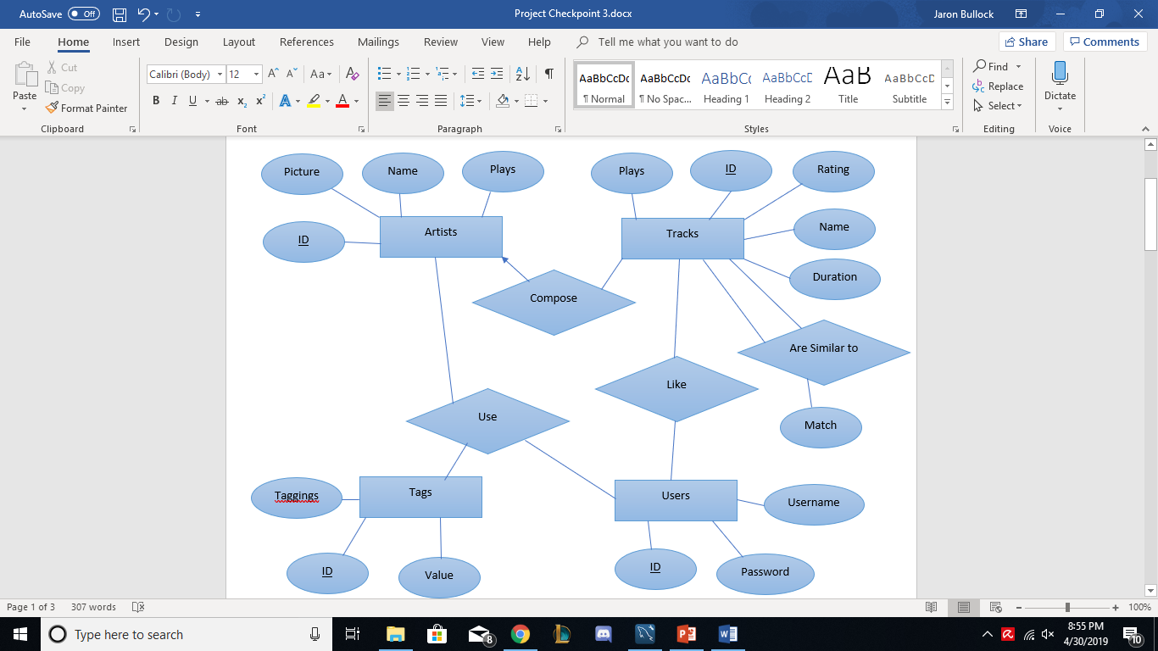
Resonance Database

Slide 12
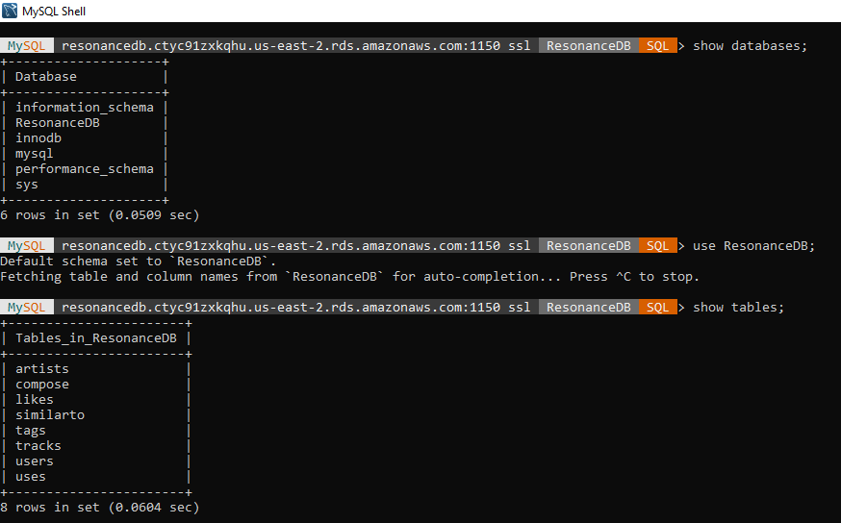
Resonance Database

Slide 13
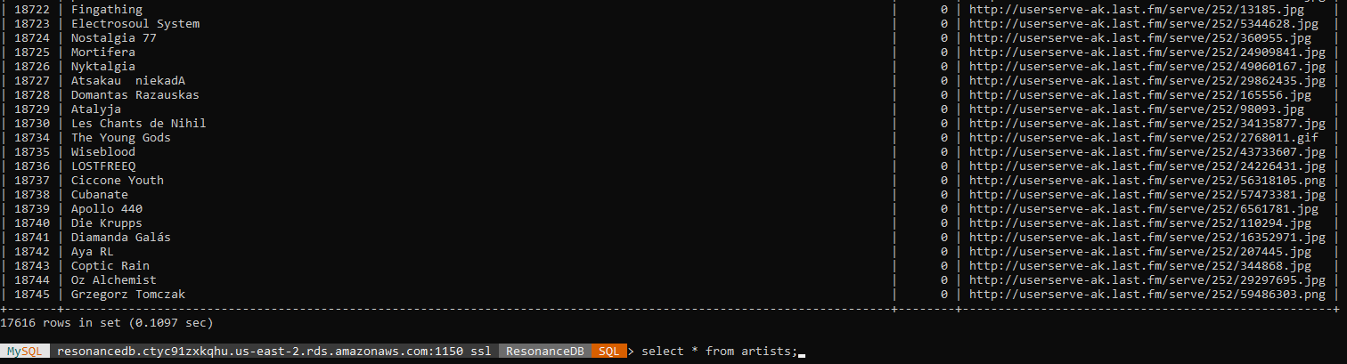
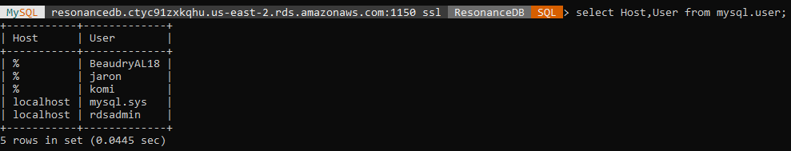
Resonance Database

Slide 14
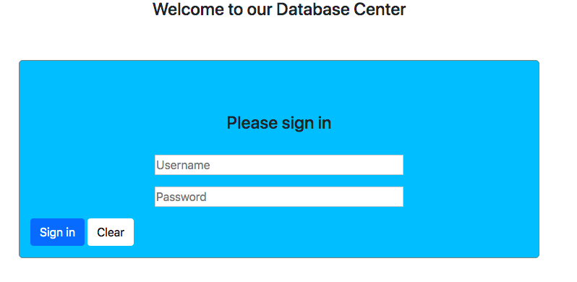
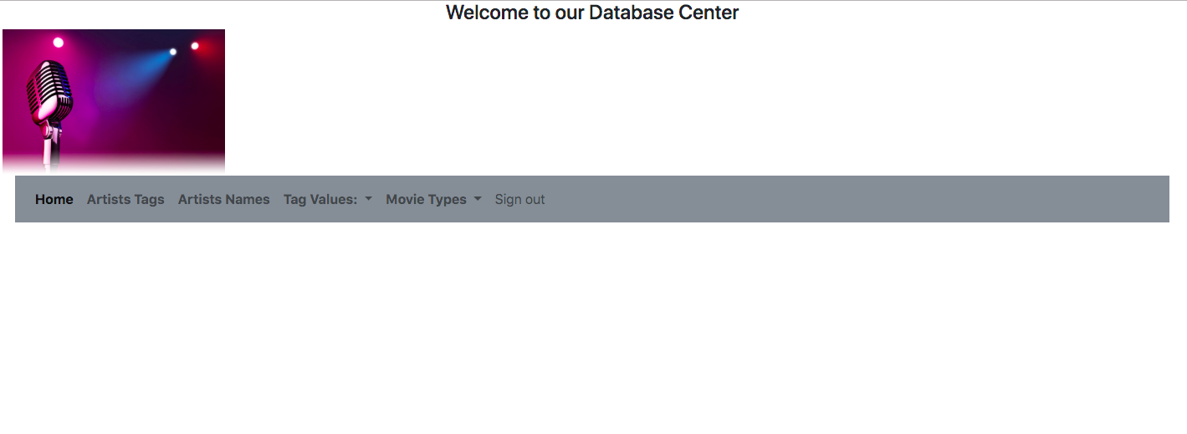
Resonance Web Portal

Slide 15
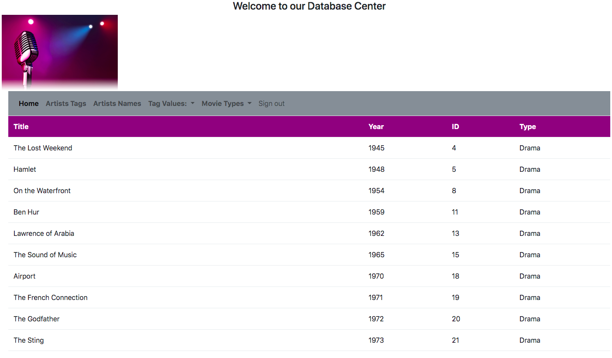
Resonance Web Portal

Slide 16
Assessment
Resonance works as intended if it can make music recommendations based on input of an artist, song or genre/tag
Test data consists of 4 artist queries, 4 song queries, and 2 genre/tag queries

Slide 17
Conclusion
Cleaning data makes everyone’s lives easier AFTER its cleaned
Trying to make an application that is easily accessible and mobile complicates everything
Interfacing between several languages is both useful and difficult
A lot of difficulties in a project of this type connecting to the database

