Slide 1
Calculating Azure Services Prices (generally)

Slide 2
General Pricing Models Across Services
Designed to provide flexibility and cost-effectiveness for initial/small workload or complex deployments.
Pay-As-You-Go
Reserved
Spot
Pay only for the resources you use without any upfront commitment.
Ideal for businesses with unpredictable workloads or for testing new services.
Discount on the standard pricing in exchange for a multi-month or year(s) commitment.
Suitable for workloads with predictable usage patterns.
Unused Azure CPU compute capacity at a significant discount.
Can be terminated with little notice if Azure needs the capacity back.

Slide 3
Cost Assistance for Customers
End-Customer Investment Funding (ECIF)
A set of funds for services delivered to Microsoft customers in support of Microsoft products, to drive deployment or migration of Microsoft products and solutions, or to provide support or product quality remediation.
Azure Commitment Discount (ACD)
A Microsoft discount program available to customers based on their commitment to spend across Azure services.
Plus others (ask STU leads)
Azure Customer Offer (ACO)
MAC agreements (26%+ 😮)

Slide 4
Acquiring Metrics & Costs
Before
During(ish)
After
Azure Pricing Calculator – Estimate hourly/monthly costs for consumption.
Can save estimates
Common examples
Uses account pricing amounts
Azure Monitor – Near real-time observability for apps, infra, network.
View metrics
Set budgets and create alerts
Print logs to stdout
Trigger your own workflows
Azure Advisor – Automated recommendations for security, reliability, and cost.
Azure Cost Management & Billing

Slide 5
Gotchas to calculating pricing
Some services or features have inter-dependencies (e.g., Function Apps needs Storage)
Dynamic settings can run on any size scale. Select specific sizes (e.g., App Service Plans for Functions) whenever possible.
General availability of a feature can change pricing unknowingly.
Data ingress/egress charges.

Slide 6
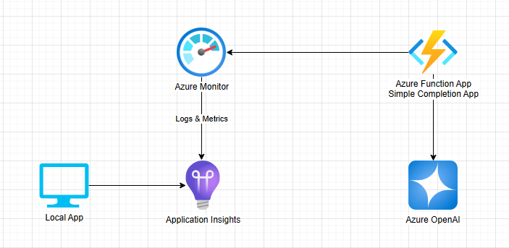
What are we building today?

Slide 7
Teams & Logistics
Groups of up to 3 maximizing varied titles (e.g., one SSP, one prin., one Sr.).
Simi & Xiaoqi, Ganesh & Matt, Chris & Shyam, Kit & Prince
SSP pick next member
Everyone should ~ be at the same place. Don’t leave your teammates behind!
Ask for help as often as needed.
We’ll likely spend a good deal of time on installation/configuration. This will set us up for future sessions.
The design is purposefully simple. We’re going to dynamically add complexity as you go. We’ll have a better gauge for next session.

Slide 8
Let’s get started
git clone https://github.com/rashedtalukder/ai-gbb-learning-shop.git

