Slide 1
How many federal Judges should the United States have?

Slide 2


Slide 3
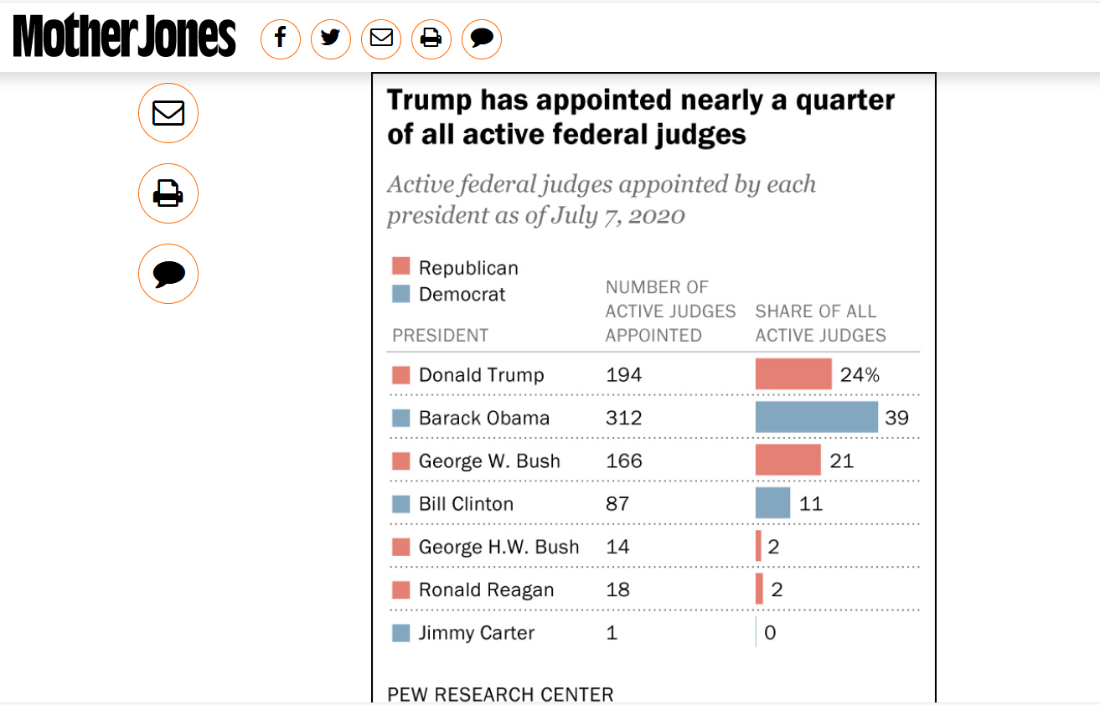

Slide 4
There are currently 673 federal district court positions – with 66 vacancies
is this enough?
Source: https://en.wikipedia.org/wiki/List_of_current_United_States_district_judges

Slide 5
Federal Courts
Supreme Court
(9)
Appellate Courts
(179)
District Court
(673)

Slide 6
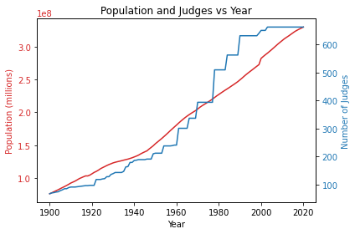
2003

Slide 7
Hypothesis:
judges are overworked because the number of judges has not kept pace with population. Congress should create more positions.

Slide 8
Keeping pace?

Slide 9
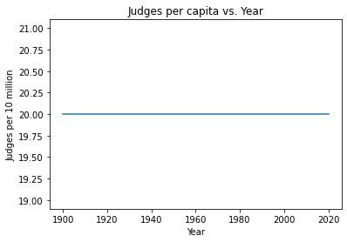
Hypothetical Constant Judges per Capita

Slide 10
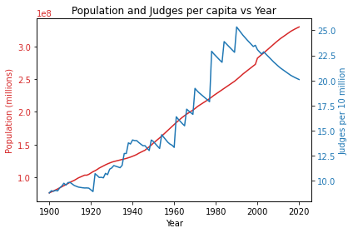
1990

Slide 11
A 20th-century surge

Slide 12
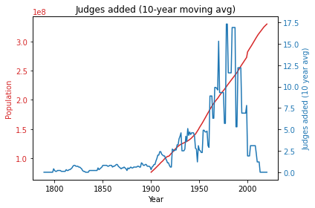

Slide 13
Complicated picture: What’s the right ratio?

Slide 14
Caseload?

Slide 15
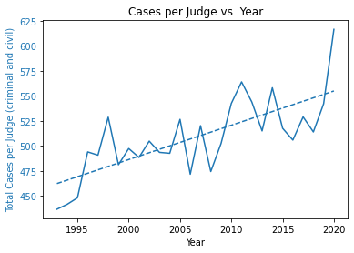
85 Judge Gap

Slide 16
conclusions
1. Dramatic change through 20 c

Slide 17
conclusions
2. Caseload has risen lately

Slide 18
conclusions
3. add 85 judges

Slide 19
Further exploration
1. Why growth of judiciary in 20th c?

Slide 20
Further exploration
2. Role of bankruptcy courts and other specialty courts

