Slide 1
Who will not vote?
Predicting nonvoters using survey data

Slide 2
Problem Statements
Can individuals who never vote (nonvoters) be predicted based on survey data?
What are the key factors that would cause a person not to vote?

Slide 3
Problem Statements
Can citizens be placed a small number of groups in which they share common characteristics?

Slide 4
Data
Survey – categorical
5836 respondents
115 features
Target:
voter category – always, sporadic, rarely/never

Slide 5
Presentation Outline
Random Forest
K-means Clustering
Other models
Recommendations

Slide 6

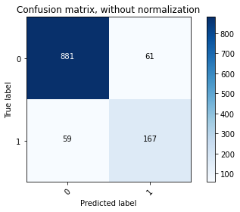

Slide 7
Most Important Responses
1. Voting is an important civic duty

Slide 8
Most Important Responses
2. Plan to vote in 2020 national election

Slide 9
Most Important Responses
3. Registered to vote

Slide 10
Most Important Responses
7. No matter who wins, nothing will change for people like me

Slide 11
Not Important Responses
demographic information and difficulty voting

Slide 12
Presentation Outline
Random Forest
K-means Clustering
Other models
Recommendations

Slide 13
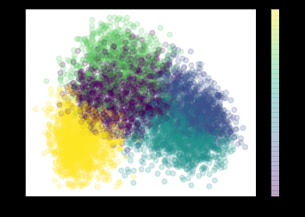
K-means clustering

Slide 14
Cluster 1: Nonvoters (849)
Voting in elections -- not at all important
I don’t believe in voting
Following what happens in government and politics -- not at all important
I don’t trust the political system to serve my needs
Do not plan to vote in November 2020 election
Never vote - 72%

Slide 15
Cluster 2: Difficulty voting/low enthusiasm (1080)
• Believing in God -- not at all important
• Displaying the American flag -- not at all important
Had to cast a provisional ballot
Supporting the military -- not so important
Couldn’t get off work to vote when polls were open
Always vote - 59%, Sporadic - 29%

Slide 16
Cluster 3: Trust in Institutions (1223)
• Trust the news media -- a lot
• The mainstream media is more interested in making money than telling the truth -- strongly disagree
• Electronic votes submitted online or by email safe/secure -- very confident
• Trust the intelligence community -- a lot
• Trust Congress -- a lot
• Always vote - 82%

Slide 17
Cluster 4: Strong Republican/Skeptical of racism (1382)
• Trust the presidency - a lot
• The Democratic Party does not want people like me to vote, and works hard to keep us from being able to vote
• Strong Republican
• Systemic racism in policing is a bigger problem than violence and vandalism in protests - Strongly disagree
• Systemic racism is a problem in the United States - Strongly disagree
• Always vote - 77%

Slide 18
Cluster 5: Weak Republican (1302)
• Systemic racism is a problem in the United States - Somewhat agree
• Systemic racism in policing is a bigger problem than violence and vandalism in protests - Somewhat disagree
• Following the 2020 presidential race -- somewhat closely
• The Republican Party wants people like me to vote but does not work hard to earn our votes
• Not very strong Republican
• Always vote - 52%, Sporadic - 29%

Slide 19
Presentation Outline
Random Forest
K-means Clustering
Other models
Recommendations

Slide 20
Other models/approaches
Principal component analysis → Clustering
Logistic Regression with all features → better recall with loss of precision

Slide 21
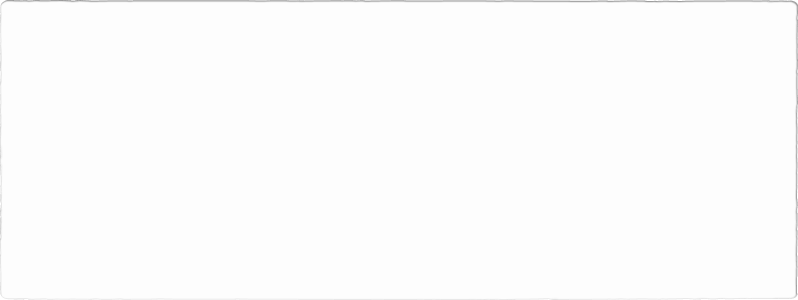


Random Forest
Logistic Regression

Slide 22
Presentation Outline
Random Forest
K-means Clustering
Other models
Recommendations

Slide 23
Recommendations
#1 Use Random Forest model to identify nonvoters with good recall and precision.
Use Logistic model to identify more nonvoters but with some loss of precision (more false positives)

Slide 24
Recommendations
#2 Use Random Forest model to identify likely voters

Slide 25
Recommendations
#3 Use clustering to identify groups of voters and tailor message to these groups

