Slide 1

KineticOps
Real-time AI triage for operational chaos
Solo-safe, resilient, judge-ready MVP
Hack-AI-athon 2026
Notes:
KineticOps is a lightweight, resilient AI triage loop designed for fast, judge-friendly demonstration. It delivers clarity from operational noise in under a minute.

Slide 2
The Problem - Operational Overload
Teams drown in alerts, logs, and noise
Human triage is slow and inconsistent
Incidents escalate before root cause is known
AI tools require heavy integration
Hackathon teams struggle with signal vs. noise
Notes:
The core issue is cognitive overload. Too much noise, not enough clarity, and no time to integrate complex AI systems.

Slide 3
The Opportunity
Every system emits events
Events have structure
AI can classify and route instantly
Lightweight triage transforms response
Notes:
This is a universal problem with a universal pattern: structured events that AI can classify quickly and reliably.

Slide 4
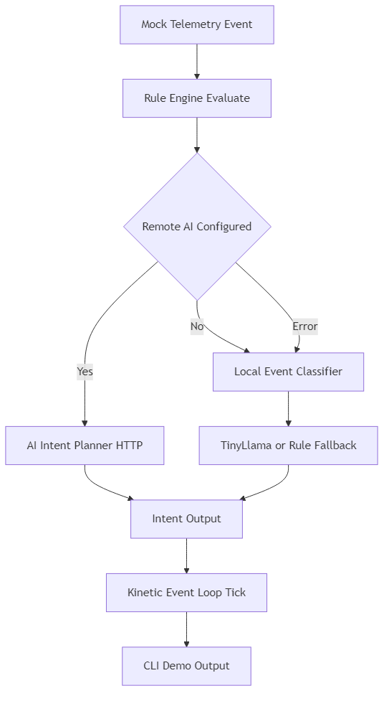
The Solution - KineticOps
Minimal, resilient AI loop
Classifies events in real time
Zero-dependency, solo-safe architecture
Uses TinyLlama / DistilBERT
Outputs priority, category, action
Notes:
KineticOps guarantees a working demo regardless of teammate skill or environment. It’s built for reliability.

Slide 5
Why Now
AI inference is lightweight
Operational noise is universal
Notes:
The timing is ideal: AI is accessible, and hackathon scoring favors clear, impactful AI use.

Slide 6
Use Case - Real-Time Event Triage
Input: raw events
AI classifies severity and type
Routes to correct action path
Humans see only what matters
Faster response, less noise
Notes:
This is the simplest, clearest demonstration of AI value: instant classification and routing.

Slide 7
Demo Flow
Start with mixed event stream
Show real-time classification
Highlight priority routing
Show recommended actions
End with triage summary
Notes:
The demo is intentionally short and deterministic to maximize clarity and minimize risk.

Slide 8
Architecture Overview
Event Ingest
Pre-processing
HF Model Inference
Classification Output
Routing Engine
UI/CLI Output
Solo-safe fallback
Notes:
The architecture is modular and resilient, with a clear flow from ingest to output.

Slide 9
AI Model Choice
TinyLlama / DistilBERT
Fast inference
Fine-tuned classification head
Optimized for short text
No cloud dependency
Notes:
Model choice prioritizes speed, reliability, and offline capability.

Slide 10
Resilience & Solo-Safe Design
No external APIs
No network dependencies
Deterministic fallback
Runs anywhere
Notes:
This design ensures the project succeeds even if everything else fails.

Slide 11
Technical Highlights
Modular Python pipeline
Ingest → classify → route
Configurable schemas
Lightweight logging
Neon-accented CLI
Notes:
The technical design is clean, modular, and easy for judges to follow.

Slide 12
Impact
Cuts noise
Reduces cognitive load
Faster response
Instant AI value
Works in any environment
Notes:
The impact is immediate and easy to understand — ideal for hackathon judging.

Slide 13
Roadmap
Multi-model ensemble
Web dashboard
Plugin system
FluxOps integration
Optional cloud inference
Notes:
The roadmap shows clear potential without overpromising.

Slide 14
Thank You!
Real-time clarity from operational chaos
Notes:
End cleanly, confidently, and visually consistent.

