Slide 1
CE889 Presentation
Drew Alexander Jonation Berry
RegNo: 2312089

Slide 2
Data
Partition
Randomly split the data into 75% training and 25% validation at the start of every epoch
Processing
Use Preprocess.py to normalise the csv file
I store the processed data in another csv file for training
Also, I keep track of the minimum and maximum of each column in the csv file for normalisation/denormalization in the game integration
The data collected is only within the boundaries of the game, so shouldn’t have any erroneous data that could be removed.

Slide 3
Design Choices

Slide 4
Architecture
My network consists of 3 layers
Decided to use only one hidden layer
Input layer has 2 neurons, one for each input
Hidden layer has 8 neurons, which is a tuned parameter (See later slides)
Output layer has 2 neurons, one for each output
Used sigmoid function as the activation function

Slide 5
OOP
Neuron class
Stores all values/weights and functions for ONE neuron
Network class
Stores the parameters of the network and all layers containing neurons
Can initialise the network, perform feed forward and validation passes, and completes backpropagation
Also, it outputs the final weights for use in the game
Training class
Handles all the data and training of the network
Also does the grid search, RMSE calculations and displaying of graph

Slide 6
Parameter Tuning

Slide 7
Parameters
The parameters used in my neural network were:
Lambda
Fixed at 0.8
Learning rate / eta
Found that 0.095 worked best
Number of hidden neurons
Found that 8 worked best
Momentum / alpha
Found that 0.0375 worked best

Slide 8
Choosing parameters
Trial and error
Tried some different values for eta, hidden neurons and alpha, to find a rough estimate of where the optimum was so that I could run a shorter grid search
Grid Search that I implemented
Used lists of possible parameters and ran training for 50 epochs or less (early stopping) on 50% of the entire dataset for each permutation of these parameters
The grid search uses the lowest validation RMSE as its measure of how good a set of parameters are
Did this multiple times to close in on an optimum set of parameters

Slide 9
Effects of parameters
Found that high values of eta and alpha (e.g. 0.6 to 0.9) make the RMSE change drastically each epoch, which results in a poorly trained network.
Different numbers of hidden neurons didn’t show too much change, apart from higher numbers greatly increasing the time for each epoch.
The parameters found by my grid search show a much smaller variance in RMSE

Slide 10
Results of training

Slide 11
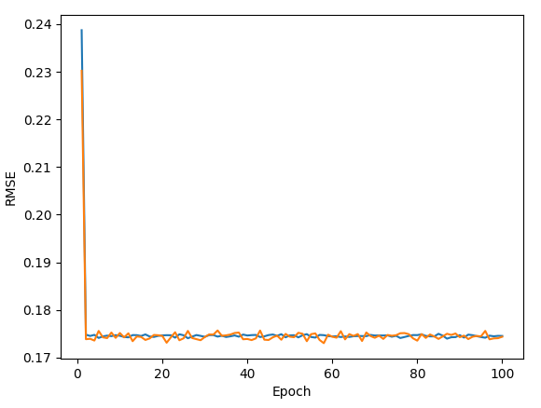
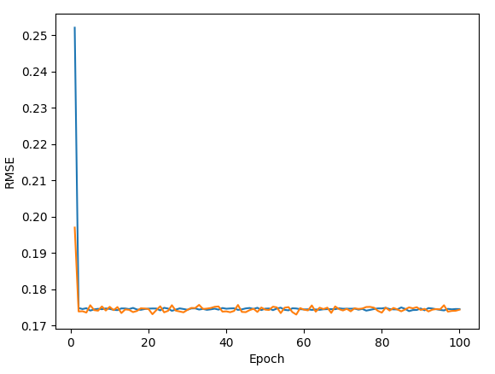
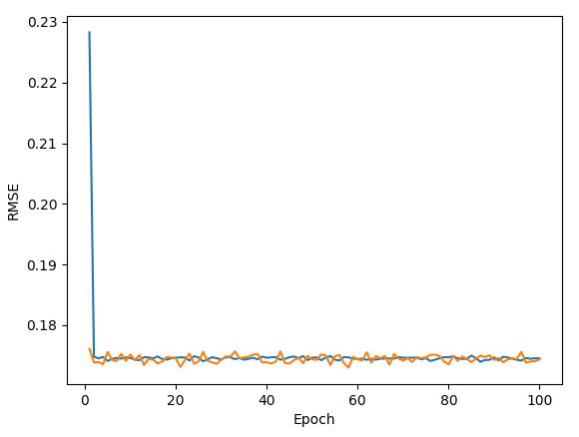
RMSE
Calculation
Every error for each output of a feed forward pass gets saved to an array
At the end of an epoch, find the RMSE from these errors
This is done for both the training and validation so they can be plotted together on a graph
Below are graphs of performance with optimum parameters:

Slide 12
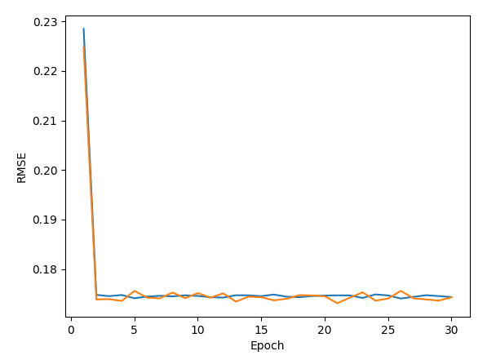
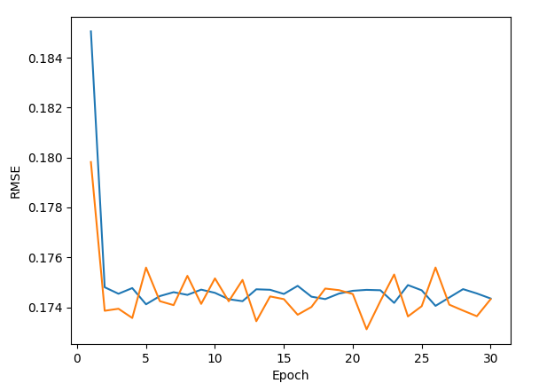
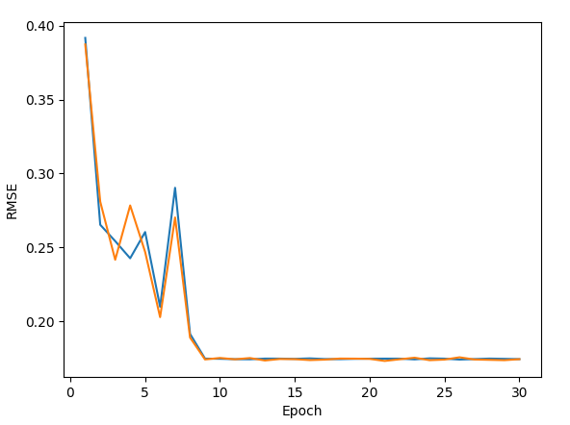
Early Stopping Criteria
At the end of every epoch, the validation RMSE is checked
If this value is less than the lowest validation RMSE found so far in training, make the current value the new lowest
If it isn’t lower, add to a count, so that when the count exceeds 10, stop early
The count is reset upon finding a new lowest RMSE
The tolerance is 10 so that the network doesn’t get stuck in a local minimum
A lower tolerance (e.g. 5) stopped the training too early
Here are some graphs showing the early stop:

Slide 13
List of files
Code
Neuron.py
Network.py
Preprocess.py
Training.py
NeuralNetHolder.py
Data files
ce889_dataCollection.csv (data collected from game)
training_data.csv (normalised data for use in training)
weights.npz (numpy file that holds the final weights for the game)
minmax.npy (numpy file that holds min and max values for normalisation in game)

