Slide 1


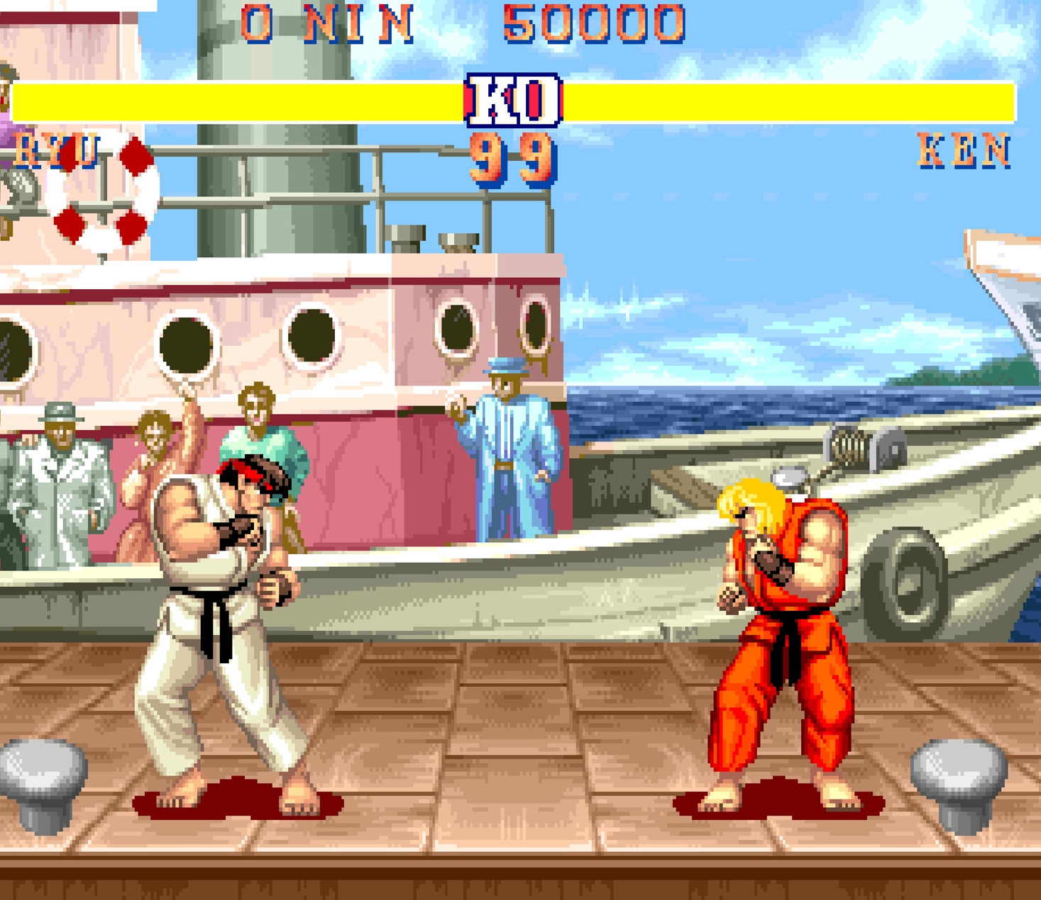

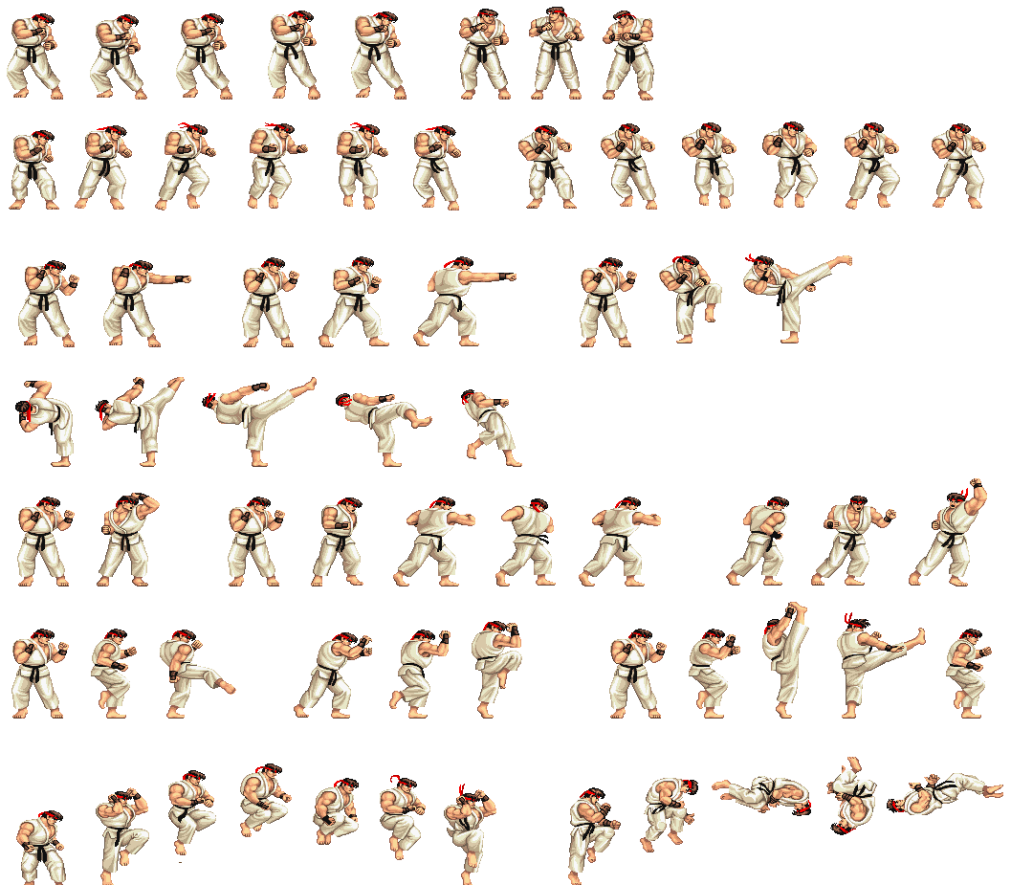
Recreating Street Fighter arcade game in Java
Drew Berry Supervisor: Yunfei Long
Aim
This project aimed to faithfully recreate the PVP fighting game Street Fighter.
Implementation
The visual interface of the game was implemented with Java Swing.
The controls were implemented with extended KeyAdapters.
Sprites and backgrounds were included with the use of ImageIO and BufferedImage classes.
Sprite animations are created from images known as sprite sheets, as shown below.
The entire game was written from scratch in Java.
Gameplay
Fight as one of eight beloved characters in a retro arcade style, across many familiar locations.
Use an array of attacks to defeat your opponent, these include jumping kicks and fireballs.
Play one of three game modes: Story, Arcade and Training.
Story allows the player to battle the computer across the world.
Arcade allows two players to clash in “best of 3” games.
Training allows new players to get accustomed to the controls.
Contact me
drewberry612@outlook.com

