Slide 1
Custorec
Founded BY DREWB.

Slide 2
What is CustoREC?
CustoRec is a first-tier records/data company. CustoRec, keeps data on customers for our clients. We have a secure and remote databases to hold and receive data. Our clients can upload and or change data anytime of the day. Each client has a specific server for their data; so no worries about data being compromised by other entities

Slide 3
Our Technology
Remote Access
SSL
Vaadin technology is used
Latest Java technology
Secure front- and-back end servers
Server Applications capable
Cloud based backup and recovery

Slide 4
ISSUES that Could Arise with CuSToReC
Customer Error
Data Outages
Upgrade times
Once edited can’t be back-dated

Slide 5
Conclusion
This is a new and cost effective service
Very secure service for data
Our clients will not have to store data centers that their locations
Global services available
Easy for clients IT departments to maintain
24/7 support provided

Slide 6
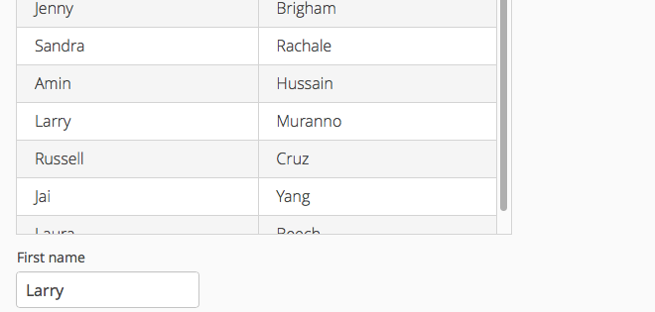
CUSTOREC Samples – Basic Sample

Slide 7
Questions?

