Slide 1
CptS 427 / 527 : Computer Security
Quiz-04
Notes:
Template-WSU Hrz 201.ppt

Slide 2
CptS 427 / 527 : Computer Security
Announcements
HA01
  Solution file available as an attachment to the assignment post
  Most did well
  Confusion regarding trust zones
Project proposals
  Some outstanding proposals
  Some proposals had missing or vague timelines
  Most proposed ideas: 2FA and messaging apps
  527 students: research manuscript preparation not included in proposed timeline
Notes:
Template-WSU Hrz 201.ppt

Slide 3
CptS 427 / 527 : Computer Security
Course Feedback
Feedback form available on the ‘Course Information’ page
Responses are collected anonymously
5 minutes
Notes:
Template-WSU Hrz 201.ppt

Slide 4
CptS 427 / 527 : Computer Security
HA-02
Second assignment available
Code analysis hands-on tutorial
Intent: learn by going through the tutorial
Deliverable: observations report
Observations report
  Include screenshots proving you did perform the tutorial activities
  Report on any bugs, typos, broken links etc.
  A brief discussion on the new things you learned (7 lines max)
Notes:
Template-WSU Hrz 201.ppt

Slide 5
CptS 427 / 527 : Computer Security
Software Vulnerabilities
Notes:
Template-WSU Hrz 201.ppt

Slide 6
Today’s Topics
Input Validation and Representation
Temporal- and State-based
API Abuse
Security Failures
Errors
Code Quality
Encapsulation
Notes:
Template-WSU Hrz 201.ppt

Slide 7
Input Validation and Representation
Untrusted inputs accepted by programs
  No input validation
  Incorrect input validation
Problem pronounced in case of special characters, encodings, unknown data types
Attacks:
  Overflows
  Command Injection (SQL Injection)
  Cross Site Scripting (XSS)
Notes:
Template-WSU Hrz 201.ppt

Slide 8
Input Validation Example
u_char *make_table(u_int width, u_int height, u_char *init_row){
u_int n;
int i;
u_char *buf;
n = width * height;
buf = (char *) malloc(n);
if(!buf)
return (NULL);
for (i=0; i<height; i++)
memcpy(&buf[i*width], init_row, width);
return buf; }
Notes:
Template-WSU Hrz 201.ppt

Slide 9
Input Validation Example
u_char *make_table(u_int width, u_int height, u_char *init_row){
u_int n;
int i;
u_char *buf;
n = width * height;
buf = (char *) malloc(n);
if(!buf)
return (NULL);
for (i=0; i<height; i++)
memcpy(&buf[i*width], init_row, width);
return buf; }
n is unsigned int
If width * height > 2³²
Problem
If n is overflowed – this will cause a buffer overflow
Notes:
Template-WSU Hrz 201.ppt

Slide 10
Temporal- and State-based
Incorrect assumptions regarding time and state of the program
  Result of complexity due to concurrency and shared system resources
Attacks
  Race Conditions
  Deadlock
  Reused Authentication Sessions
Notes:
Template-WSU Hrz 201.ppt

Slide 11
Race Condition Attacks
Program checks the state of a resource before using it
State can change between the check and use
The check is invalidated if the state changes
Mitigations
  Use return values for checks
  Store files in protected directories
  Avoid using shared/temp directories
Notes:
Template-WSU Hrz 201.ppt

Slide 12
Race Condition Attack Example
User
Attacker
if(!access(file,W_OK)) {
f = fopen(file,"w+");
operate(f);
...
}
else {
fprintf(stderr,"Unable to open
file %s.\n",file);
}
symlink(file, malicious)
Notes:
Template-WSU Hrz 201.ppt

Slide 13
Race Condition Mitigation Example
f = fopen(file,"w+");
if(!f) {
operate(f);
...
}
else {
fprintf(stderr,"Unable to open
file %s.\n",file);
}
Notes:
Template-WSU Hrz 201.ppt

Slide 14
API Abuse
API – contract between a client and server
  Either party may fail to uphold their part of the contract
Possible abuses
  Malware injection
  Unchecked return value
  Misuse of privilege management
  String manipulation functions
Notes:
Template-WSU Hrz 201.ppt

Slide 15
API Abuse Example: Unchecked Return Value
void host_lookup(char *user_supplied_addr){
struct hostent *hp;
in_addr_t *addr;
uint32_t len = 64;
char *hostname;
validate_addr_form(user_supplied_addr);
addr = inet_addr(user_supplied_addr);
hp = gethostbyaddr(addr, sizeof(struct in_addr);
hostname = (char *) malloc(len)
strncpy(hostname, hp->h_name, len);
}
Malloc’s return never checked
No null termination
Notes:
Template-WSU Hrz 201.ppt

Slide 16
Security Failures
Programs incorrectly implement security functions
  Caused by programmers overlooking or incorrectly assuming functions
Examples
  Unchecked randomness
  Unchecked privileges
  Missing access controls
  Namesake cryptography
Notes:
Template-WSU Hrz 201.ppt

Slide 17
Security Failures Example: Unchecked Randomness
Debian OpenSSL 2008 (CVE-2008-0166)
  Dev accidentally removed code to randomize keys
  Possibility of unique keys went down from millions to 32,767
crypto/rand/md_rand.c: 247:
MD_Update(&m,buf,j);
Notes:
Template-WSU Hrz 201.ppt

Slide 18
Errors
Mishandled errors reported
Examples
  NullPointerException
  Catch block empty
  Catch block overly-broad
Notes:
Template-WSU Hrz 201.ppt

Slide 19
Errors Example: Null Pointer Exceptions
Null pointer dereferences occur when a program expects a non-null pointer but the pointer turns out to be null
Typically causes a program crash or exit
Can be created by a number of factors including race conditions
Mitigation
  Always check pointers for nulls
Notes:
Template-WSU Hrz 201.ppt

Slide 20
Errors Example: Null Pointer Exceptions
void host_lookup(char *user_supplied_addr){
struct hostent *hp;
in_addr_t *addr;
char hostname[64];
validate_addr_form(user_supplied_addr);
addr = inet_addr(user_supplied_addr);
hp = gethostbyaddr(addr, sizeof(struct in_addr),
strcpy(hostname, hp->h_name); }
Check to ensure “user_supplied_addr” &
“addr” != NULL!
Notes:
Template-WSU Hrz 201.ppt

Slide 21
Code Quality
Poor quality code leads to unintended program operations
Examples
  Memory leaks
  Use after release
  Double references
  Unreleased resources
Notes:
Template-WSU Hrz 201.ppt

Slide 22
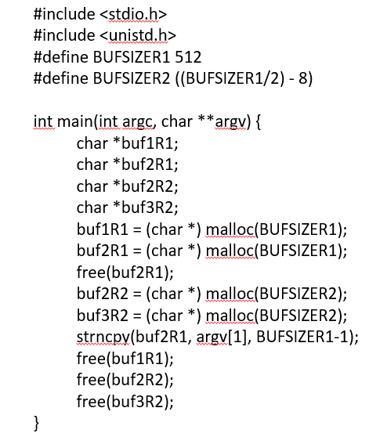
Code Quality Example: Use after release
buf2R1 freed
buf2R1 used…
Notes:
Template-WSU Hrz 201.ppt

Slide 23
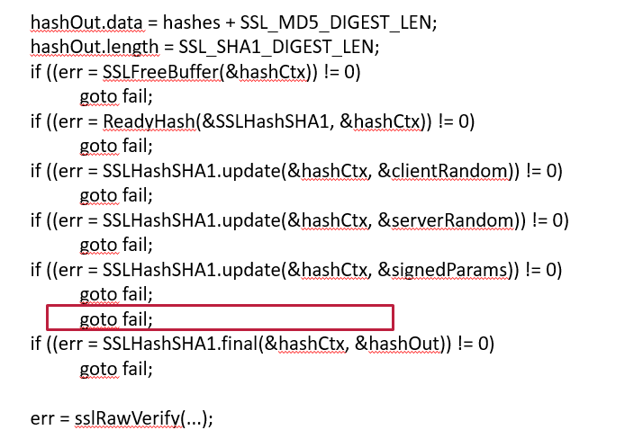
Code Quality Example: Double Reference
Apple’s SSL GoTo Fail
Notes:
Template-WSU Hrz 201.ppt

Slide 24
Encapsulation
Incorrectly defined boundaries between systems
Data and users crossing properly defined boundaries
Examples
  Trust boundary violation
  Information / data leaks
  Executable traces
Notes:
Template-WSU Hrz 201.ppt

Slide 25
Encapsulation Example: Heartbleed
Heartbleed violates trust boundaries to leak inaccessible data
Payload contains an instruction to go beyond the intended register length
Mitigations
  Before providing data, always check for request register length
Notes:
Template-WSU Hrz 201.ppt

Slide 26
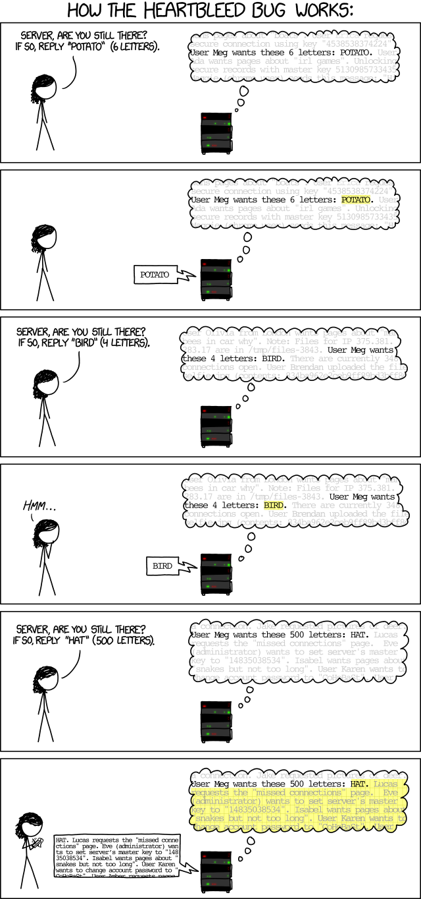
Encapsulation Example: Heartbleed
Notes:
Template-WSU Hrz 201.ppt

Slide 27
Encapsulation Example: Heartbleed
Notes:
Template-WSU Hrz 201.ppt

Slide 28
Next lecture
Web Security
Notes:
Template-WSU Hrz 201.ppt

Slide 29
Any questions?
Notes:
Template-WSU Hrz 201.ppt

