Slide 1
CptS 427 / 527 : Computer Security
Cryptography Basics
Notes:
Template-WSU Hrz 201.ppt

Slide 2
Today’s Topics
Cryptography
  Goals
  Property and threats
  Types of implementation
Notes:
Template-WSU Hrz 201.ppt

Slide 3
Cryptography: Goals
Provide for data resources:
  Confidentiality
  Integrity
  Authenticity (verifies provenance)
  Authentication (verifies identity)
Underlying concept for many security tools
Has been used for thousands of years in various forms
Notes:
Template-WSU Hrz 201.ppt

Slide 4
Cryptography: Property & Threats
Perfect secrecy
  Cipher text shouldn’t reveal plain text
Attacks
  Brute-force: try all possible keys until you find THE key
  Cryptanalysis: analyze the encryption algorithm
    determine characteristics/patterns of the encrypted data
    Crack the algorithm using the characteristics
  Coercion
  Implementation failures
Notes:
Template-WSU Hrz 201.ppt

Slide 5
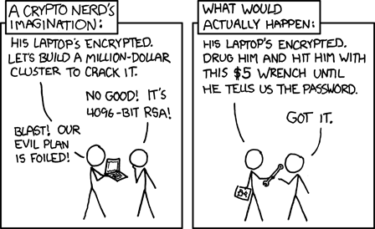
Notes:
Template-WSU Hrz 201.ppt

Slide 6
Cryptography: Implementation
Encryption
  Symmetric key
  Asymmetric key
Hash functions
Authentication
  Message authentication codes (MACs) – Symmetric
  Digital signatures – Asymmetric
Notes:
Template-WSU Hrz 201.ppt

Slide 7
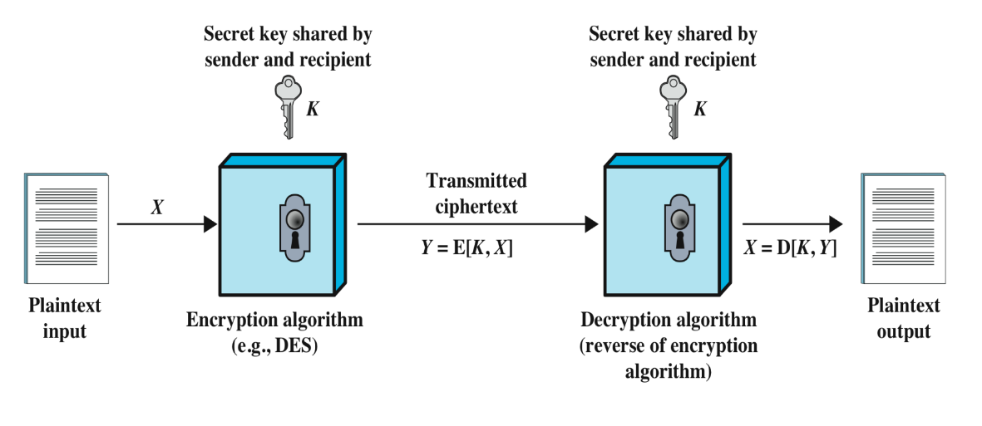
Symmetric Key
Encryption and decryption performed by a shared key
Sender and receiver have a copy each
Popular until 1970s
Vulnerability increases with people involved
Definitions
  X - Plain Text
  Y- Cipher Text
  K - Key
  E - Encryption Algorithm
  D - Decryption Algorithm
Notes:
Template-WSU Hrz 201.ppt

Slide 8
Symmetric Key
Ciphering in blocks
  Breaks text into blocks, processes each block
  Mode of operation defines how blocks fit together
  Examples: AES, DES, 3DES
Ciphering in streams
  Encrypts text as a continuous stream
  XOR cipher text with plain text
  Examples: RC4, ChaCha20
Notes:
Template-WSU Hrz 201.ppt

Slide 9
Symmetric Key
Advantages
  Fast and efficient
  Provides confidentiality and authenticity
Disadvantages
  Key sharing, key management
Notes:
Template-WSU Hrz 201.ppt

Slide 10
Asymmetric Key
AKA public-key encryption
Encryption and decryption performed by separate keys
  Public key
  Private key
Algorithms used are mathematically ‘hard’ i.e. computationally intense
Growing in popularity since 1990s
Vulnerable; replaced by PKE (Asymmetric)
Notes:
Template-WSU Hrz 201.ppt

Slide 11
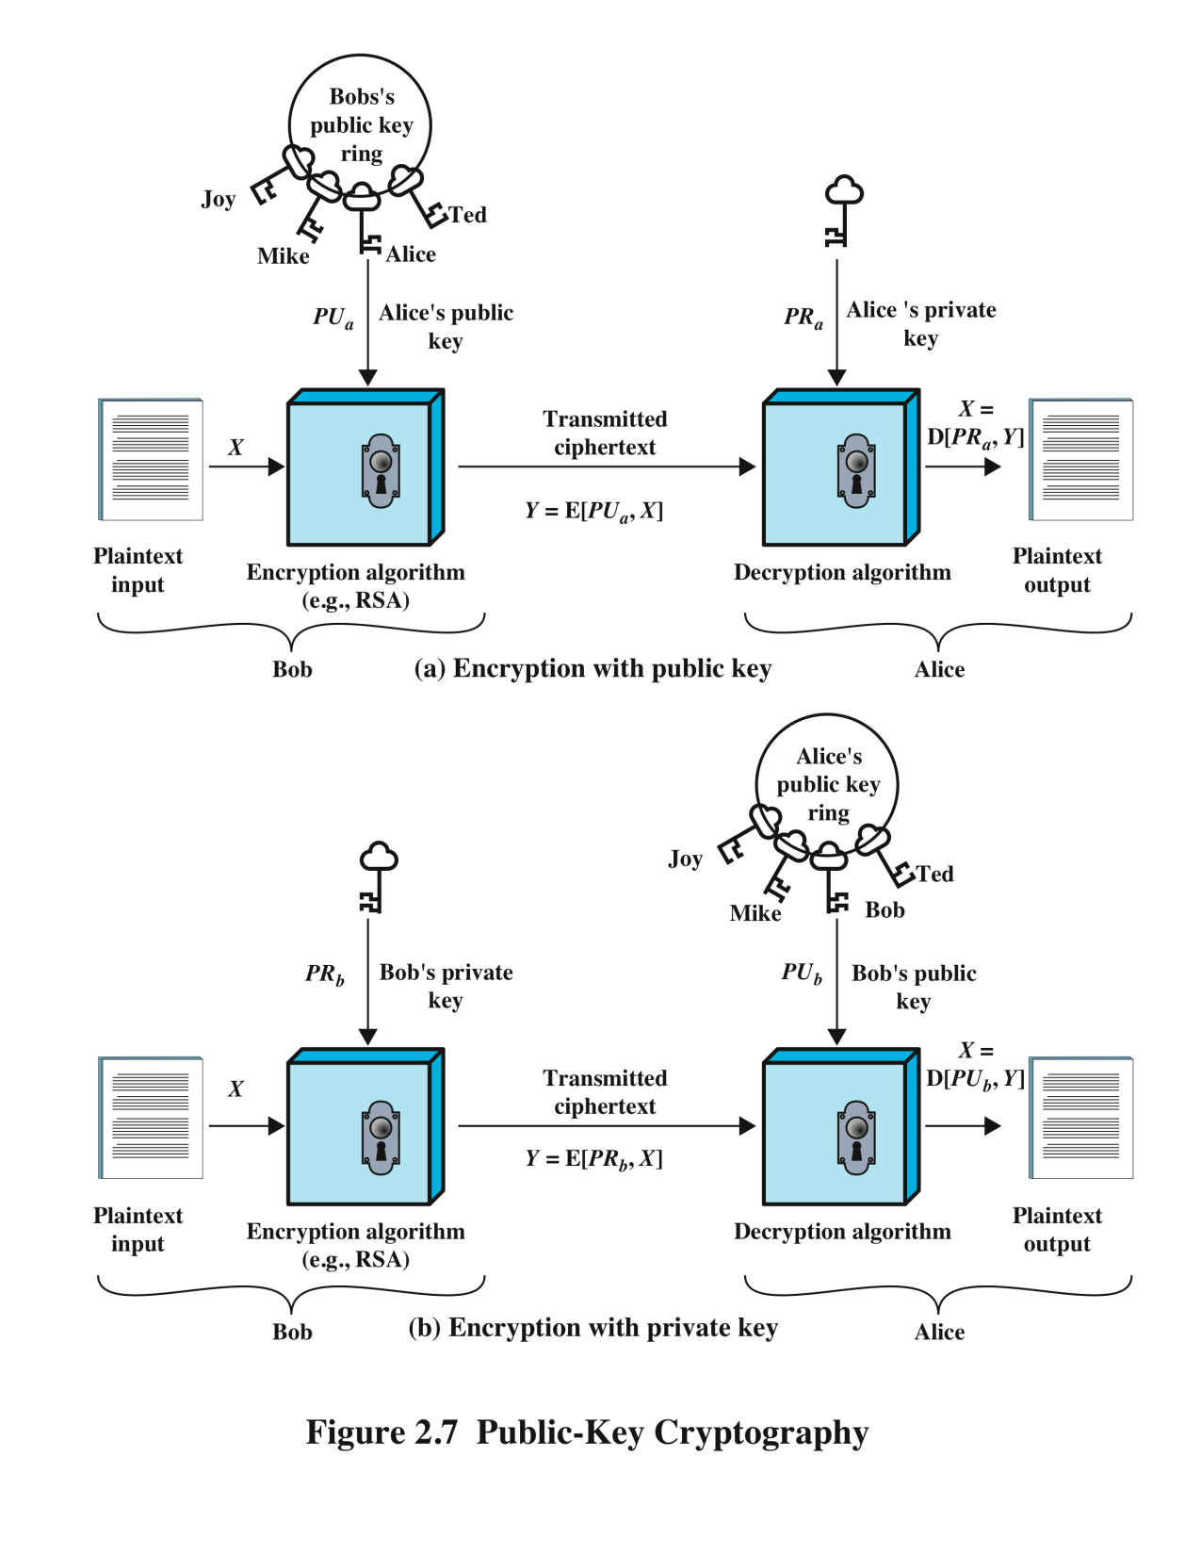
Asymmetric Key Encrypt w/ Public Key
Definitions
  X - Plain Text
  Y- Cipher Text
  E – encryption algorithm
  D – decryption algorithm
  PU – public key - Provided to the public
  PR – private key - Kept private
Provides:
Confidentiality
Authentication
Notes:
Template-WSU Hrz 201.ppt

Slide 12
Asymmetric Key Encrypt w/ Private Key
Definitions
  X - Plain Text
  Y- Cipher Text
  E – encryption algorithm
  D – decryption algorithm
  PU – public key - Provided to the public
  PR – private key - Kept private
Provides:
Authenticity
Notes:
Template-WSU Hrz 201.ppt

Slide 13
Asymmetric Key
Advantages
  Easier key management
  Can provide digital signatures
Disadvantages
  Slower and heavier than Symmetric
Notes:
Template-WSU Hrz 201.ppt

Slide 14
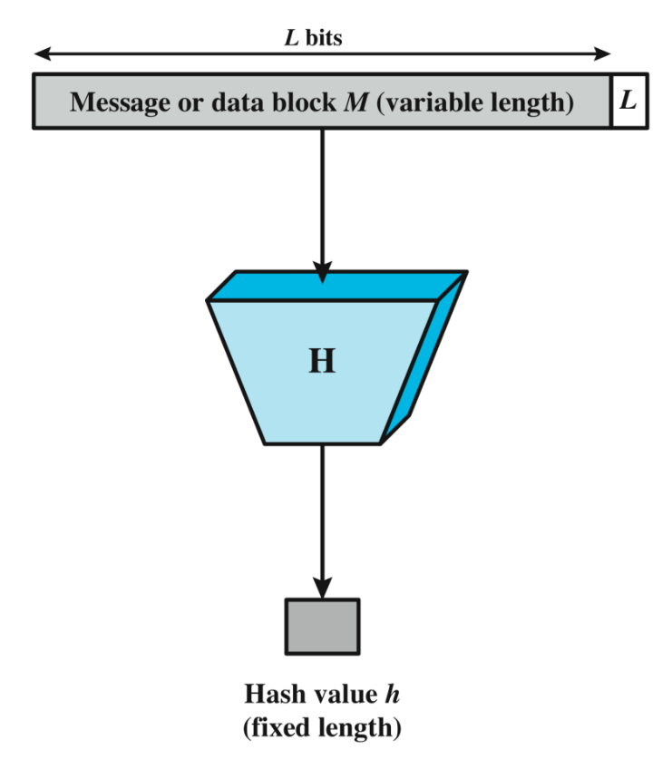
Hashing
One-way encryption
Takes any number of data items
Processes via a hash function
  h = H(M);
  h – fixed length
  M – any length
  H – hash function
Creates a unique digest called hash
Examples: SHA, MD5
Notes:
Template-WSU Hrz 201.ppt

Slide 15
Hashing Examples
Unix commands
  # echo "This is a test message to demonstrate hash functions" | sha1sum
    > 799772e0410af26e43ee279af9f630150c7bb8bb
  # echo "This is a test message to demonstrate hash functions." | sha1sum
    > 5bd891f72d006b2eaff8b0ad36457fe7cce6f21c
  # echo "This is a tset message to demonstrate hash functions" | sha1sum
    > d3e266656a24a986e6303eccab4474447b887def
  # echo "This is a test message to demonstrate hash functions" | sha512sum
  >72a26cb6e857cecbaf6b2b88bfaebd680de0551e091e87e7f822c10
  933ce58c696356d88124a114ff1eec089a3a2e8f2cecb0916c567f8 20c12d07c598d790c5

Slide 16
Hashing
Used for:
  digital signatures
  HMACs
  password storage
Provides: integrity and authentication
Advantages:
  Can turn 3 GB of data into a 3 KB digest
Disadvantages:
  One-way process
Notes:
Template-WSU Hrz 201.ppt

Slide 17
Next lecture
HA-01
MACs (Message Authentication Codes)
Digital Certificates
Notes:
Template-WSU Hrz 201.ppt

Slide 18
Any questions?
Notes:
Template-WSU Hrz 201.ppt

