Slide 1
CptS 427 / 527 : Computer Security
Announcements
HA-01 is live, due 9/14
  Threat modeling, as discussed in Lecture 03
Quizzes delegated to Arefeen (asiful.arefeen@wsu.edu)
  Same format and time limits
  Reasonable accommodations will remain
  Contact: forum or email (for private issues)
Notes:
Template-WSU Hrz 201.ppt

Slide 2
CptS 427 / 527 : Computer Security
Cryptography Basics
Notes:
Template-WSU Hrz 201.ppt

Slide 3
Today’s Topics
Recap of previous lecture
Message authentication codes
Digital signatures and certificates
Authentication
Notes:
Template-WSU Hrz 201.ppt

Slide 4
Recap
Crypto goals, property, and implementation
  Encryption
    Symmetric & Asymmetric
  Hashing
Notes:
Template-WSU Hrz 201.ppt

Slide 5
MACs
Message Authentication Codes
NOT Media Access Control
Provide integrity and authentication
Can be used independently or alongside encryption / hashing
Notes:
Template-WSU Hrz 201.ppt

Slide 6
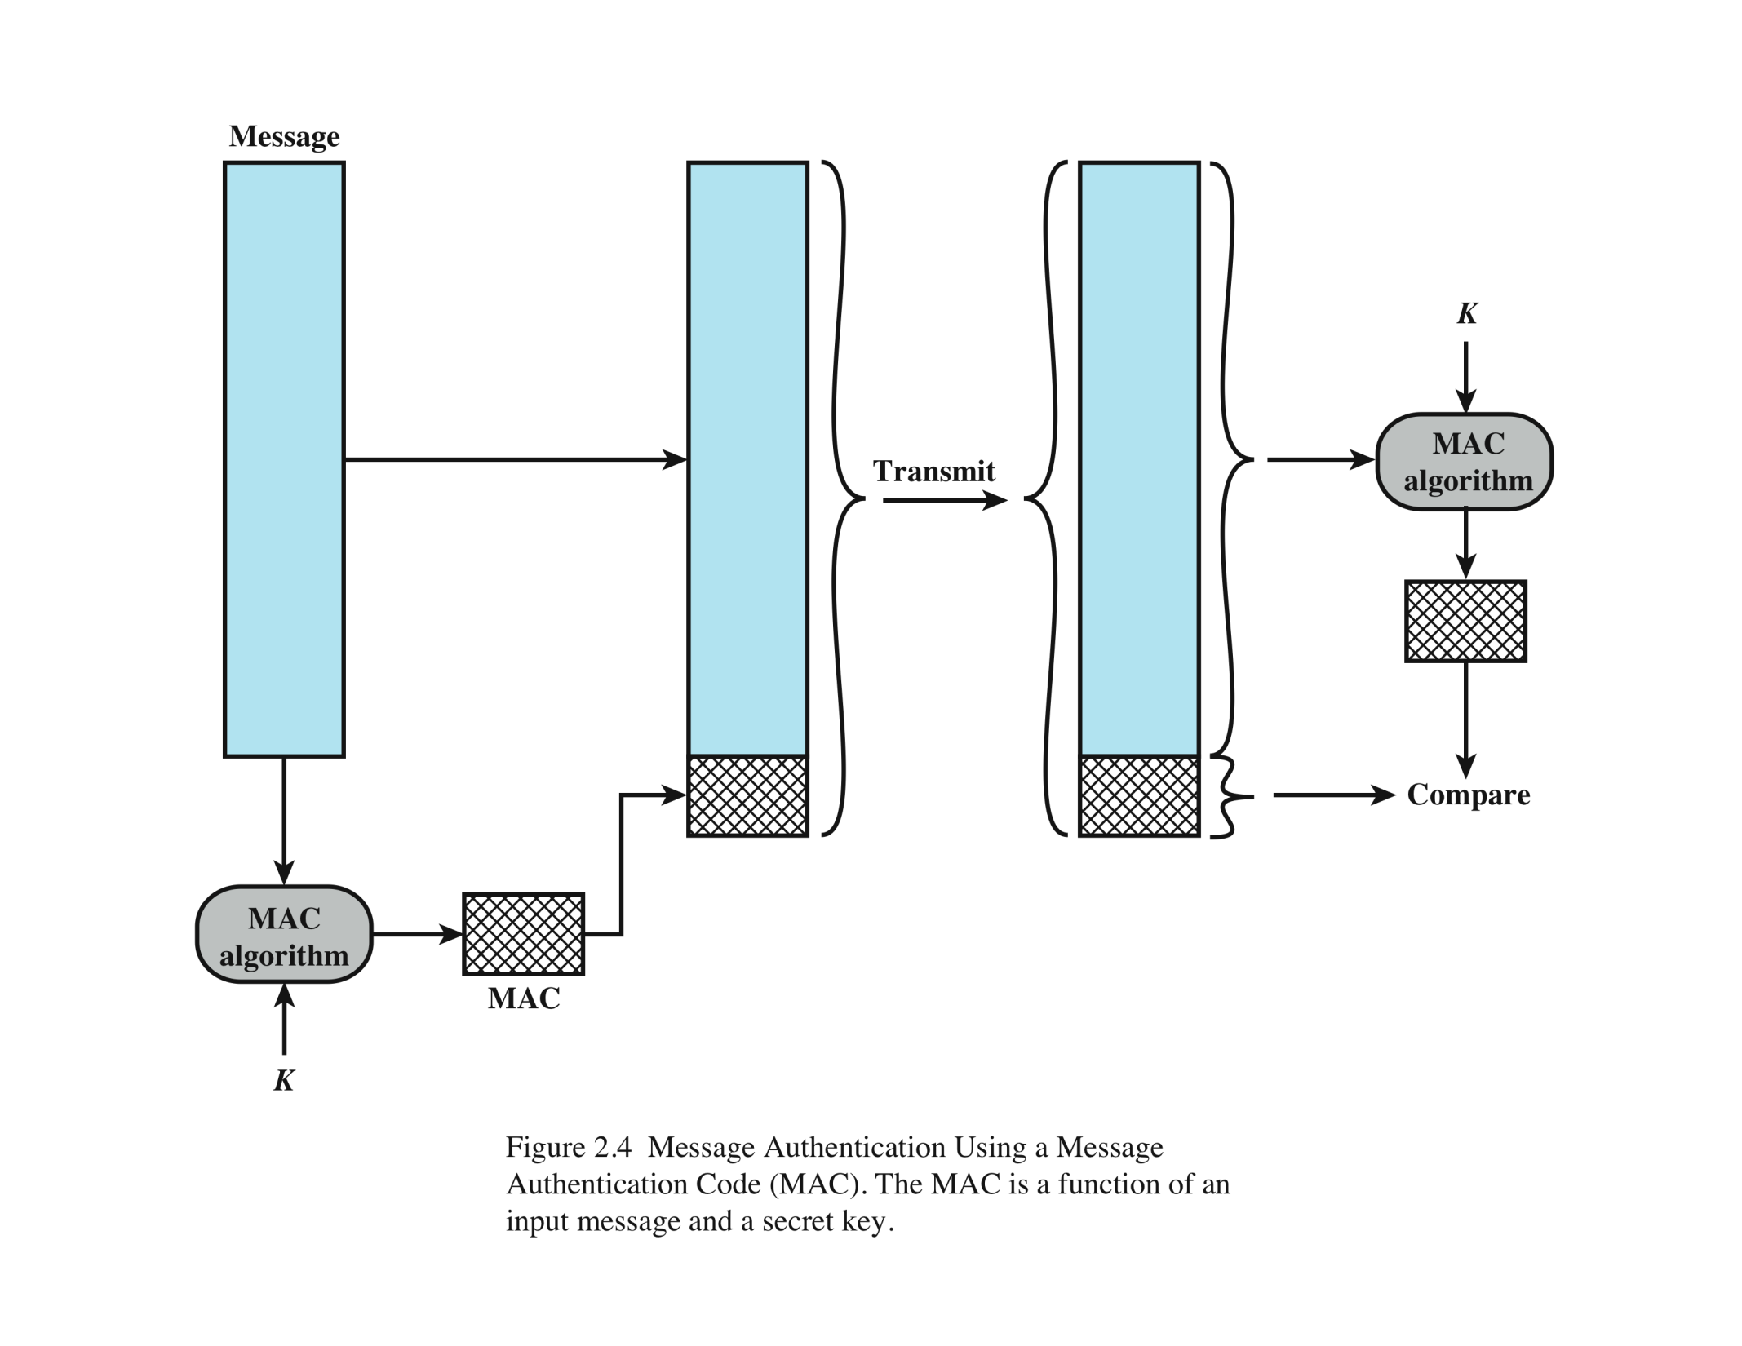
MAC
Alice
Bob
(M)
MACM = F(K,M)
MACM = F(K,M)
M
Preshared Key
Notes:
Template-WSU Hrz 201.ppt

Slide 7
MAC Security
Integrity
  If message is manipulated in transit, MACs don’t match
  F(K, M) != F(K, M’)
Authentication
  The preshared key, K, provides authentication
Drawbacks
  Key management
  Repudiation (everyone that can access K can create the same MAC)
Notes:
Template-WSU Hrz 201.ppt

Slide 8
Digital Signatures
Provide authenticity and integrity
Uses asymmetric encryption
Recall:
  A member’s public key is available for everyone in the group
  A member’s private key is available to only the member
Notes:
Template-WSU Hrz 201.ppt

Slide 9
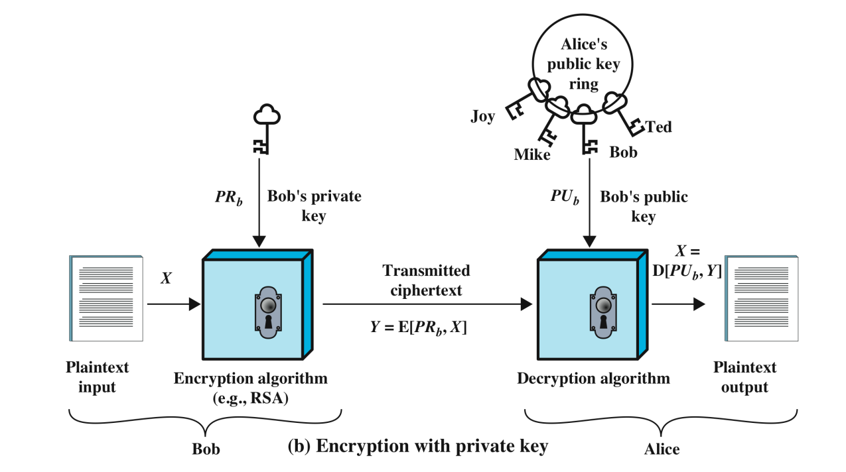
Notes:
Template-WSU Hrz 201.ppt

Slide 10
Digital Certificates
Provide root of trust
Helps protect against spoofing / tampering
Relies on a central certification authority (CA)
  VeriSign, Comodo, …
If CA is compromised, the entire trust chain is vulnerable
Notes:
Template-WSU Hrz 201.ppt

Slide 11
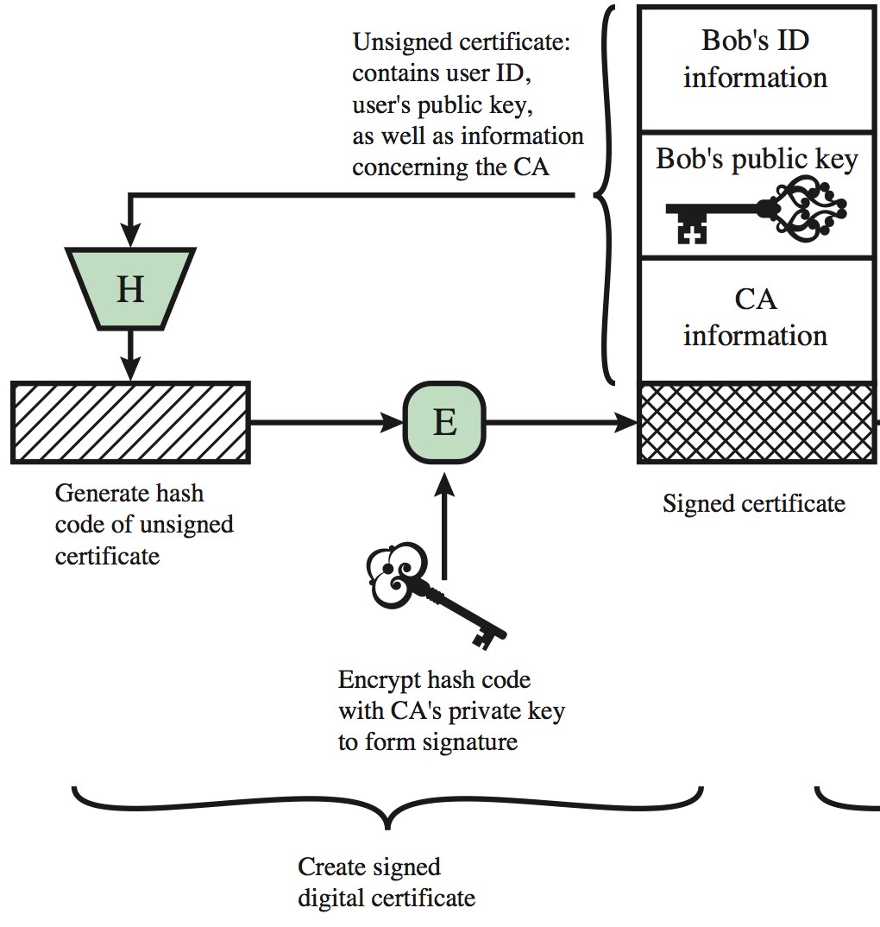
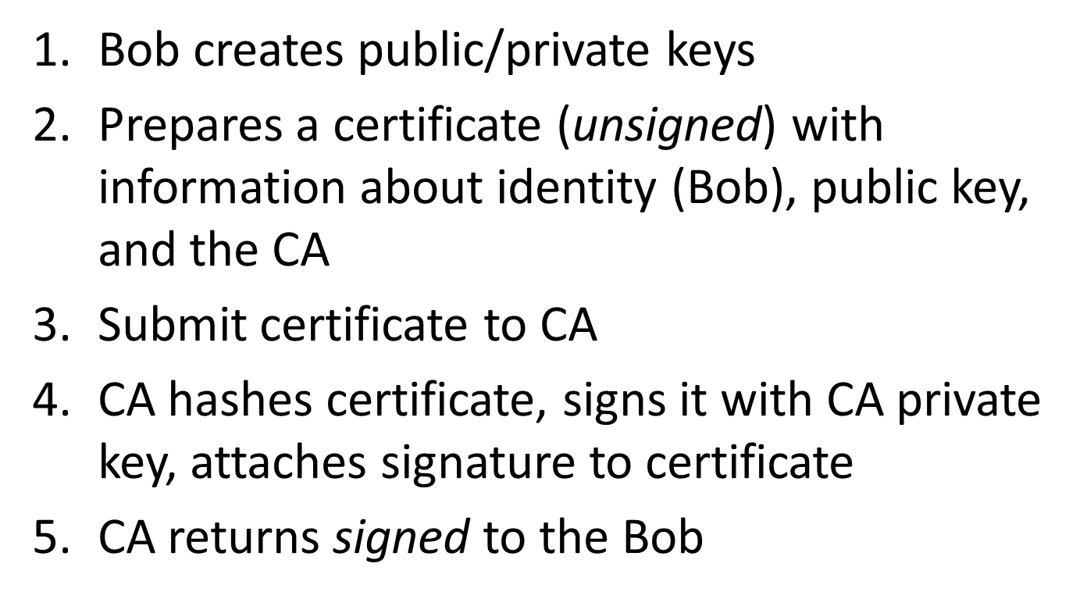
Digital Certificate Creation
Notes:
Template-WSU Hrz 201.ppt

Slide 12
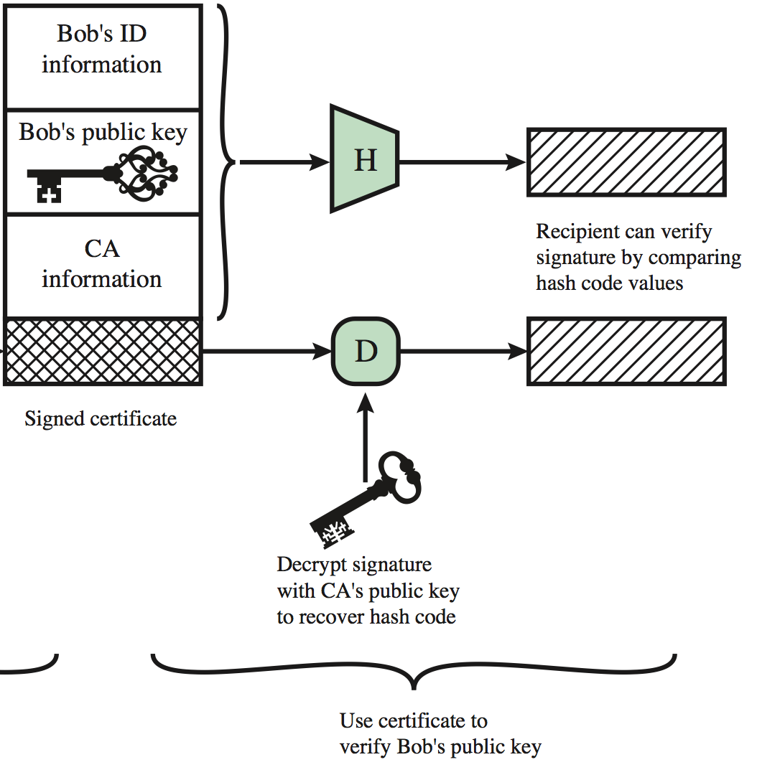
Digital Certificate Usage
Alice requests communication with Bob
Bob sends signed certificate to Alice
Alice (already has CA public key) creates hash of certificate, checks to see if the hash matches the CA signed part of certificate
If equal, cert has not been tampered with and public key in certificate can be trusted
If not equal, potentially spoofed/tampered communication!
Notes:
Template-WSU Hrz 201.ppt

Slide 13
Authentication
An application of cryptographic mechanisms
Overview:
  Definition
  Factors
  Threats
  Storage
  Protocols
Notes:
Template-WSU Hrz 201.ppt

Slide 14
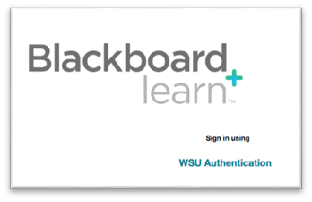
Authentication – Definition
“The process of verifying an identity claimed by or for a system entity”
learn.wsu.edu/
Student
????
Notes:
Template-WSU Hrz 201.ppt

Slide 15
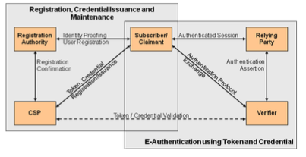
Authentication – E-Authentication
Developed by NIST
  Registration Authority – Trusted Entity that establishes and vouches for the identify or attributes of a Claimant/(Subscriber) to a CSP
Claimant/(Subscriber) – the party whose identity is to be verified with an authentication protocol
  Relying Party – Entities that depends upon the claimant (subscribers) credential or a Verifier’s assertion of a claimants identity.
Assertion - statement from a Verifier to a Relying Party (RP) that contains identity information about a Subscriber
  CSP (Credential Service Provider) – trusted entity that issues credentials to the Claimant/subscriber
  Verifier – party that verifies the identity of claimant
Credential – data structure that authoritatively binds an identity to a token, can be verified when presented to verifier during transaction
Token - Something that the Claimant possesses and controls (typically a cryptographic module or password) that is used to authenticate the Claimant’s identity.
Notes:
Template-WSU Hrz 201.ppt

Slide 16
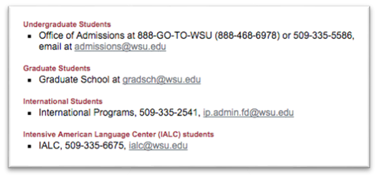
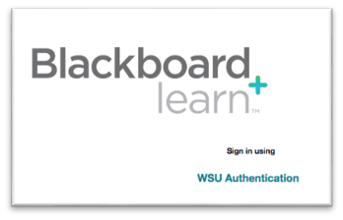
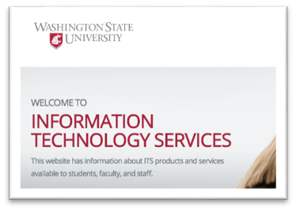
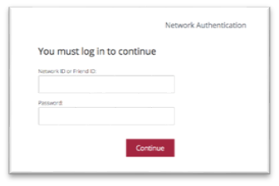
Authentication – E-Authentication
Developed by NIST
Admissions/Grad School/ International Programs
learn.wsu.edu/
Student
WSU ITS
shibidp.wsu.edu
Notes:
Template-WSU Hrz 201.ppt

Slide 17
Authentication - Factors
How do we authenticate? Using factors
Factors:
  Something you know
    Password, pin, security Q/A
  Something you possess
    Smart card, token generator
  Something you are
    Static: fingerprints, iris scan, face recognition
    Dynamic: voice recognition
Multifactor (2FA, 3FA) is the new norm
  Prevents single point of failure
Notes:
Template-WSU Hrz 201.ppt

Slide 18
Authentication - Levels
As defined by NIST:
  Level 1 – no ID proofing, 1FA
  Level 2 – ID proofing, 1FA
  Level 3 – ID proofing, 2FA (password, token)
  Level 4 – ID proofing, 2FA+ (password, token, iris scan,…)
Notes:
Template-WSU Hrz 201.ppt

Slide 19
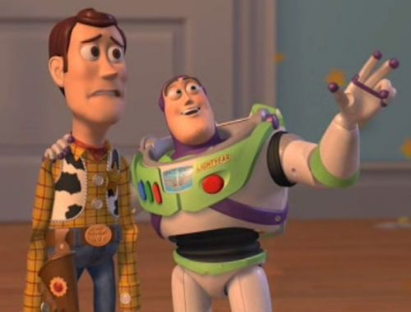


Notes:
Template-WSU Hrz 201.ppt

Slide 20
Passwords
Most popular: cheap and easy
Password quality
  Length
  Diversity of characters
  Non-dictionary words
Strength can be measured using entropy
  Entropy: bits taken to store all possible combinations
Notes:
Template-WSU Hrz 201.ppt

Slide 21





Entropy
How many bits are need to represent the information?
Randomly Selected Passwords:
H - entropy
l - password length
b - characters in alphabet
- Binary value [0,1]
- Alphabet [a-z]
Example:
8 character ASCII
- All ASCIIs
User Selected Passwords:
Source: NIST 800-63 Rev 2
- First character = 4 bits
- Next 7 characters = 2 bits/character
- 9th -> 20th characters = 1.5 bit/character
- After 20th character = 1 bit/characters
And…
- Bonus 6 bits if check for dictionary words
- Bonus 6 bits if uppercase and non-alphabetic
What’s the entropy of English?
- We know P(e,t,a,o)>>P(j,q,x,z)
- Entropy of English words ~= 2.6 bits
Notes:
Template-WSU Hrz 201.ppt

Slide 22
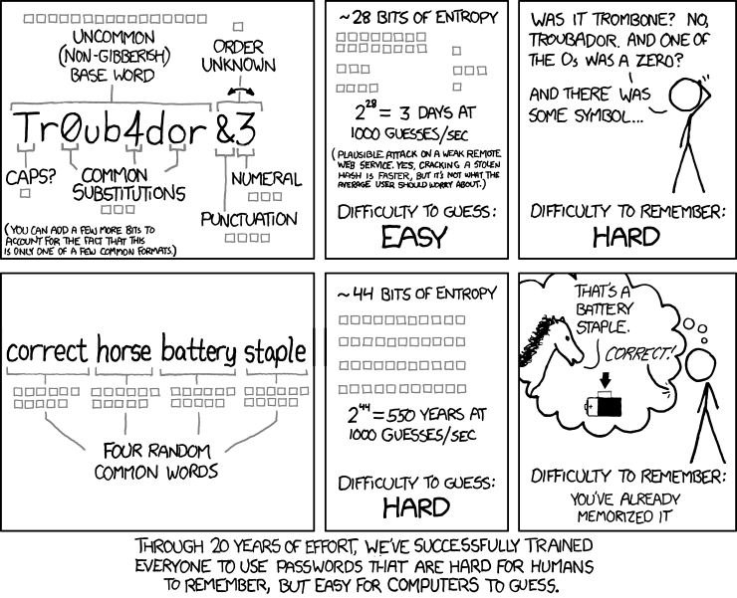
Notes:
Template-WSU Hrz 201.ppt

Slide 23
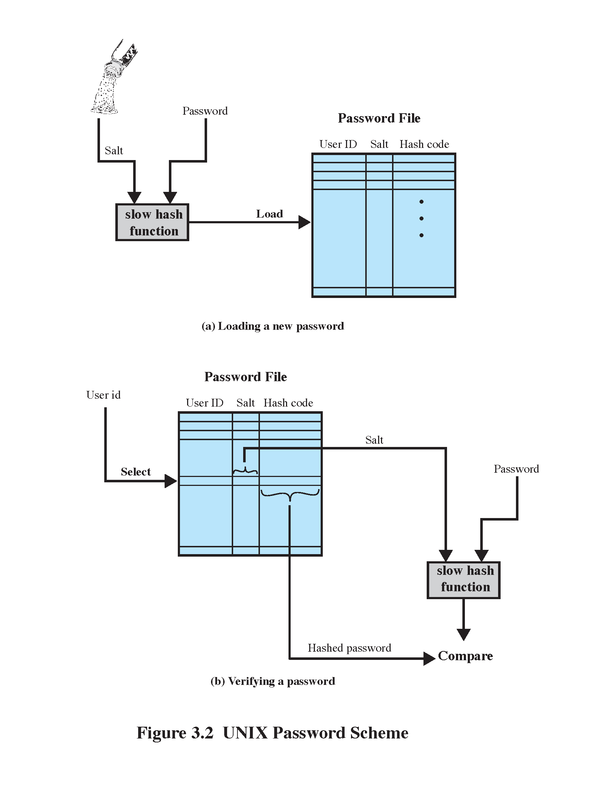
Storing Passwords - Password Hashes
Hash Usage
Hash Creation
Example: OpenBSD (55 chars, 128bit salt, 192bit hash)
Notes:
Template-WSU Hrz 201.ppt

Slide 24





Authentication Threats
What Threats Exists?
Hacker
Network
Credential
Verifier/
Target System
Claimant
Host System
Notes:
Template-WSU Hrz 201.ppt

Slide 25
Authentication Threats
Hacker
4) Denial of Service
5) Replay
6) Eavesdrop
Steal Token
Guess Token
Network
7) Host Attack
3)Trojan/Malware
Credential
Verifier/
Target System
Claimant
Host System
Notes:
Template-WSU Hrz 201.ppt

Slide 26
Authentication Threats
-Password written down
-Passwords reused
-Default blank/known passwords
-Brute force guess
-Unencrypted transmission
-Offline password hashing
http://arstechnica.com/security/2013/05/how-crackers-make-minced-meat-out-of-your-password
-Keylogger
4) Denial of Service
5) Replay
6) Eavesdrop
Steal Token
Guess Token
Network
7) Host Attack
3)Trojan/Malware
Credential
Verifier/
Target System
Claimant
Host System
Notes:
Template-WSU Hrz 201.ppt

Slide 27
Cracking Passwords
Assume: attacker gets access to a password file
File can be brute-forced to crack the hash
  1 high-end GPU: 8.2x(10^9) passwords/sec
Rainbow table
  Large public dictionary of hash to password translation
  Significantly reduces processing time
  Contains 99.9% of Windows LM hashes (until XP)
Notes:
Template-WSU Hrz 201.ppt

Slide 28
Are strong passwords secure?
Yes
https://www.usenix.org/legacy/event/hotsec07/tech/full_papers/florencio/florencio.pdf
6-digit pins are sufficient
  if 3 strikes lockout rule is enforced
  Less than 1% chance of password being cracked
Notes:
Template-WSU Hrz 201.ppt

Slide 29
Next lecture
Security questions
Biometrics
Tokens, and others auth factors
Auth protocols
Notes:
Template-WSU Hrz 201.ppt

Slide 30
Any questions?
Notes:
Template-WSU Hrz 201.ppt

