Slide 1
CptS 427 / 527 : Computer Security
Announcements
How will ‘3’ grade affect the class?
  higher class avg → grade scale curved up
Course project proposals due 9/11 EOD
Notes:
Template-WSU Hrz 201.ppt

Slide 2
CptS 427 / 527 : Computer Security
Cryptography Applications
Notes:
Template-WSU Hrz 201.ppt

Slide 3
Today’s Topics
Authentication Factors
  Secret Questions
  Biometrics
  Tokens
Network Auth Protocols
  Challenge Response
  Needham-Schroeder
  Kerberos
  OpenID
Notes:
Template-WSU Hrz 201.ppt

Slide 4
Secret / Security Questions
Information that’s not easily available
  Ideally, info that’s never available
Problem: ‘secret’ is relative
  Some secrets are easy to guess
  Others are easy to crack
History of exploits
  Sara Palin’s email account (guessing, brute-force)
  Matt Honan’s hack adventure (clever engineering chain)
Notes:
Template-WSU Hrz 201.ppt

Slide 5
Matt Honan’s Hack Chain
  A Twitter account
  Pw reset
  A Gmail account
  Pw reset
  An Apple account
  Pw reset required
  Amazon Tech provides last 4 cc #s
4 cc #s, email addr, billing addr
  An Amazon account
Notes:
Template-WSU Hrz 201.ppt

Slide 6
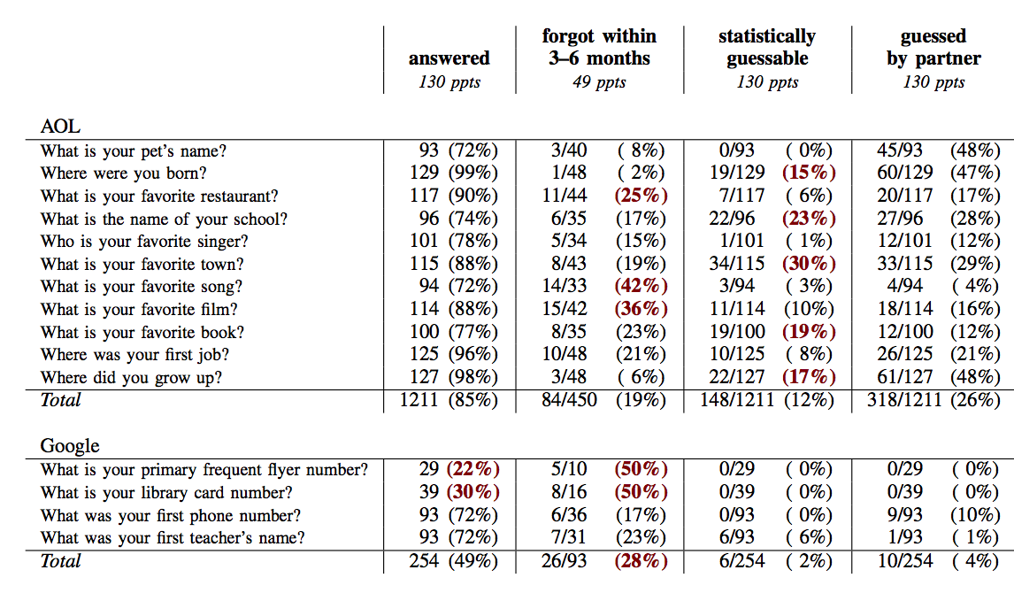
Secret / Security Questions
Notes:
Template-WSU Hrz 201.ppt

Slide 7
Biometrics
Examples
  Iris, fingerprint, hand geo, voice, etc.
Advantages
  No issue of remembrance
  No issue of additional security equipment (no tokens, OTP)
Problems
  Expensive to implement
  Complex to accurately compute
    Most implementations have low accuracy
  Privacy issues
  Can’t change
Notes:
Template-WSU Hrz 201.ppt

Slide 8
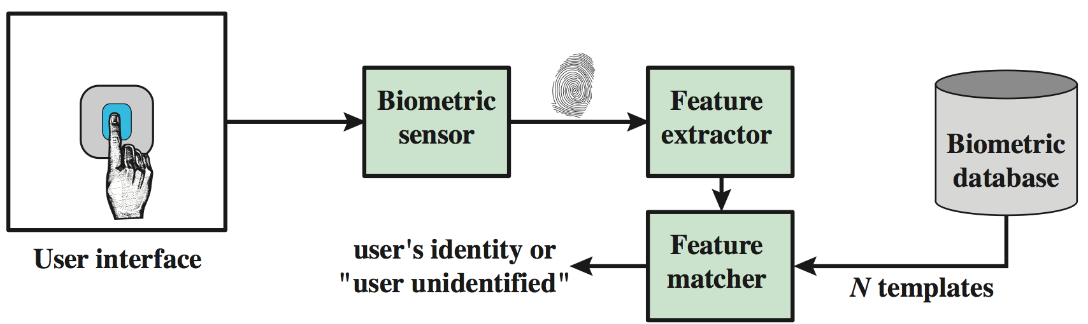
Biometrics
Reading and verification of biometrics
  Done by algorithms
  Riddled with errors / low accuracy
  Hard to replicate patterns everyday
    Dirty hands, teary eyes, finger not in the same angle
Notes:
Template-WSU Hrz 201.ppt

Slide 9
Biometrics: Binary Classification
Authentication
Success
Authentication
Failure
Authentic
User
True Positive
False Negative
(false non-match)
False Positive
(false match)
Attacker
True Negative
Notes:
Template-WSU Hrz 201.ppt

Slide 10
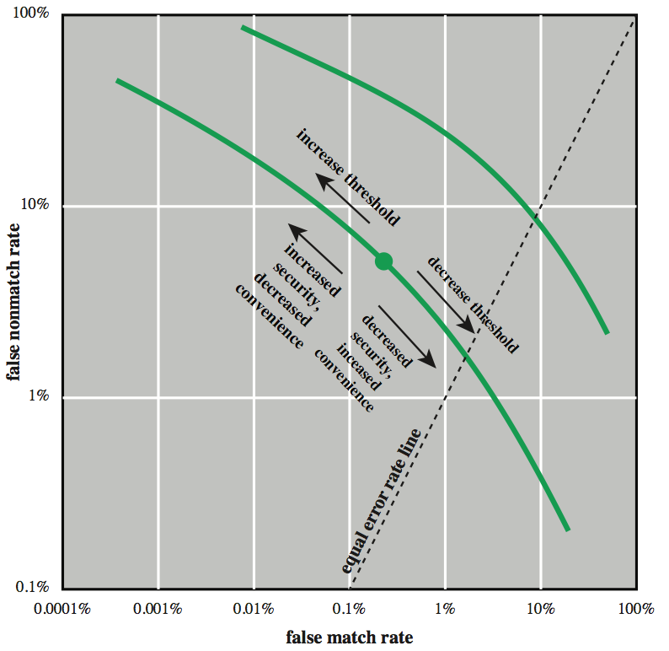
Biometrics: Accuracy Tradeoffs
Notes:
Template-WSU Hrz 201.ppt

Slide 11
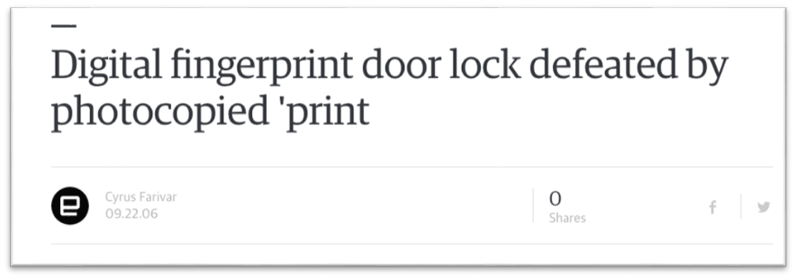
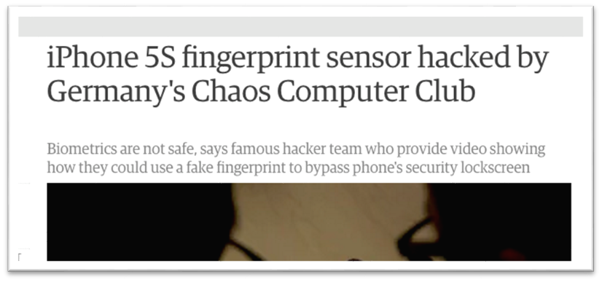
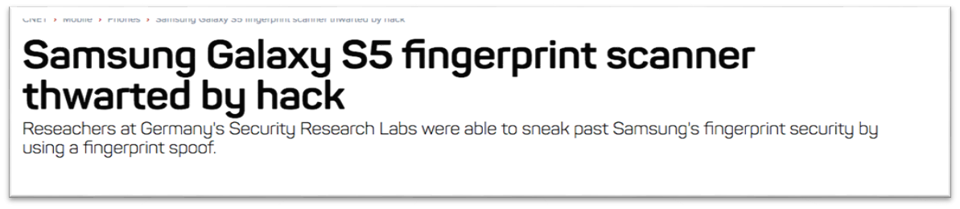
Biometrics: Accuracy Problems
Notes:
Template-WSU Hrz 201.ppt

Slide 12
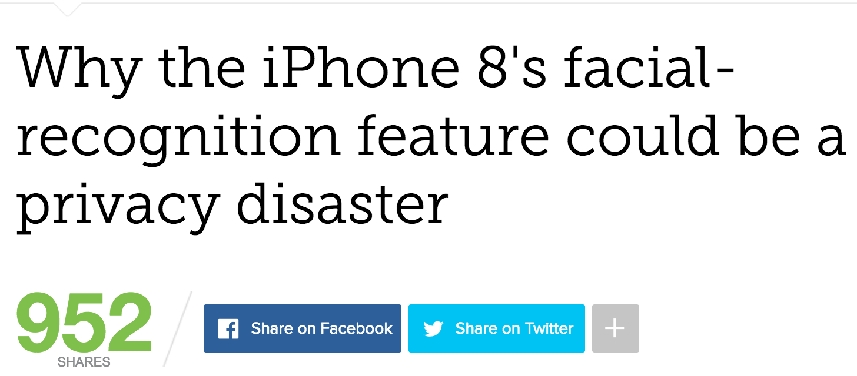
Biometrics: Privacy Problems
Issues:
  Faces maybe similar
  Face information is widely available
  Camera must be ”always on”
Notes:
Template-WSU Hrz 201.ppt

Slide 13
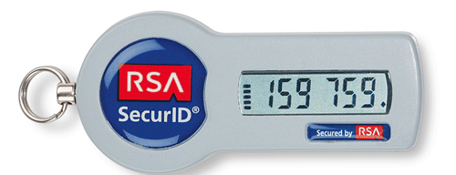
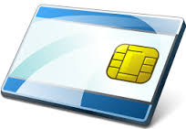
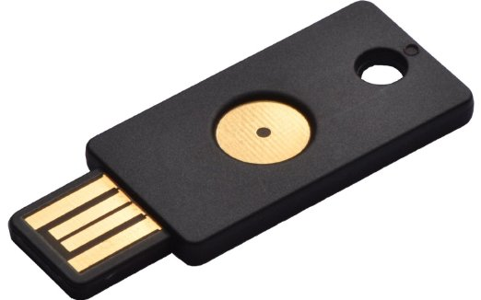
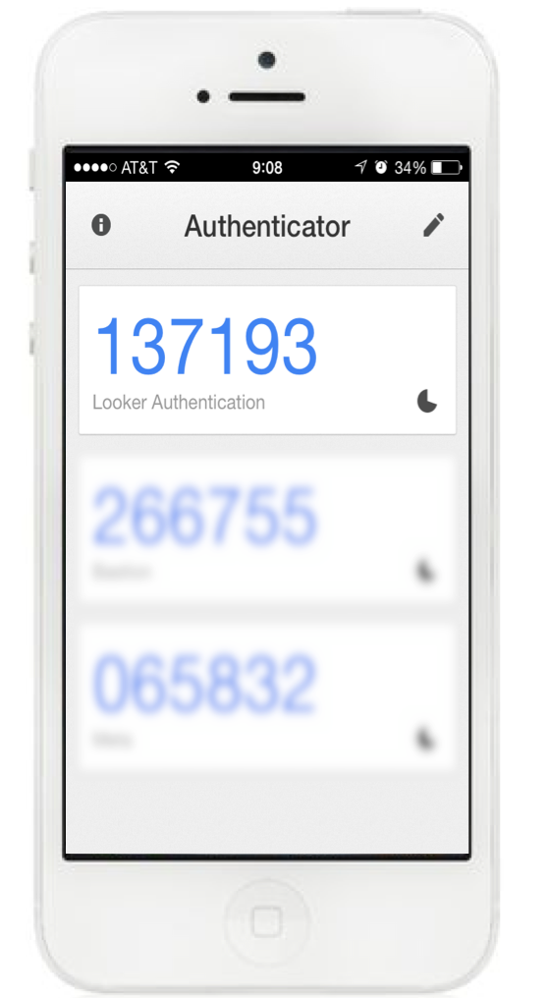
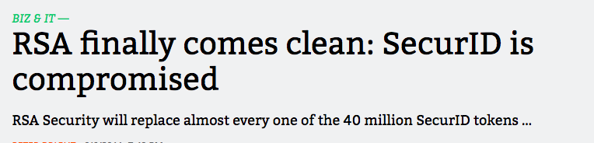
Tokens
Examples
  RSA SecureID
    OTP in sync with servers
  Smart cards
    Embedded crypto processor
  Phones
    SMS messages
Advantages: accurate than biometrics
Problems
  Expensive
  Can be lost, stolen, cracked
Notes:
Template-WSU Hrz 201.ppt

Slide 14
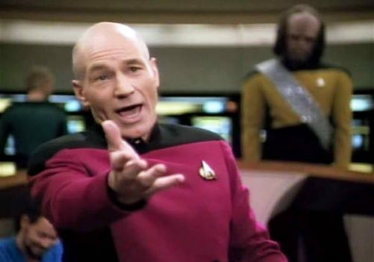
MFA: The Path Forward
Notes:
Template-WSU Hrz 201.ppt

Slide 15
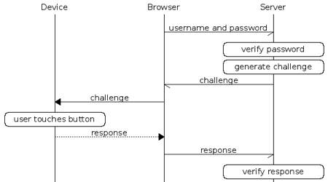
Fast Identity Online (FIDO) Alliance
Emerging MFA online standard
  Governs websites, web apps
  Supports multiple devices
Notes:
Template-WSU Hrz 201.ppt

Slide 16
SMS Authentication
Receive an OTP to your phone
Use OTP to access a service
The service usually has username/password as well
Is this secure?
Notes:
Template-WSU Hrz 201.ppt

Slide 17
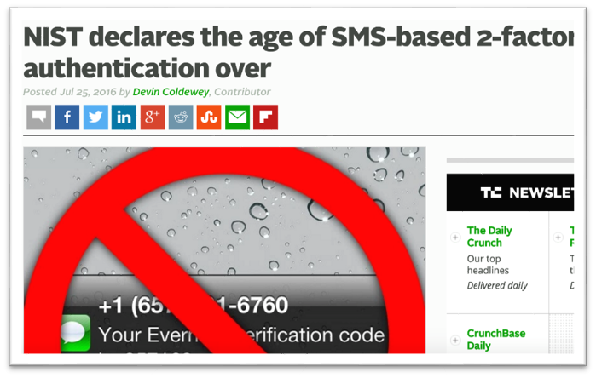
SMS Authentication
Debated about SMS being a factor in MFA
SMS messages can be re-directed easily
  VoIP, account redirect with mobile carrier
Notes:
Template-WSU Hrz 201.ppt

Slide 18
Network Authentication Protocols
Challenge Response
Needham-Schroeder
Kerberos
OpenID
Notes:
Template-WSU Hrz 201.ppt

Slide 19
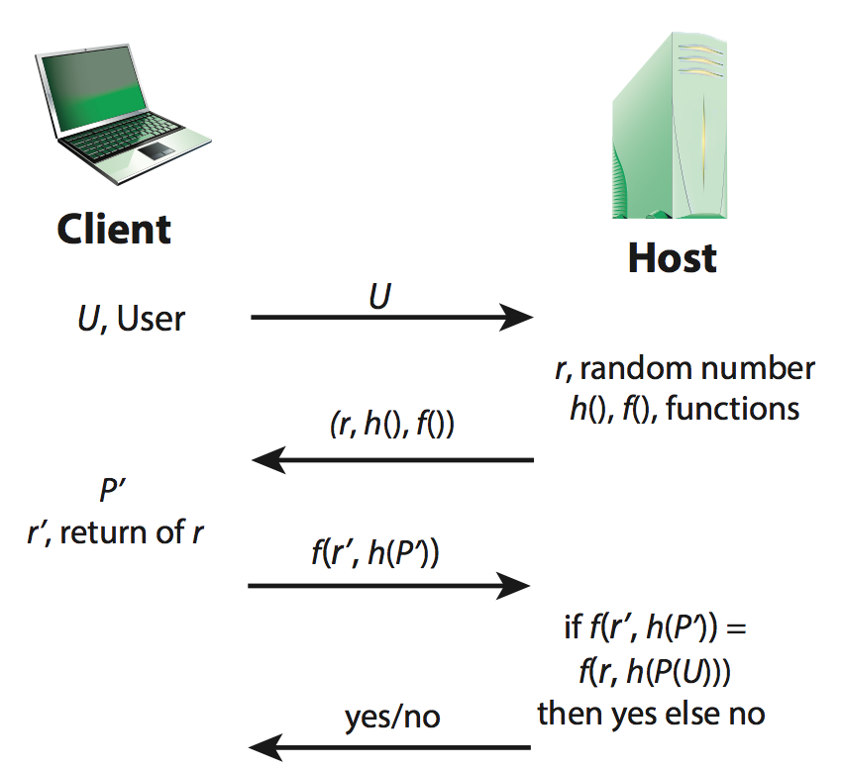
Challenge Response Protocol
U – User
P – Password
r – nonce (random number)
h() – hash function
f() – challenge/response function (probably also a hash fn)
Notes:
Template-WSU Hrz 201.ppt

Slide 20
Challenge Response Protocol
Advantages
  Doesn’t transmit user’s credential, transmits hash
  Uses nonce to randomize every access attempt
Threats
  Eavesdropper
  Replay
  Man in the Middle
Notes:
Template-WSU Hrz 201.ppt

Slide 21
Needham-Schroeder Protocol
Same Schroder from ‘Security Design Principles’
  Michael Schroeder – WSU grad (1967)
Motivation:
  A & B want to chat but don’t trust each other
  They both trust S
  How to make key sharing possible?
Notes:
Template-WSU Hrz 201.ppt

Slide 22
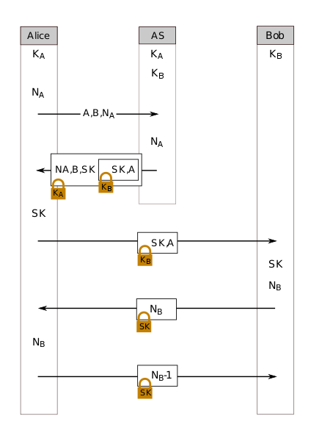
Needham-Schroeder Protocol
S is the trusted server
N_A and N_B are nonces (rand numbers)
K_A is the symmetric key of A
K_B is the symmetric key of B
SK is the symmetric key generated by S, to be used by A and B for their session
Notes:
Template-WSU Hrz 201.ppt

Slide 23
Needham Schroeder Protocol
Uses third party to authenticate two users
Uses shared keys
Problems:
  Replay attack
    If K_(AB) is compromised
Basis for Kerberos Protocol
Notes:
Template-WSU Hrz 201.ppt

Slide 24
Kerberos Protocol
Motivation:
  Credential storage on systems?
    Can’t stores all credentials on all systems for a cloud app
Example: University accounts
Solution: single authentication server
Popular for network auth (e.g. MS AD)
Notes:
Template-WSU Hrz 201.ppt

Slide 25
Kerberos Terminology
Authentication Server (AS)
  Authenticates each users database of all users/passwords
Ticket
  credential used for authenticate to systems
Ticket-Granting Server (TGS)
  Validates TGTs and provides service tickets
Ticket-Granting Ticket (TGT)
  Used to obtain a service ticket from TGS
Authenticator
  Verifies sender of ticket is same as entity included in ticket
Notes:
Template-WSU Hrz 201.ppt

Slide 26
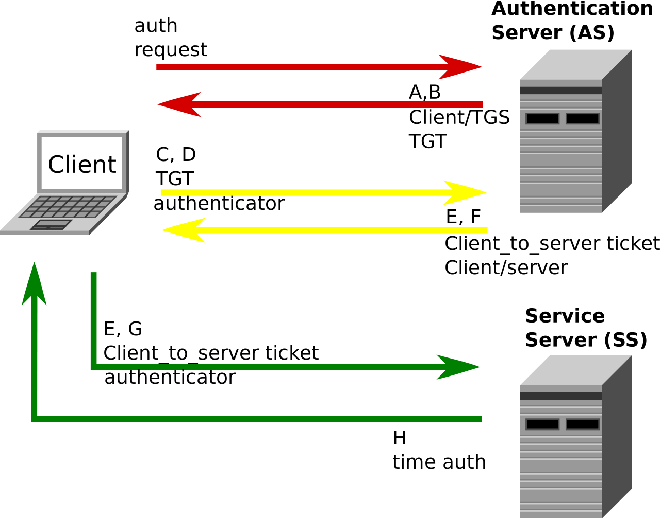
Kerberos Terminology

Slide 27
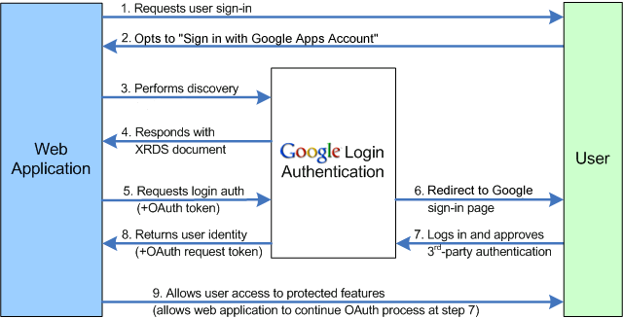
OpenID Protocol
Provides trusted third-party services for authentication
Notes:
Template-WSU Hrz 201.ppt

Slide 28
OpenID Protocol
Multiple sub-protocols
  Oauth, OpenID Connect
Problems
  Trust
  Privacy (service sees all the sites you visit)
  Companies store your web traffic data
    Data is $$$$
Notes:
Template-WSU Hrz 201.ppt

Slide 29
Authentication Protocols
MFA apps are still insecure
Vulnerable to
  Phishing
  Trojan / malware
Evidence for cracking MFA exists
  https://www.schneier.com/blog/archives/2005/03/the_failure_of.html
Notes:
Template-WSU Hrz 201.ppt

Slide 30
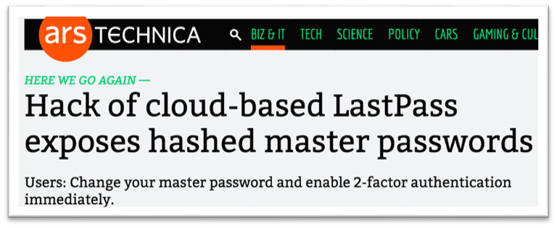

Password Managers
Better to use local pwd managers
Cloud pwd managers are more vulnerable
Notes:
Template-WSU Hrz 201.ppt

Slide 31
Next lecture
Access Control
No class on Monday
Notes:
Template-WSU Hrz 201.ppt

Slide 32
Any questions?
Notes:
Template-WSU Hrz 201.ppt

