Slide 1
CYPHER
AI conversation practice
A platform for practising English through realistic conversations.
Voice or text answers. Adaptive partners. Personal feedback.
CYPHER
01 / 12
Notes:
Sources: CYPHER project code and project-owner screenshots. Screenshots show development versions. Browser chrome and taskbar have been removed and image proportions preserved.

Slide 2
Presentation roadmap
A clear view of the project
01 The learning need and the product
02 Rooms, levels and conversation flow
03 Feedback, architecture and next steps
CYPHER
02 / 12
Notes:
Sources: CYPHER project code and project-owner screenshots. Screenshots show development versions. Browser chrome and taskbar have been removed and image proportions preserved.

Slide 3
The learning need
Practice before the real conversation
Interviews and academic discussions require answers in context. Knowing vocabulary alone does not prepare a learner for every situation.
CYPHER gives learners a simulated partner, opportunities to retry and feedback on their answers.
CYPHER
03 / 12
Notes:
Sources: CYPHER project code and project-owner screenshots. Screenshots show development versions. Browser chrome and taskbar have been removed and image proportions preserved.

Slide 4
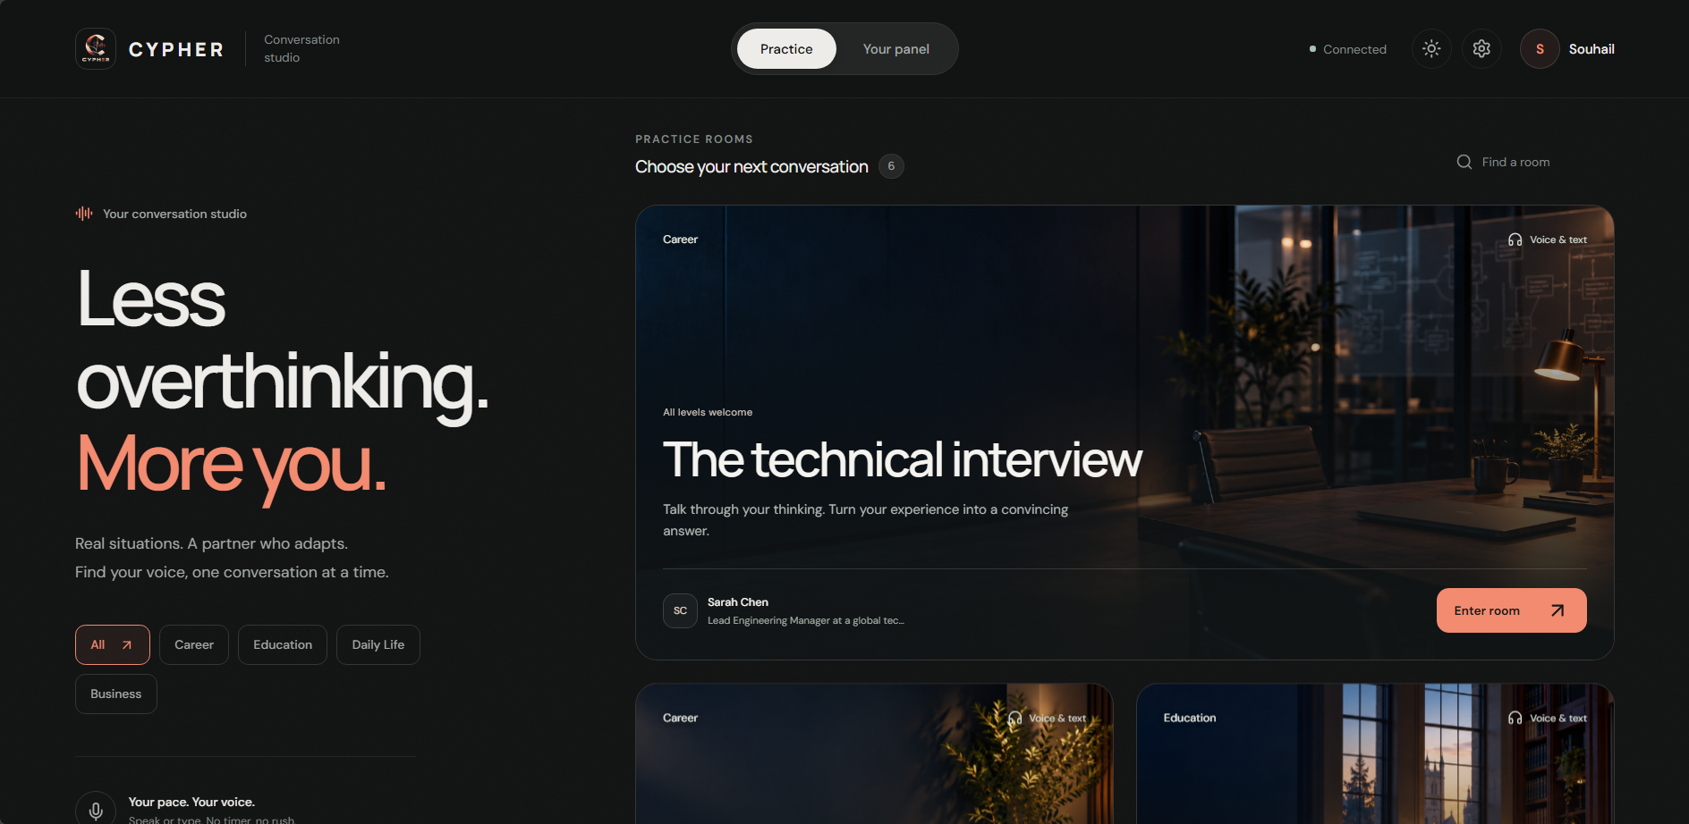
The conversation studio
Real situations in one place
Users select a room before starting a conversation.
CYPHER
04 / 12
Notes:
Sources: CYPHER project code and project-owner screenshots. Screenshots show development versions. Browser chrome and taskbar have been removed and image proportions preserved.

Slide 5
Six practice scenarios
A purpose for every conversation
Technical interview
Behavioral interview
University defense
Campus conversation
Coffee conversation
Salary negotiation
CYPHER
05 / 12
Notes:
Sources: CYPHER project code and project-owner screenshots. Screenshots show development versions. Browser chrome and taskbar have been removed and image proportions preserved.

Slide 6
Difficulty levels
A challenge suited to the learner
Beginner: 9 questions
Intermediate: 12 questions
Advanced: 15 questions
Short prompts and support at beginner level.
More depth and precision at higher levels.
No countdown timer.
CYPHER
06 / 12
Notes:
Sources: CYPHER project code and project-owner screenshots. Screenshots show development versions. Browser chrome and taskbar have been removed and image proportions preserved.

Slide 7
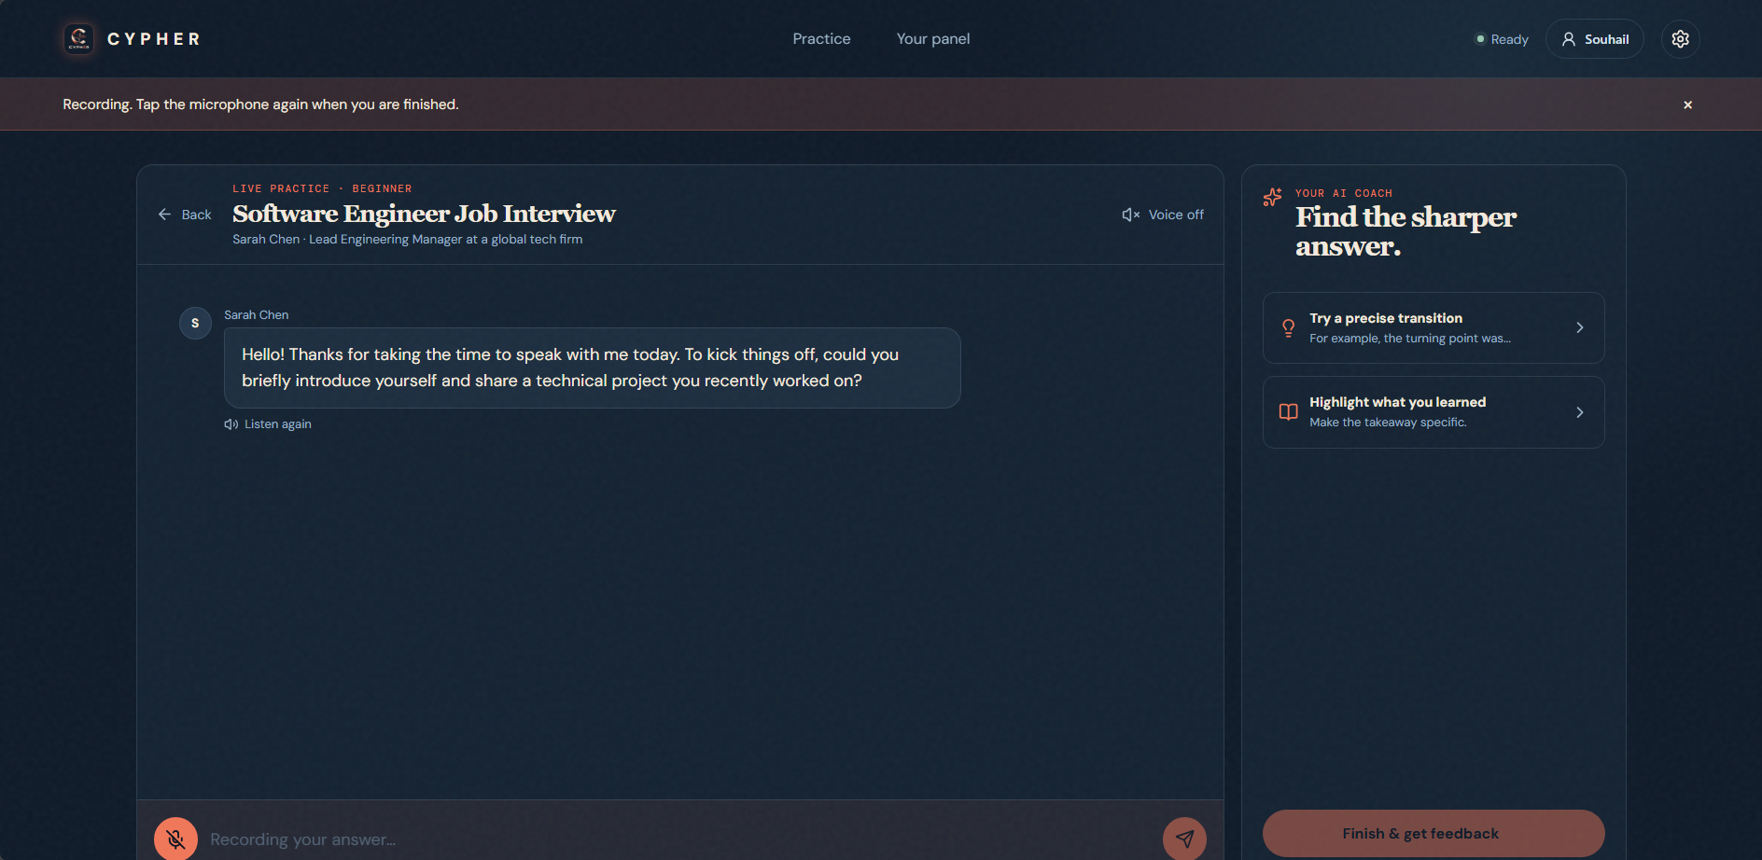
Voice and text
Two ways to answer
Users can type an answer or record it with the microphone.
CYPHER
07 / 12
Notes:
Sources: CYPHER project code and project-owner screenshots. Screenshots show development versions. Browser chrome and taskbar have been removed and image proportions preserved.

Slide 8
Conversation logic
Guidance when an answer is difficult
1. The AI reviews the response.
2. The user can retry, up to three attempts per question.
3. An explicit “I don’t know” skips the question.
4. The session moves on after the answer or the final attempt.
CYPHER
08 / 12
Notes:
Sources: CYPHER project code and project-owner screenshots. Screenshots show development versions. Browser chrome and taskbar have been removed and image proportions preserved.

Slide 9
Response-based pressure
The partner reacts to the answer
Clear, relevant and developed answers can reduce pressure.
Unclear, brief or uncertain responses can increase pressure.
The interface reflects the partner’s mood.
Reaching maximum pressure ends the conversation and contributes to the results.
CYPHER
09 / 12
Notes:
Sources: CYPHER project code and project-owner screenshots. Screenshots show development versions. Browser chrome and taskbar have been removed and image proportions preserved.

Slide 10
Feedback and progress
A personal record of practice
AI estimate of CEFR level and overall score.
Feedback on grammar, vocabulary, coherence and task completion.
Suggested corrections and practice drills.
Saved sessions and previous reports in the user panel.
AI feedback is not an official language certification.
CYPHER
10 / 12
Notes:
Sources: CYPHER project code and project-owner screenshots. Screenshots show development versions. Browser chrome and taskbar have been removed and image proportions preserved.

Slide 11
Technical architecture
Frontend, API and AI services
React + Vite
Interface, microphone recording and audio playback. GSAP and Framer Motion support animation.
Python + FastAPI
Authentication, conversations and assessment endpoints.
Groq
Conversation generation and response analysis.
Whisper and Edge TTS
Audio transcription and generated speech.
SQLite
User accounts and practice history.
CYPHER
11 / 12
Notes:
Sources: CYPHER project code and project-owner screenshots. Screenshots show development versions. Browser chrome and taskbar have been removed and image proportions preserved.

Slide 12
Summary and next steps
Realistic English conversation practice
Current product
Six scenarios, three difficulty levels, voice and text interaction, and saved personal feedback.
Proposed next steps
Test with learners, evaluate feedback consistency and prepare deployment.
CYPHER
12 / 12
Notes:
Sources: CYPHER project code and project-owner screenshots. Screenshots show development versions. Browser chrome and taskbar have been removed and image proportions preserved.

