Slide 1
WORKSHOP · 60 MINUTES · DEVOPS FOUNDATIONS
IPv4 vs IPv6
for DevOps Engineers
“Don’t panic. It’s just more numbers.”
Conceptual clarity · de-mystifying hex · security without NAT · a hands-on SR Linux lab
Notes:
Welcome. ~40 min concepts, ~20 min hands-on lab. By the end they should read an IPv6 address without worry, understand why NAT isn't needed, and have configured a dual-stack link themselves. IPv6 is additive — it cleans up what they already know, it doesn't replace it. ~1 min on this slide.

Slide 2
00:00 · THE HOOK
Why do we even care?
THE PROBLEM
THE FIX: STOP RATIONING
IPv4 = ~4.3 billion addresses
3.4 × 10³⁸
2³² total — fewer than people on Earth. The global free pool ran dry years ago.
unique IPv6 addresses (340 undecillion)
Every grain of sand on Earth could have its own trillion addresses — and we'd barely dent the pool.
THE BAND-AIDS (AND THEIR COST)
NAT · RFC 1918 private space · CGNAT
– Per-packet translation latency
So every device, container, and pod can hold a real, globally unique address — no sharing, no translation.
– Overlapping CIDRs & config sprawl
– Obscured source IPs → hard to audit
– NAT gateways = cost & throughput limits

Slide 3
00:05 · THE ANATOMY
Structure — and a mental model
IPv4 — like a local 7-digit number
IPv6 — like a full international number
192.168.1.1
2001:0db8:0000:0000:
0000:8a2e:0370:7334
32 bits · 4 base-10 octets · needs an operator (NAT) when two places want the same number
128 bits · 8 base-16 hextets · globally unique, no operator needed
READING THE TWO HALVES
2001:0db8:85a3:1f2c : 0000:0000:8a2e:7334
network / prefix (which LAN — like country + area code) interface / host (which device on it)
Notes:
Only two facts matter: 32 vs 128 bits, decimal vs hex.

Slide 4
00:10 · THE ANATOMY
The cheat code: shrinking an address
Full: 2001:0db8:0000:0000:0000:8a2e:0370:7334
1
Drop leading zeros in each block
2
Collapse one run of zero-blocks to ::
:0db8: → :db8:
:0:0:0: → :: (once only!)
RESULT
2001:db8::8a2e:370:7334
Notes:
Quick class exercise: shorten fe80:0000:0000:0000:0202:b3ff:fe1e:8329. ~5 min.

Slide 5
00:14 · ADDRESSES IN THE WILD
Address types & the /64 convention
THE TYPES YOU'LL ACTUALLY MEET
THE /64 CONVENTION
Global Unicast
2000::/3
Host / LAN subnets are /64 — because SLAAC needs the lower 64 bits for the host.
public & routable — yes, on the host
Link-Local
fe80::/10
2001:db8:acd2 : 0017 :: / 64
auto, every interface; used by the plumbing
Unique Local
fd00::/8
◄ 48: global prefix ► ◄16: subnet►
lower 64 bits = interface ID (the host)
the v6 'private' range (≈ RFC 1918)
Multicast
ff00::/8
...but it's a convention, not a law:
replaces broadcast entirely
Point-to-point links → often /127 (RFC 6164)
Loopbacks / single hosts → /128
Loopback
::1/128
localhost
Unspecified / default
:: · ::/0
DevOps payoff: for LANs, subnet sizing leaves your IaC — Terraform just templates a /64.
bind-to-all (::) · default route ::/0 (= 0/0)
Notes:
~6 min.

Slide 6
00:18 · AUTO-CONFIGURATION
How a host actually gets its address
SLAAC
DHCPv6
NDP
Stateless Address Auto-config
Stateful assignment (when you want it)
Neighbor Discovery — ARP's replacement
The host asks “any routers here?” (Router Solicitation); the router replies with the /64 prefix (Router Advertisement). The host builds its own address: prefix + its own interface ID. No server, no lease — it just works.
A central server hands out addresses and options (DNS, etc.) and tracks who has what — just like IPv4 DHCP. Often paired with SLAAC: prefix via RA, DNS via DHCPv6.
Runs over ICMPv6 + multicast. Finds neighbors on the link, detects duplicate addresses, and tracks reachability. There's no ARP and no broadcast in IPv6.
Hosts self-address at scale — no DHCP infra to run or break.
Use when you need managed, audited, centrally-controlled assignment.
It's the “neighbor table” you'll inspect in the lab after a ping.
Typical boot flow: host sends RS → router answers RA (prefix) → host forms address via SLAAC → NDP checks it's unique & finds the gateway
Notes:
This is the slide the workbook leans on, so explain it properly. SLAAC: a host can configure its own global address with zero DHCP, because the lower 64 bits are the host's to choose (tie back to the /64 slide). DHCPv6 is for when you still want central control/tracking — and the two are often combined (RA for the prefix, DHCPv6 for DNS). NDP replaces ARP entirely and uses multicast not broadcast — that's the neighbor table they'll see in the lab. Walk the boot flow at the bottom left-to-right. ~5 min.

Slide 7
00:23 · DEVOPS IMPACT
What actually changes for infrastructure
Feature
IPv4
IPv6
DevOps impact
NAT
Mandatory for private nodes to reach out
Not needed — nodes hold global addresses
No NAT gateways, egress proxies, or CIDR overlap
Header
Variable length, options → more parsing
Fixed 40-byte header, streamlined
Faster, more predictable routing & firewalls
Subnetting
VLSM math: /24, /27, /30 …
Standard /64 per LAN
Subnet sizing drops out of IaC templates
Security
IPsec optional, bolted on
IPsec standardized in design*
Cleaner baseline — but SGs/firewalls still rule
* IPsec was a MUST in early specs, relaxed to SHOULD in RFC 6434 — it's standardized & consistent, but not auto-on.
Notes:
Walk each row as 'what disappears from my job': NAT gateways, subnet-sizing decisions, slow header processing. IPv6 standardized IPsec but it is NOT auto-on; the real control is still the firewall / Security Group. ~7 min.

Slide 8
00:29 · SECURITY
Dismantling the fear: routable ≠ reachable
Core axiom: a globally unique address is not an open door. Reachability is a policy decision.
THE NAT FALLACY
WHAT ACTUALLY PROTECTS YOU
“Behind NAT, attackers can't reach me.”
Stateful firewalls & Security Groups drop unsolicited inbound by default — in v4 AND v6. A public IPv6 host is invisible if the policy drops inbound at the edge.
NAT was address rationing, never a security control. Hiding source IPs actually hurts you — audit logs, service meshes, and tracing a compromised container all fight the translation layer.
And brute-force scanning is dead:
a /64 = 18.4 quintillion hosts → ~580,000 yrs
to scan at 1M/sec.
Notes:
NAT's 'protection' was a side effect, and the default-deny stateful firewall (or Security Group) is what actually kept them safe — in v4 too. The scan-math is the fun kicker: one classic attack (sweep the subnet) simply stops scaling, so attackers pivot to DNS/logs/cert-transparency instead. ~6 min.

Slide 9
00:35 · SECURITY & CLOUD
Privacy without NAT — and the dual-stack reality
KEEP THE 'PRIVATE SUBNET' PATTERN
NOBODY FLIPS A SWITCH
IPv4: instance → NAT Gateway → internet
The real world is dual-stack: v4 and v6 run side by side, services answering on both, for years — nobody turns IPv4 off overnight. Migration is incremental, and that's exactly what you'll build in the lab: one link, both families at once.
IPv6: instance → Egress-Only IGW → internet
Outbound the instance starts: allowed. Unsolicited inbound: dropped. Same isolation as NAT — no rewrite, no bottleneck, and the gateway is free on AWS.
◆
Cloud
◆
Kubernetes
◆
Your apps
AWS, Azure & GCP do IPv6 subnets, route tables & LBs natively.
Dual-stack built in — Pods get both a v4 and a v6 address.
Cover BOTH families in every rule & listener, or you leave a gap.
Notes:
the Egress-Only Internet Gateway gives NAT's exact behavioral contract (outbound yes, unsolicited inbound no) without translation or the bill; Azure/GCP have egress-firewall equivalents. ~6 min.

Slide 10
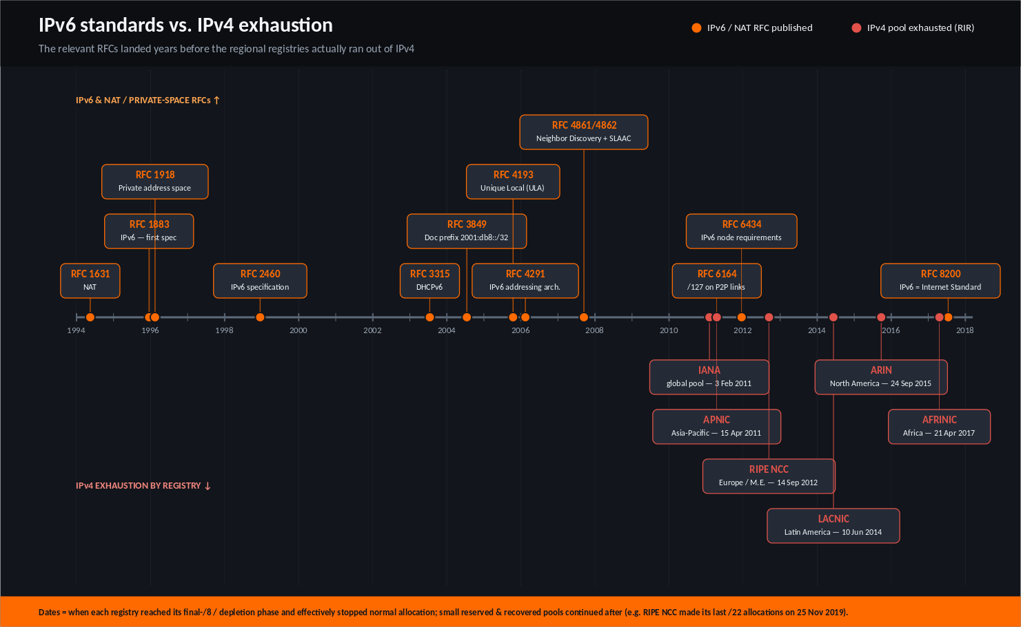

Slide 11
00:40 · HANDS-ON LAB (20 MIN)
Lab: a dual-stack link you build yourself
TOPOLOGY · containerlab + SR Linux
YOU WILL
server-a server-b
1
Deploy the topology
(lo0) (lo0)
| |
2
Configure a dual-stack interface (v4 + v6)
[srl1]===e1-1===[srl2]
3
Read the address SR Linux abbreviates for you
2001:db8:12::/64 + 192.168.12.0/30
4
Inspect the neighbor (ND) table — ARP's replacement
Two SR Linux routers, one dual-stack link, two 'server' subnets to connect.
5
Add static routes & ping across the fabric
6
Prove routable ≠ reachable with an ACL (bonus)
Notes:
Transition to hands-on. Everything they configure maps to a concept from the talk: dual-stack interface = 'real world is dual-stack'; ND table = 'multicast replaced broadcast'; static routes = 'route tables, simplified'; ACL bonus = 'routable ≠ reachable'. Workbook has full commands, fill-in blanks, an answer key, and a DevOps gotchas cheat sheet. Budget ~20 min; bonus is optional.

Slide 12
00:58 · WRAP-UP
What to remember tomorrow
1
It's just more numbers
RESOURCES
Two rules tame any address. Hex isn't the enemy.
Cloud docs
AWS / Azure / GCP 'IPv6 VPC'
2
No more NAT tax
Kubernetes
Global addresses + egress-only gateways = privacy, no translation.
kubernetes.io dual-stack
Routable ≠ reachable
Lab
3
containerlab.dev · SR Linux docs
Security is the firewall / Security Group, never IP hiding.
Standards
Design for dual-stack
RFC 4291 · 4861 · 6434
4
Linux
Both families, every rule & listener — cloud and k8s already are.
ip -6 addr · ip -6 route
Notes:
if they keep only four things, these are them. Take questions. ~2 min.

