Slide 1
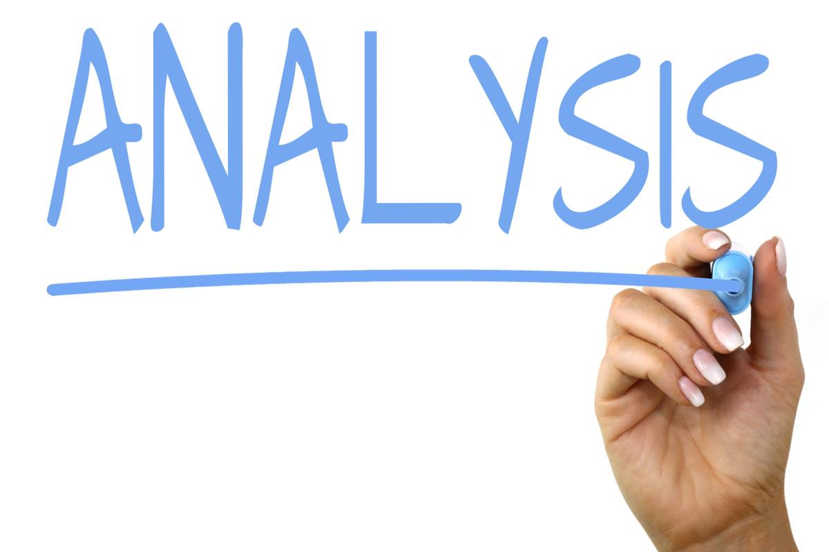
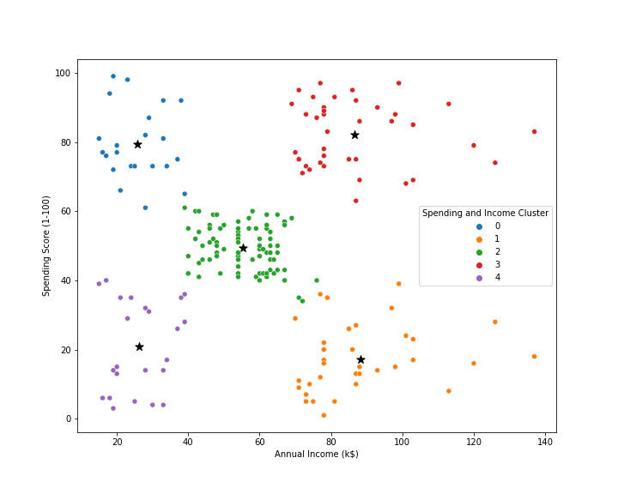
Target Cluster
Target group would be cluster 3 which has a high Spending Score and high income
54% of cluster 3 shoppers are women. We should look for ways to attract these customers using a marketing campaign targeting popular items in this cluster
Cluster 2 presents an interesting opportunity to market to the customers for sales event on popular items.

