Slide 1
Automatically Generating REST API Test Cases
Andrew Gifford

Slide 2
Motivation
I have developed a number of REST APIs
Creating base test cases for a lot of endpoints can be time consuming, having a baseline to work off can save a lot of time

Slide 3
The Problem
Some tools for automated test generation do already exist.
However, they are expensive and proprietary
I have learned that this is the case for a reason!
Had to greatly narrow the scope of the project.

Slide 4
Scope of Work
IN SCOPE
OUT OF SCOPE
Automated test generation based on query parameter specifications
Automatic file generation with project structure
Mutation testing
Node.js CLI tool
Determining proper API response outcome for each test case
Test inputs are made readable to allow the developer to easily figure out what the output should look like.
In-project Library

Slide 5
The Goal/Process
Identify all API endpoints in an Express.JS application
Two methods - JSON configuration/manual specification, TS node analysis
Identify specification of query parameters
Create test input values that meet specifications
Generate test.js files to output in project folder

Slide 6
Test Case Generation Methods
Random inputs
Each input is randomly generated according to their defined type in .spec.json
For strings: Randomly generated sequence of words that fit within the defined bounds OR regex if defined
For numbers: Random int between defined bounds
For dates: A random timestamp within the past month
Invalid inputs
Each input is given incorrectly independently and ensures an error is thrown
Strings are passed as numbers, numbers are passed as strings, etc.
Boundary scenarios
Each input is tested at its bounds, if specified.
Examples
Number with limits -100 and 100 are tested at -100, 0, and 100
Strings are tested at minimum and maximum length of random characters
Numbers without limits are tested at -Inf and +Inf

Slide 7
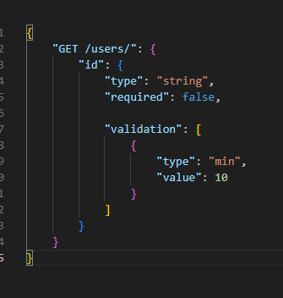
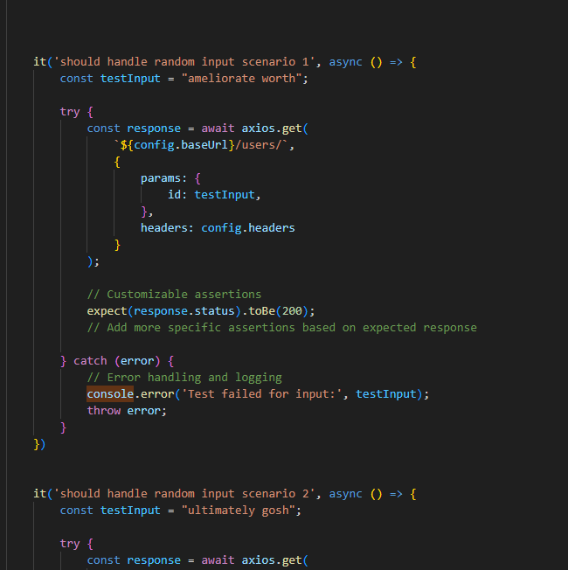
Results
Every valid .js or .ts file with a corresponding .spec.json file has test cases created.
Currently, test cases only cover defined query parameters only with number, string, and Date types.
The tests require the library “mocha” to run. Mocha is the most commonly used testing syntax in the Node.JS ecosystem.
index.spec.json
Automatically generated test cases

Slide 8
To-Do, Future Work
Add support for defined route parameters, not just query parameters
Extend type support to custom data types
Mutation testing needs full implementation.
This work already began, however is taking longer than expected.
TypeScript provides a library to analyze nodes and find statements where mutants can be introduced.
Black box tests could be implemented. Currently, this solution is white box.

