Slide 1
MLB Draft picks and career success – a statistical regression
By Drew Gillis

Slide 2
What is the regression?
Finding if there is a correlation between a baseball player’s draft pick and their career success, measured in WAR (Wins Above Replacement)
Will also factor in Years of Experience to the regression
If draft pick is not a good predictor of future success, but years correlates with success, I will perform a regression of the correlation between draft pick and future years played
I compiled statistics from the 300 active, non-pitcher, MLB players in a .csv file, then manipulated this .csv with Pandas inside of Python

Slide 3
Why does it matter?
If I can prove that a player’s high draft pick has a correlation to their future success, I can try to find optimal picks for teams to try and acquire (i.e. pick #1, 14, or 76 is the most optimal according to this study)
If it proves there is hardly any correlation, then I can argue teams should trade their top picks for more picks/current players, and optimize their value
I’ve seen a lot of #1 overall picks disappoint, while the league leader in active career WAR was picked 402nd. Curiosity!

Slide 4
How did I create/perform the regression?
1. I manually entered data from fangraphs.com about the players’ draft pick (or if they were internationally signed), career WAR, and years played
I opened this .csv file inside of Python’s Pandas library as a data frame, and manipulated the data frame to omit internationally signed players
I found that the distribution of WAR was not normal (bell curve) but instead was logarithmic, so I created a logarithmic WAR stat to somewhat normalize
Using matplotlib and statmodels libraries, I ran the variables against each other in multiple regressions

Slide 5

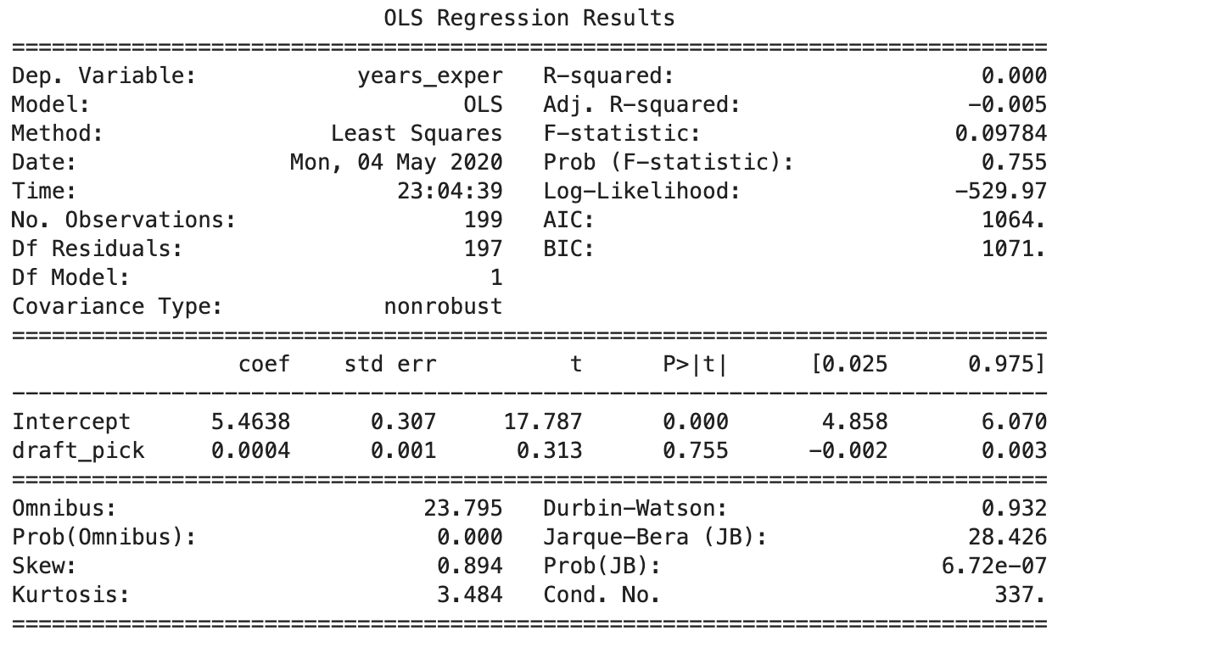
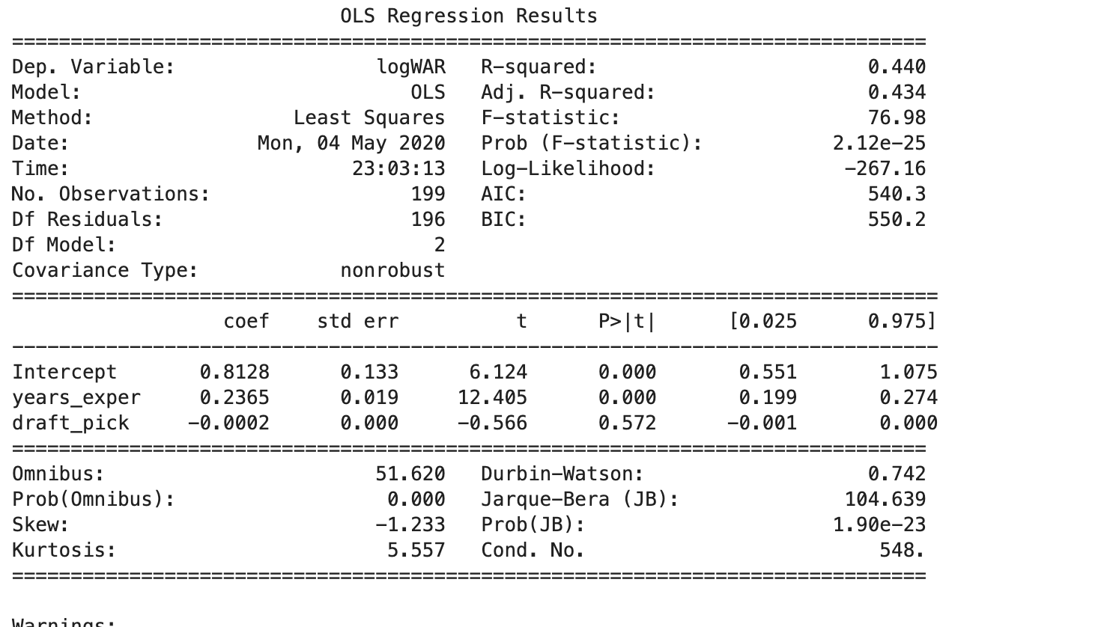
DEMO!

Slide 6
What works?
The regressions calculate correctly, based on the stats given by the .csv file. I was able to find:
No correlation between draft picks and career WAR
Strong correlation between years played and career WAR
No correlation between draft picks and years played
Thus, my initial plan for the project was completed and found good and usable results!

Slide 7
What doesn’t work?
While I found the answers I was looking for, a couple of roundabouts had to be taken.
My pool of players shrunk a lot due to internationally-signed players not entering the MLB draft.
I had to take a few players at the bottom of the list out because their career numbers are… terrible. But the worst rated player according to WAR was drafted #7 overall, so I feel like I missed an important data point.

Slide 8
Future additions for better results
Increase the size of the player pool to include retired players after a certain year
Assigning international signing bonuses to a draft pick that represents their signing – then I can account for the large number of players that do not get drafted but are scouted and signed in the same manner.
Including pitchers – originally were not included due to WAR complications (pitchers are generally overvalued)
Could even do their model separately, just want to include them in the study as well.

