Slide 1
Forecasting Exchange Rates Using A Neural Network
PRESENTATION
AUGUST 20, 2019

Slide 2
Agenda
August 20, 2019
1 |  | Project Context
2 |  | The Network
3 |  | The Model
4 |  | Results

Slide 3

Exchange rates indicate the worldwide demand for a currency
Notes:
key findings from our work

Slide 4
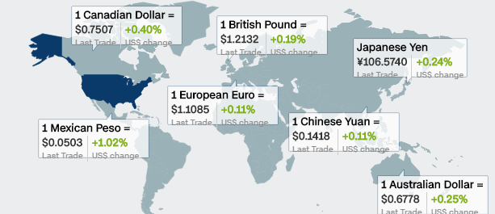

Project Context
EXCHANGE RATES
What are exchange rates?
Nominal?
Real?
How are exchange rates determined?
Why are exchange rates used?
$$ex.r∗ {Price}_{ U.S.}= {Price}_{ World }$$
$$ex.r = \frac{{Price }_{World}}{{Price }_{U.S.}}$$

Slide 5
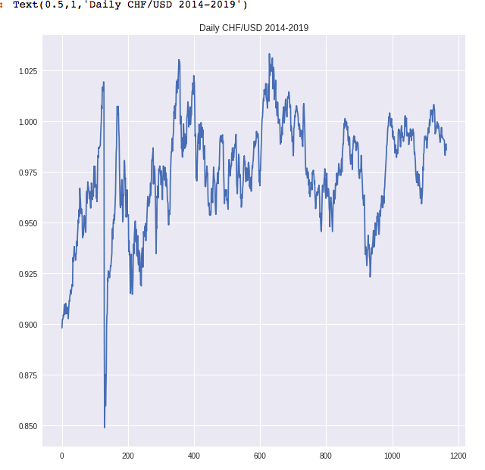
Project Context
Time series
Autoregressive process
AR (p)
Stationarity
Constant mean and variance over time
Non-stationarity
Random-walk

Slide 6
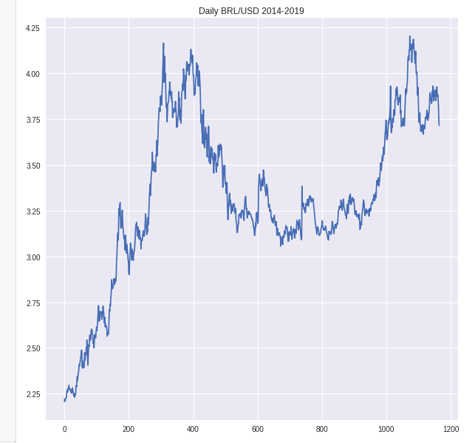
Project Context
Time series
Autocorrelation
Adjacent observations are related
Autocorrelation function (ACF / PCF)
Correlation between a series and its lags
First Difference
The change in output between one period

Slide 7
Agenda
August 20, 2019
1 |  | Project Context
2 |  | The Network
3 |  | The Model
4 |  | Results

Slide 8
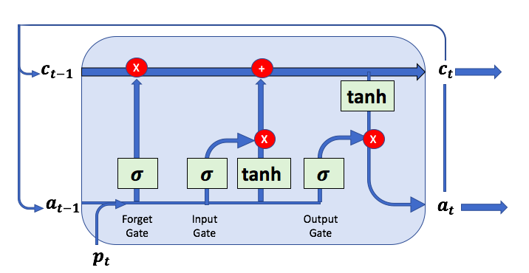
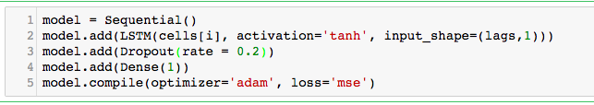
The Network
Long Short-Term memory

Slide 9
Agenda
August 20, 2019
1 |  | Project Context
2 |  | The Network
3 |  | The Model
4 |  | Results

Slide 10
The Model
PRETESTING
Swiss Franc (July 2014 – January 2019)
Brazilian Real (July 2014 – January 2019)

Slide 11
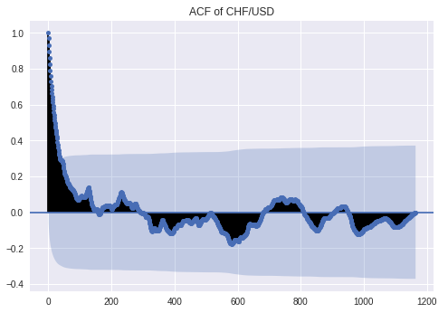
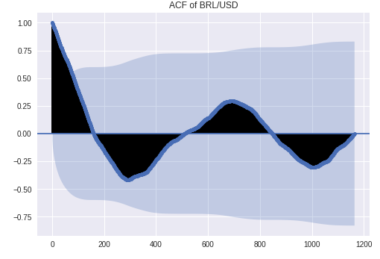
The Model
PRETESTING
Swiss Franc ACF
Brazilian Real ACF

Slide 12
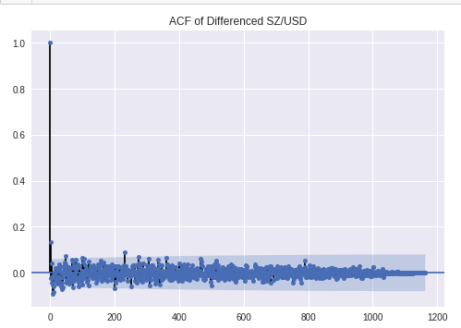
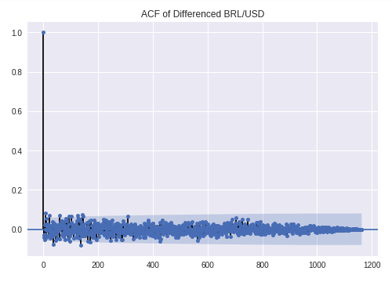
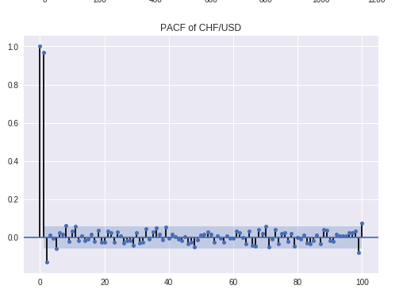
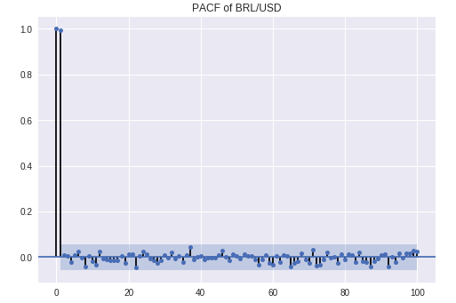
The Model
PRETESTING
Swiss Franc
Brazilian Real

Slide 13
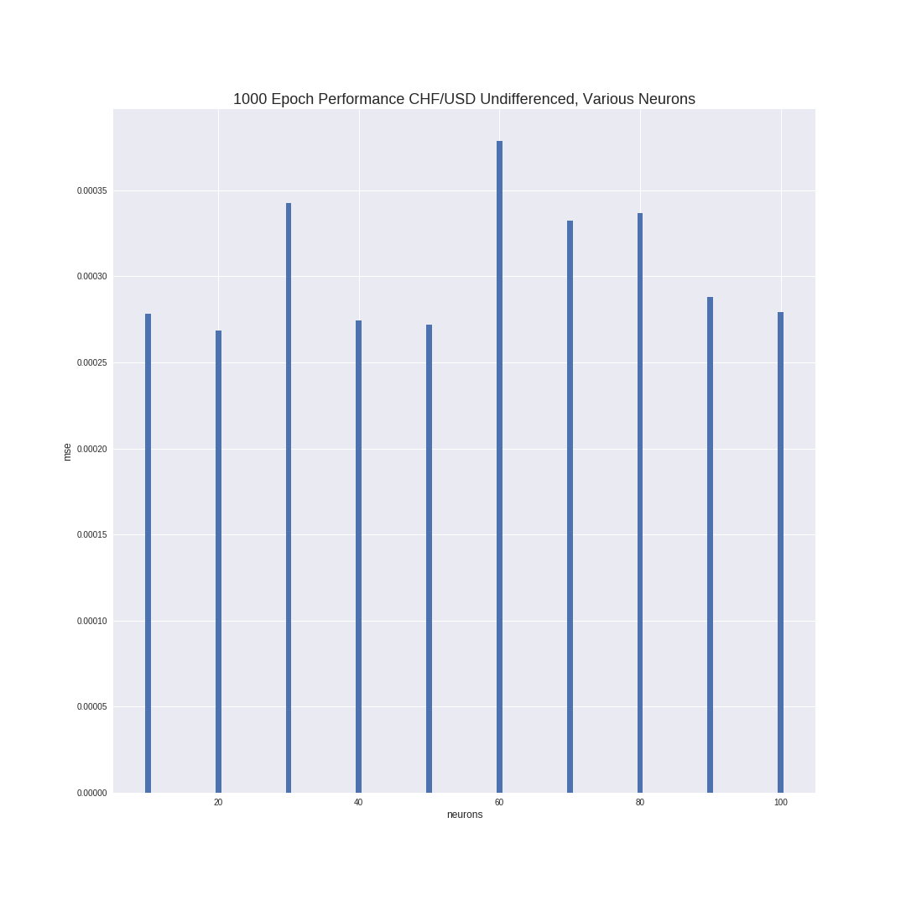
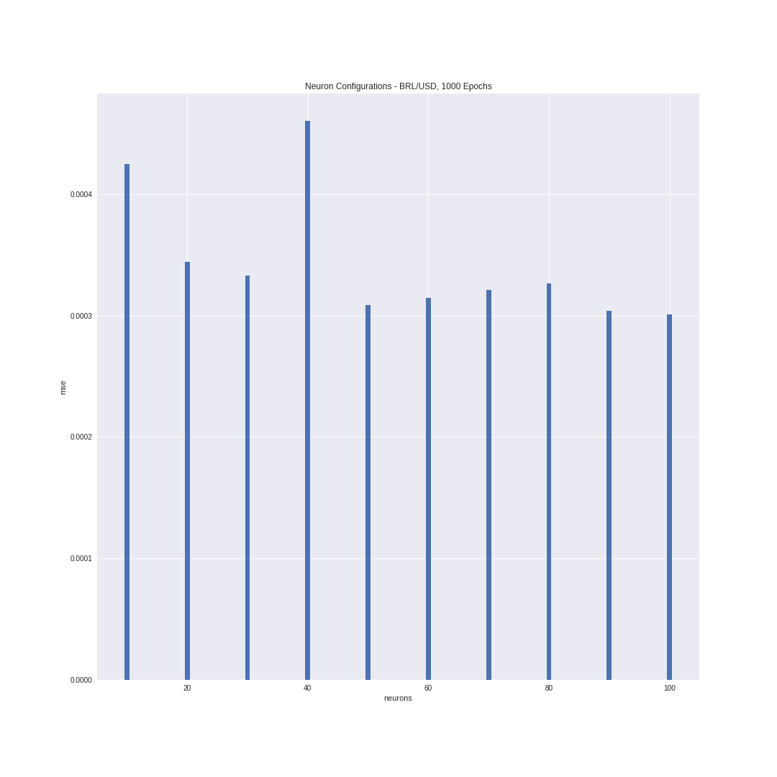
The Model
PRETESTING – optimal neurons
Swiss Franc
Brazilian Real

Slide 14
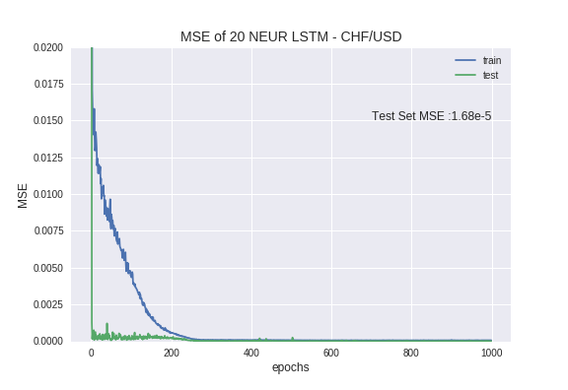
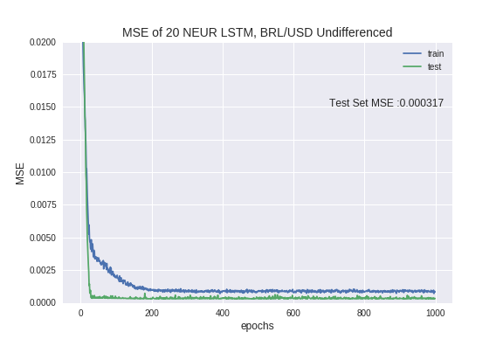
The Model
Train & TEST
Swiss Franc
Brazilian Real

Slide 15
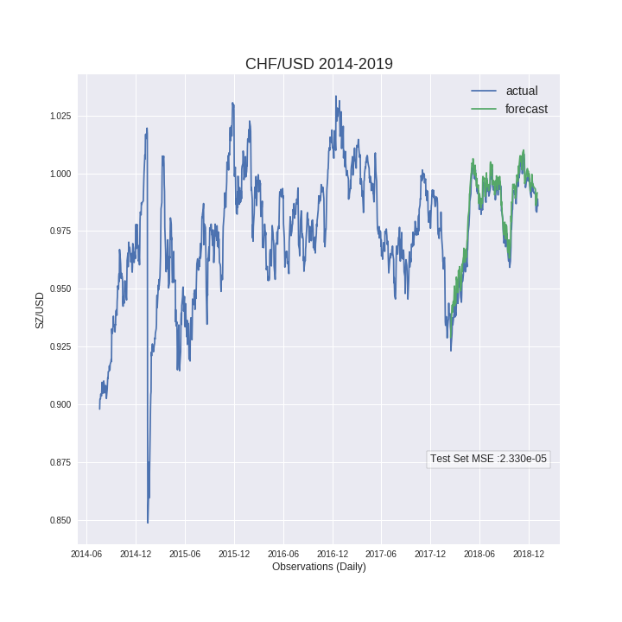
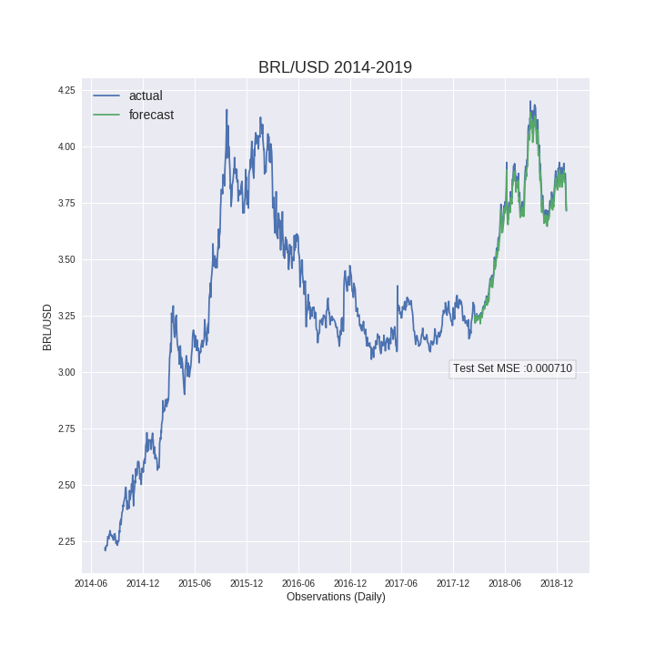
The Model
Forecast
Swiss Franc
Brazilian Real

Slide 16
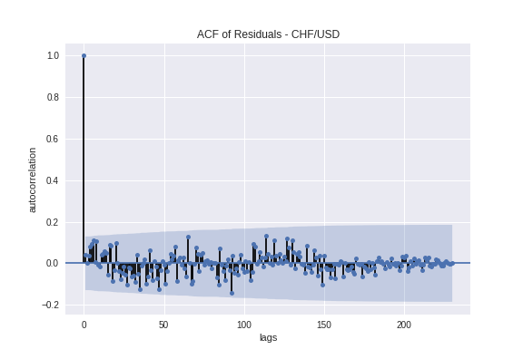
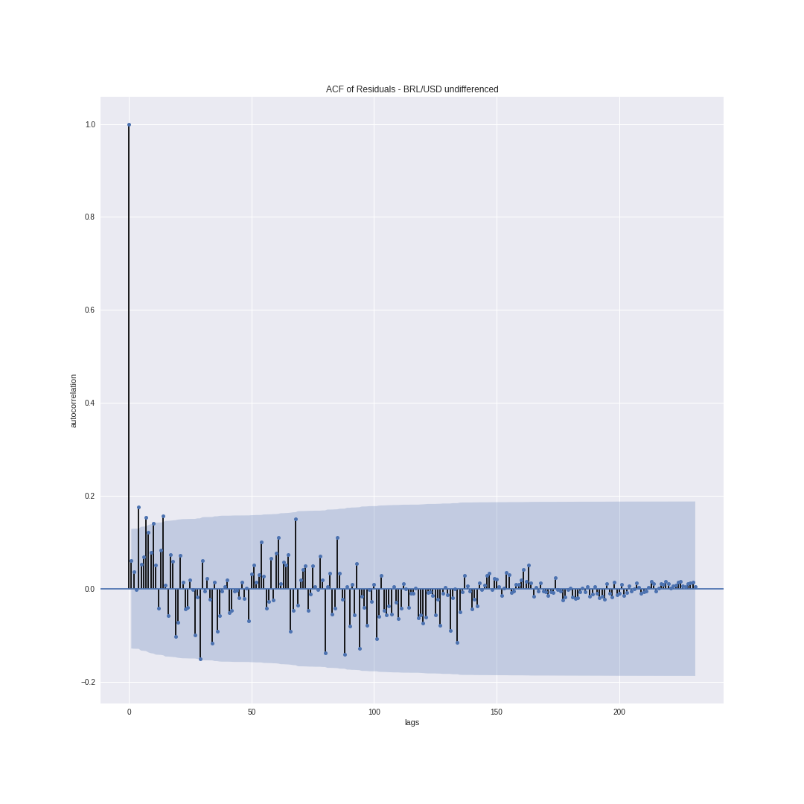
The Model
Performance
Swiss Franc
Brazilian Real

Slide 17
Agenda
August 20, 2019
1 |  | Project Context
2 |  | The Network
3 |  | The Model
4 |  | Results

Slide 18
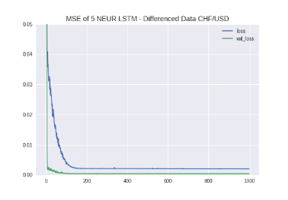
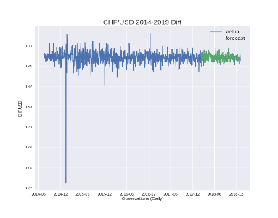
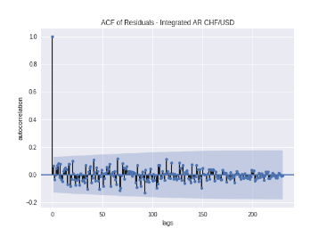
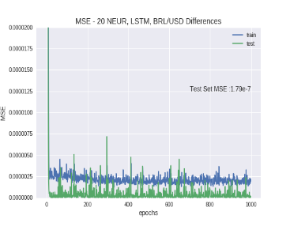
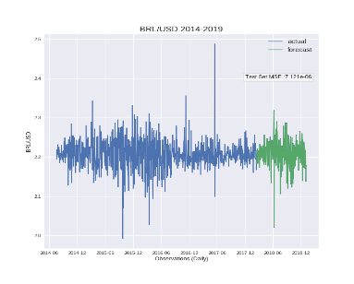
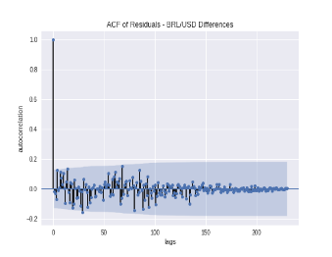
Results
Testing with Differenced Data

Slide 19
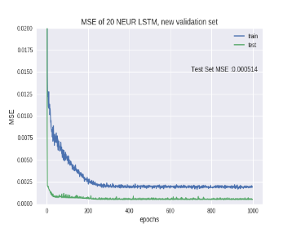
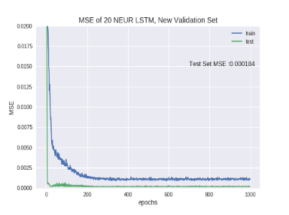
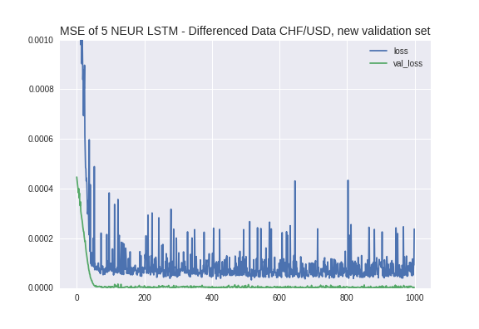
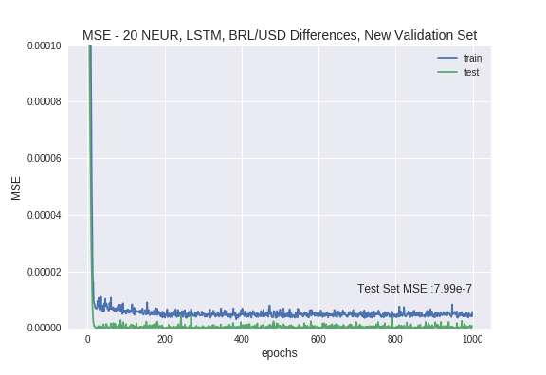
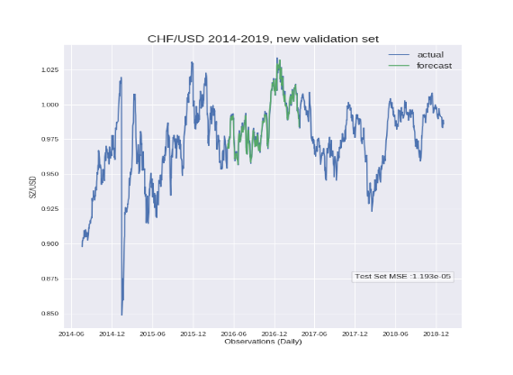
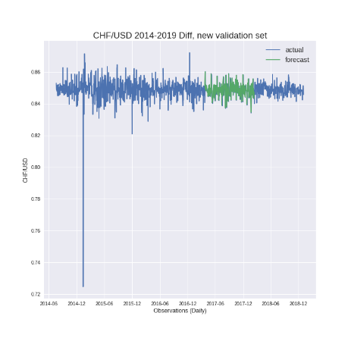
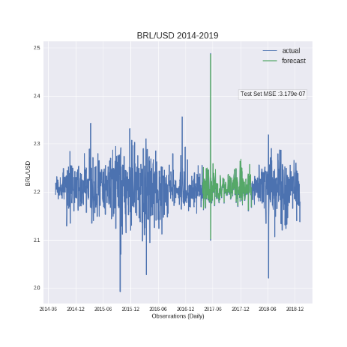
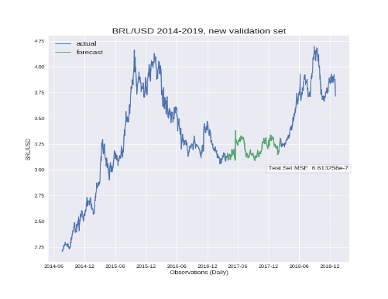
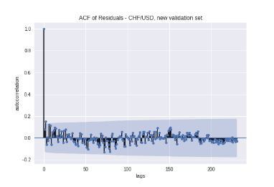
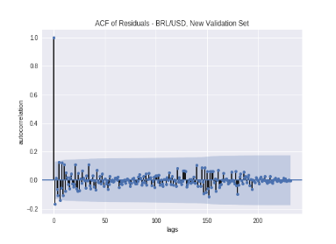
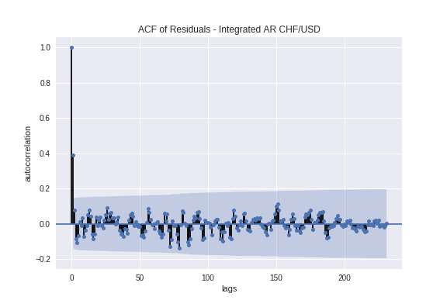
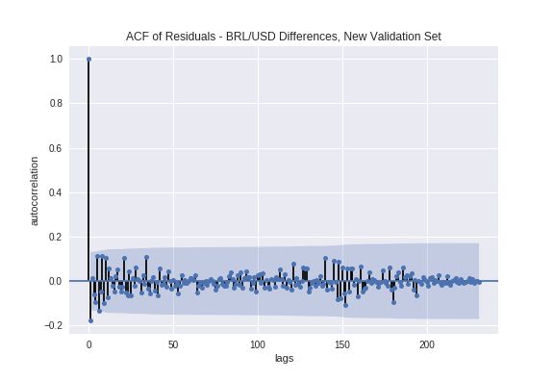
Results
Validation – Training on years 1 and 2 | Testing on year 3
Levels
First Differences

Slide 20
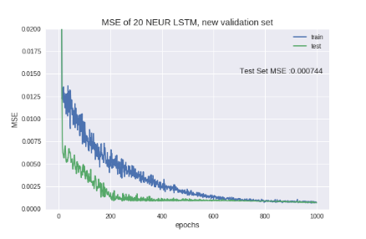
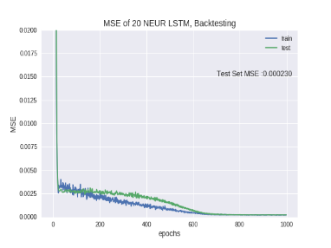
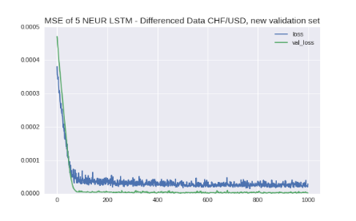
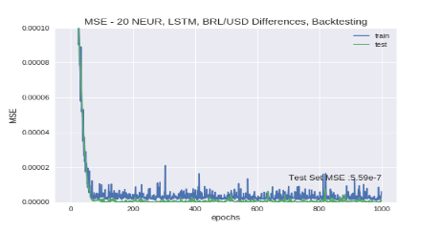
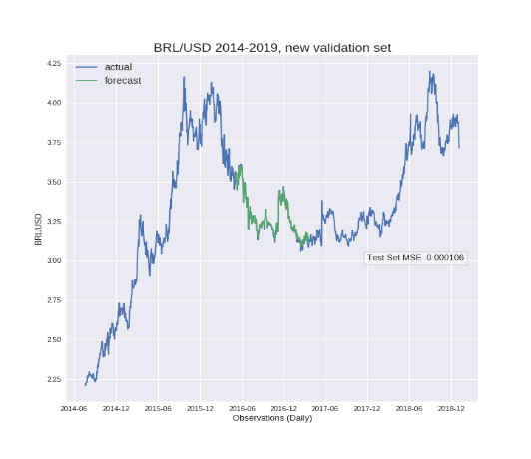
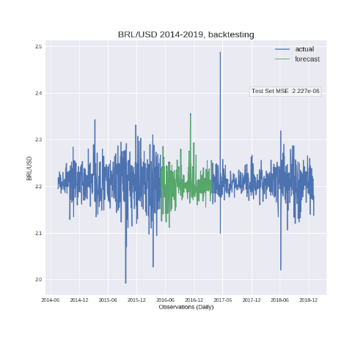
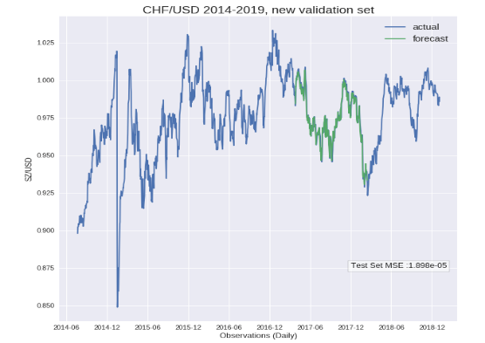
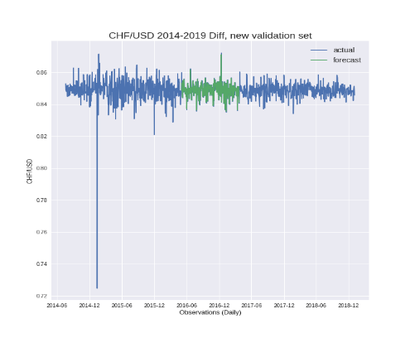
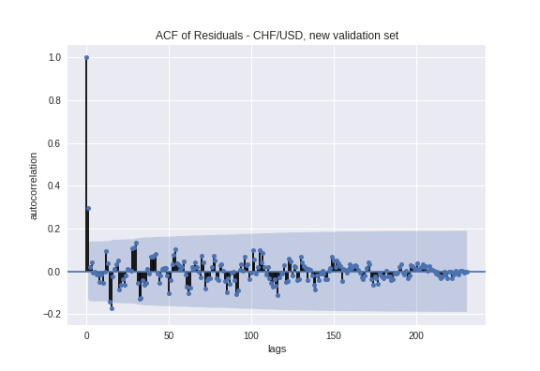
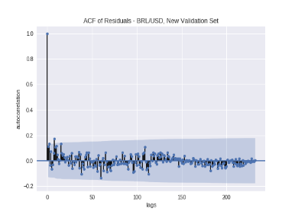
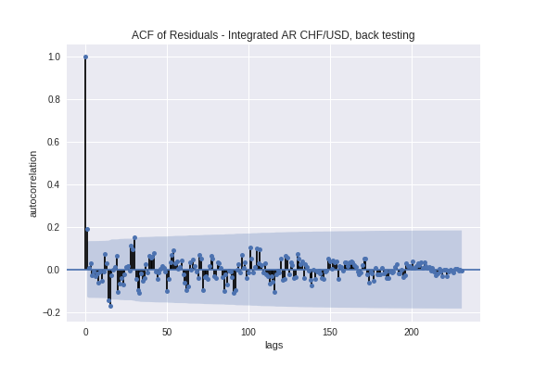
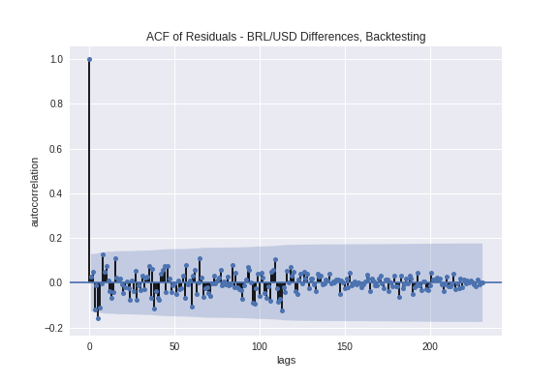
Results
Back testing – Training on year 3 | Testing on year 2
Levels
First Differences

Slide 21
Conclusion
Forecasting Using LSTM
Accurate
Unbiased estimates
Not economically significant
Future Considerations:
Modify the learning rate
Use a different optimizer
Utilize additional layers

Slide 22
Thank you.

