Slide 1


Slide 2
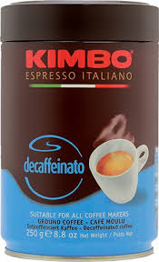
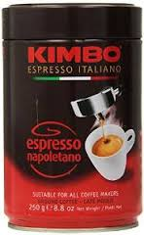
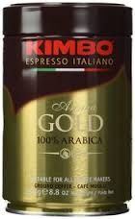
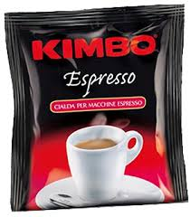

Code | Description | Unit Wt | Case Pack
10165 | Espresso Napolitano, Ground Bag | 250 g | 12
10213 | Espresso Arabica, 100%, Beans, Bag | 250 g | 20
14003 | Espresso Extra Cream, Beans , Bag | 1 kg | 6
10212 | Espresso Arabica, 100%, Ground, Tin | 250 g | 12
10167 | Espresso Napolitano, GRND TIN | 250 g | 12
10319 | Espresso Decaff, Ground, TIN | 250 g | 12
14617 | Espresso Cialda,( PODS ) | EA | 200
14625 | Espresso Capsula, ( Capsules ) | EA | 100
17059 | Crema Al Caffe, 900g | EA | 6

Slide 3

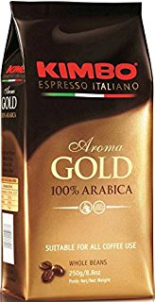
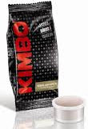
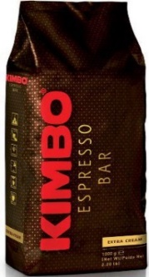
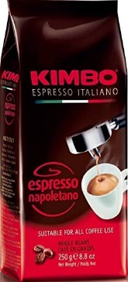
Item Code | Item | Case Pack | Unit Cost | Case Price
010165 | Espresso Napolitano, 250g Beans,Bag | 12 | $6.56 | $78.70
010213 | Arabica, 100%, 250g, Beans, Bag | 12 | $7.14 | $85.68
014003 | Extra Cream, 1kg Beans | 6 | $21.63 | $129.79
010212 | Arabica, 100%, 250g GRND, TIN | 12 | $7.47 | $89.62
010167 | Espresso Napolitano, 250g GRND TIN | 12 | $6.76 | $81.10
010319 | Decaff, 250g, Ground, TIN | 12 | $6.41 | $76.94
014617 | Cialda, Kimbo, Espresso Pods | 200 | $0.40 | $80.00
014625 | Capsula, Espresso, Capsules | 100 | $0.45 | $45.00
017059 | Crema Al Caffe, 900g | 6 | $15.53 | $93.17

