Slide 1
Design of Experiments
Suhwan Kim
Department of Statistics
Inha University
May 13, 2022

Slide 2
The $2^{2}−$ Design
Example : Chemical Process
Two-factors (A and B) with two levels
where A = reactant concentration, B = catalyst amount; y = recovery
Factor |  | Treatment Combination | Replicate
A | B |  | I | II | III | Total
- | - | A low, B low | 28 | 25 | 27 | 80
+ | - | A high, B low | 36 | 32 | 32 | 100
- | + | A low, B high | 18 | 19 | 23 | 60
+ | + | A high, B high | 31 | 30 | 29 | 90
Design of Experiments

Slide 3
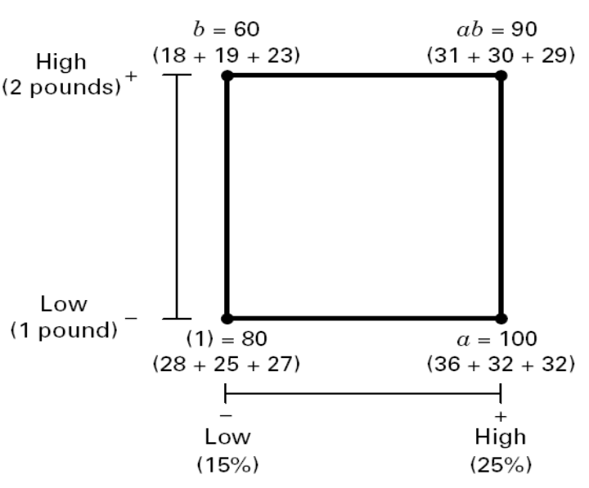
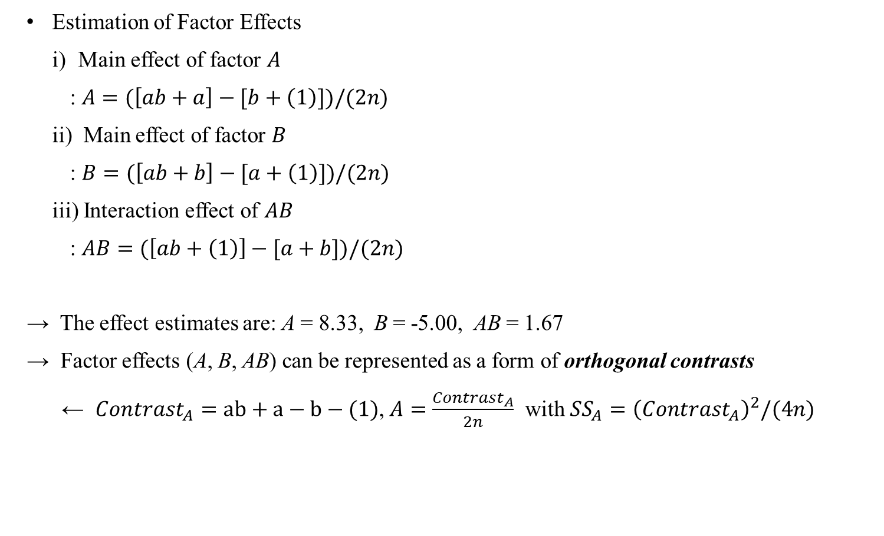
The $2^{2}−$ Design
Estimation of Factor Effects
Main effect of factor $A$
: $A=(\left[ab+a\right]−[b+\left(1\right)])/(2n)$
ii) Main effect of factor $B$
: $B=(\left[ab+b\right]−[a+\left(1\right)])/(2n)$
iii) Interaction effect of $AB$
: $AB=(\left[ab+\left(1\right)\right]−[a+b])/(2n)$
→ The effect estimates are: A = 8.33, B = -5.00, AB = 1.67
→ Factor effects (A, B, AB) can be represented as a form of orthogonal contrasts
← $Contrast_{A}=ab+a−b−(1)$, $A=\frac{Contrast_{A}}{2n}$ with $SS_{A}={\left(Contrast_{A}\right)}^{2}/(4n)$
B
A
Design of Experiments

Slide 4
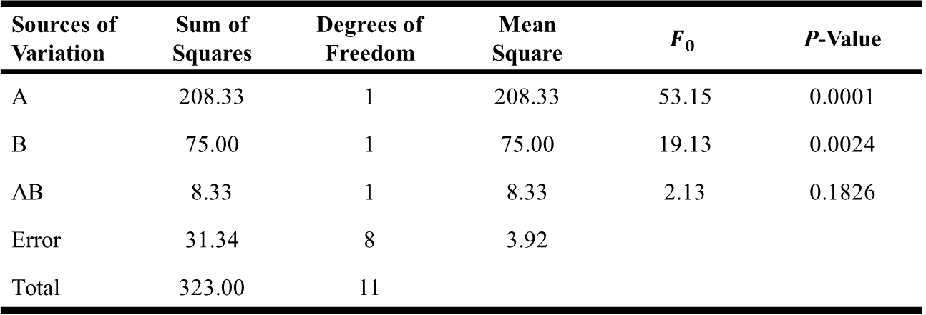

The $2^{2}−$ Design
ANOVA Table
Fitted regression model
: $\hat{y}=27.5+\left(8.33/2\right)x_{1}−\left(5.00/2\right)x_{2}$
→ Note that the regression coefficient is (effect estimate/2) with $x_{i}=±1$
Sources of Variation | Sum of Squares | Degrees of Freedom | Mean Square | $$F_{0}$$ | P-Value
A | 208.33 | 1 | 208.33 | 53.15 | 0.0001
B | 75.00 | 1 | 75.00 | 19.13 | 0.0024
AB | 8.33 | 1 | 8.33 | 2.13 | 0.1826
Error | 31.34 | 8 | 3.92
Total | 323.00 | 11
Design of Experiments

Slide 5
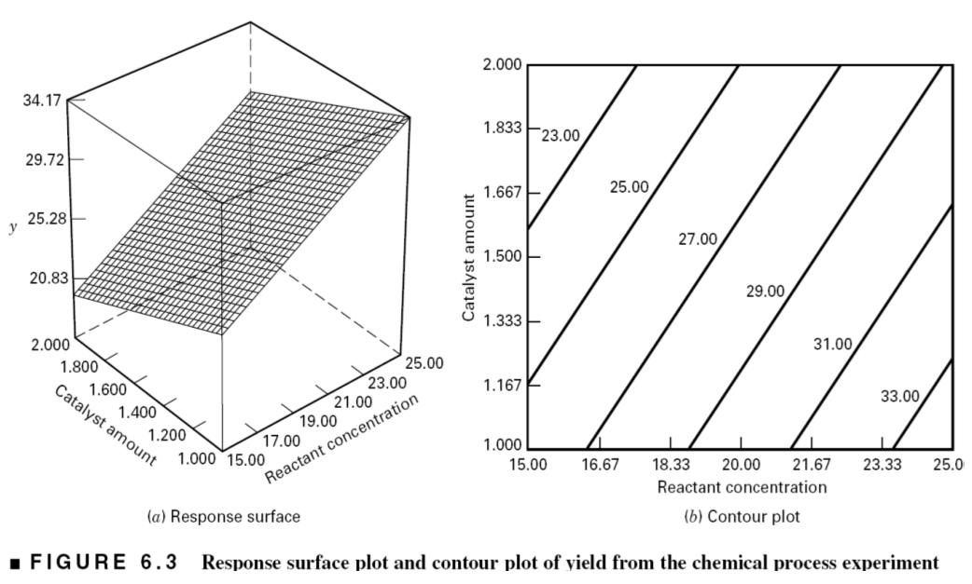
The $2^{2}−$ Design
Response Surface
→ No interaction term is included: Response surface is a plane
→ Yield increases as reactant concentration increases and catalyst decreases
Design of Experiments

Slide 6
Chapter 6. Two-Level Factorial Experiments (Part 2)

Slide 7
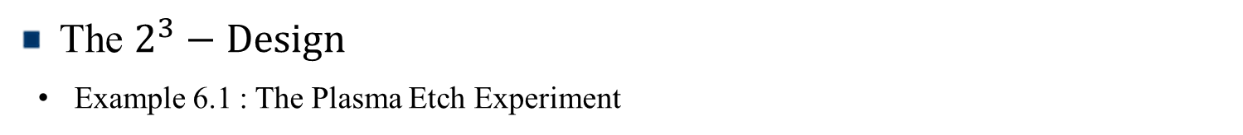
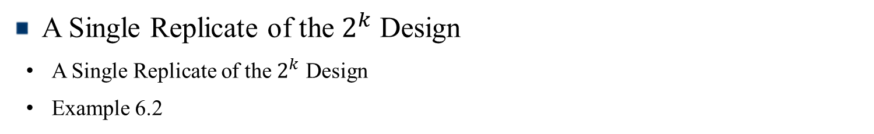
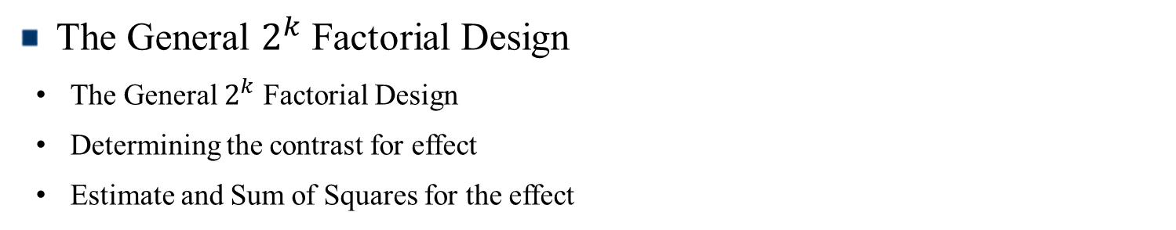
Contents
The $2^{3}−Design$
Example 6.1 : The Plasma Etch Experiment
The General $2^{k}$ Factorial Design
The General $2^{k}$ Factorial Design
Determining the contrast for effect
Estimate and Sum of Squares for the effect
A Single Replicate of the $2^{k}$ Design
A Single Replicate of the $2^{k}$ Design
Example 6.2

Slide 8
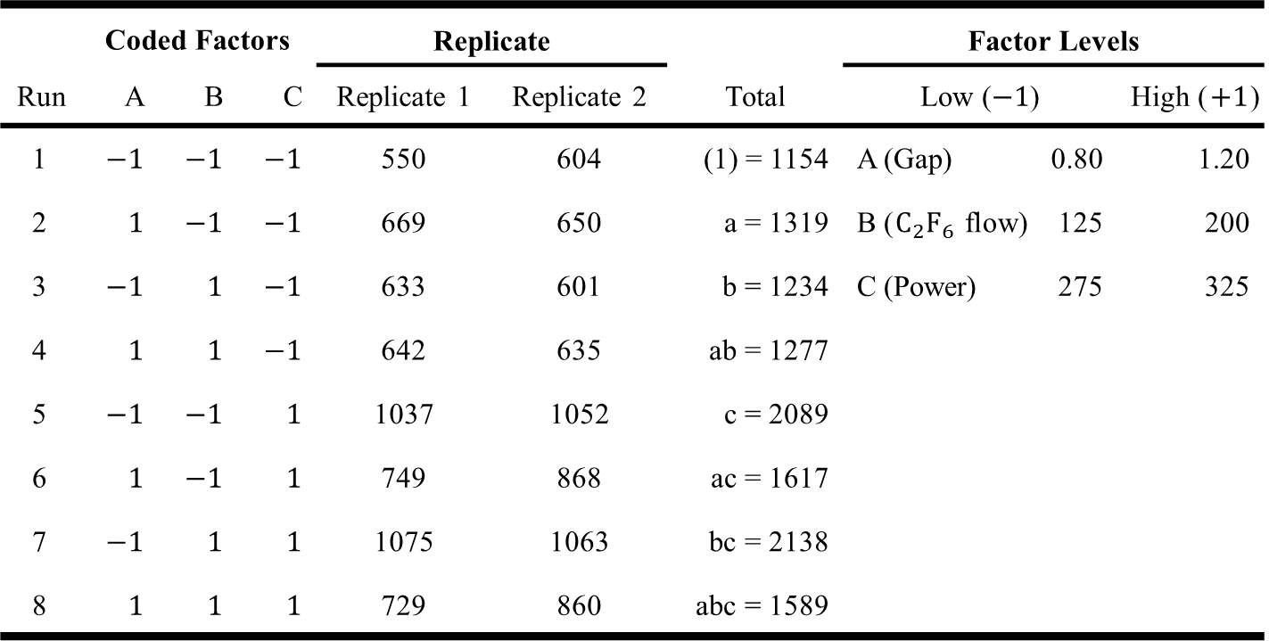

The $2^{3}−$ Design
Example 6.1 : The Plasma Etch Experiment ($y=$ Etch Rate)
 | Coded Factors |  |  | Replicate |  |  | Factor Levels
Run | A | B | C | Replicate 1 | Replicate 2 | Total | Low ($−1$) |  | High ($+1$)
1 | $$−1$$ | $$−1$$ | $$−1$$ | 550 | 604 | (1) = 1154 | A (Gap) | 0.80 | 1.20
2 | $$1$$ | $$−1$$ | $$−1$$ | 669 | 650 | a = 1319 | B ($C_{2}F_{6}$ flow) | 125 | 200
3 | $$−1$$ | $$1$$ | $$−1$$ | 633 | 601 | b = 1234 | C (Power) | 275 | 325
4 | $$1$$ | $$1$$ | $$−1$$ | 642 | 635 | ab = 1277
5 | $$−1$$ | $$−1$$ | $$1$$ | 1037 | 1052 | c = 2089
6 | $$1$$ | $$−1$$ | $$1$$ | 749 | 868 | ac = 1617
7 | $$−1$$ | $$1$$ | $$1$$ | 1075 | 1063 | bc = 2138
8 | $$1$$ | $$1$$ | $$1$$ | 729 | 860 | abc = 1589
Design of Experiments

Slide 9
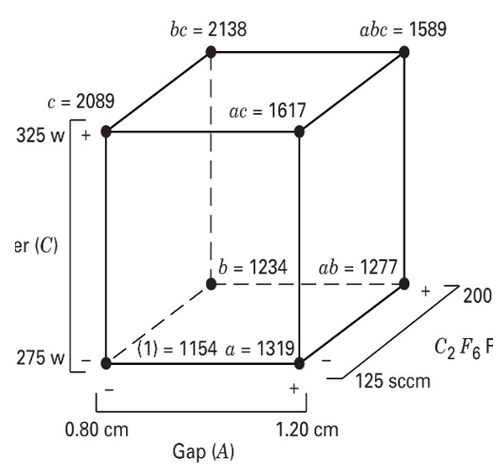
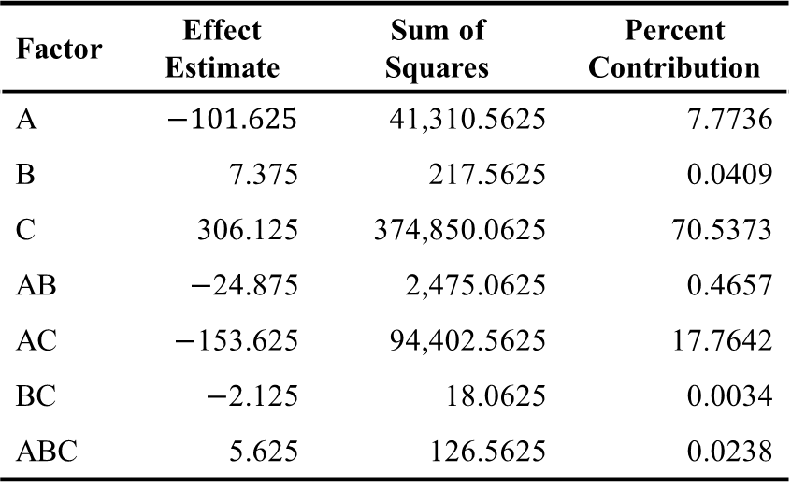
The $2^{3}−$ Design
Estimation of Factor Effects
Factor | Effect Estimate | Sum of Squares | Percent Contribution
A | $$−101.625$$ | 41,310.5625 | 7.7736
B | 7.375 | 217.5625 | 0.0409
C | 306.125 | 374,850.0625 | 70.5373
AB | $−$24.875 | 2,475.0625 | 0.4657
AC | $−$153.625 | 94,402.5625 | 17.7642
BC | $−$2.125 | 18.0625 | 0.0034
ABC | 5.625 | 126.5625 | 0.0238
Design of Experiments

Slide 10
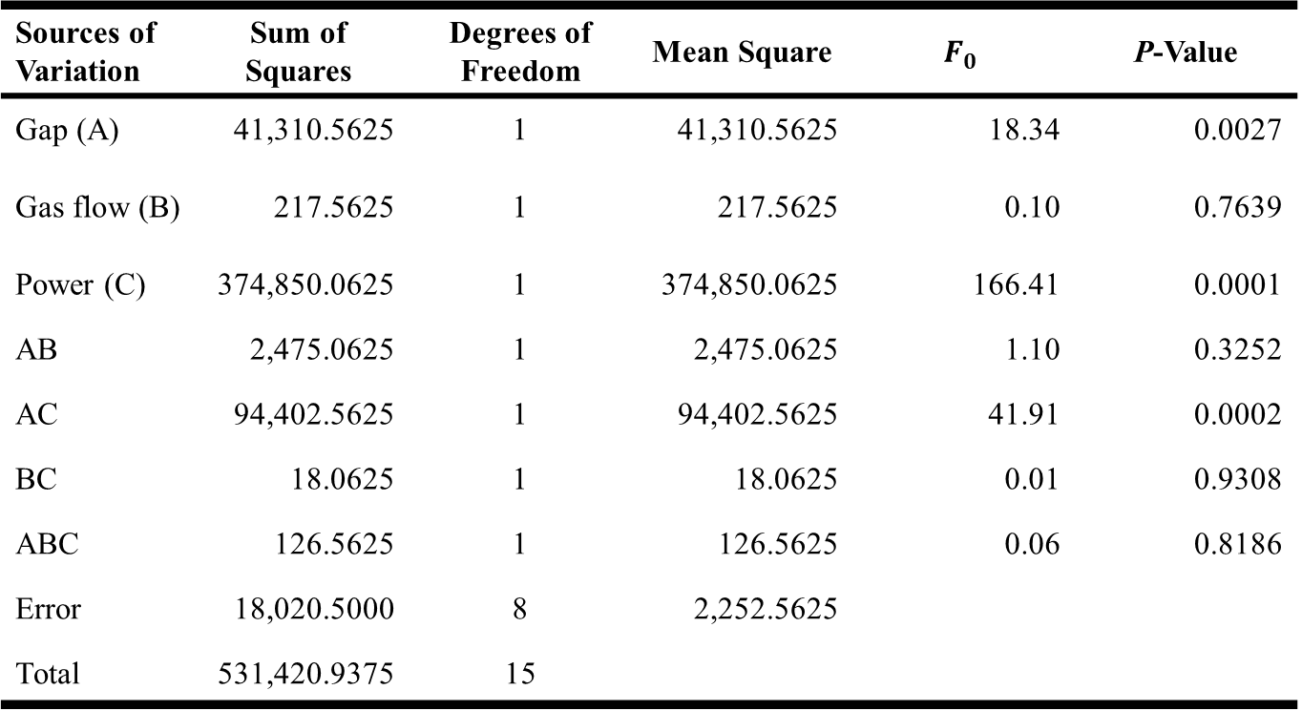
The $2^{3}−$ Design
ANOVA Summary – Full Model
Sources of Variation | Sum of Squares | Degrees of Freedom | Mean Square | $$F_{0}$$ | P-Value
Gap (A) | 41,310.5625 | 1 | 41,310.5625 | 18.34 | 0.0027
Gas flow (B) | 217.5625 | 1 | 217.5625 | 0.10 | 0.7639
Power (C) | 374,850.0625 | 1 | 374,850.0625 | 166.41 | 0.0001
AB | 2,475.0625 | 1 | 2,475.0625 | 1.10 | 0.3252
AC | 94,402.5625 | 1 | 94,402.5625 | 41.91 | 0.0002
BC | 18.0625 | 1 | 18.0625 | 0.01 | 0.9308
ABC | 126.5625 | 1 | 126.5625 | 0.06 | 0.8186
Error | 18,020.5000 | 8 | 2,252.5625
Total | 531,420.9375 | 15
Design of Experiments

Slide 11
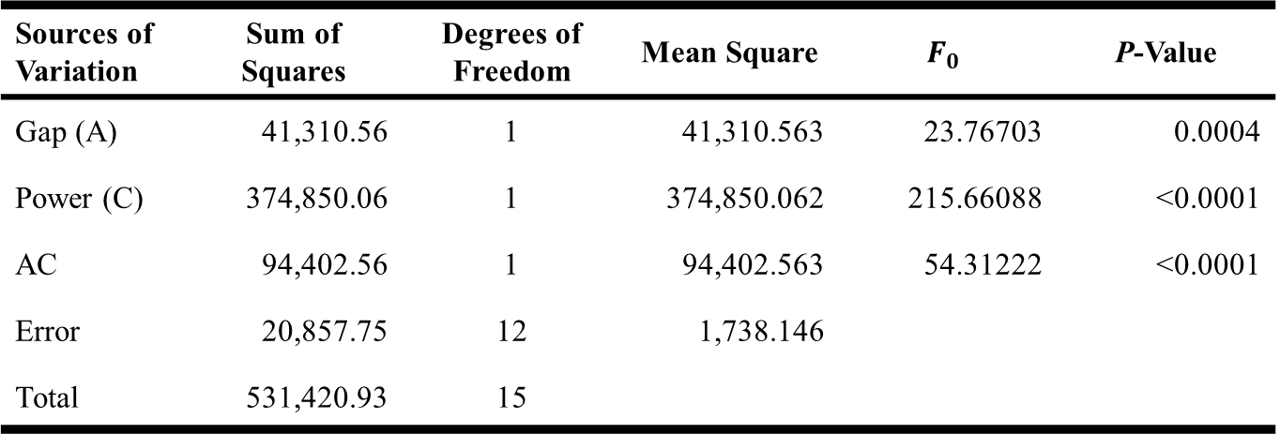
The $2^{3}−$ Design
ANOVA Summary – Reduced Model
Sources of Variation | Sum of Squares | Degrees of Freedom | Mean Square | $$F_{0}$$ | P-Value
Gap (A) | 41,310.56 | 1 | 41,310.563 | 23.76703 | 0.0004
Power (C) | 374,850.06 | 1 | 374,850.062 | 215.66088 | <0.0001
AC | 94,402.56 | 1 | 94,402.563 | 54.31222 | <0.0001
Error | 20,857.75 | 12 | 1,738.146
Total | 531,420.93 | 15
Design of Experiments

Slide 12
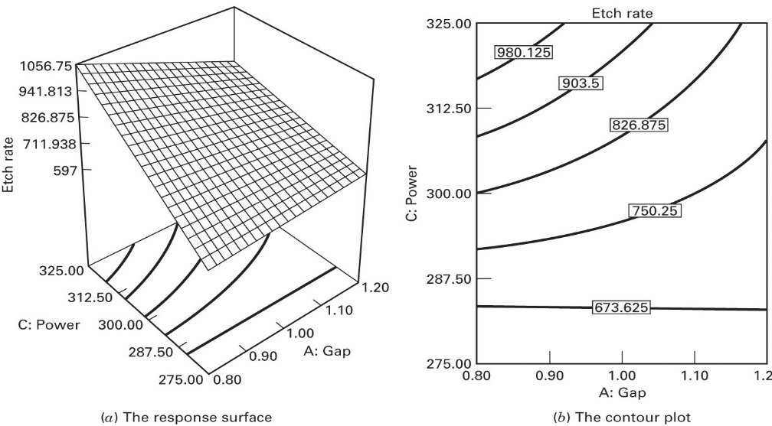
The $2^{3}−$ Design
Response Surface
Design of Experiments

Slide 13

The $2^{3}−$ Design
Model Summary Statistics for Reduced Model
i) $R^{2}$ and adjusted $R^{2}$:
$R^{2}=\frac{SS_{Model}}{SS_{T}}=\frac{5.106×{10}^{5}}{5.314×{10}^{5}}=0.9608$
$R_{Adj}^{2}=1−\frac{SS_{E}/df_{E}}{SS_{T}/df_{T}}$ $=1−\frac{20857.75/12}{5.314×{10}^{5}/15}$ $=0.9509$
ii) $R^{2}$ for prediction (based on PRESS)
$R_{Pred}^{2}=1−\frac{PRESS}{SS_{T}}=1−\frac{37080.44}{5.314×{10}^{5}}=0.9302 PRESS=\sum_{i=1}^{n}{{\left(y_{i}−{\hat{y}}_{i,−i}\right)}^{2}}$
Design of Experiments

Slide 14
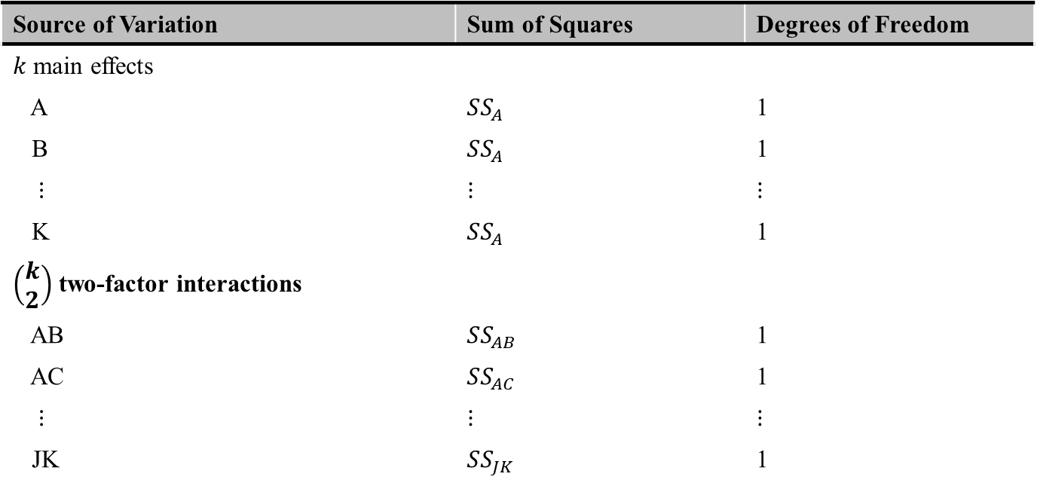

The General $2^{k}$ Factorial Design
A design with $k$ factors each at two levels ($2^{k}−1$ effects)
$k$ main effects,$_{k}C_{2}$ two-factor interactions,$_{k}C_{3}$ three-factor interactions, $…$
Analysis of Variance for a $2^{k}$ design
Source of Variation | Sum of Squares | Degrees of Freedom
$k$ main effects
A | $$SS_{A}$$ | 1
B | $$SS_{A}$$ | 1
$⋮$ | $$⋮$$ | $$⋮$$
K | $$SS_{A}$$ | 1
$\left(\begin{aligned}k \\ 2\end{aligned}\right)$ two-factor interactions
AB | $$SS_{AB}$$ | 1
AC | $$SS_{AC}$$ | 1
$⋮$ | $$⋮$$ | $$⋮$$
JK | $$SS_{JK}$$ | 1
Design of Experiments

Slide 15
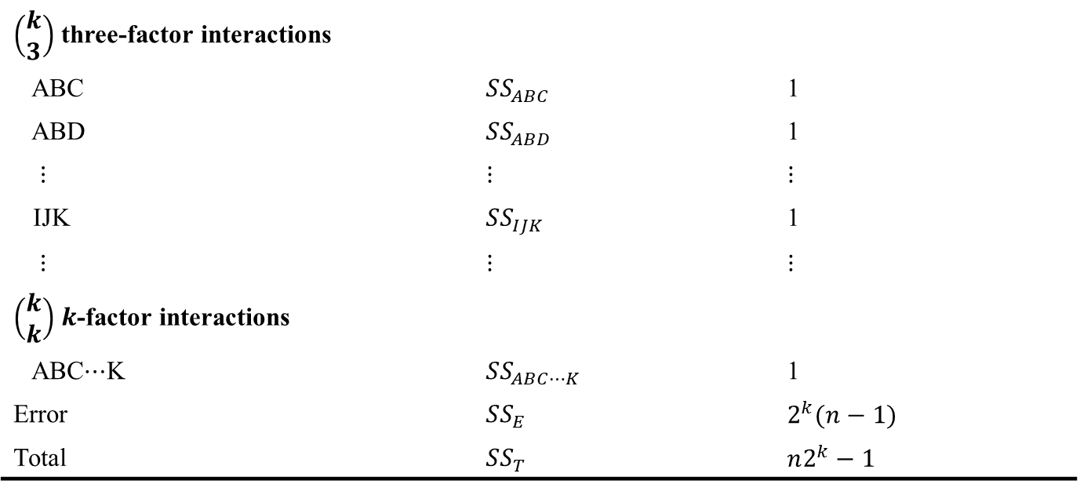
The General $2^{k}$ Factorial Design
$\left(\begin{aligned}k \\ 3\end{aligned}\right)$ three-factor interactions
ABC | $$SS_{ABC}$$ | 1
ABD | $$SS_{ABD}$$ | 1
$⋮$ | $$⋮$$ | $$⋮$$
IJK | $$SS_{IJK}$$ | 1
$⋮$ | $$⋮$$ | $$⋮$$
$\left(\begin{aligned}k \\ k\end{aligned}\right)$ $k$-factor interactions
ABC$⋯$K | $$SS_{ABC⋯K}$$ | 1
Error | $$SS_{E}$$ | $$2^{k}(n−1)$$
Total | $$SS_{T}$$ | $$n2^{k}−1$$
Design of Experiments

Slide 16
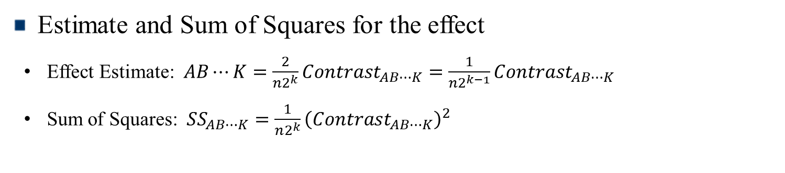
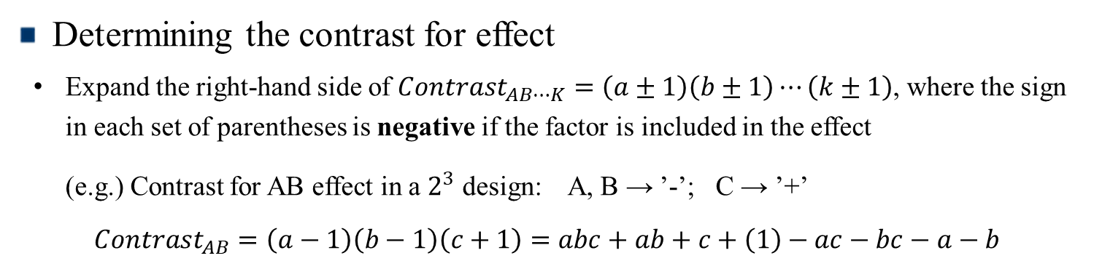
The General $2^{k}$ Factorial Design
Determining the contrast for effect
Expand the right-hand side of $Contrast_{AB⋯K}=\left(a±1\right)\left(b±1\right)⋯\left(k±1\right)$, where the sign in each set of parentheses is negative if the factor is included in the effect
(e.g.) Contrast for AB effect in a $2^{3}$ design: A, B → ’-’; C → ’+’
$$Contrast_{AB}=\left(a−1\right)\left(b−1\right)\left(c+1\right)=abc+ab+c+\left(1\right)−ac−bc−a−b$$
Estimate and Sum of Squares for the effect
Effect Estimate: $AB⋯K=\frac{2}{n2^{k}}Contrast_{AB⋯K}=\frac{1}{n2^{k−1}}Contrast_{AB⋯K}$
Sum of Squares: $SS_{AB⋯K}=\frac{1}{n2^{k}}{\left(Contrast_{AB⋯K}\right)}^{2}$
Design of Experiments

Slide 17
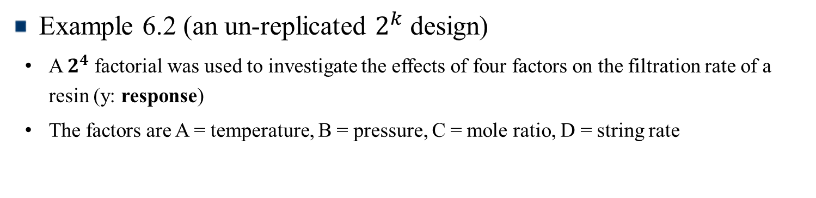

A Single Replicate of the $2^{k}$ Design
These are $2^{k}$ factorial designs with one observation at each corner of the “cube”
An un-replicated $2^{k}$ factorial design is also called a “single replicate” of the $2^{k}$
Lack of replication causes potential problem in statistical testing
→ With no replication, fitting the full model results in zero degrees of freedom for error
Potential solutions to this problem
Pooling high-order interactions to estimate error
Normal probability plotting of effects
Example 6.2 (an un-replicated $2^{k}$ design)
A $2^{4}$ factorial was used to investigate the effects of four factors on the filtration rate of a resin (y: response)
The factors are A = temperature, B = pressure, C = mole ratio, D = string rate
Design of Experiments

Slide 18
A Single Replicate of the $2^{k}$ Design
Run Number | Factor
 | A | B | C | D | Run Label | Filtration Rate (gal/h)
1 | - | - | - | - | (1) | 45
2 | + | - | - | - | a | 71
3 | - | + | - | - | b | 48
4 | + | + | - | - | ab | 65
5 | - | - | + | - | c | 68
6 | + | - | + | - | ac | 60
7 | - | + | + | - | bc | 80
8 | + | + | + | - | abc | 65
9 | - | - | - | + | d | 43
10 | + | - | - | + | ad | 100
11 | - | + | - | + | bd | 45
12 | + | + | - | + | abd | 104
13 | - | - | + | + | cd | 75
14 | + | - | + | + | acd | 86
15 | - | + | + | + | bcd | 70
16 | + | + | + | + | abcd | 96
Design of Experiments

Slide 19

A Single Replicate of the $2^{k}$ Design
Contrast Constants for the $2^{k}$ Design
 | A | B | AB | C | AC | BC | ABC | D | AD | BD | ABD | CD | ACD | BCD | ABCD
(1) | - | - | + | - | + | + | - | - | + | + | - | + | - | - | +
a | + | - | - | - | - | + | + | - | - | + | + | + | + | - | -
b | - | + | - | - | + | - | + | - | + | - | + | + | - | + | -
ab | + | + | + | - | - | - | - | - | - | - | - | + | + | + | +
c | - | - | + | + | - | - | + | - | + | + | - | - | + | + | -
ac | + | - | - | + | + | - | - | - | - | + | + | - | - | + | +
bc | - | + | - | + | - | + | - | - | + | - | + | - | + | - | +
abc | + | + | + | + | + | + | + | - | - | - | - | - | - | - | -
d | - | - | + | - | + | + | - | + | - | - | + | - | + | + | -
ad | + | - | - | - | - | + | + | + | + | - | - | - | - | + | +
bd | - | + | - | - | + | - | + | + | - | + | - | - | + | - | +
abd | + | + | + | - | - | - | - | + | + | + | + | - | - | - | -
cd | - | - | + | + | - | - | + | + | - | - | + | + | - | - | +
acd | + | - | - | + | + | - | - | + | + | - | - | + | + | - | -
bcd | - | + | - | + | - | + | - | + | - | + | - | + | - | + | -
abcd | + | + | + | + | + | + | + | + | + | + | + | + | + | + | +
Design of Experiments

Slide 20

A Single Replicate of the $2^{k}$ Design
Factor Effect Estimate and Sum of Squares with $SS_{Total}=5730.94$
Model Term | Effect Estimate | Sum of Squares | Percent Contribution
A | 21.625 | 1870.56 | 32.6397
B | 3.125 | 39.0625 | 0.681608
C | 9.875 | 390.062 | 6.80626
D | 14.625 | 855.563 | 14.9288
AB | 0.125 | 0.0625 | 0.00109057
AC | -18.125 | 1314.06 | 22.9293
AD | 16.625 | 1105.56 | 19.2911
BC | 2.375 | 22.5625 | 0.393696
Model Term | Effect Estimate | Sum of Squares | Percent Contribution
BD | -0.375 | 0.5625 | 0.00981515
CD | -1.125 | 5.0625 | 0.0883363
ABC | 1.875 | 14.0625 | 0.245379
ABD | 4.125 | 68.0625 | 1.18763
ACD | -1.625 | 10.5625 | 0.184307
BCD | -2.625 | 27.5625 | 0.480942
ABCD | 1.375 | 7.5625 | 0.131959
Design of Experiments

Slide 21
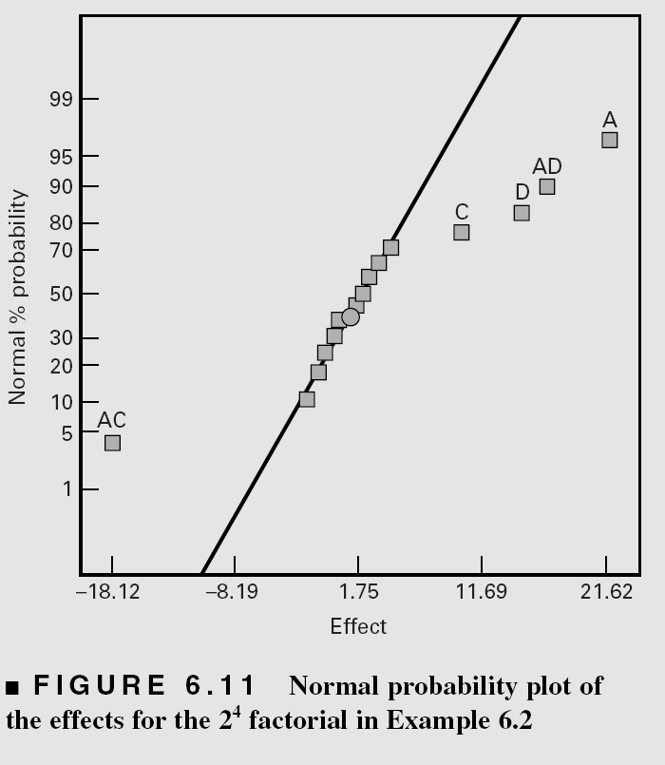
A Single Replicate of the $2^{k}$ Design
Normal Probability Plot of the Effects
→ Large effects are far from the line (A, C, D, AC, AD)
Design of Experiments

Slide 22
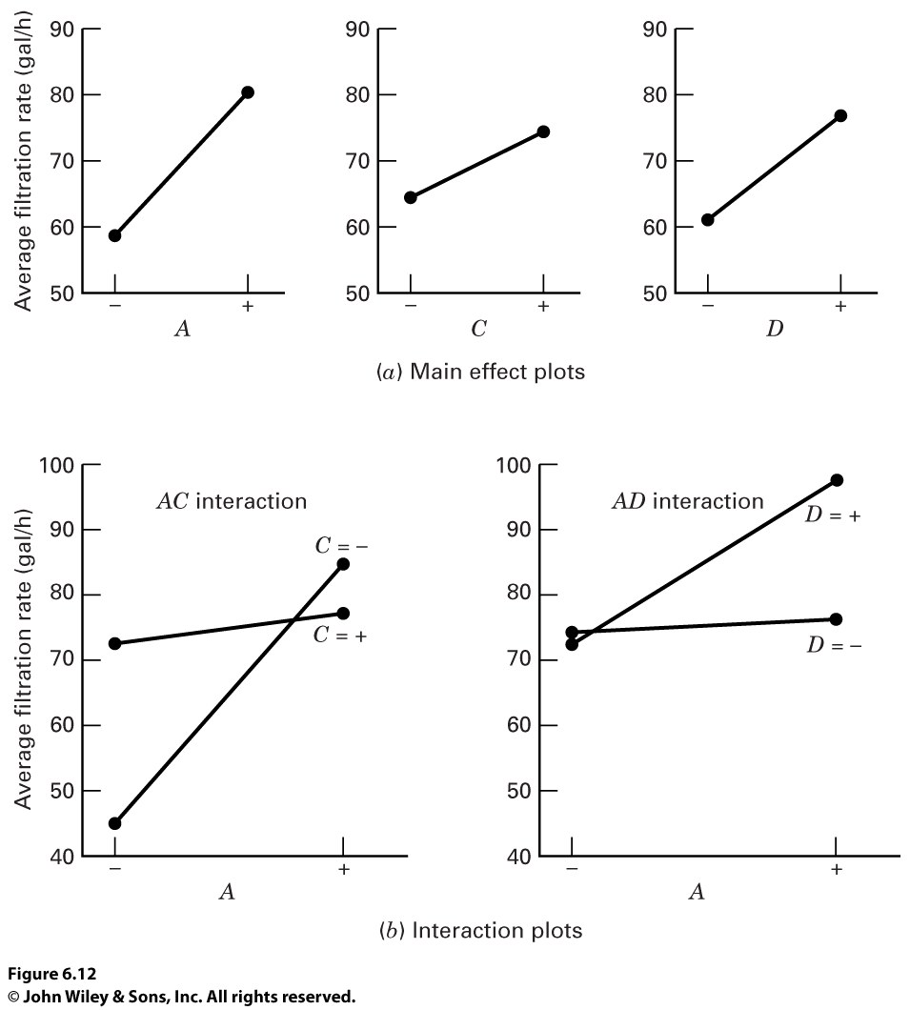

A Single Replicate of the $2^{k}$ Design
Main Effect Plots and Interaction Plots
→ A, C, D Main Effects and AC, AD Interaction Effects are significant
→ B (Pressure) is not significant and all interaction involving B are negligible
→ Discard B from experiment: $2^{3}$ Factorial in A, C and D with 2 replicates
Design of Experiments

Slide 23
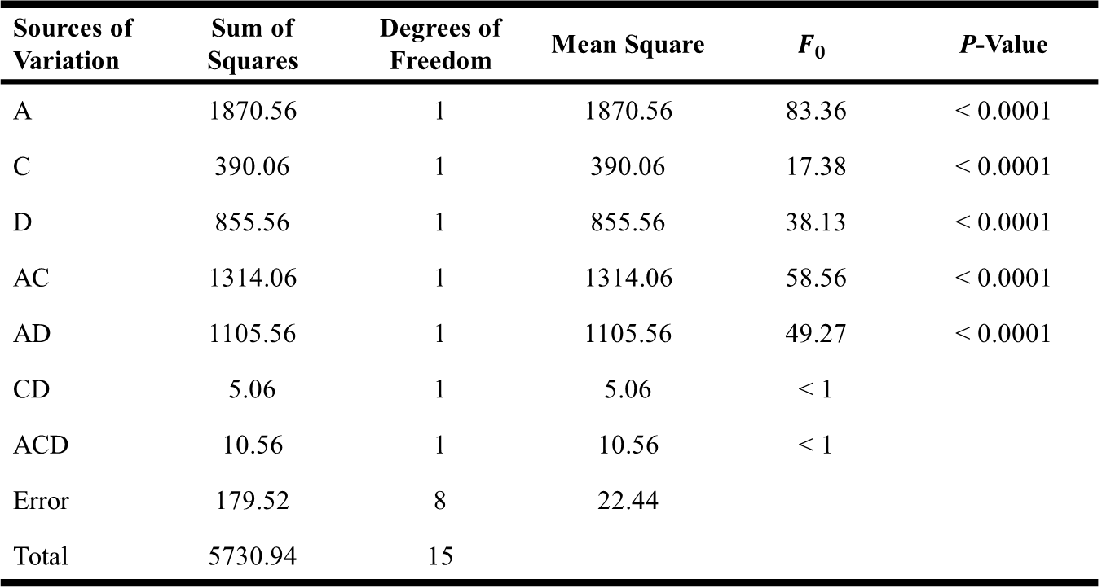
A Single Replicate of the $2^{k}$ Design
Analysis of Variance in A, C, and D
Sources of Variation | Sum of Squares | Degrees of Freedom | Mean Square | $$F_{0}$$ | P-Value
A | 1870.56 | 1 | 1870.56 | 83.36 | < 0.0001
C | 390.06 | 1 | 390.06 | 17.38 | < 0.0001
D | 855.56 | 1 | 855.56 | 38.13 | < 0.0001
AC | 1314.06 | 1 | 1314.06 | 58.56 | < 0.0001
AD | 1105.56 | 1 | 1105.56 | 49.27 | < 0.0001
CD | 5.06 | 1 | 5.06 | < 1
ACD | 10.56 | 1 | 10.56 | < 1
Error | 179.52 | 8 | 22.44
Total | 5730.94 | 15
Design of Experiments

Slide 24

A Single Replicate of the $2^{k}$ Design
Diagnostic Checking
Significant Effects: A = 21.625, C = 9.875, D = 14.625, AC = -18.125, AD = 16.625
→ Regression Model
: $\hat{y}=70.06+\left(\frac{21.625}{2}\right)x_{1}+\left(\frac{9.875}{2}\right)x_{3}+\left(\frac{14.625}{2}\right)x_{4}−\left(\frac{18.125}{2}\right)x_{1}x_{3}+\left(\frac{16.625}{2}\right)x_{1}x_{4}$
Normal Probability Plot of Residuals
Contour Plots of Filtration Rate
Design of Experiments

