Slide 1
Design of Experiments
Suhwan Kim
Department of Statistics
Inha University
May 19, 2022

Slide 2
Chapter 7. Blocking and Confounding Systems for Two-Level Factorials (Part 1)

Slide 3
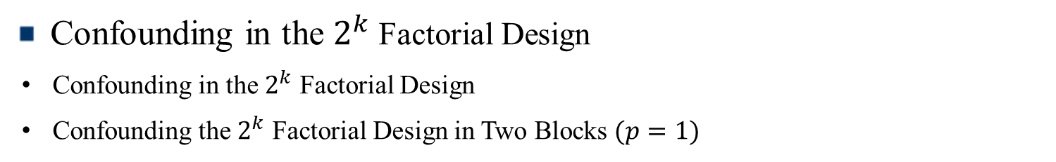
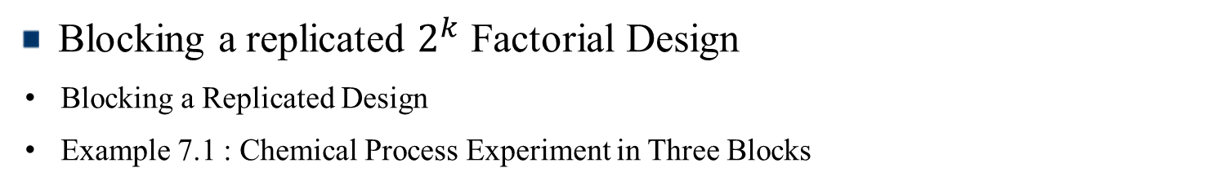
Contents
Blocking a replicated $2^{k}$ Factorial Design
Blocking a Replicated Design
Example 7.1 : Chemical Process Experiment in Three Blocks
Confounding in the $2^{k}$ Factorial Design
Confounding in the $2^{k}$ Factorial Design
Confounding the $2^{k}$ Factorial Design in Two Blocks $(p=1)$

Slide 4

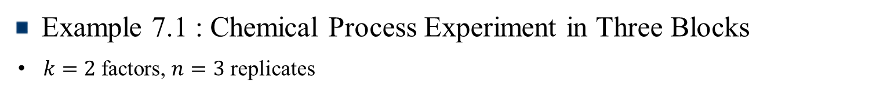
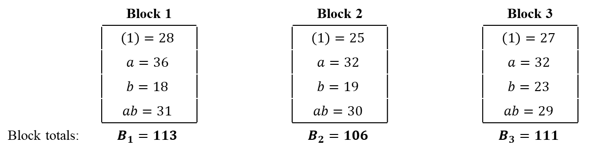
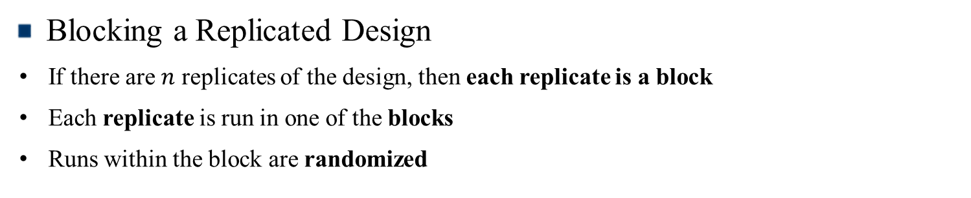
Blocking a replicated $2^{k}$ Factorial Design
Blocking a Replicated Design
If there are $n$ replicates of the design, then each replicate is a block
Each replicate is run in one of the blocks
Runs within the block are randomized
Example 7.1 : Chemical Process Experiment in Three Blocks
$k=2$ factors, $n=3$ replicates
 | Block 1 |  | Block 2 |  | Block 3
 | $$\left(1\right)=28$$ |  | $$\left(1\right)=25$$ |  | $$\left(1\right)=27$$
 | $$a=36$$ |  | $$a=32$$ |  | $$a=32$$
 | $$b=18$$ |  | $$b=19$$ |  | $$b=23$$
 | $$ab=31$$ |  | $$ab=30$$ |  | $$ab=29$$
Block totals: | $$B_{1}=113$$ |  | $$B_{2}=106$$ |  | $$B_{3}=111$$
$$SS_{Blocks}=\sum_{i=1}^{3}{\frac{B_{i}^{2}}{4}}−\frac{y.{..}^{2}}{12}=6.50$$
Design of Experiments

Slide 5
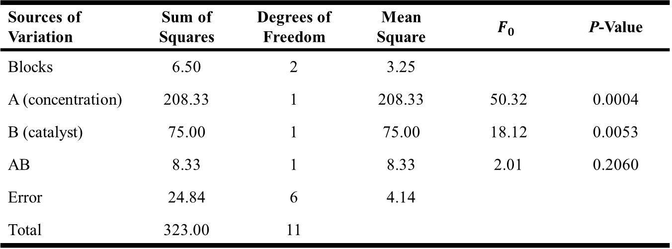
Blocking a replicated $2^{k}$ Factorial Design
Analysis of Variance for the Chemical Process Experiment in Three Blocks
Sources of Variation | Sum of Squares | Degrees of Freedom | Mean Square | $$F_{0}$$ | P-Value
Blocks | 6.50 | 2 | 3.25
A (concentration) | 208.33 | 1 | 208.33 | 50.32 | 0.0004
B (catalyst) | 75.00 | 1 | 75.00 | 18.12 | 0.0053
AB | 8.33 | 1 | 8.33 | 2.01 | 0.2060
Error | 24.84 | 6 | 4.14
Total | 323.00 | 11
Design of Experiments

Slide 6

Confounding in the $2^{k}$ Factorial Design
Confounding in the $2^{k}$ Factorial Design
Confounding is a design technique for arranging a complete factorial experiments in blocks ($block size<\# Treatment Combinations$)
Causes certain treatment effects confounded indistinguishable from with blocks effect
Consider the construction and analysis of $2^{k}$ factorial design in $2^{p}$ incomplete block ($p<k$)
Design of Experiments

Slide 7
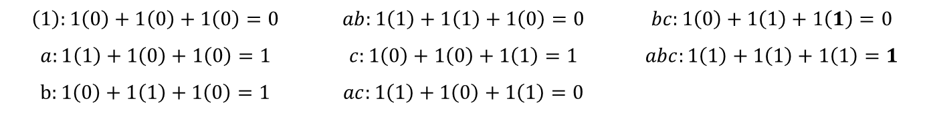
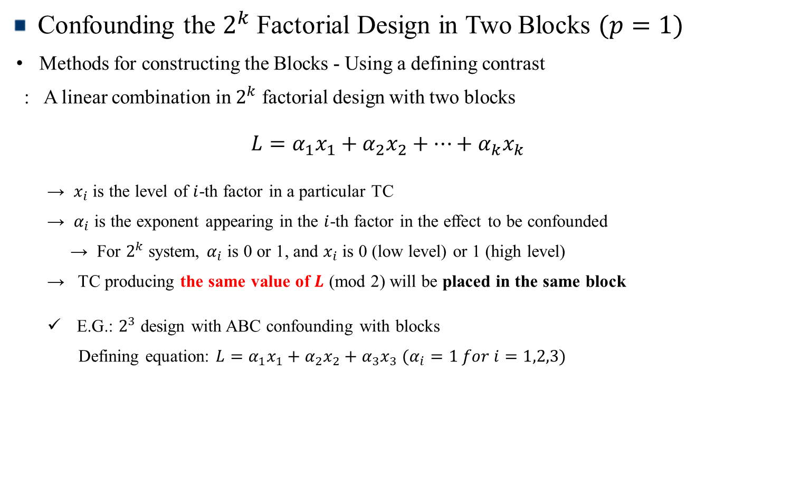
Confounding in the $2^{k}$ Factorial Design
Confounding the $2^{k}$ Factorial Design in Two Blocks $(p=1)$
Methods for constructing the Blocks - Using a defining contrast
: A linear combination in $2^{k}$ factorial design with two blocks
$$L=α_{1}x_{1}+α_{2}x_{2}+⋯+α_{k}x_{k}$$
→ $x_{i}$ is the level of $i$-th factor in a particular TC
→ $α_{i}$ is the exponent appearing in the $i$-th factor in the effect to be confounded
→ For $2^{k}$ system, $α_{i}$ is 0 or 1, and $x_{i}$ is 0 (low level) or 1 (high level)
→ TC producing the same value of $L$ (mod 2) will be placed in the same block
E.G.: $2^{3}$ design with ABC confounding with blocks
Defining equation: $L=α_{1}x_{1}+α_{2}x_{2}+α_{3}x_{3}$ $(α_{i}=1 for i=1,2,3)$
$$\left(1\right):1\left(0\right)+1\left(0\right)+1\left(0\right)=0$$ | $$ab:1\left(1\right)+1\left(1\right)+1\left(0\right)=0$$ | $$bc:1\left(0\right)+1\left(1\right)+1\left(1\right)=0$$
$$a:1\left(1\right)+1\left(0\right)+1\left(0\right)=1$$ | $$c:1\left(0\right)+1\left(0\right)+1\left(1\right)=1$$ | $$abc:1\left(1\right)+1\left(1\right)+1\left(1\right)=1$$
$$b:1\left(0\right)+1\left(1\right)+1\left(0\right)=1$$ | $$ac:1\left(1\right)+1\left(0\right)+1\left(1\right)=0$$
Design of Experiments

Slide 8
Chapter 7. Blocking and Confounding Systems for Two-Level Factorials (part 2)

Slide 9
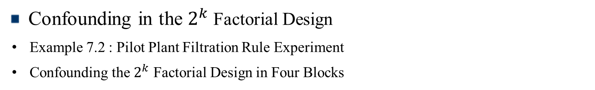
Contents
Confounding in the $2^{k}$ Factorial Design
Example 7.2 : Pilot Plant Filtration Rule Experiment
Confounding the $2^{k}$ Factorial Design in Four Blocks

Slide 10
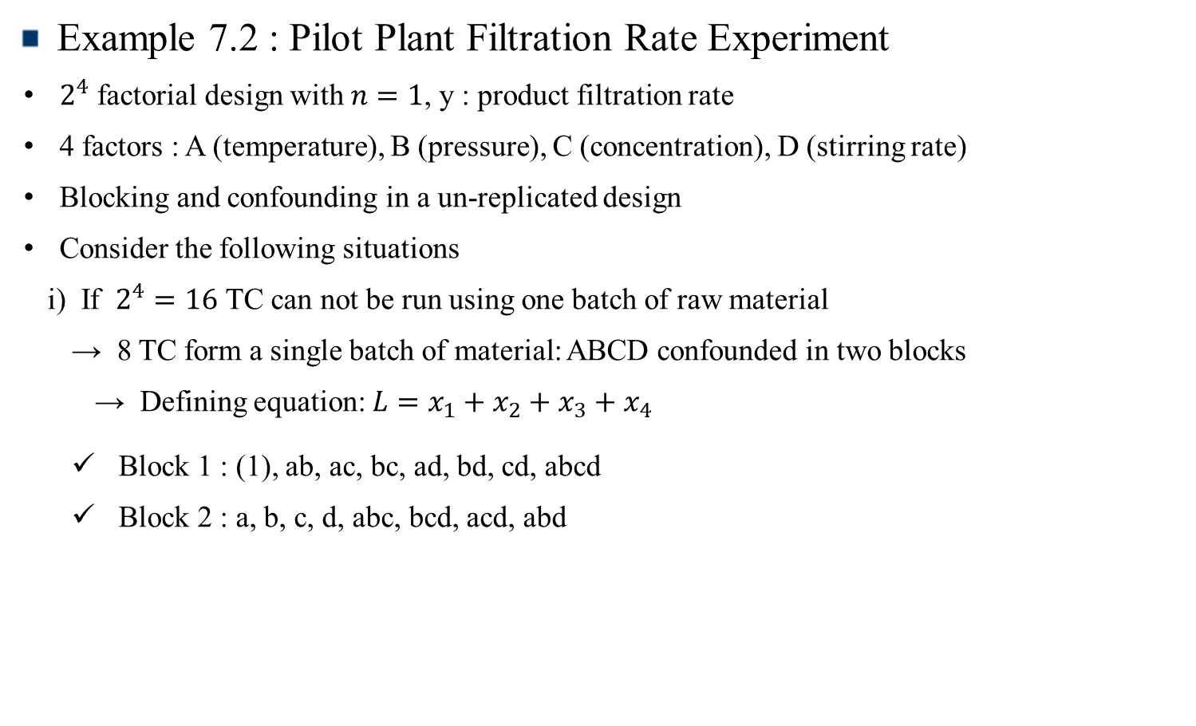
Confounding in the $2^{k}$ Factorial Design
Example 7.2 : Pilot Plant Filtration Rate Experiment
$2^{4}$ factorial design with $n=1$, y : product filtration rate
4 factors : A (temperature), B (pressure), C (concentration), D (stirring rate)
Blocking and confounding in a un-replicated design
Consider the following situations
i) If $2^{4}=16$ TC can not be run using one batch of raw material
→ 8 TC form a single batch of material: ABCD confounded in two blocks
→ Defining equation: $L=x_{1}+x_{2}+x_{3}+x_{4}$
Block 1 : (1), ab, ac, bc, ad, bd, cd, abcd
Block 2 : a, b, c, d, abc, bcd, acd, abd
Design of Experiments

Slide 11
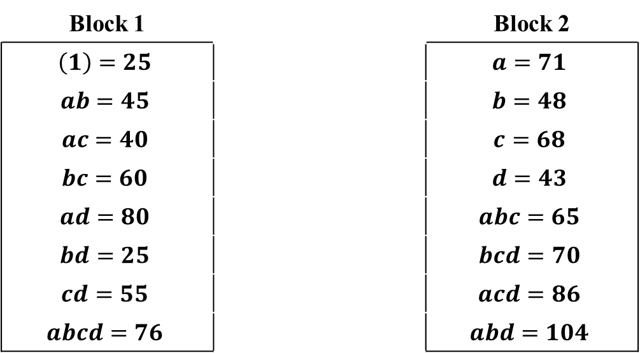
Confounding in the $2^{k}$ Factorial Design
ii) Observations in block 1 are reduced by 20 units ← the simulated “block effect”
Block 1 |  | Block 2
$$\left(1\right)=25$$ |  | $$a=71$$
$$ab=45$$ |  | $$b=48$$
$$ac=40$$ |  | $$c=68$$
$$bc=60$$ |  | $$d=43$$
$$ad=80$$ |  | $$abc=65$$
$$bd=25$$ |  | $$bcd=70$$
$$cd=55$$ |  | $$acd=86$$
$$abcd=76$$ |  | $$abd=104$$
Design of Experiments

Slide 12
Confounding in the $2^{k}$ Factorial Design
Run Number | Factor
 | A | B | C | D | Run Label | Filtration Rate (gal/h)
1 | - | - | - | - | (1) | 45
2 | + | - | - | - | a | 71
3 | - | + | - | - | b | 48
4 | + | + | - | - | ab | 65
5 | - | - | + | - | c | 68
6 | + | - | + | - | ac | 60
7 | - | + | + | - | bc | 80
8 | + | + | + | - | abc | 65
9 | - | - | - | + | d | 43
10 | + | - | - | + | ad | 100
11 | - | + | - | + | bd | 45
12 | + | + | - | + | abd | 104
13 | - | - | + | + | cd | 75
14 | + | - | + | + | acd | 86
15 | - | + | + | + | bcd | 70
16 | + | + | + | + | abcd | 96
Design of Experiments

Slide 13

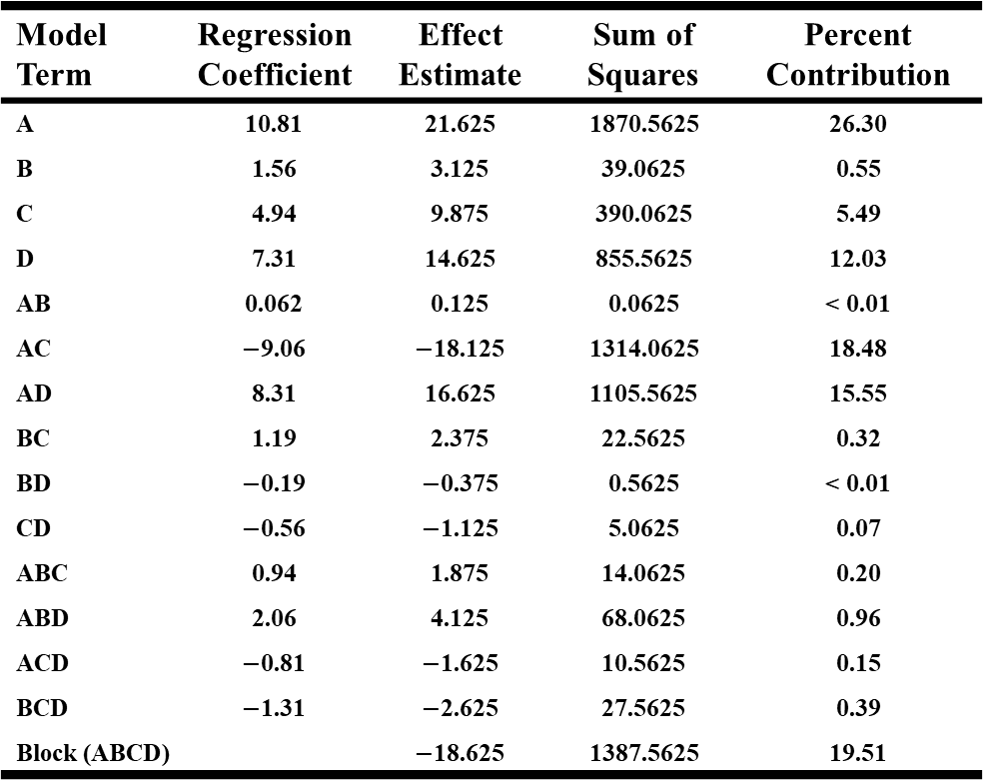
Confounding in the $2^{k}$ Factorial Design
Effect estimates
Model Term | Regression Coefficient | Effect Estimate | Sum of Squares | Percent Contribution
A | 10.81 | 21.625 | 1870.5625 | 26.30
B | 1.56 | 3.125 | 39.0625 | 0.55
C | 4.94 | 9.875 | 390.0625 | 5.49
D | 7.31 | 14.625 | 855.5625 | 12.03
AB | 0.062 | 0.125 | 0.0625 | < 0.01
AC | $−$9.06 | $−$18.125 | 1314.0625 | 18.48
AD | 8.31 | 16.625 | 1105.5625 | 15.55
BC | 1.19 | 2.375 | 22.5625 | 0.32
BD | $−$0.19 | $−$0.375 | 0.5625 | < 0.01
CD | $−$0.56 | $−$1.125 | 5.0625 | 0.07
ABC | 0.94 | 1.875 | 14.0625 | 0.20
ABD | 2.06 | 4.125 | 68.0625 | 0.96
ACD | $−$0.81 | $−$1.625 | 10.5625 | 0.15
BCD | $−$1.31 | $−$2.625 | 27.5625 | 0.39
Block (ABCD) |  | $−$18.625 | 1387.5625 | 19.51
$$Block effet= {\overline{y}}_{B1}−{\overline{y}}_{B2}$$
$$= 406/8−555/8$$
$$= −18.625$$
$$SS_{Blocks}=\left({406}^{2}+{555}^{2}\right)/8$$
$$− {961}^{2}/16$$
$$=1387.56$$
Design of Experiments

Slide 14
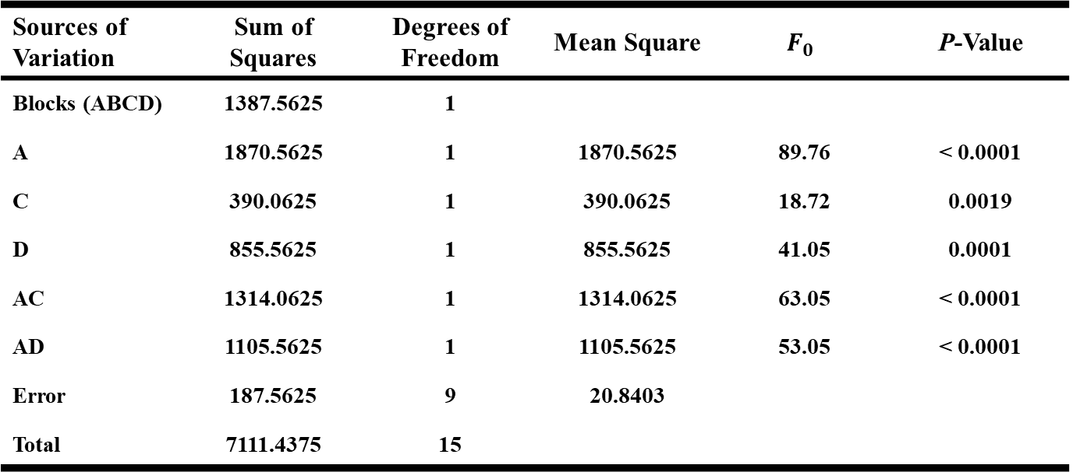
Confounding in the $2^{k}$ Factorial Design
ANOVA Table
→ Normal probability plot shows A, C, D, AC, AD are emerging
→ The ABCD interaction (or block effect) is not considered as part of the error term
→ The reset of the analysis is unchanged from the original analysis
Sources of Variation | Sum of Squares | Degrees of Freedom | Mean Square | $$F_{0}$$ | P-Value
Blocks (ABCD) | 1387.5625 | 1
A | 1870.5625 | 1 | 1870.5625 | 89.76 | < 0.0001
C | 390.0625 | 1 | 390.0625 | 18.72 | 0.0019
D | 855.5625 | 1 | 855.5625 | 41.05 | 0.0001
AC | 1314.0625 | 1 | 1314.0625 | 63.05 | < 0.0001
AD | 1105.5625 | 1 | 1105.5625 | 53.05 | < 0.0001
Error | 187.5625 | 9 | 20.8403
Total | 7111.4375 | 15
Design of Experiments

Slide 15
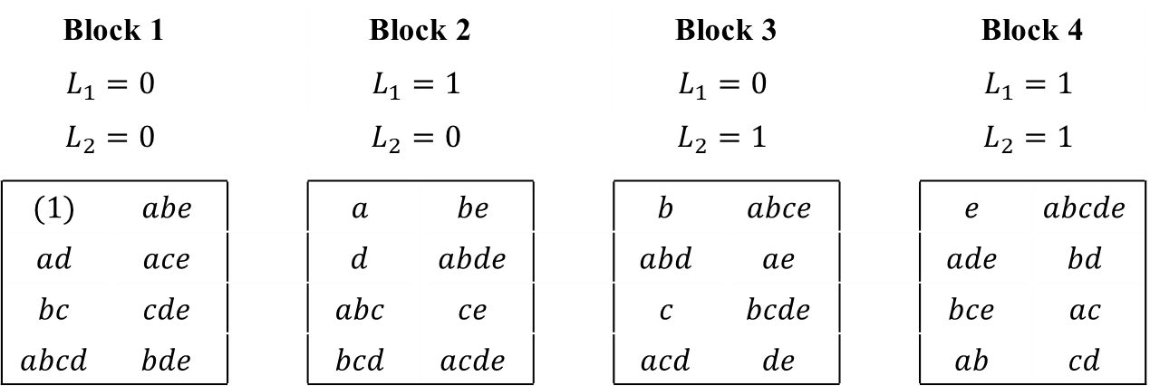

Confounding in the $2^{k}$ Factorial Design
Confounding the $2^{k}$ Factorial Design in Four Blocks
Can construct $2^{k}$ factorial design confounded in four blocks of $2^{k−2}$ observations
→ Useful for $k≥4$ and block sizes are relatively small
Example $2^{5}$ design : each block hold 8 runs
→ Select two effects to be confounded (e.g., ADE and BCE)
→ Two defining equations: $L_{1}=x_{1}+x_{4}+x_{5}$ and $L_{2}=x_{2}+x_{3}+x_{5}$
Block 1 |  |  | Block 2 |  |  | Block 3 |  |  | Block 4
$$L_{1}=0$$ |  |  | $$L_{1}=1$$ |  |  | $$L_{1}=0$$ |  |  | $$L_{1}=1$$
$$L_{2}=0$$ |  |  | $$L_{2}=0$$ |  |  | $$L_{2}=1$$ |  |  | $$L_{2}=1$$
$$(1)$$ | $$abe$$ |  | $$a$$ | $$be$$ |  | $$b$$ | $$abce$$ |  | $$e$$ | $$abcde$$
$$ad$$ | $$ace$$ |  | $$d$$ | $$abde$$ |  | $$abd$$ | $$ae$$ |  | $$ade$$ | $$bd$$
$$bc$$ | $$cde$$ |  | $$abc$$ | $$ce$$ |  | $$c$$ | $$bcde$$ |  | $$bce$$ | $$ac$$
$$abcd$$ | $$bde$$ |  | $$bcd$$ | $$acde$$ |  | $$acd$$ | $$de$$ |  | $$ab$$ | $$cd$$
Design of Experiments

