Slide 1
Design of Experiments
Suhwan Kim
Department of Statistics
Inha University
May 27, 2022

Slide 2
Chapter 8. Fractional Factorial Designs

Slide 3
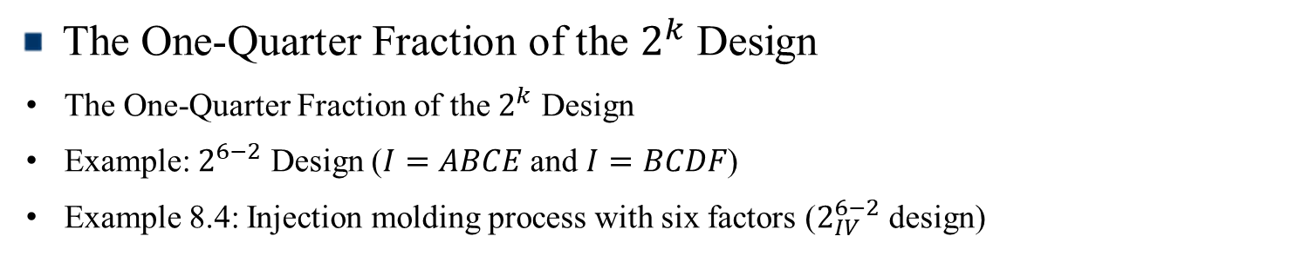
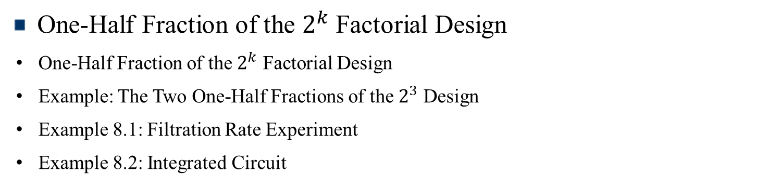
Contents
Introduction
Fractional Factorial Design (FFD)
One-Half Fraction of the $2^{k}$ Factorial Design
One-Half Fraction of the $2^{k}$ Factorial Design
Example: The Two One-Half Fractions of the $2^{3}$ Design
Example 8.1: Filtration Rate Experiment
Example 8.2: Integrated Circuit
The One-Quarter Fraction of the $2^{k}$ Design
The One-Quarter Fraction of the $2^{k}$ Design
Example: $2^{6−2}$ Design ($I=ABCE$ and $I=BCDF$)
Example 8.4: Injection molding process with six factors ($2_{IV}^{6−2}$ design)

Slide 4
Introduction
Fractional Factorial Design (FFD)
Motivation : As the number of factors becomes large, the size of the designs grows very quickly
If certain high-order interactions are negligible, effects of main and low-order interactions may be obtained by running only a fraction of the complete fractional experiment
Why do Fractional Factorial Designs work? (Three Principal)
The sparsity of effects principle
The projection property
Sequential experimentation
Design of Experiments

Slide 5
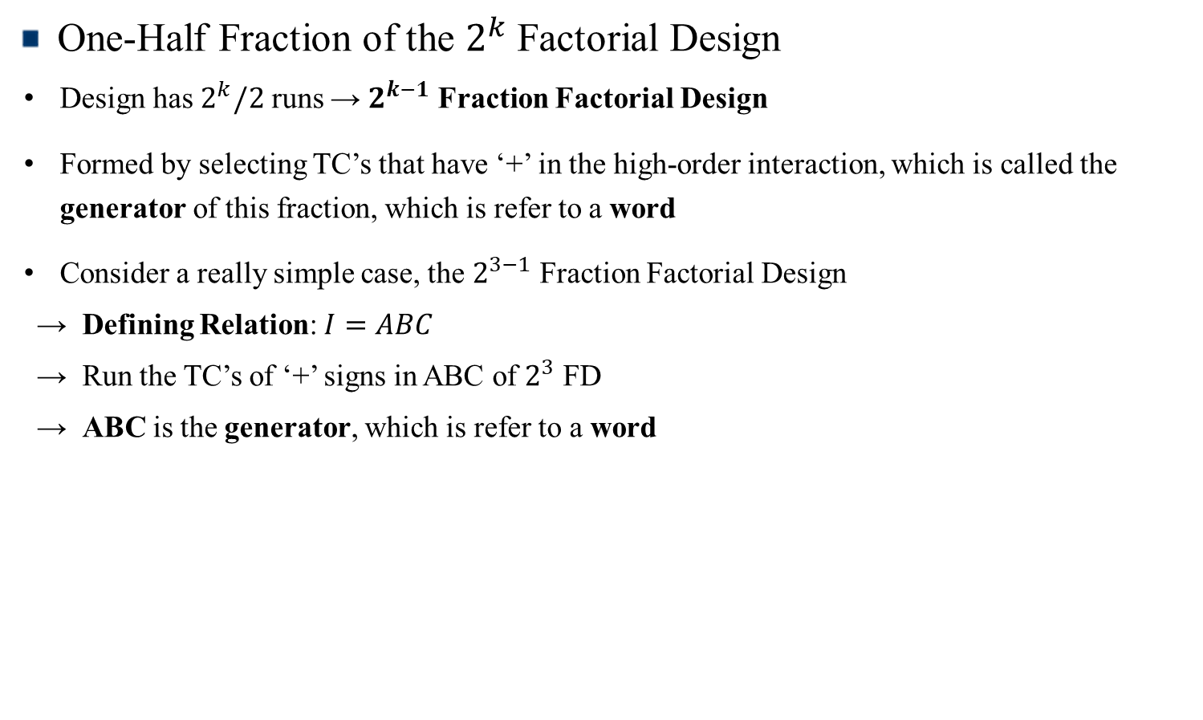
One-Half Fraction of the $2^{k}$ Factorial Design
One-Half Fraction of the $2^{k}$ Factorial Design
Design has $2^{k}/2$ runs → $2^{k−1}$ Fraction Factorial Design
Formed by selecting TC’s that have ‘+’ in the high-order interaction, which is called the generator of this fraction, which is refer to a word
Consider a really simple case, the $2^{3−1}$ Fraction Factorial Design
→ Defining Relation: $I=ABC$
→ Run the TC’s of ‘+’ signs in ABC of $2^{3}$ FD
→ ABC is the generator, which is refer to a word
Design of Experiments

Slide 6

One-Half Fraction of the $2^{k}$ Factorial Design
Table 8.1: Plus and Minus Signs for the $2^{k}$ Factorial Design
Treatment Combination | Factorial Effect
 | I | A | B | C | AB | AC | BC | ABC
a | + | + | - | - | - | - | + | +
b | + | - | + | - | - | + | - | +
c | + | - | - | + | + | - | - | +
abc | + | + | + | + | + | + | + | +
ab | + | + | + | - | + | - | - | -
ac | + | + | - | + | - | + | - | -
bc | + | - | + | + | - | - | + | -
(1) | + | - | - | - | + | + | + | -
Design of Experiments

Slide 7
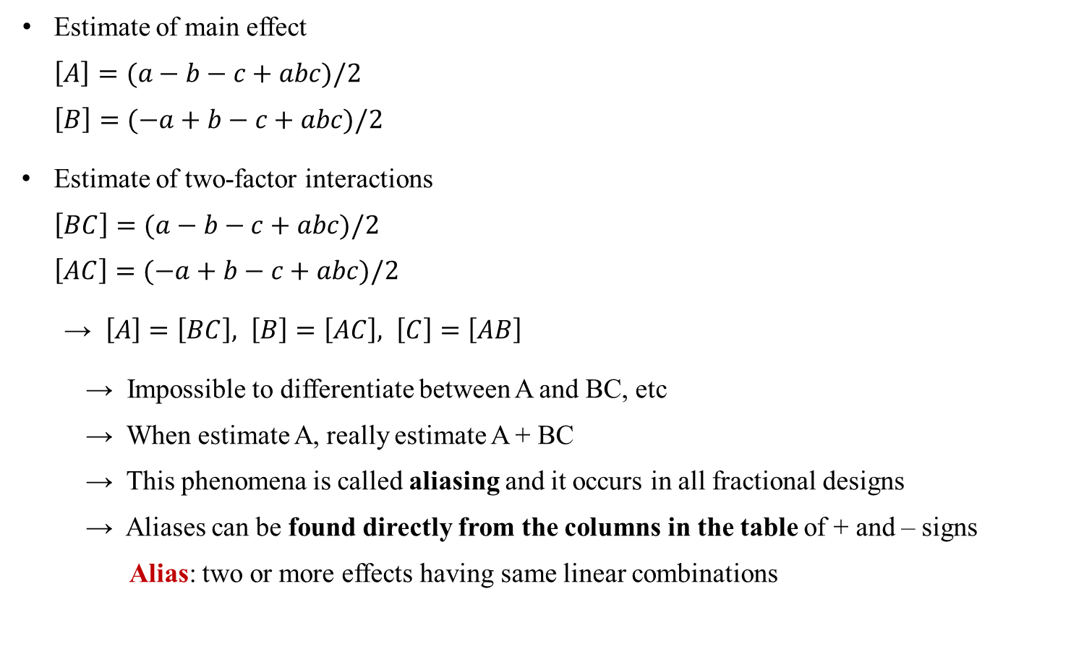
One-Half Fraction of the $2^{k}$ Factorial Design
Estimate of main effect
$\left[A\right]=(a−b−c+abc)/2$
$\left[B\right]=(−a+b−c+abc)/2$
Estimate of two-factor interactions
$\left[BC\right]=(a−b−c+abc)/2$
$\left[AC\right]=(−a+b−c+abc)/2$
→ $\left[A\right]=\left[BC\right], \left[B\right]=\left[AC\right], \left[C\right]=\left[AB\right]$
→ Impossible to differentiate between A and BC, etc
→ When estimate A, really estimate A + BC
→ This phenomena is called aliasing and it occurs in all fractional designs
→ Aliases can be found directly from the columns in the table of + and – signs
Alias: two or more effects having same linear combinations
Design of Experiments

Slide 8
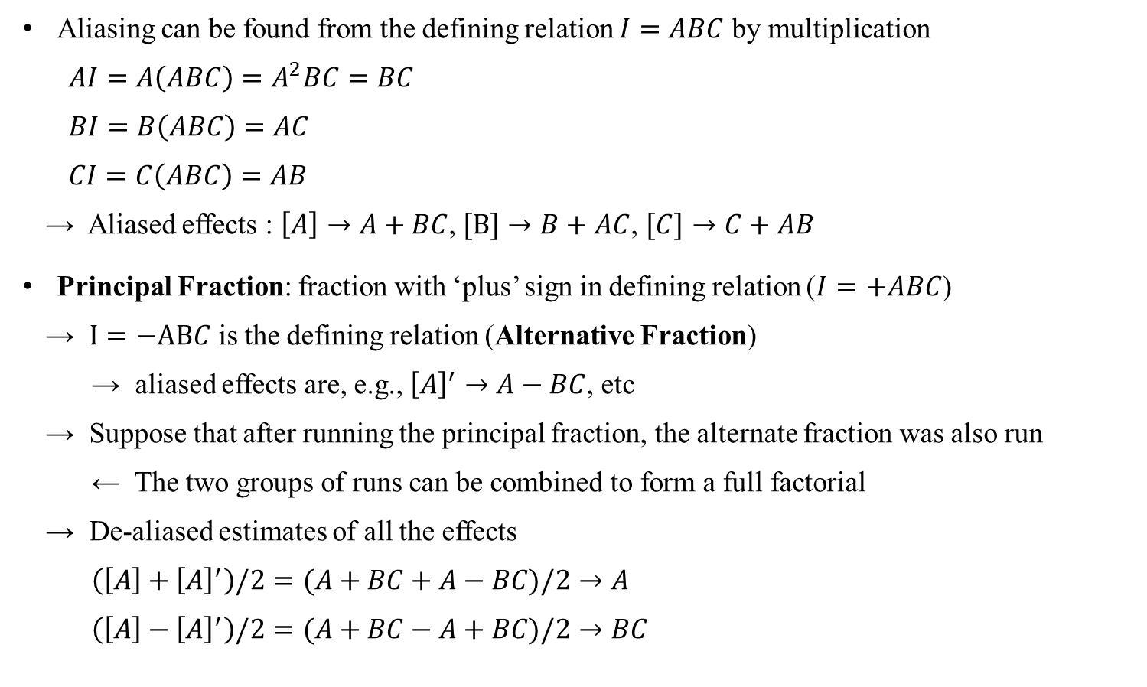
One-Half Fraction of the $2^{k}$ Factorial Design
Aliasing can be found from the defining relation $I=ABC$ by multiplication
$AI=A\left(ABC\right)=A^{2}BC=BC$
$BI=B\left(ABC\right)=AC$
$CI=C\left(ABC\right)=AB$
→ Aliased effects : $\left[A\right]→A+BC$, $[B]→B+AC$, $[C]→C+AB$
Principal Fraction: fraction with ‘plus’ sign in defining relation ($I=+ABC$)
→ $I=−ABC$ is the defining relation (Alternative Fraction)
→ aliased effects are, e.g., ${\left[A\right]}^{′}→A−BC$, etc
→ Suppose that after running the principal fraction, the alternate fraction was also run
← The two groups of runs can be combined to form a full factorial
→ De-aliased estimates of all the effects
$\left(\left[A\right]+{\left[A\right]}^{′}\right)/2=(A+BC+A−BC)/2→A$
$\left(\left[A\right]−{\left[A\right]}^{′}\right)/2=(A+BC−A+BC)/2→BC$
Design of Experiments

Slide 9
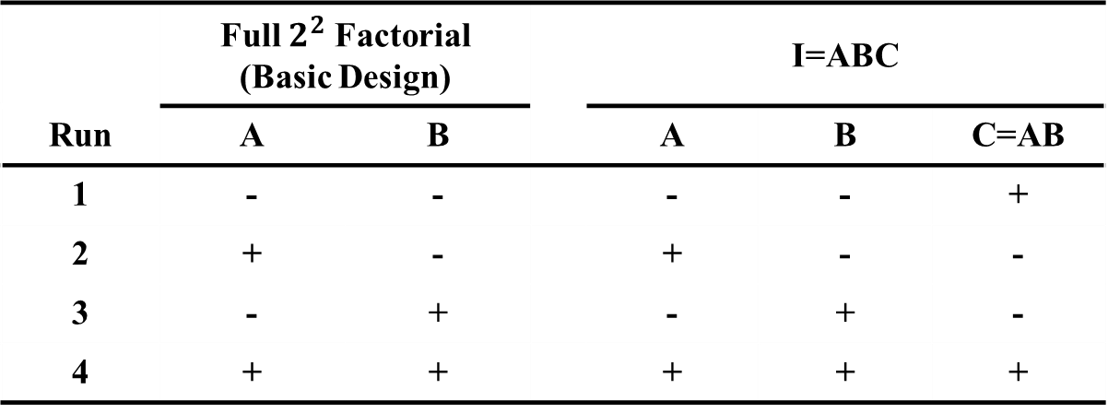

One-Half Fraction of the $2^{k}$ Factorial Design
Example: The Two One-Half Fractions of the $2^{3}$ Design
Writing down the full $2^{2}$ factorial (basic design), and then equating $C=AB$
(note that alternative fraction: $C=−AB$)
 | Full $2^{2}$ Factorial (Basic Design) |  |  | I=ABC
Run | A | B |  | A | B | C=AB
1 | - | - |  | - | - | +
2 | + | - |  | + | - | -
3 | - | + |  | - | + | -
4 | + | + |  | + | + | +
Design of Experiments

Slide 10

One-Half Fraction of the $2^{k}$ Factorial Design
Example 8.1: Filtration Rate Experiment
$2_{IV}^{4−1}$ design with $I=ABCD$ (principal fraction)
Basic design: A, B, C → $D=ABC$
Main effect is aliased with a 3-factor interaction, 2-factor interaction is aliased with another 2-factor interaction
 | Basic Design |  |  |  | Treatment Combination | Filtration Rate
Run | A | B | C | D=ABC
1 | - | - | - | - | (1) | 45
2 | + | - | - | + | ad | 100
3 | - | + | - | + | bd | 45
4 | + | + | - | - | ab | 65
5 | - | - | + | + | cd | 75
6 | + | - | + | - | ac | 60
7 | - | + | + | - | bc | 80
8 | + | + | + | + | abcd | 96
Design of Experiments

Slide 11
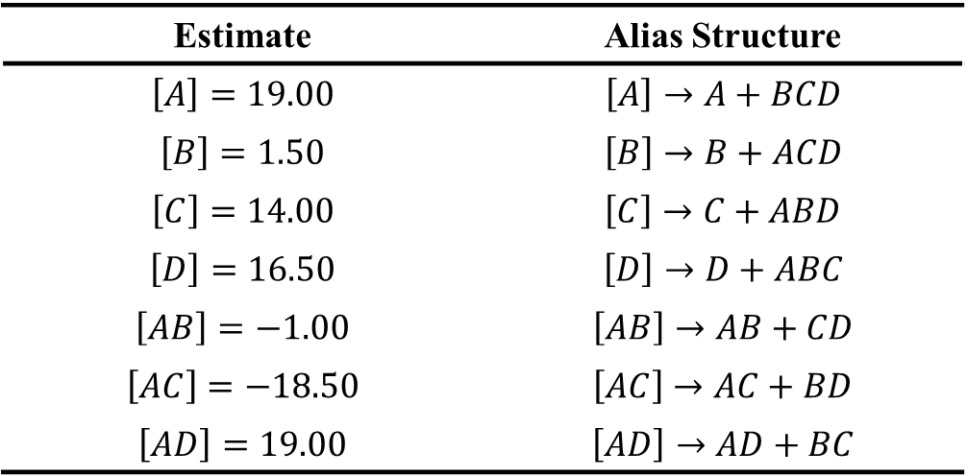
One-Half Fraction of the $2^{k}$ Factorial Design
Estimates of Effects and Aliases from Example 8.1
Estimate | Alias Structure
$\left[A\right]=19.00$ | $\left[A\right]→A+BCD$
$\left[B\right]=1.50$ | $\left[B\right]→B+ACD$
$\left[C\right]=14.00$ | $\left[C\right]→C+ABD$
$\left[D\right]=16.50$ | $\left[D\right]→D+ABC$
$\left[AB\right]=−1.00$ | $\left[AB\right]→AB+CD$
$\left[AC\right]=−18.50$ | $\left[AC\right]→AC+BD$
$\left[AD\right]=19.00$ | $\left[AD\right]→AD+BC$
Design of Experiments

Slide 12

One-Half Fraction of the $2^{k}$ Factorial Design
Example 8.2: Integrated Circuit
$2_{V}^{5−1}$ design with $I=ABCDE$ (principal fraction)
 | Basic Design |  |  |  |  | Treatment Combination | Yield
Run | A | B | C | D | E=ABCD
1 | - | - | - | - | + | e | 8
2 | + | - | - | - | - | a | 9
3 | - | + | - | - | - | b | 34
4 | + | + | - | - | + | abe | 52
5 | - | - | + | - | - | c | 16
6 | + | - | + | - | + | ace | 22
7 | - | + | + | - | + | bce | 45
8 | + | + | + | - | - | abc | 60
9 | - | - | - | + | - | d | 6
10 | + | - | - | + | + | ade | 10
11 | - | + | - | + | + | bde | 30
12 | + | + | - | + | - | abd | 50
13 | - | - | + | + | + | cde | 15
14 | + | - | + | + | - | acd | 21
15 | - | + | + | + | - | bcd | 44
16 | + | + | + | + | + | abcde | 63
Design of Experiments

Slide 13
One-Half Fraction of the $2^{k}$ Factorial Design
Estimates of effects, regression coefficients
Variable | Regression Coefficient | Estimated Effect | Sum of Squares
Overall Average | 30.3125
A | 5.5625 | 11.1250 | 495.062
B | 16.9375 | 33.8750 | 4590.062
C | 5.4375 | 10.8750 | 473.062
D | -0.4375 | -0.8750 | 3.063
E | 0.3125 | 0.6250 | 1.563
AB | 3.4375 | 6.8750 | 189.063
AC | 0.1875 | 0.3750 | 0.563
AD | 0.5625 | 1.1250 | 5.063
AE | 0.5625 | 1.1250 | 5.063
BC | 0.3125 | 0.6250 | 1.563
BD | -0.0625 | -0.1250 | 0.063
BE | -0.0625 | -0.1250 | 0.063
CD | 0.4375 | 0.8750 | 3.063
CE | 0.1875 | 0.3750 | 0.563
DE | -0.6875 | -1.3750 | 7.563
Design of Experiments

Slide 14
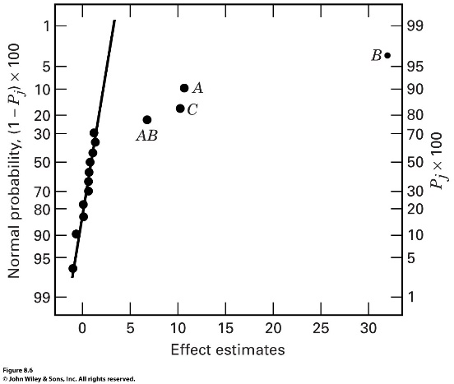
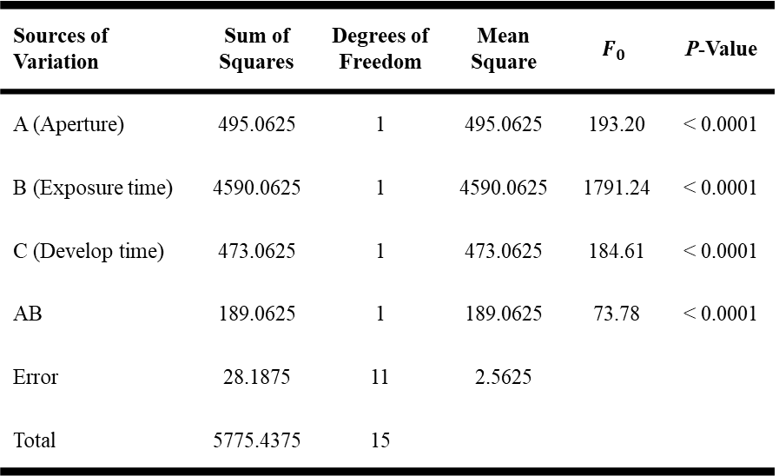
One-Half Fraction of the $2^{k}$ Factorial Design
Normal probability and Analysis of Variance
Sources of Variation | Sum of Squares | Degrees of Freedom | Mean Square | $$F_{0}$$ | P-Value
A (Aperture) | 495.0625 | 1 | 495.0625 | 193.20 | < 0.0001
B (Exposure time) | 4590.0625 | 1 | 4590.0625 | 1791.24 | < 0.0001
C (Develop time) | 473.0625 | 1 | 473.0625 | 184.61 | < 0.0001
AB | 189.0625 | 1 | 189.0625 | 73.78 | < 0.0001
Error | 28.1875 | 11 | 2.5625
Total | 5775.4375 | 15
Design of Experiments

Slide 15
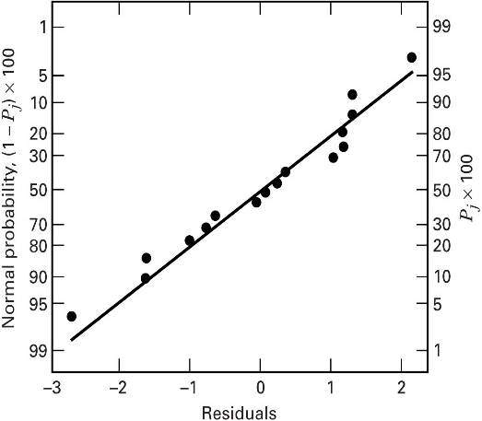
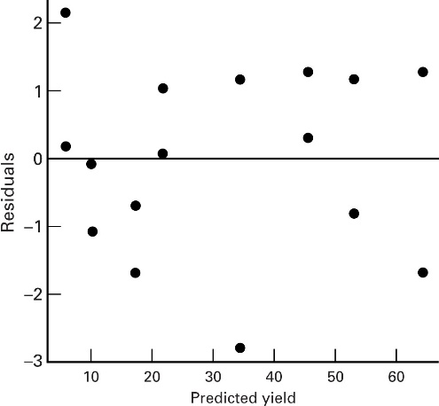
One-Half Fraction of the $2^{k}$ Factorial Design
Diagnostic
← Both plots are satisfied
Design of Experiments

Slide 16
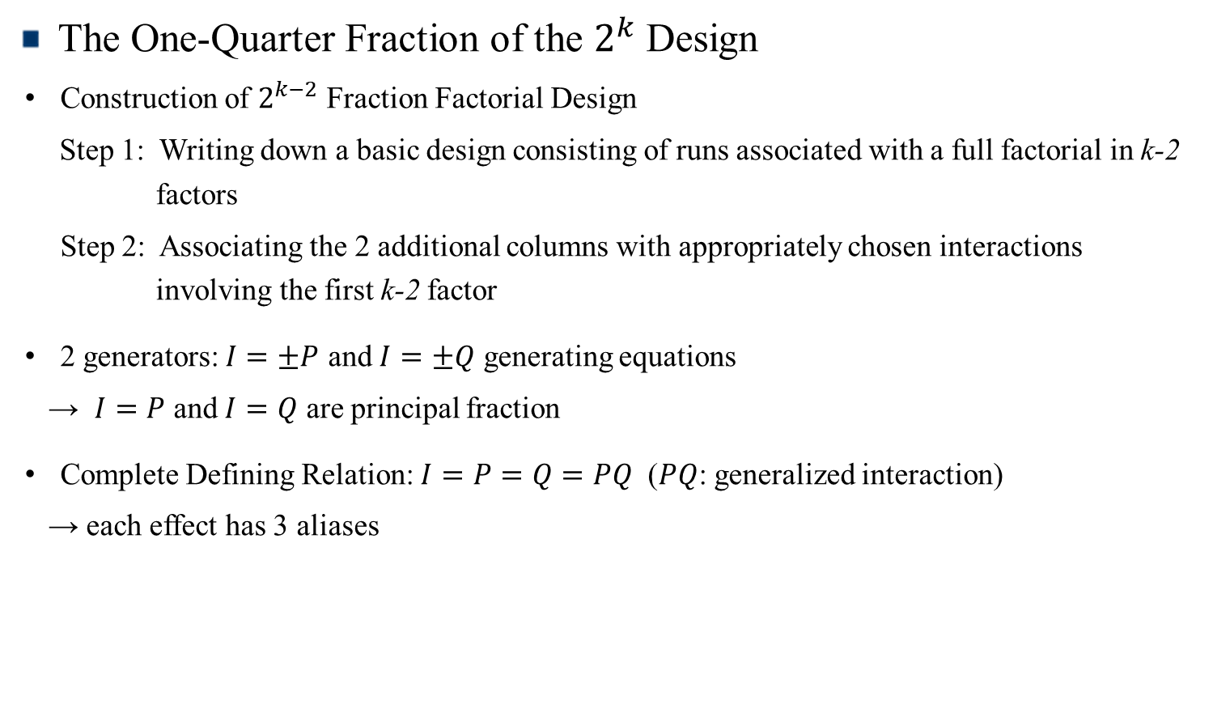
The One-Quarter Fraction of the $2^{k}$ Design
The One-Quarter Fraction of the $2^{k}$ Design
Construction of $2^{k−2}$ Fraction Factorial Design
Step 1: Writing down a basic design consisting of runs associated with a full factorial in k-2 factors
Step 2: Associating the 2 additional columns with appropriately chosen interactions involving the first k-2 factor
2 generators: $I=±P$ and $I=±Q$ generating equations
→ $I=P$ and $I=Q$ are principal fraction
Complete Defining Relation: $I=P=Q=PQ$ ($PQ$: generalized interaction)
→ each effect has 3 aliases
Design of Experiments

Slide 17
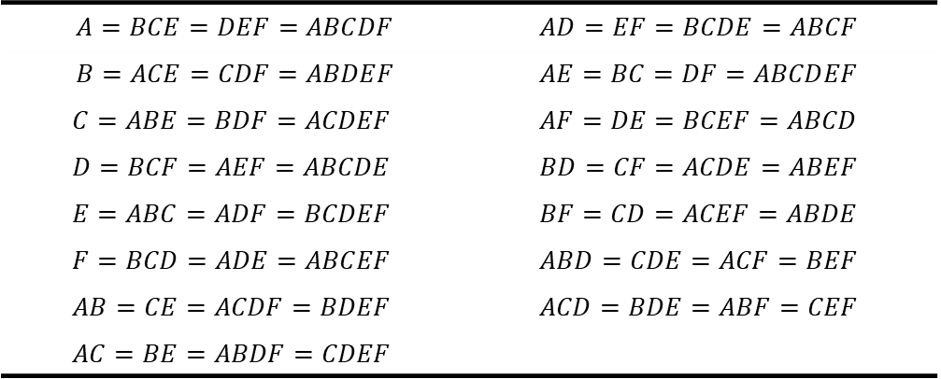

The One-Quarter Fraction of the $2^{k}$ Design
Example: $2^{6−2}$ Design ($I=ABCE$ and $I=BCDF$)
Complete defining relation: $I=ABCE=BCDF=ADEF$ (i.e., resolution IV)
Alias of any effect = effect * word (of defining relation)
E.g., Alias of A : $A=A\left(ABCE\right)=A\left(BCDF\right)=A(ADEF)$
→ $A=BCE=ABCDF=DEF$
Alias Structure for the $2_{IV}^{6−2}$ Design with $I=ABCE=BCDF=ADEF$
$A=BCE=DEF=ABCDF$ | $$AD=EF=BCDE=ABCF$$
$B=ACE=CDF=ABDEF$ | $$AE=BC=DF=ABCDEF$$
$$C=ABE=BDF=ACDEF$$ | $$AF=DE=BCEF=ABCD$$
$$D=BCF=AEF=ABCDE$$ | $$BD=CF=ACDE=ABEF$$
$$E=ABC=ADF=BCDEF$$ | $$BF=CD=ACEF=ABDE$$
$$F=BCD=ADE=ABCEF$$ | $$ABD=CDE=ACF=BEF$$
$$AB=CE=ACDF=BDEF$$ | $$ACD=BDE=ABF=CEF$$
$$AC=BE=ABDF=CDEF$$
Design of Experiments

Slide 18

The One-Quarter Fraction of the $2^{k}$ Design
Construction of the $2_{V}^{6−2}$ design with the Generators $I=ABCE$ and $I=BCDF$
 | Basic Design
Run | A | B | C | D | E=ABC | F=BCD
1 | - | - | - | - | - | -
2 | + | - | - | - | + | -
3 | - | + | - | - | + | +
4 | + | + | - | - | - | +
5 | - | - | + | - | + | +
6 | + | - | + | - | - | +
7 | - | + | + | - | - | -
8 | + | + | + | - | + | -
9 | - | - | - | + | - | +
10 | + | - | - | + | + | +
11 | - | + | - | + | + | -
12 | + | + | - | + | - | -
13 | - | - | + | + | + | -
14 | + | - | + | + | - | -
15 | - | + | + | + | - | +
16 | + | + | + | + | + | +
Design of Experiments

Slide 19
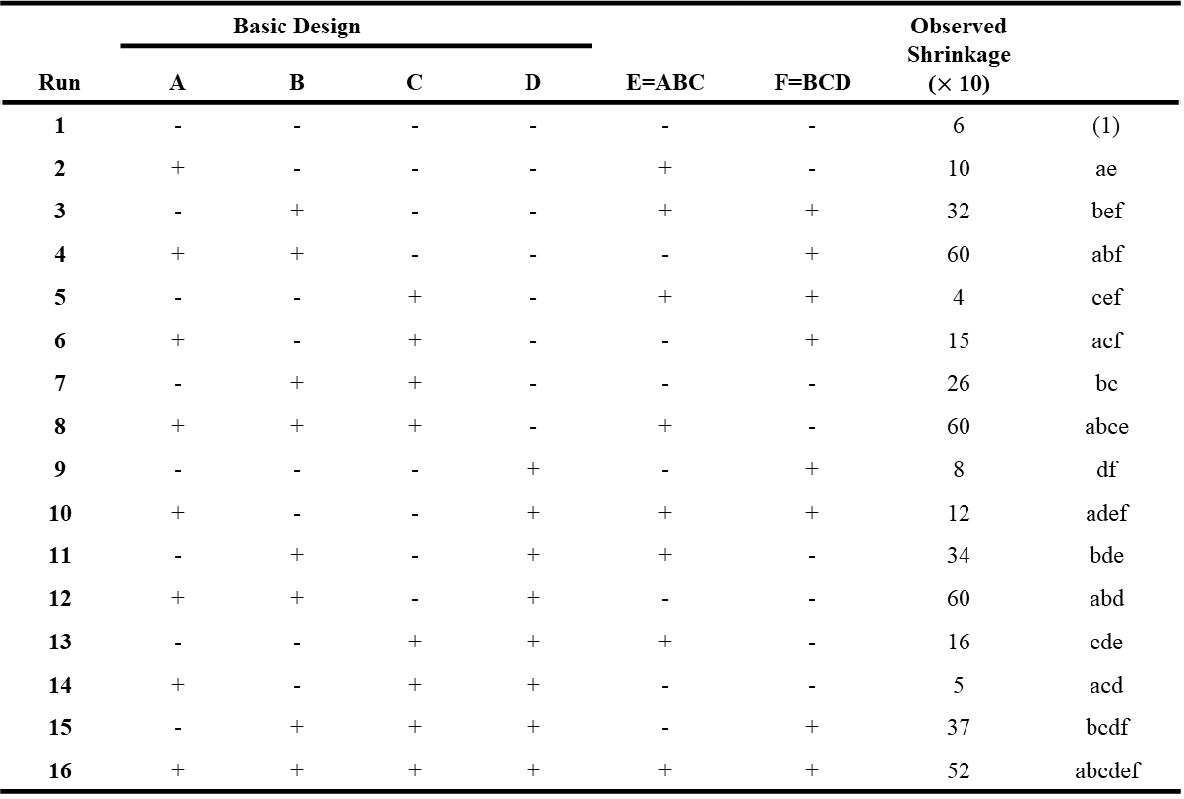

The One-Quarter Fraction of the $2^{k}$ Design
Example 8.4: Injection molding process with six factors ($2_{IV}^{6−2}$ design)
 | Basic Design |  |  |  |  |  | Observed Shrinkage ($×$ 10)
Run | A | B | C | D | E=ABC | F=BCD
1 | - | - | - | - | - | - | 6 | (1)
2 | + | - | - | - | + | - | 10 | ae
3 | - | + | - | - | + | + | 32 | bef
4 | + | + | - | - | - | + | 60 | abf
5 | - | - | + | - | + | + | 4 | cef
6 | + | - | + | - | - | + | 15 | acf
7 | - | + | + | - | - | - | 26 | bc
8 | + | + | + | - | + | - | 60 | abce
9 | - | - | - | + | - | + | 8 | df
10 | + | - | - | + | + | + | 12 | adef
11 | - | + | - | + | + | - | 34 | bde
12 | + | + | - | + | - | - | 60 | abd
13 | - | - | + | + | + | - | 16 | cde
14 | + | - | + | + | - | - | 5 | acd
15 | - | + | + | + | - | + | 37 | bcdf
16 | + | + | + | + | + | + | 52 | abcdef
Design of Experiments

Slide 20
The One-Quarter Fraction of the $2^{k}$ Design
Estimates of effects, regression coefficients
Variable | Regression Coefficient | Estimated Effect | Sum of Squares
Overall Average | 27.3125
A | 6.9375 | 13.8750 | 770.062
B | 17.8125 | 35.6250 | 5076.562
C | -0.4375 | -0.8750 | 3.063
D | 0.6875 | 1.3750 | 7.563
E | 0.1875 | 0.3750 | 0.563
F | 0.1875 | 0.3750 | 0.563
AB + CE | 5.9375 | 11.8750 | 564.063
AC + BE | -0.8125 | -1.6250 | 10.562
AD + EF | -2.6875 | -5.3750 | 115.562
AE + BC + DF | -0.9375 | -1.8750 | 14.063
AF + DE | 0.3125 | 0.6250 | 1.563
BD + CF | -0.0625 | -0.1250 | 0.063
BF + CD | -0.0625 | -0.1250 | 0.063
ABD | 0.0625 | 0.1250 | 0.063
ABF | -2.4375 | -4.8750 | 95.063
Design of Experiments

Slide 21
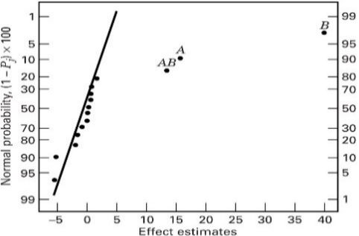
The One-Quarter Fraction of the $2^{k}$ Design
Normal probability plot of effects
→ Two factors (A, B) and the AB interaction are important
Design of Experiments

Slide 22
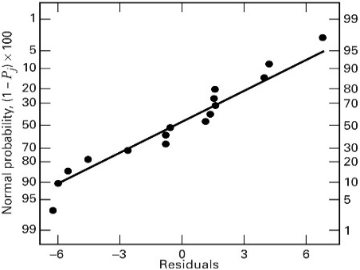
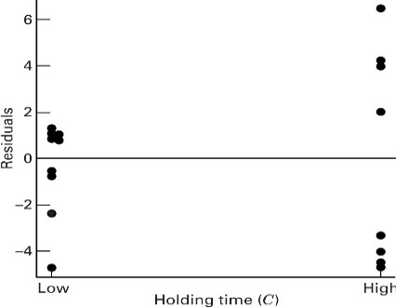
The One-Quarter Fraction of the $2^{k}$ Design
Residual analysis
→ Residual analysis indicates there are some dispersion effects
Design of Experiments

