Slide 1
Design of Experiments
Suhwan Kim
Department of Statistics
Inha University
June 2 , 2022

Slide 2
Chapter 8. Fractional Factorial Designs

Slide 3
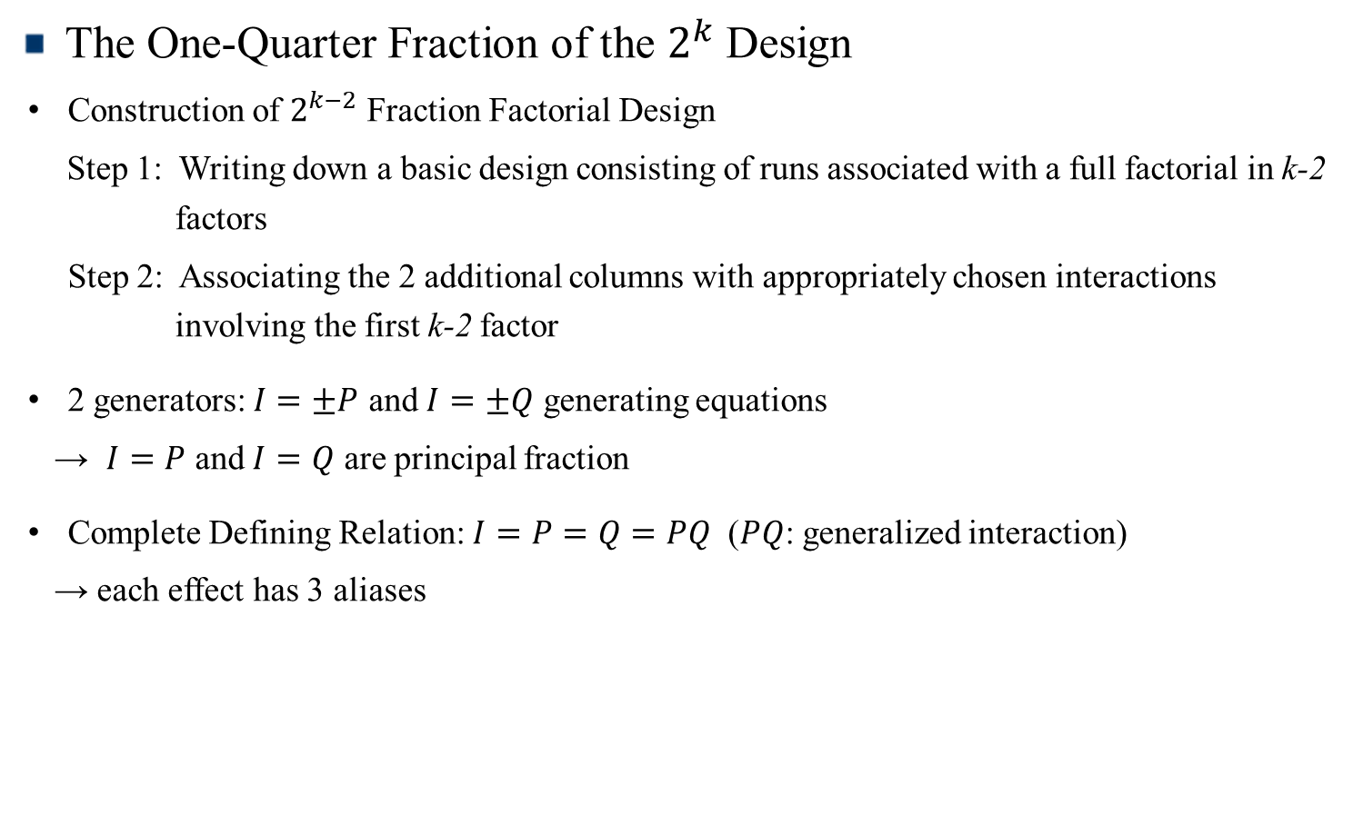
The One-Quarter Fraction of the $2^{k}$ Design
The One-Quarter Fraction of the $2^{k}$ Design
Construction of $2^{k−2}$ Fraction Factorial Design
Step 1: Writing down a basic design consisting of runs associated with a full factorial in k-2 factors
Step 2: Associating the 2 additional columns with appropriately chosen interactions involving the first k-2 factor
2 generators: $I=±P$ and $I=±Q$ generating equations
→ $I=P$ and $I=Q$ are principal fraction
Complete Defining Relation: $I=P=Q=PQ$ ($PQ$: generalized interaction)
→ each effect has 3 aliases
Design of Experiments

Slide 4
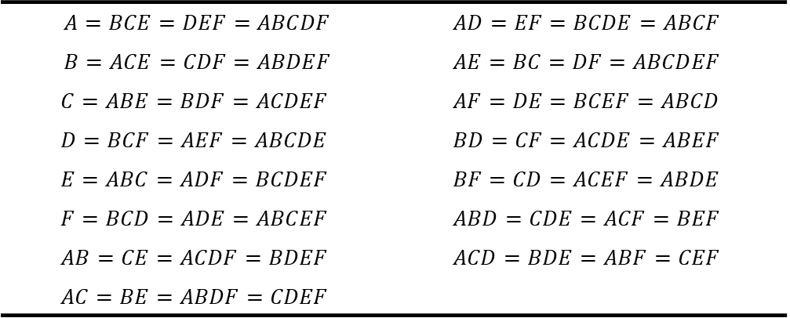

The One-Quarter Fraction of the $2^{k}$ Design
Example: $2^{6−2}$ Design ($I=ABCE$ and $I=BCDF$)
Complete defining relation: $I=ABCE=BCDF=ADEF$ (i.e., resolution IV)
Alias of any effect = effect * word (of defining relation)
E.g., Alias of A : $A=A\left(ABCE\right)=A\left(BCDF\right)=A(ADEF)$
→ $A=BCE=ABCDF=DEF$
Alias Structure for the $2_{IV}^{6−2}$ Design with $I=ABCE=BCDF=ADEF$
$A=BCE=DEF=ABCDF$ | $$AD=EF=BCDE=ABCF$$
$B=ACE=CDF=ABDEF$ | $$AE=BC=DF=ABCDEF$$
$$C=ABE=BDF=ACDEF$$ | $$AF=DE=BCEF=ABCD$$
$$D=BCF=AEF=ABCDE$$ | $$BD=CF=ACDE=ABEF$$
$$E=ABC=ADF=BCDEF$$ | $$BF=CD=ACEF=ABDE$$
$$F=BCD=ADE=ABCEF$$ | $$ABD=CDE=ACF=BEF$$
$$AB=CE=ACDF=BDEF$$ | $$ACD=BDE=ABF=CEF$$
$$AC=BE=ABDF=CDEF$$
Design of Experiments

Slide 5

The One-Quarter Fraction of the $2^{k}$ Design
Construction of the $2_{V}^{6−2}$ design with the Generators $I=ABCE$ and $I=BCDF$
 | Basic Design
Run | A | B | C | D | E=ABC | F=BCD
1 | - | - | - | - | - | -
2 | + | - | - | - | + | -
3 | - | + | - | - | + | +
4 | + | + | - | - | - | +
5 | - | - | + | - | + | +
6 | + | - | + | - | - | +
7 | - | + | + | - | - | -
8 | + | + | + | - | + | -
9 | - | - | - | + | - | +
10 | + | - | - | + | + | +
11 | - | + | - | + | + | -
12 | + | + | - | + | - | -
13 | - | - | + | + | + | -
14 | + | - | + | + | - | -
15 | - | + | + | + | - | +
16 | + | + | + | + | + | +

Slide 6
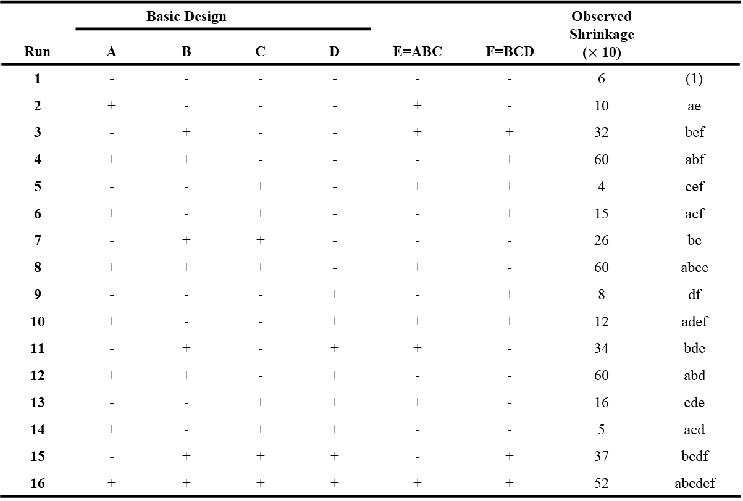

The One-Quarter Fraction of the $2^{k}$ Design
Example 8.4: Injection molding process with six factors ($2_{IV}^{6−2}$ design)
 | Basic Design |  |  |  |  |  | Observed Shrinkage ($×$ 10)
Run | A | B | C | D | E=ABC | F=BCD
1 | - | - | - | - | - | - | 6 | (1)
2 | + | - | - | - | + | - | 10 | ae
3 | - | + | - | - | + | + | 32 | bef
4 | + | + | - | - | - | + | 60 | abf
5 | - | - | + | - | + | + | 4 | cef
6 | + | - | + | - | - | + | 15 | acf
7 | - | + | + | - | - | - | 26 | bc
8 | + | + | + | - | + | - | 60 | abce
9 | - | - | - | + | - | + | 8 | df
10 | + | - | - | + | + | + | 12 | adef
11 | - | + | - | + | + | - | 34 | bde
12 | + | + | - | + | - | - | 60 | abd
13 | - | - | + | + | + | - | 16 | cde
14 | + | - | + | + | - | - | 5 | acd
15 | - | + | + | + | - | + | 37 | bcdf
16 | + | + | + | + | + | + | 52 | abcdef
Design of Experiments

Slide 7
The One-Quarter Fraction of the $2^{k}$ Design
Estimates of effects, regression coefficients
Variable | Regression Coefficient | Estimated Effect | Sum of Squares
Overall Average | 27.3125
A | 6.9375 | 13.8750 | 770.062
B | 17.8125 | 35.6250 | 5076.562
C | -0.4375 | -0.8750 | 3.063
D | 0.6875 | 1.3750 | 7.563
E | 0.1875 | 0.3750 | 0.563
F | 0.1875 | 0.3750 | 0.563
AB + CE | 5.9375 | 11.8750 | 564.063
AC + BE | -0.8125 | -1.6250 | 10.562
AD + EF | -2.6875 | -5.3750 | 115.562
AE + BC + DF | -0.9375 | -1.8750 | 14.063
AF + DE | 0.3125 | 0.6250 | 1.563
BD + CF | -0.0625 | -0.1250 | 0.063
BF + CD | -0.0625 | -0.1250 | 0.063
ABD | 0.0625 | 0.1250 | 0.063
ABF | -2.4375 | -4.8750 | 95.063
Design of Experiments

Slide 8
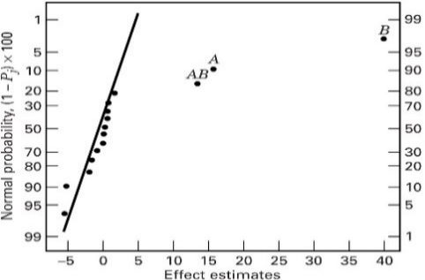
The One-Quarter Fraction of the $2^{k}$ Design
Normal probability plot of effects
→ Two factors (A, B) and the AB interaction are important
Design of Experiments

Slide 9
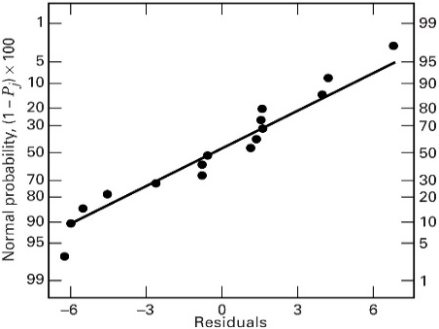
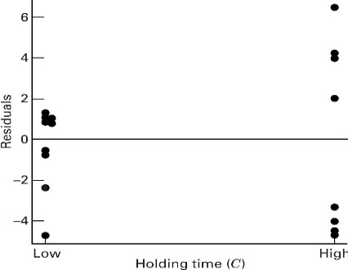
The One-Quarter Fraction of the $2^{k}$ Design
Residual analysis
→ Residual analysis indicates there are some dispersion effects
Design of Experiments

Slide 10
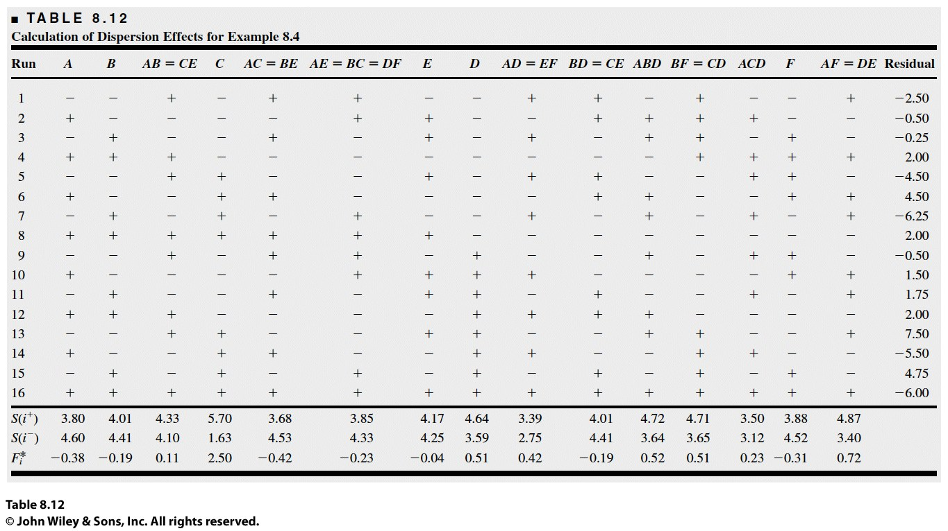
The One-Quarter Fraction of the $2^{k}$ Design
Calculation of Dispersion Effects
Design of Experiments

Slide 11
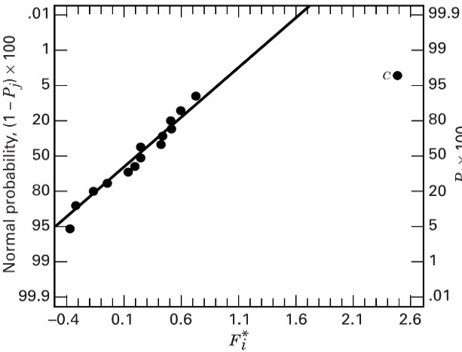

The One-Quarter Fraction of the $2^{k}$ Design
→ Note that $S(i^{+})$ (or $S(i^{−})$) is the SD of the residuals of the ‘+’ (or ‘-’) sign runs
→ Consider a statistics, $F_{i}^{∗}=ln⁡(S^{2}\left(i^{+}\right)/S^{2}\left(i^{−}\right))$
← If $S^{2}\left(i^{+}\right)≈S^{2}(i^{−})$, then $F_{i}^{∗}\sim N\left(0,σ_{θ}^{2}\right)$
← The ratio can be used to judge the difference in the response variability at the two levels of factor i
Normal probability plot of $F_{i}^{∗}$
Design of Experiments

Slide 12
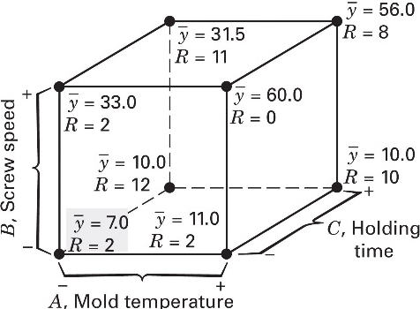

The One-Quarter Fraction of the $2^{k}$ Design
Average and the range of observed shrinkage
← The low level of B produce low average shrinkage
← At low level of B, any $(A_{i},C_{j})$ results in low average shrinkage
← At low level of C, can achieve low variability in shrinkage
Design of Experiments

Slide 13
Chapter 8. Fractional Factorial Designs (part 2)

Slide 14
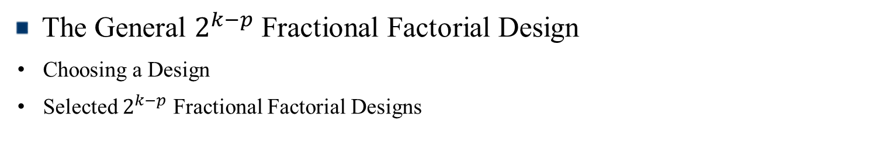
Contents
The General $2^{k−p}$ Fractional Factorial Design
Choosing a Design
Selected $2^{k−p}$ Fractional Factorial Designs

Slide 15
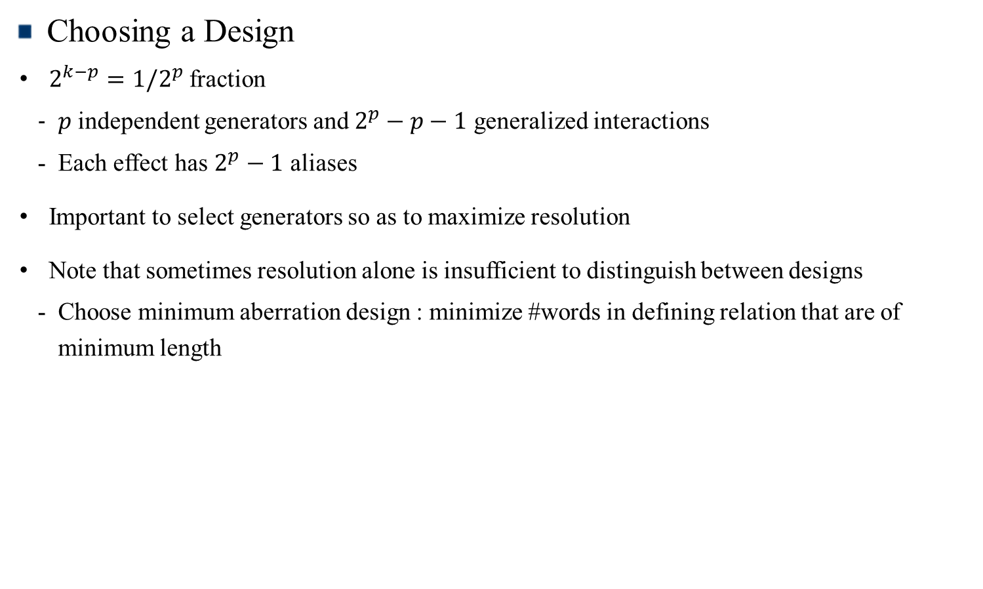
The General $2^{k−p}$ Fractional Factorial Design
Choosing a Design
$2^{k−p}=1/2^{p}$ fraction
$p$ independent generators and $2^{p}−p−1$ generalized interactions
Each effect has $2^{p}−1$ aliases
Important to select generators so as to maximize resolution
Note that sometimes resolution alone is insufficient to distinguish between designs
Choose minimum aberration design : minimize #words in defining relation that are of minimum length
Design of Experiments

Slide 16
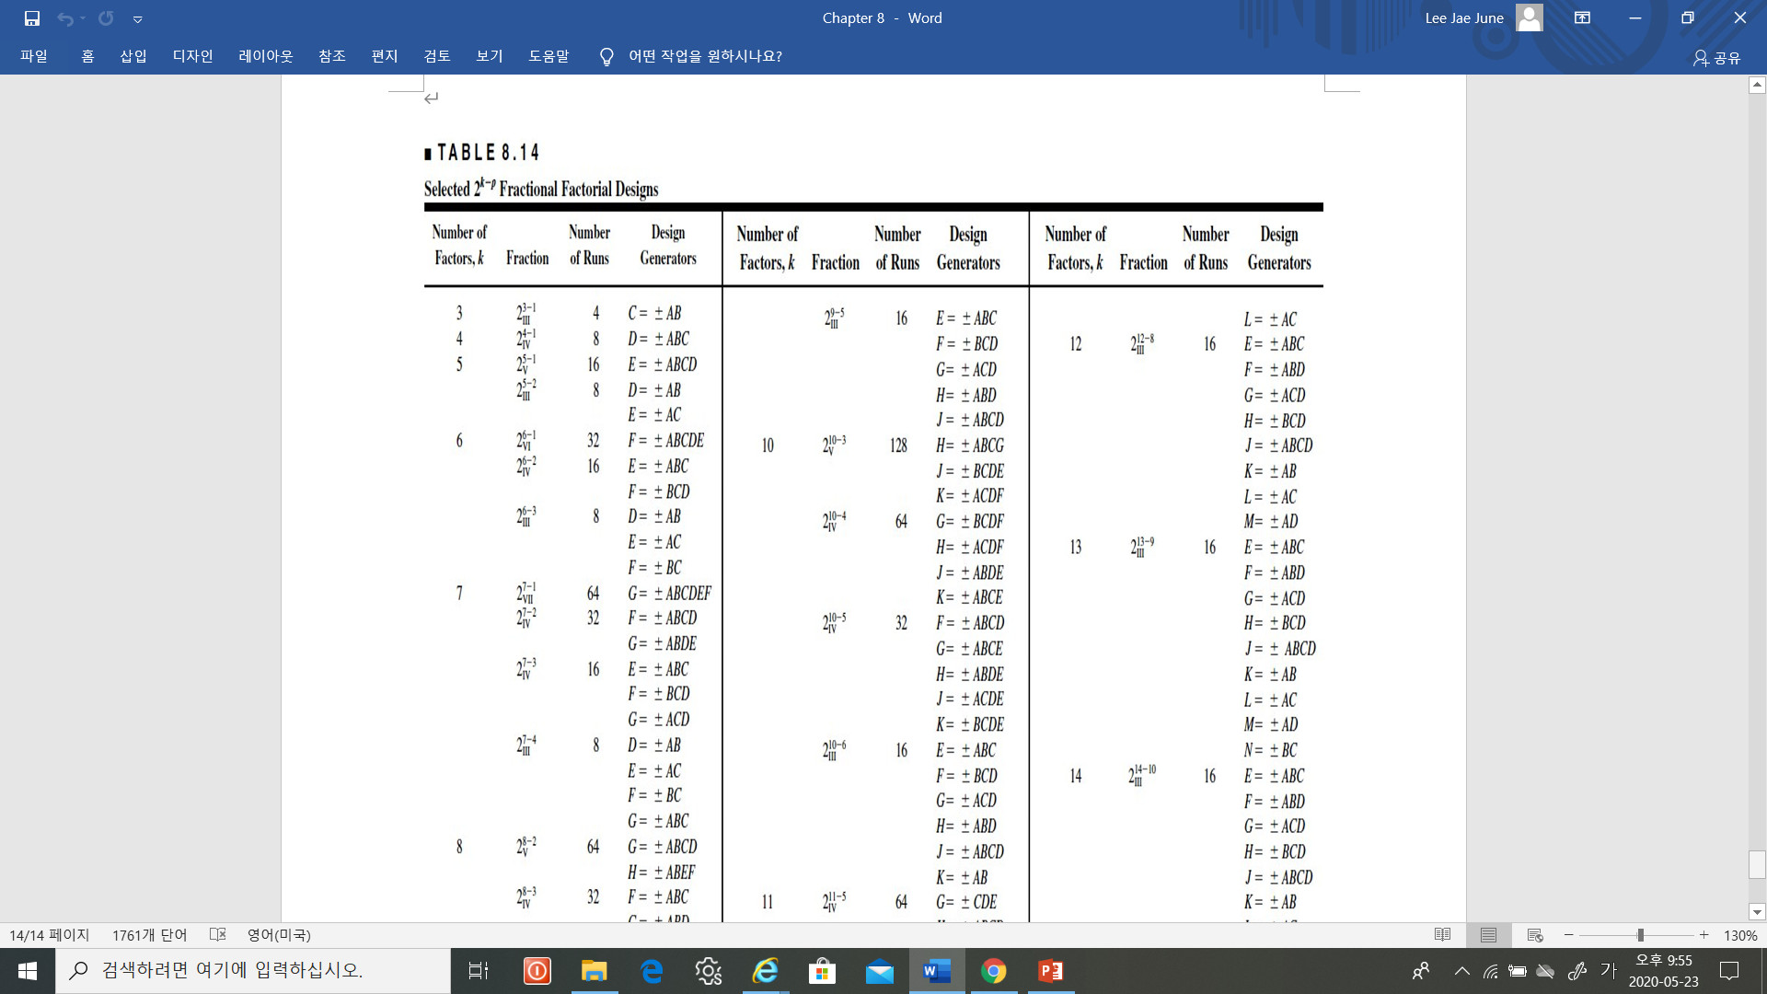

The General $2^{k−p}$ Fractional Factorial Design
Selected $2^{k−p}$ Fractional Factorial Designs
Design of Experiments

